Slide 1
Algorithm

Slide 2
System
primitive action editor
dressing controller
cloth simulator

Slide 3
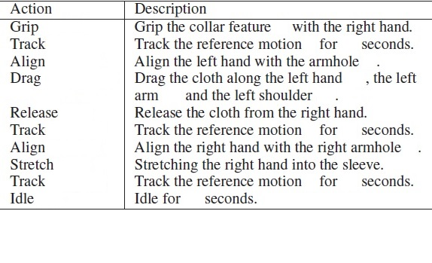
primitive action editor dressing controller
primitive action
dressing controller: to handle each of the primitive action
primitive action editor: for user to assemble a sequence of actions

Slide 4
Garments
a finite element mesh
linear stretching
bending models
The collisions

Slide 5
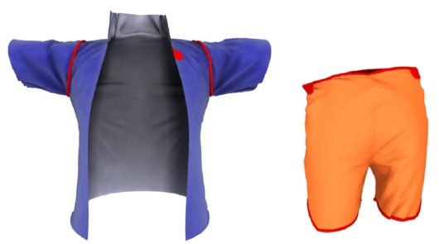
Garment Features
Important for dressing control
a set of vertices on the cloth mesh
Each feature is either a target or a location for a hand to grasp.
vertex loop

Slide 6
Dressing Problem
The dressing problem, in its most abstract form, can be viewed as path planning
The validity of the path depends on the evolution of another dynamic system, the cloth.

Slide 7
primitive actions
The two most important actions are alignment and traversal
We monitor the cloth state and solve an optimization at each time step only during the alignment phase.
For other actions, we plan the entire path at the beginning of the action, and do not take the state of cloth into consideration.

Slide 8
Alignment
end effector: one body part
the goal is to control the end effector to pass through this garment feature.
alignment is a process of chasing a moving feature

Slide 9
Alignment
This can be challenging because the target cloth feature is often folded and occluded by other parts of the cloth.
it is highly likely that it will collide with the cloth in the neighborhood of the feature and knock the target away.

Slide 10
Alignment controller
a cloth-aware, feedback controller for the alignment action.
an intermediate goal is that a point on the cloth that is visible from the end effector and has the smallest distance to the target feature.

Slide 11
Alignment controller
finds an intermediate goal
moves the end effector a small distance in a way that minimizes the chance of knocking away the target feature.
These two steps are performed iteratively until the end effector successfully reaches the feature.

Slide 12
IK
move the end effector by solving a collision-free inverse kinematics (IK) problem.
keeps the full body motion similar to the reference, and guarantees that the body parts do not overlap with each other.

Slide 13
Traversal-Dragging
if the character is using his or her right hand to dress the left arm, the path nodes are points just off the surface of the left wrist, the left elbow and the left shoulder
solved by the collision-free IK

Slide 14
Traversal-Stretching
move the limb’s end effector away from the body
the friction force caused by the stretching limb is canceled by the tension force of the cloth pulling from the anchor node.

Slide 15
Other Actions
Tracking: To preserve the dressing style
Grip and Release:
The cloth feature moves together with the character’s hand if it is gripped
The cloth feature no longer moves with the end effector once it is released.

Slide 16
Other Actions
Idling:
This action freezes the character’s motion
The main purpose is to wait for the clothes to settle before proceeding to the next dressing action.

