Slide 1
Hero_mora
caramelyo

Slide 2
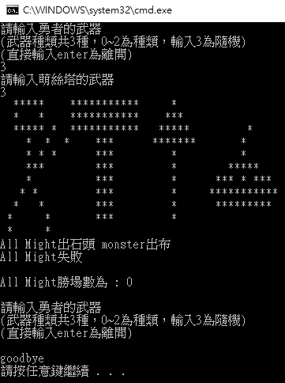
Hero_mora
Objectives : random object and class practice
Basic Idea : Mora + visualization in cmd

Slide 3
Hero_mora
Procedure :
Input the weapon for hero first (there must be some message to show how many weapons are in your program, how to input a weapon and how to leave your game)
Input the weapon for monster

Slide 4
Hero_mora
Procedure :
Print the images(bitmap) of hero, monster and their weapons in the same row
Those characters(hero and monster) will attack each other with mora
Which one do characters (randomly)select from paper, scissors and stone depends on the weapon they use
Print what they select and the result of mora
hero
weapon
monster

Slide 5
Hero_mora
Procedure :
If the result of mora is deuce, then replay the mora
If hero is the winner, then regenerate a monster with random weapon and then play the mora again (those procedure in ppt p. 4) until hero loses
If hero loses, then print how many times he wins
After hero loses, repeat the whole program until user input the exit message (press “enter” directly)

Slide 6
Hero_mora
Weapon
Sword => the odds are 3/5 to select paper, 1/5 to select stone and 1/5 to select scissors
hammer => the odds are 1/5 to select paper, 3/5 to select stone and 1/5 to select scissors
Spear => the odds are 1/5 to select paper, 1/5 to select stone and 3/5 to select scissors

Slide 7
Hero_mora
We will provide all images you need; that is, the bitmaps of hero, monster and basic weapons
The height and width of each bitmap are 11 bits
use “class” technology in your game; in other words, make your game more structural

Slide 8
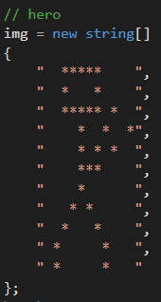
Hero_mora
Hero bitmap

Slide 9
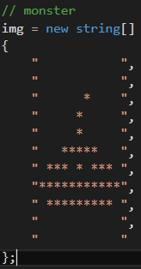
Hero_mora
Monster(slime) bitmap

Slide 10
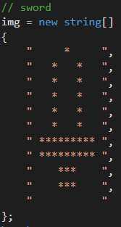
Hero_mora
Sword bitmap

Slide 11
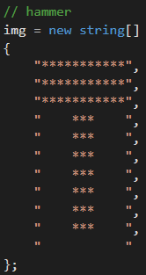
Hero_mora
Hammer bitmap

Slide 12
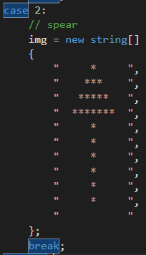
Hero_mora
Spear bitmap

Slide 13
Hero_mora
Any questions?

Slide 14
Hero_mora
Good luck!

