Slide 1
sql_connection_to_remote_database
Caramelyo

Slide 2
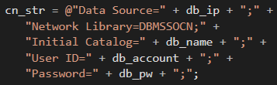
sql_connection_to_remote_database
The difference is the connection string

Slide 3
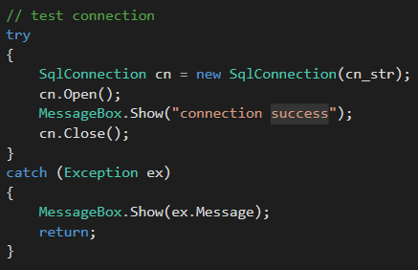
sql_connection_to_remote_database
Test connection

Slide 4
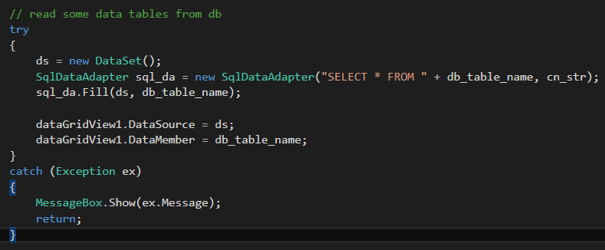
sql_connection_to_remote_database
Read some data

Slide 5

sql_connection_to_remote_database
Git the visual studio project
https://github.com/CaramelYo/sql_connection_to_remote_database
In release mode

Slide 6
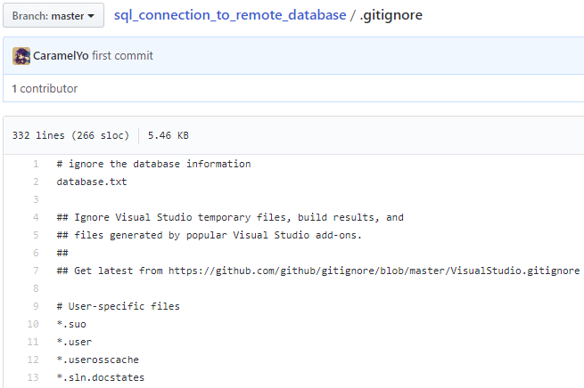
sql_connection_to_remote_database
.gitignore for visual studio

Slide 7
Any questions?

Slide 8
Thank you for your listening

