Slide 1
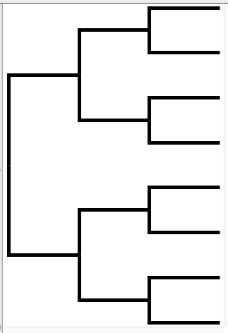

Tree
s1_site_1_A
s1
s2_site_1_E
s2
s3_site_1_A
s3
s4_site_1_A
s4
s1_site_2_C
s2_site_2_C
s3_site_2_E
Alignment
s4_site_2_C
Species | Sequence
s1 | A C D …
s2 | E C D …
s3 | A E D …
s4 | A C E …
s1_site_3_D
s2_site_3_D
s3_site_3_D
s4_site_3_E
Notes:
Chroma Clade can optionally colour the branches of the tree according to residues observed in descendent sequences
This represents a crude ancestral reconstruction
Helps to show along which branches particular substitutions may have occurred

