Slide 1
Hybrid Dilated Lightweight ECA-YOLO for Thermal Object Detection
Satya Mohit
IEEE Sensors Journal Target

Slide 2
Project Overview
• Goal: Lightweight object detection on thermal (LWIR) imagery
• Dataset: 1,067 thermal images, 3,849 annotations, 4 classes
• Person (28.0%), Trolley (55.7%), Bag (9.2%), Unattended (7.1%)
• Base model: YOLOv8n (3.01M parameters, 8.1 GFLOPs)
• Two key modifications to the backbone:
• Dilated Convolutions (rate=2) in deeper C2f stages
• Efficient Channel Attention (ECA) in all C2f blocks

Slide 3
Thermal IR Challenges
• Low contrast and no colour / texture information
• Small, blurred objects with poor edge definition
• Class ambiguity — bags & unattended objects look similar
• Limited labelled thermal datasets vs. RGB domain
• Standard YOLO models designed for RGB, not thermal

Slide 4
Proposed Architecture — Hybrid Dilated ECA-YOLO
• Backbone: 10 layers with two types of C2f blocks
• C2f_ECA (dense, d=1): early stages P2–P3 for fine details
• C2f_ECA_Dilated (d=2): deeper stages P4–P5 for larger receptive field
• Dilated convolutions expand receptive field without adding parameters
• ECA: lightweight channel attention (single 1D conv, k=3)
• Detection head: Standard YOLOv8 PANet (unchanged)
• Total: 3.01M params, 8.1 GFLOPs — same as baseline YOLOv8n

Slide 5
Ablation Study Results
• Baseline YOLOv8n 100ep: mAP@50 = 85.50%, mAP@50-95 = 62.55%
• + ECA only: mAP@50 = 86.31% (+0.81)
• + Dilated only: mAP@50 = 86.02% (+0.52)
• + Dilated + ECA (Ours): mAP@50 = 87.89% (+2.39)
• Cosine annealing LR scheduler used for all 100-epoch runs
• Improvements are additive — both modules contribute

Slide 6
Detection Performance — Best Model (v30)
• Precision: 87.22% | Recall: 83.38%
• mAP@50: 87.89% | mAP@50-95: 64.73%
• Per-class mAP@50 improvements over baseline:
• Person: 94.4% → 95.2%
• Trolley: 95.3% → 96.3%
• Bag: 74.5% → 80.3% (+5.8 pp — largest gain)
• Unattended: 77.7% → 79.8%
• Biggest gains on hardest classes (Bag, Unattended)

Slide 7
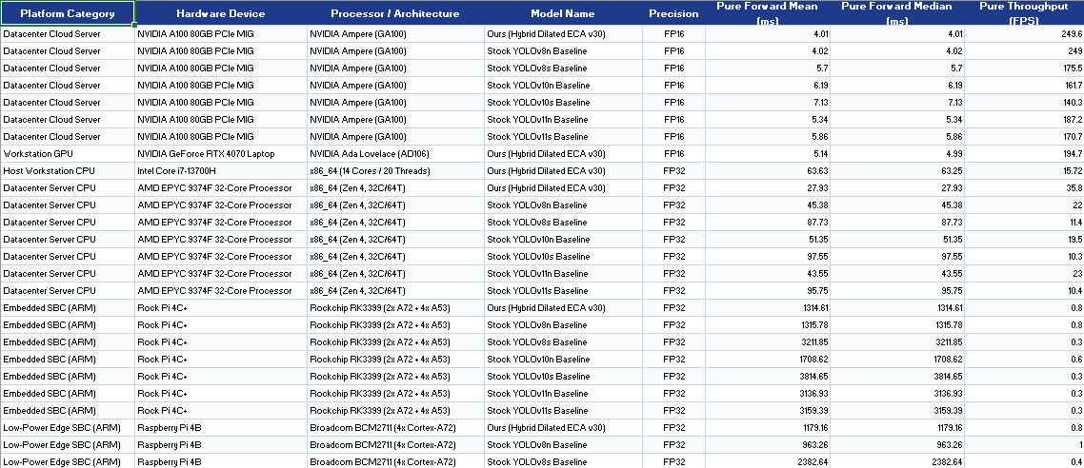
Cross-Hardware Deployment
• Benchmarked on 5 platforms (FP16 on GPU, FP32 on CPU/ARM):
• NVIDIA A100 80GB: 3.90 ms E2E (256.5 FPS)
• RTX 4070 Laptop: 5.38 ms E2E
• AMD EPYC 9374F CPU: 27.93 ms E2E (35.8 FPS)
• Rock Pi 4C+ (RK3399 ARM): 1238 ms E2E
• Raspberry Pi 4B (Cortex-A72): 970 ms E2E
• Our model matches or beats YOLOv8n latency on all platforms

Slide 8
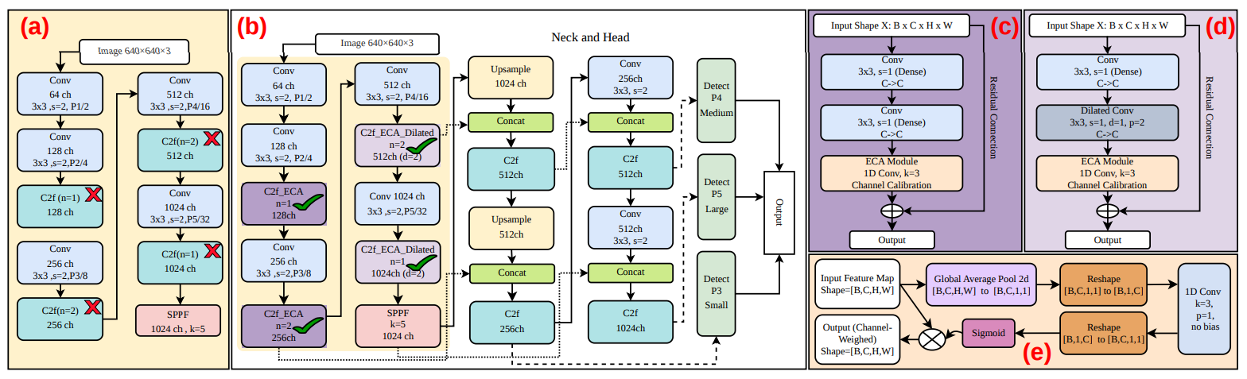
Model Architecture

Slide 9
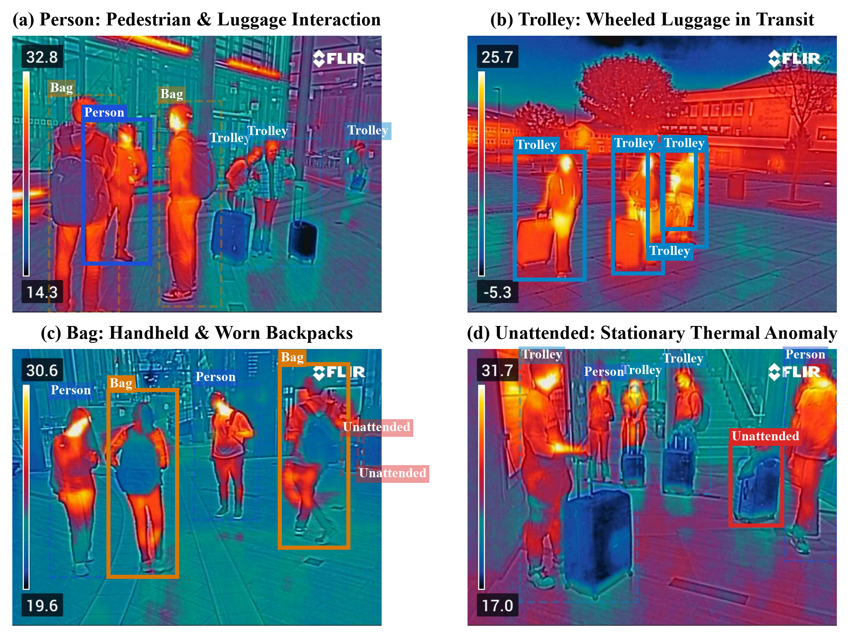
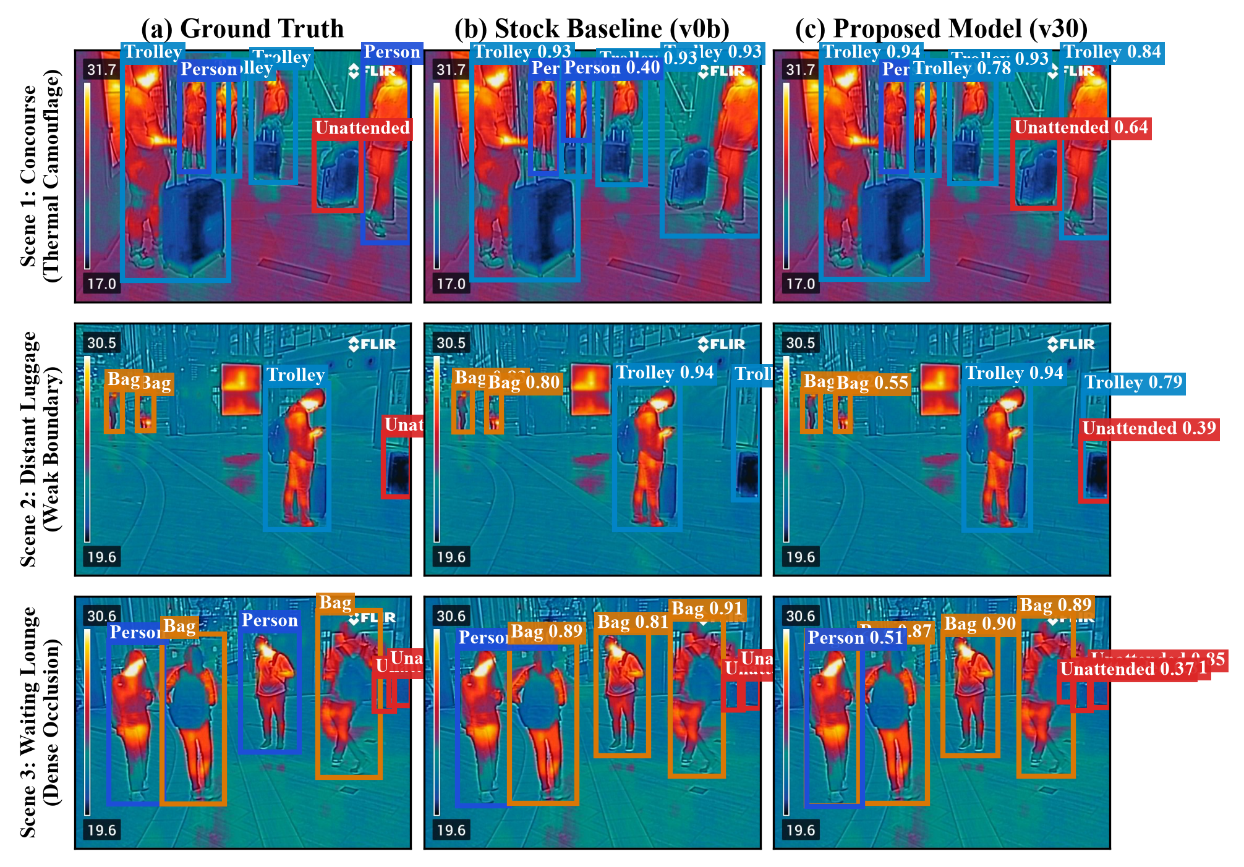
Figures

Slide 10
Figures

Slide 11
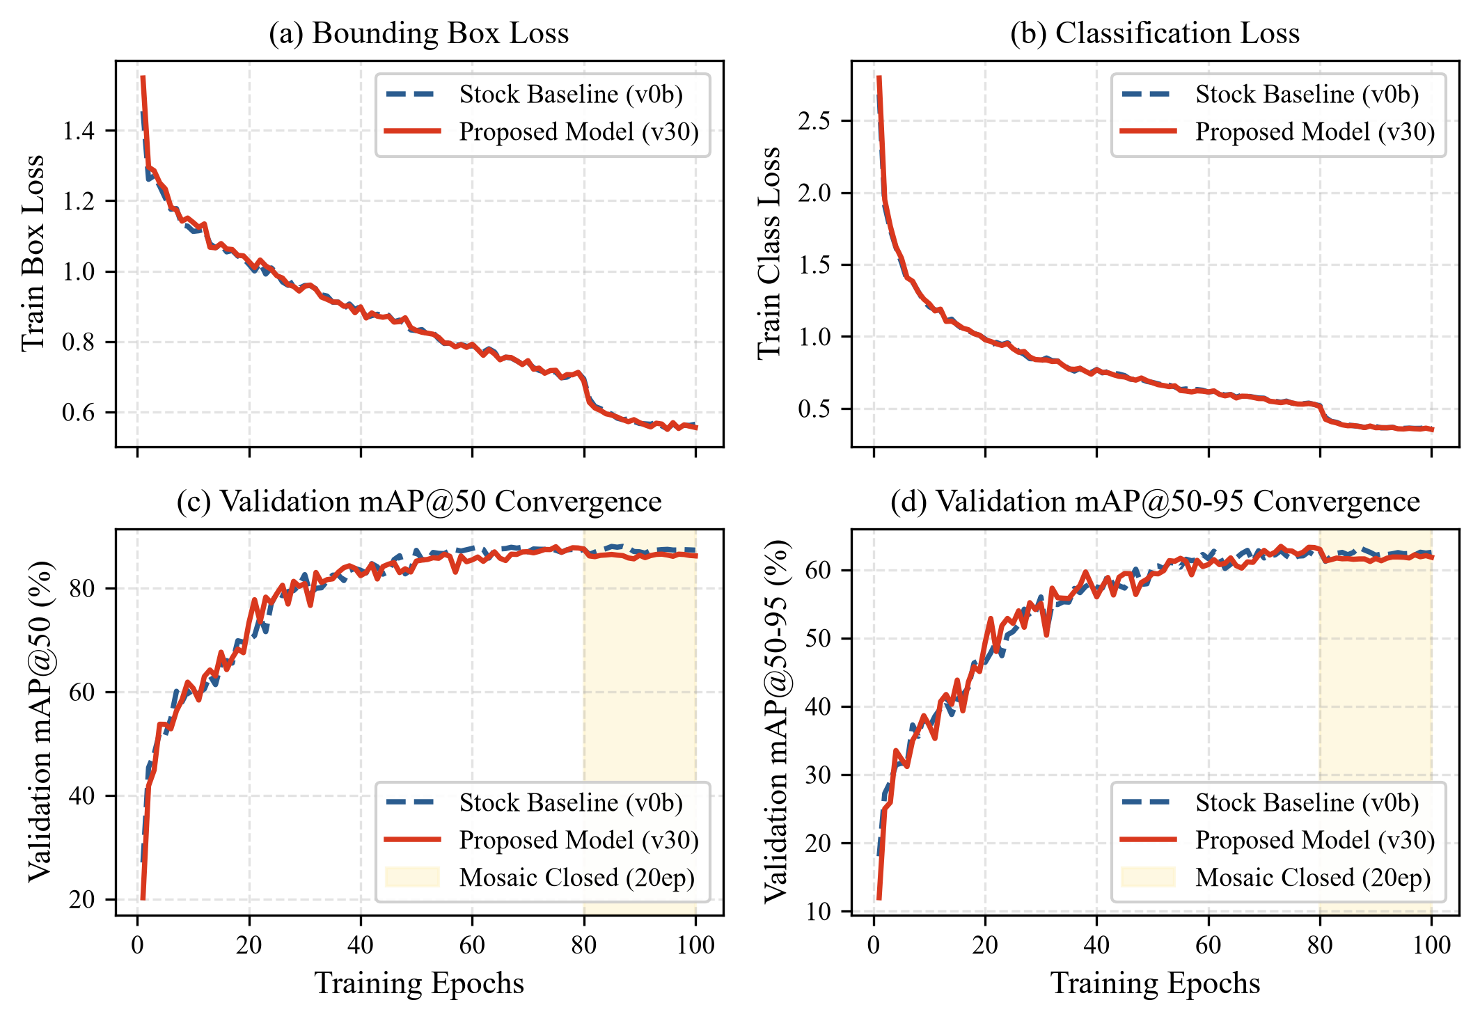
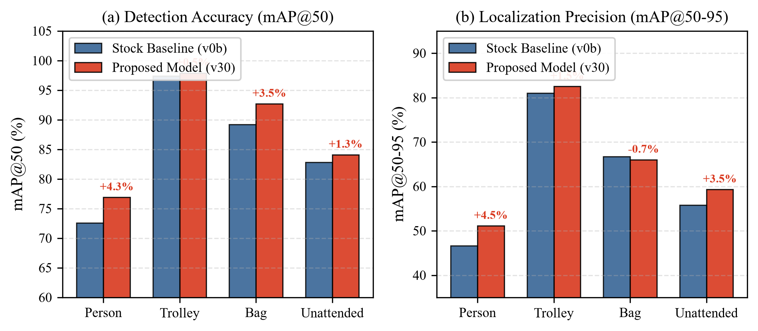
Figures

