Slide 1
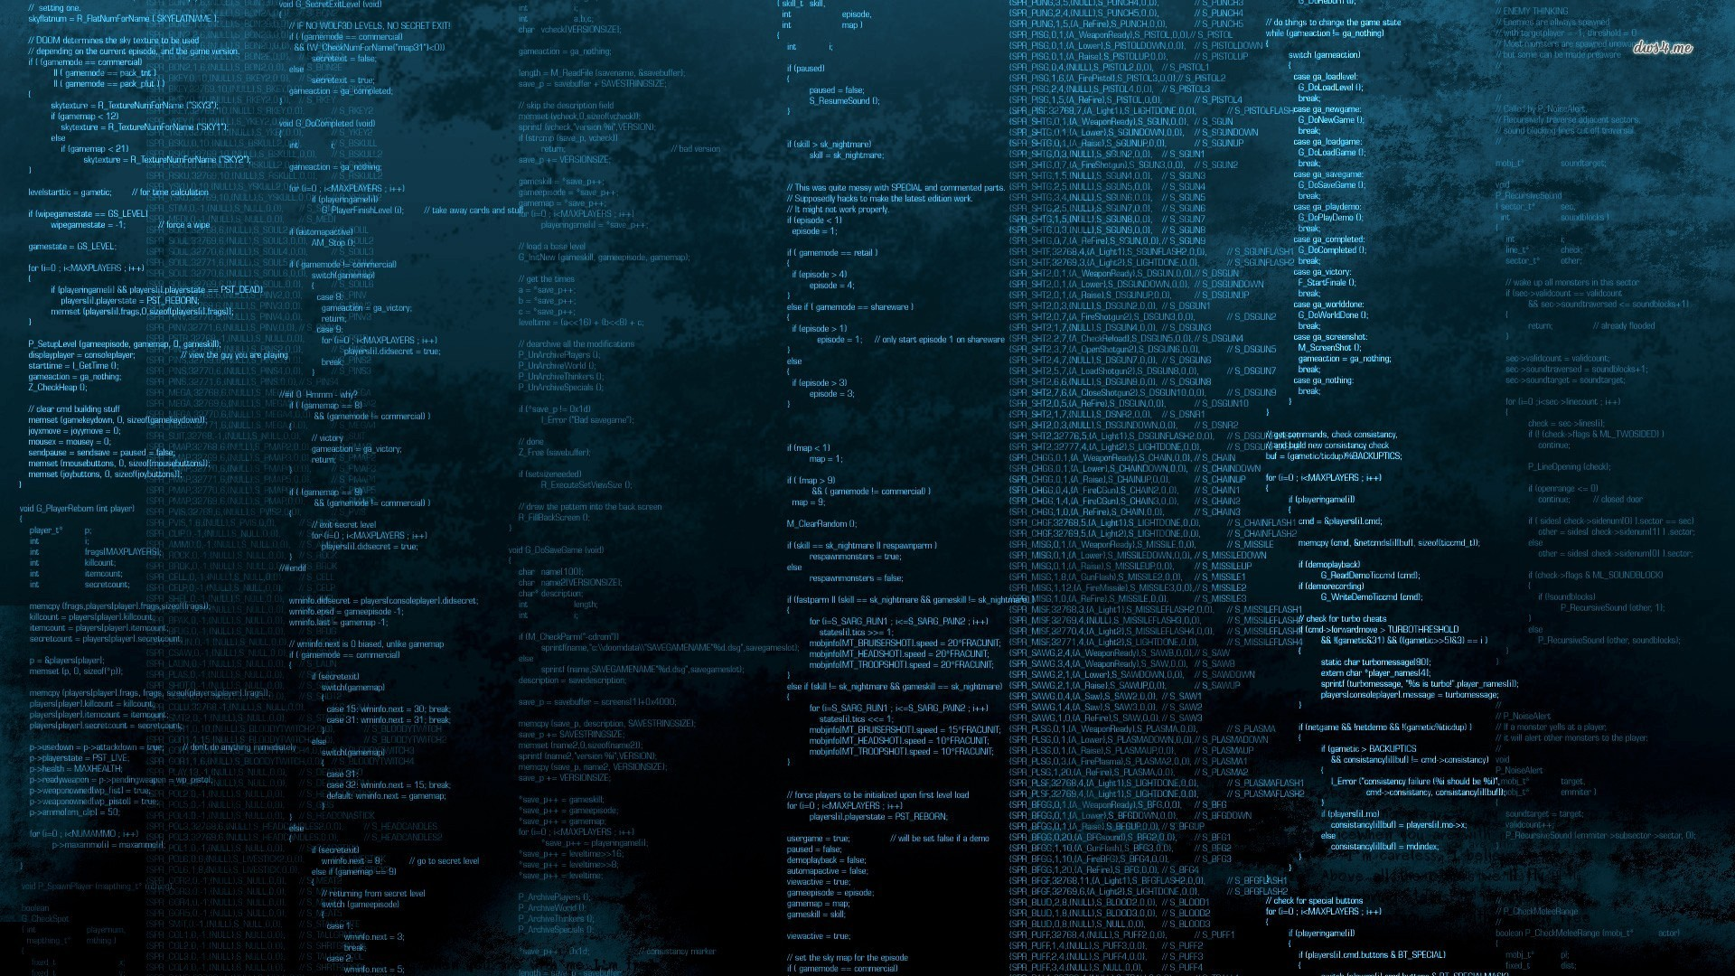
The Carbonara Project
The front window of malware research

Slide 2
Carbonara is a malware analysis/reverse engineering platform and community.

Slide 3
Main features
What is Carbonara about?
Binary analysis
Procedure matching
Machine Learning
Perform advanced static analysis directly from your browser.
Find common patterns across binaries and speedup your work
Run your binaries against our machine learning engine to discover if it’s malicious.
Results are shared on the community

Slide 4
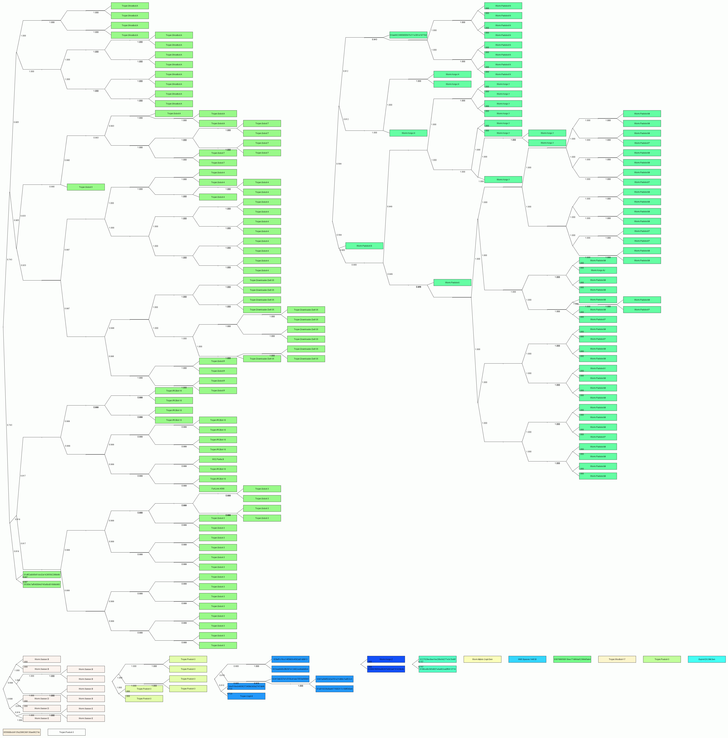
Malwares reuse components

Slide 5

Procedure matching
• Read the disassembled code of each procedure and match it with
others.
• Given a procedure, get a list of similar procedures.

Slide 6
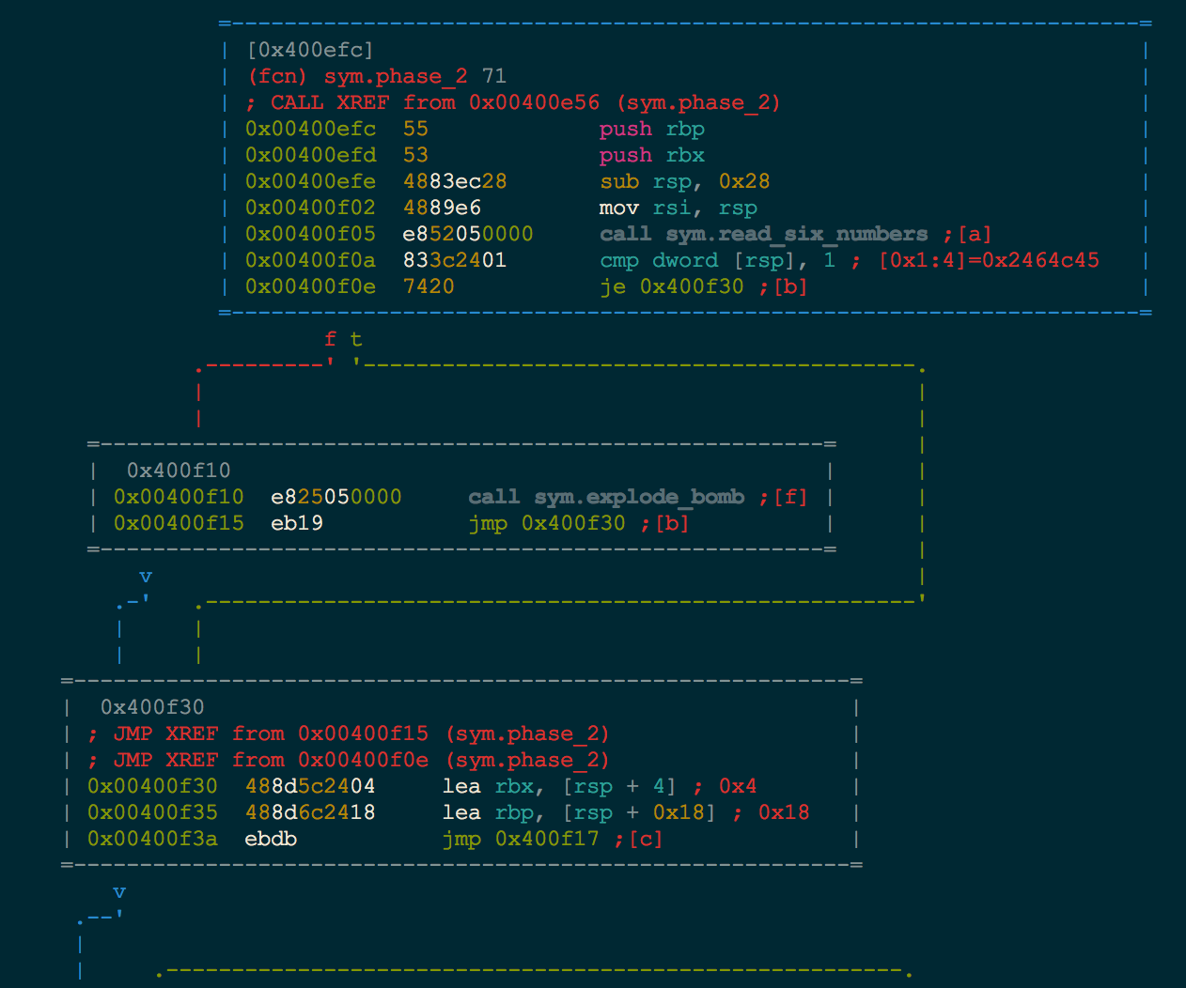
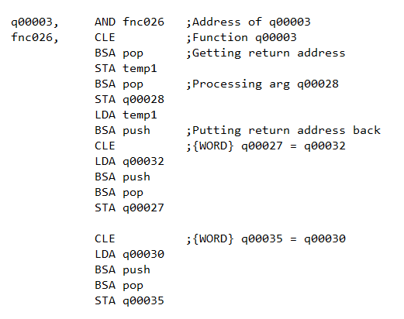
Binary analysis
• Upload a raw binary and get useful information about it (assembly,
sections, strings etc.)
• Retrieve all the procedures that compose the uploaded program.

Slide 7
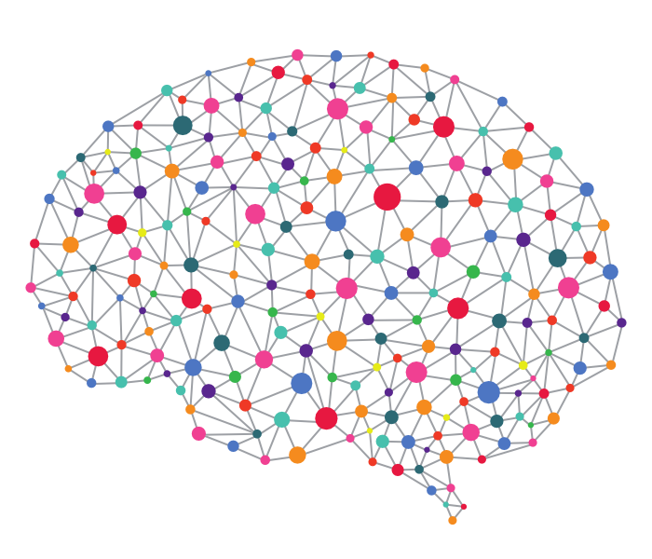
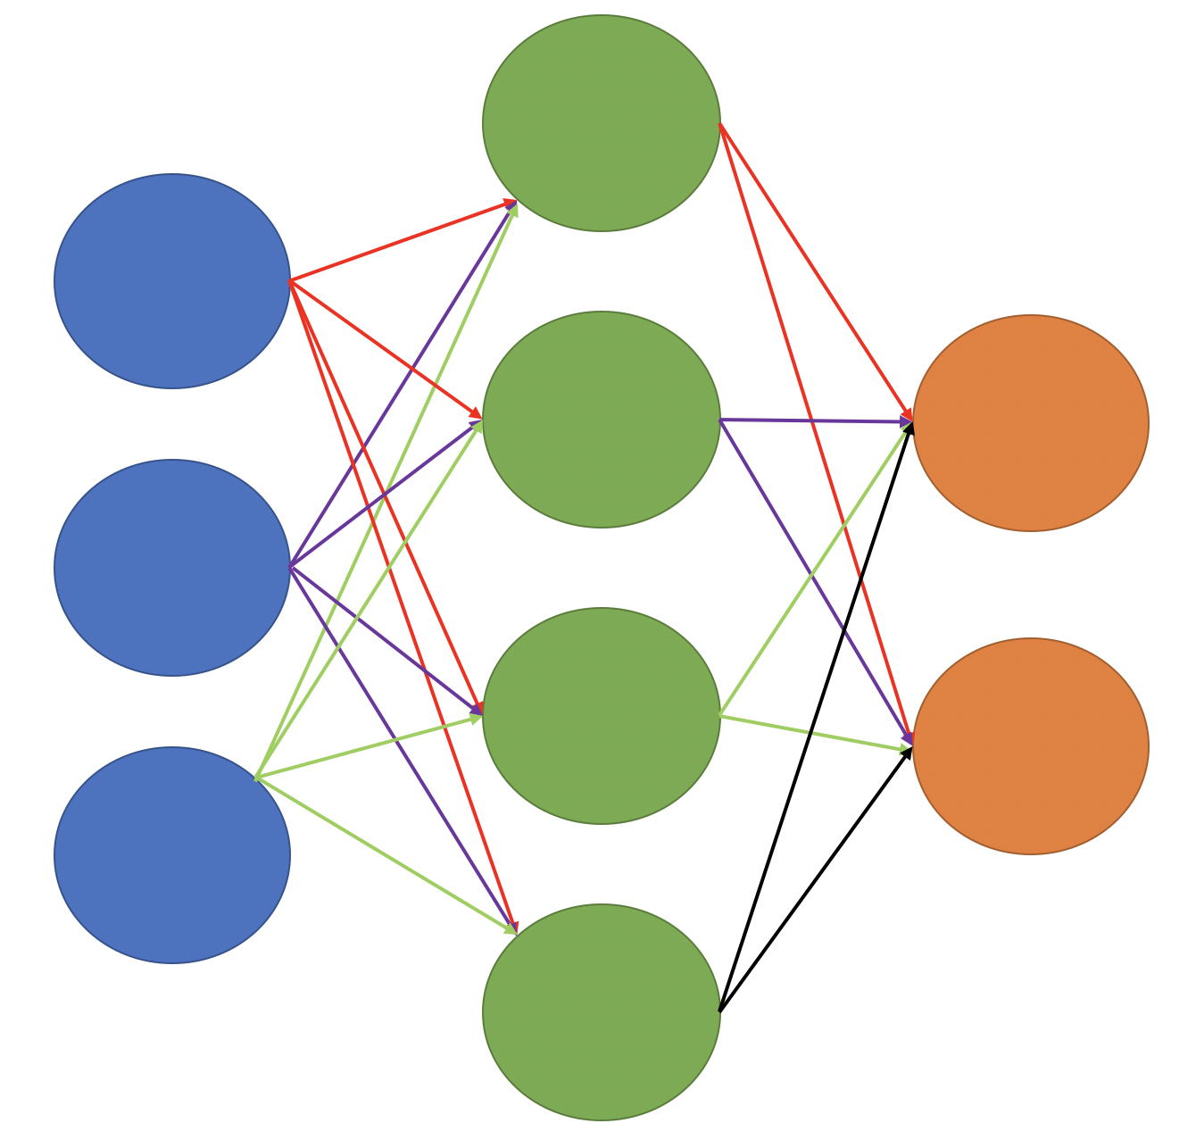
Machine Learning
Is it malicious?

Slide 8

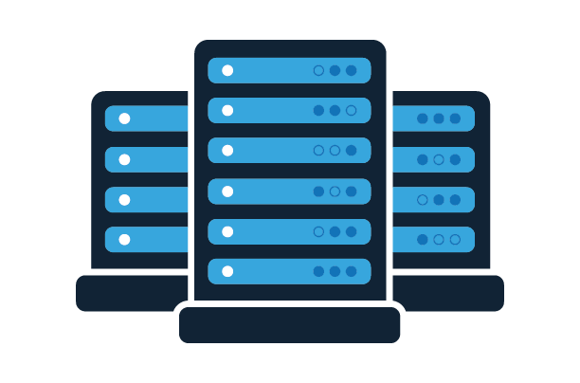



The Infrastructure
Analysis server
Back-end
Machine Learning engine
CLI
Front-end

Slide 9
A simple use case.

Slide 10

Bob uses Carbonara to analyse a certain function A

Slide 11

Alice uses Carbonara to find out that her binary is made of functions A and B

Slide 12
Alice reads Bob’s analysis of A.
She can concentrate only on B.
A

Slide 13
Machine Learning engine
Our progress
We built the server infrastructure
We’ve prototyped the model
What are the issues?
Finding good data for training is hard
Training a good model requires a lot of computing power
Notes:
Delete pictures
Drag and Drop your images

Slide 14

Guanciale (Analysis Engine)
Our progress
Retrieval data from various tools and disassemblers (radare2, IDA Pro)
Procedure abstraction and hashing
What are the issues?
Extract info from IDA Pro database
Testing the algorithm takes a lot of time
Notes:
Delete pictures
Drag and Drop your images

Slide 15
Front-end
Our progress
Created Login/Register pages
Created Dashboard page for updates and searching
Created Profile page showing user activities
Created Upload, Binary and Procedure pages
Notes:
Delete pictures
Drag and Drop your images

Slide 16
Back-end
Our progress
User registration
Managing DB for procedures descriptions
Save report from analysis server
What are the issues?
Choose the right way to represents procedures and link them to programs.
Optimise singular procedures to work in disk.
Notes:
Delete pictures
Drag and Drop your images

Slide 17
Roadmap
What’s ahead?
Make it social
Add data and interaction
between components
Design
Comments, discussions, ratings, reputation.
Graphic enhancements through better design and meaningful animations.
Add more meaningful information on binaries, link data together to create an ecosystem.
Notes:
Delete pictures
Drag and Drop your images

Slide 18
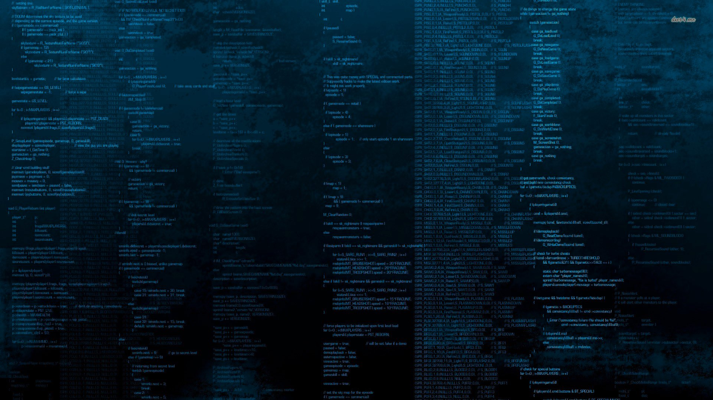

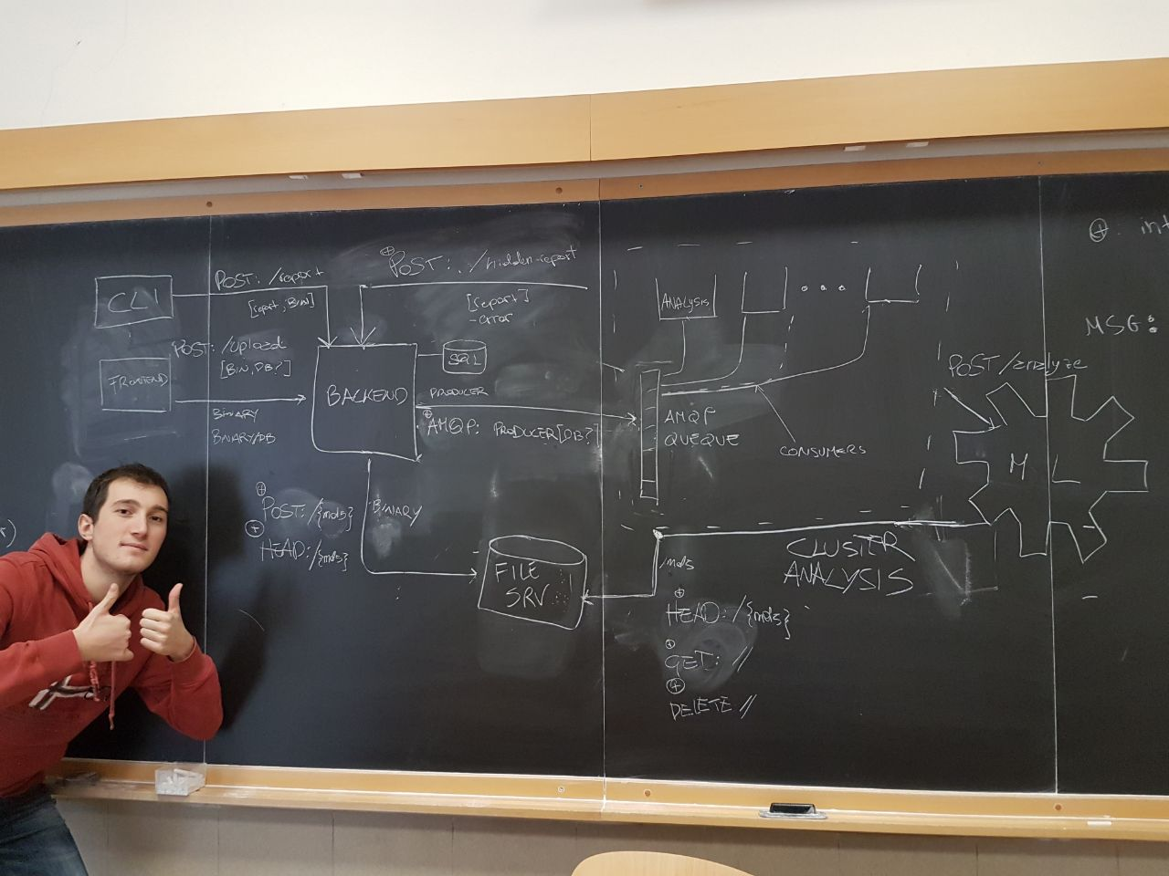
Where everything started.
Notes:
Delete Picture
Drag and Drop your image
Send to Back

