Slide 1
ML Project:
Half-Chess
Tripp Isbell, Joseph Green, James Lee

Slide 2
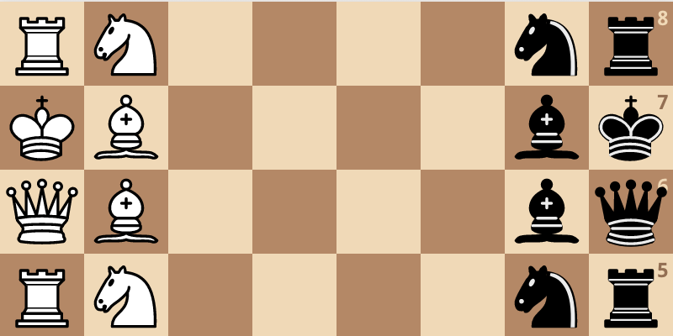
Half Chess
Half the chess, half the fun, (much) less than half the complexity.

Slide 3
Method overview
We start with a random network that generates data (board states, actions, eventual results) through self-play.
The network makes its move by doing a (relatively small) amount of Monte-Carlo Tree Searches, calling the network to produce a board valuation (instead of doing a full roll-out) whenever it hits an unexplored board state.
After 100 or 200 self-play games, we train a new network (starting with the parameters from the current network) on the board data
We pit the new network against the current network, and update the current network with the new network’s parameters (the apprentice becomes the master) if the new network wins at least 60% of the non-drawn games.

Slide 4
Issues with original Half-Chess
Self-play games took too long to play out, often ending at arbitrary move-count cutoffs
Landing a checkmate was too complicated of a task for a network playing near-randomly, but avoiding one could be learned through playing safely,
This resulted in the network learning too conservative of a strategy and self-play games resulted in more and more draws.

Slide 5
Issues with original Half-Chess
These could be solved through more resources, as we could afford to have games play out longer and increase the breadth of its Monte-Carlo Tree Searches (increasing its chance to find the path to a checkmate)
But we don’t have such resources, so we had to modify the game rules to suit our purposes

Slide 6
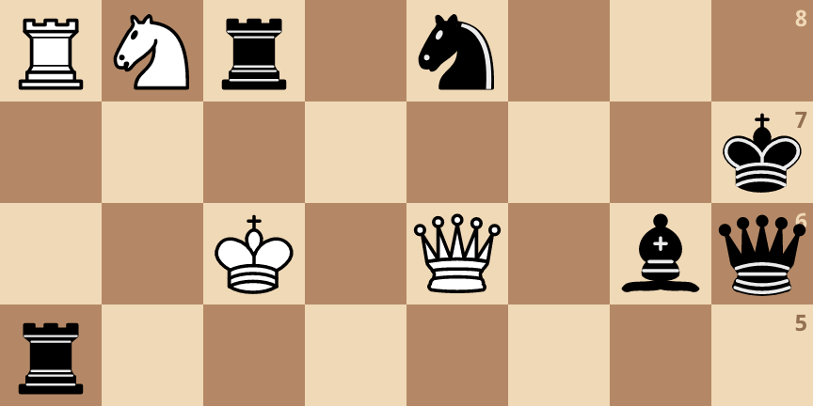
Checkers Half-Chess
Pieces can only move sideways or forward, no backward moves.

Slide 7
Checkers Half-Chess
This simplifies the task in several ways:
The game length is considerably shorter, as moves are somewhat a finite resource (pieces become less useful the further down the board they travel)
The king cannot back out of check, so checkmates are easier to land
The action space is reduced, so the policy network head only has to learn a policy distribution over 348 actions instead of 600.
In regular half-chess, when the game was down to a few pieces left, the game would go on for many turns until a draw since a checkmate/stalemate is hard to land at that point. In checkers half-chess, we can call a draw early when both kings pass all of their opponent’s attackers and become safe.

Slide 8
Network Architecture
We updated our network to more closely emulate that of a scaled down Alpha-Zero or Leela-Chess Zero. Since our network wasn’t the limiting factor in our training process (the self-play games were), we could add a little complexity.
We use 3 residual blocks, each with two 3x3 convolutional layers followed by a batch-norm, with ReLU as the activation function.
After the res-blocks we use a squeeze-excitation unit, which pools the HxW means across each channel and learns a mapping from them
Then (same as before) we have a fully connected policy head with 348 outputs, and a fully connected value head with a single tanh output.
(We’re not sure if the residual blocks are really necessary or if Alpha-Zero / LC0 just use them because they’re really deep)

Slide 9
Network Architecture
Input planes
Since most of the time in the training process was in self-play games and not network training, we decided to increase network complexity a little.
This seemed to help with regards to policy loss, but its unclear how much of that was the network and how much the reduction in action space.
Conv 3x3 512 channels
Conv 3x3 512 channels
Conv 3x3 512 channels
Conv 3x3 512 channels
Conv 3x3 512 channels
Conv 3x3 512 channels
Conv 3x3 512 channels
Policy: fc -> 348 outputs in (0,1)
SE unit
Value: fc -> 1 output in (-1, 1)

Slide 10
Additional changes
We added a few additional changes from our old model to encourage exploration to try and avoid the repetitive drawing behaving we saw as training went on.
They use a parameter called temperature in Alpha-Zero / Leela Chess Zero to promote exploration during MCTS, and start with this parameter turned on and decay it as the tree searches get deeper. When it reaches zero, actions are taken deterministically based on visitation frequencies. We added this temperature decay to our tree searches.
We also added dirichlet noise at the root of the MTCS to avoid deterministic behaviour at the start of the game (also mentioned in Alpha-Zero paper)

Slide 11
Results
It definitely seems to have improved from our chess bot on the old version which ended up drawing most of its games against a random opponent.
We noticed many more games ending decisively throughout the training process, the self-play games only became saturated with draws after a few days of training.
The trained bot was generally able to beat or draw a random opponent this time.
Results from 300 games against random opponent
Wins | Losses | Draws
193 | 0 | 107

Slide 12
Network comparisons over training
We also saved some checkpoint networks at different iterations to compare our final network’s performance against to measure progress.
We thought it would be fun to do it tournament style, and have the different networks compete in a bunch of single-elimination, 2 games (both sides) per match tournaments and tally up the wins.
We included the networks 0, 1, 3, 14, 29, 48, 70, 98, named by the training iteration when we saved the network. (Network 0 is a randomly initialized network with no training)
Network 98 is the eventual network we ended up with since we did 100 total iterations during training.

Slide 13
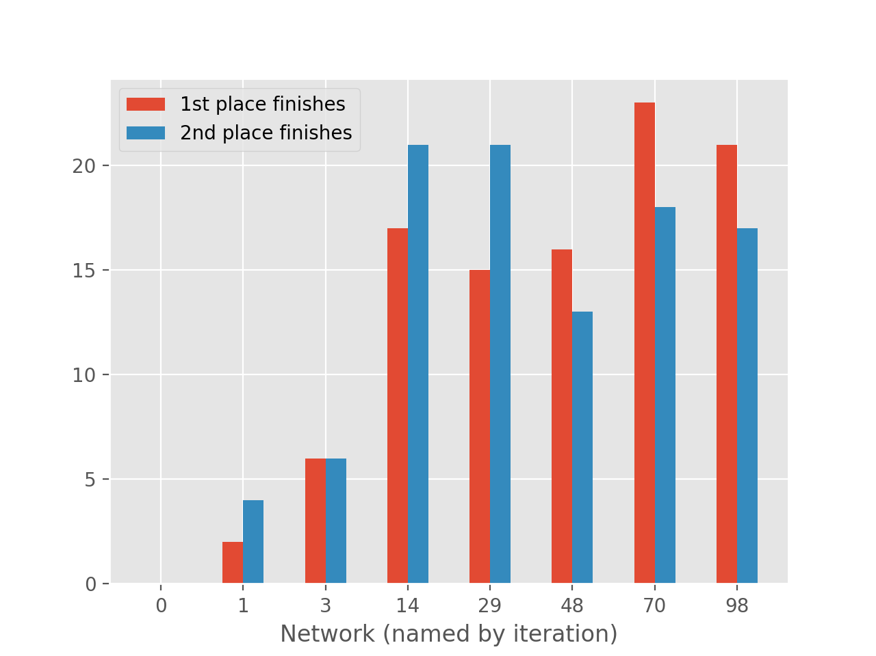
Tournament Results
Note that the networks are not sampled “linearly” at evenly spaced numbers of iterations, so progress looks a little skewed
Small, local tournaments would likely be a good tactic to incorporate into the training process to help ensure that the new net is a true improvement (since a network could develop a strategy to beat the previous network only, not a general strategy to win)
Being able to play enough games to ensure an improvement is another resource issue, though

Slide 14
Tournament Results
So it looks like there was some improvement over the training run, though to be sure we’d need to run a lot more games and tournaments with more networks to determine the true “best” network, it just takes a while to run these tournaments and we’re running low on free google bucks.
We did sort of expect to see the progression more evident in the first few iterations, as once we got to the last 40 iterations or so the self-play games resulted in a lot of draws leading to networks replacing other networks with a small win advantage like 2 wins, 1 loss, and 37 draws (we did 40 total self-play games to determine if the new network would replace the old).
Hence a lot of our network updates towards the end were likely more through randomness than actual improvement, which is probably why 98 performed worse than 70
14 was also a powerhouse when it appeared in training, replacing its predecessor with 20 wins and 1 loss, and staying on top for a while.

Slide 15
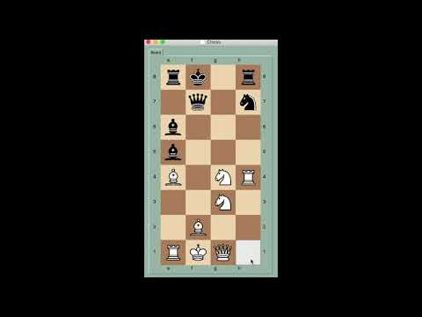
Net (white) beating random opponent (black)

Slide 16
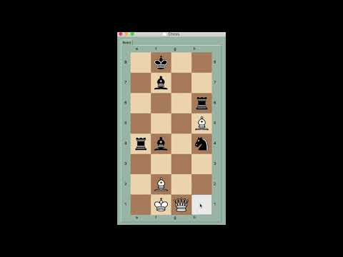
Net (white) drawing against itself (black)

Slide 17
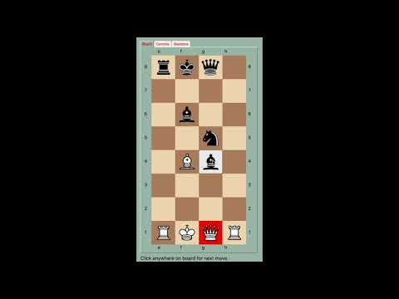
Net (black) beating a human player (white) due to a queen blunder

Slide 18
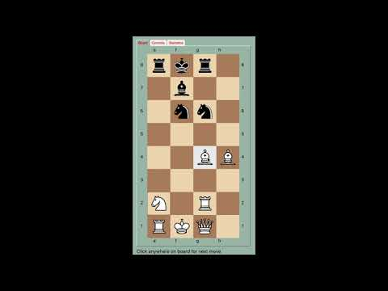
Net (black) losing to vengeful human player (white) after blundering its own queen

Slide 19
Discussion
It definitely appears to be playing somewhat intelligently, most of its moves make sense at you can predict that it will make a good move if you set it up for one (offer a queen sacrifice and it will take it, etc).
It also (sometimes) recognizes and avoids some pretty complex maneuvers such as pins and double attacks
It’s certainly not human-level, as it makes a lot of blunders and gives up pieces, particularly in the early game. Once it gets down to a few remaining pieces it plays almost optimally and becomes pretty hard to beat.
It is moderately difficult to play for us if we’re not trying too hard or if we play fast. (Though we aren’t particularly good at chess)

Slide 20
How could this be scaled up?
Our ultimate limiting factor here is the data. We don’t have the resources to generate enough of it because it takes a long time to play out chess games (even in our specific variant designed to be short).
The data that we’re generating also isn’t very high quality, as we’re only able to do about 35 MCTS per turn due to computational constraints. Because of this, the network misses a lot of important moves it could make and attacks it could avoid, particularly in the early game when the branching factor is high. This noticeably improves in the late game though.
This approach really works well in a distributed setup, as many self-play games can be carried out at once (which is why DeepMind used 5000 TPUs)

Slide 21
Acknowledgements
We adapted our implementation from alpha-zero-general which has a nice, simplified (read single GPU) version of Alpha-Zero for various board games.
We modified our chess environment from python-chess
We used a GUI from PySimpleGUI to play with the network

