Slide 1
COMPILER DESIGN
COMP 442/6421 – Compiler Design
Intermediate representations
Introduction to code generation
Joey Paquet, 2000-2026

Slide 2
Introduction to code generation
COMP 442/6421 – Compiler Design
Front end:
  Lexical Analysis
  Syntactic Analysis
  Intermediate Code/Representation Generation
  Intermediate Code/Representation Optimization
  Semantic Analysis
Back end:
  Object Code Generation
  Object Code Optimization
The front end is machine-independent, i.e. the decisions made in its processing do not depend on the target machine on which the translated program will be executed.
A well-designed front end can be reused to build compilers for different target machines, i.e. a “retargetable” compiler.
The back end is machine-dependent, i.e. these steps are related to the nature of the assembly or machine language of the target architecture.
Joey Paquet, 2000-2026

Slide 3
Introduction to code generation
COMP 442/6421 – Compiler Design
After syntactic analysis, we have a number of options to choose from:
Lexical
Analyzer
Syntactic
Analyzer
Semantic
Translation
Object
Code
Lexical
Analyzer
Syntactic
Analyzer
Semantic
Translation
Intermediate
Code
Object
Code
our project
Lexical
Analyzer
Syntactic
Analyzer
Intermediate
Representation
Semantic
Translation
Object
Code
Lexical
Analyzer
Syntactic
Analyzer
Intermediate
Representation
Semantic
Translation
Intermediate
Code
Object
Code
Front End
Back End
Joey Paquet, 2000-2026

Slide 4
Intermediate representations and intermediate code
COMP 442/6421 – Compiler Design
Intermediate representations synthetize the syntactic information gathered during the parse, generally in the form of a tree or directed graph.
Intermediate representations enable high-level code optimization.
In out project, we use an Abstract Syntax Tree (AST) as an intermediate representation.
Intermediate code is a low-level coded (text) representation of the program, directly translatable to object code.
Intermediate code enables low-level, architecture-dependent optimizations.
We don’t have intermediate code in our project.
Joey Paquet, 2000-2026

Slide 5
COMP 442/6421 – Compiler Design
Intermediate representations
Joey Paquet, 2000-2026

Slide 6
Abstract syntax tree
COMP 442/6421 – Compiler Design
Parse tree (concrete syntax tree) emphasize the grammatical structure of the program, based on the exact concrete syntax of the grammar.
Abstract syntax tree emphasize the actual computations to be performed. They do not refer to the actual non-terminals defined in the grammar, nor to tokens that play no role in defining the translated program, hence their name.
When implementing an LL parser, there is generally substantial differences between the parse tree and the corresponding abstract syntax tree.
A parse tree contains grammar-specific nodes, e.g. non-terminal symbols, punctuation, etc. These are not necessary for further processing. Abstract syntax trees do not include them, hence the name abstract.
Joey Paquet, 2000-2026

Slide 7
Parse tree vs. abstract syntax tree
COMP 442/6421 – Compiler Design
Parse Tree
Abstract Syntax Tree
x = a*b+a*b;
x = a*b+a*b
A
=
id
=
E
;
x
+
x
E
+
E
*
*
id
*
id
id
*
id
a
b
a
b
a
b
a
b
Joey Paquet, 2000-2026

Slide 8
Directed acyclic graph
COMP 442/6421 – Compiler Design
Directed acyclic graphs (DAG) are a relative of syntax trees: they are used to show the syntactic structure of valid programs in the form of a graph with the following restrictions:
  Edges between nodes can only be unidirectional.
  There cannot be cycles in a DAG, i.e. no path can ever lead twice to the same node.
  Presence of a root node.
For example, in a DAG representation, the nodes for repeated variables and expressions are merged into a single node.
DAGs are more complex to build and use than syntax trees, but easily allows the implementation of a variety of optimization techniques by avoiding redundant operations.
Joey Paquet, 2000-2026

Slide 9
Abstract syntax tree vs. directed acyclic graph
COMP 442/6421 – Compiler Design
Abstract Syntax Tree
Directed Acyclic Graph
x = a*b+a*b
x = a*b+a*b
=
=
x
+
x
+
*
*
*
a
b
a
b
a
b
Joey Paquet, 2000-2026

Slide 10
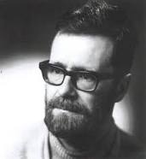
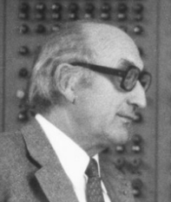
Postfix notation
COMP 442/6421 – Compiler Design
Reverse Polish notation (RPN), also known as Polish postfix notation or simply postfix notation.
"Polish" refers to the nationality of logician Jan Łukasiewicz, who invented it in 1924.
Mathematical notation in which operators follow their operands, in contrast to Polish notation, in which operators precede their operands.
It does not need any parentheses as long as each operator has a fixed number of operands.
The postfix notation was used by Friedrich L. Bauer and Edsger W. Dijkstra while working on the design of a compiler for the Algol language in the 1960s to reduce computer memory access and utilize a stack to evaluate expressions.
Edsger Dijkstra
Friedrich L. Bauer
Joey Paquet, 2000-2026

Slide 11
Postfix notation
COMP 442/6421 – Compiler Design
Can be generated from an abstract syntax tree using post-order traversal.
Some programming language constructs can be translated into post-fix notation.
Edsger Dijstra invented the shunting-yard algorithm to translate them from infix notation to post-fix notation.
This algorithm was later expanded into operator precedence parsing, which is essentially LR shift-reduce parsing without the notion of state.
Much less powerful than LR, e.g. cannot deal with grammars that have more than one consecutive non-terminals nor epsilon in a right-hand-side.
Can be used to minimize the memory consumption used for intermediate results.
a+b ⇒ ab+
a+b*c ⇒ abc*+
if A then B else C ⇒ ABC?
if A then if B then C else D else E ⇒ ABCD?E?
x=a*b+a*b ⇒ xab*ab*+=
Joey Paquet, 2000-2026

Slide 12
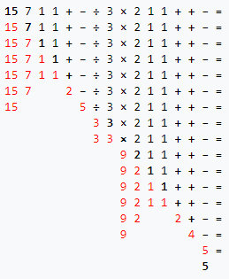
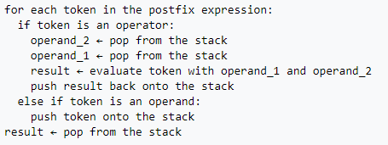
Postfix notation
COMP 442/6421 – Compiler Design
Example of processing post-fix notation:
  Expression in post-fix notation in black.
  Current token in black bold.
  Content of stack in red.
This example assumes that all operators are binary.
Stack-based evaluation of expressions expressed in post-fix notation:
((15/(7-(1+1)))*3)-(2+(1+1))
Joey Paquet, 2000-2026

Slide 13
Three-address code
COMP 442/6421 – Compiler Design
Three-address codes (TAC or 3AC) is an intermediate language that maps directly to “assembly pseudo-code”, i.e. architecture-independent assembly code.
It breaks the program into short uniform statements requiring no more than three variables (hence its name) and no more than one operator.
As it is an intermediate (abstract) language, its “addresses” represent symbolic addresses (i.e. variables), as opposed to either registers or memory addresses that would be used by the target machine code.
These characteristics allows 3AC to:
  be more abstract than assembly language, enabling optimizations at the higher abstract level.
  have high resemblance to assembly language, enabling easy translation to assembly language.
Joey Paquet, 2000-2026

Slide 14
Three-address code
COMP 442/6421 – Compiler Design
source | 3AC
x = a+b*c | t := b*c x := a+t
x = (-b+sqrt(b^2-4*a*c))/(2*a) | t1 := b * b t2 := 4 * a t3 := t2 * c t4 := t1 - t3 t5 := sqrt(t4) t6 := 0 - b t7 := t5 + t6 t8 := 2 * a t9 := t7 / t8 x := t9
for (i = 0; i < 10; ++i) { b[i] = i*i; } ... | t0 := 0 L1: t1 = t1 >= 10 if t1 goto L2 t2 := t0 * t0 t3 := t0 * 4 t4 := b + t3 *t4 := t2 t0 := t0 + 1 goto L1 L2: ...
Joey Paquet, 2000-2026

Slide 15
Three-address code
COMP 442/6421 – Compiler Design
The temporary variables are generated at compile time and may be added to the symbol table.
In the generated code, the variables will refer to actual memory cells. Their address (or alias), or offset, may also be stored in the symbol table.
3AC can also be represented as quadruples, which are a kind of abstract assembly instructions that can then be translated into concrete assembly languages.
3AC | ASM
t := b*c | L 3,b M 3,c ST 3,t
x := a+t | L 3,a A 3,t ST 3,x
3AC | Quadruples
t := b*c | MULT t,b,c
x := a+t | ADD x,a,t
Joey Paquet, 2000-2026

Slide 16
Intermediate languages
COMP 442/6421 – Compiler Design
We can also generate code in a language for which we already have a compiler or interpreter.
Such languages are generally low-level and dedicated to the compiler construction task, and come with their own execution model.
It provides the compiler writer with a “virtual machine”.
Various compilers can be built using the same intermediate language and virtual machine, which essentially acts as a final execution back-end for the compiler.
The virtual machine compiler/interpreter can be compiled on different physical machines to provide a translator to various architectures.
Many contemporary languages, such as Java, Perl, PHP, Python, C#, and Ruby use a similar execution architecture.
For the project, we have the Moon processor, which provides a virtual assembly language and a compiler/interpreter for that language.
Joey Paquet, 2000-2026

Slide 17
COMP 442/6421 – Compiler Design
Project architectural overview
Joey Paquet, 2000-2026

Slide 18
Project architectural overview
COMP 442/6421 – Compiler Design
source code
lexical analysis
code generation
Moon code
Moon
processor
token stream
decorated AST
syntax analysis
AST
semantic analysis
Your compiler generates Moon code.
The Moon processor (virtual machine) is used to execute your output program.
The Moon processor is written as a C program.
Your compiler is thus retargetable by recompilation of the Moon processor on your target computer.
Joey Paquet, 2000-2026

Slide 19
Project architectural overview
COMP 442/6421 – Compiler Design
Semantic verification/translation is done using Semantic Actions.
As the AST is traversed, semantic actions applicable to the currently traversed node type are triggered.
Many semantic actions need to be used in order to do the entire semantic verification/translation.
Some semantic actions need to be applied prior to others, so you need to organize them in phases, i.e. groups of semantic actions that can be triggered as a group.
A separate Semantic Actions module should be created that consists of a library of functions that the compiler will call as the AST is traversed. Ideally, there should be one such module for each phase, and each phase is externally triggered in a particular sequence.
For example, the following phases should be created and triggered:
  Semantic actions to create the symbol tables
  Semantic actions to do type checking
  Semantic actions to do object code generation
This can easily be done using the Visitor pattern.
Joey Paquet, 2000-2026

Slide 20
Project architectural overview
COMP 442/6421 – Compiler Design
Semantic
Analysis and
Translation
Module
AbstractVisitor class
SemanticAnalyzer Module
SAphase1visitor class
AST
visit(ASTnode1)
visit(ASTnode4)
visit(ASTnode9)
ASTnode1
ASTnode2
visit(ASTnode2)
visit(ASTnode8)
visit(ASTnode10)
ASTnode3
…
ASTnode5
SAphaseNvisitor class
Moon code
ASTnode6
visit(ASTnode1)
visit(ASTnode4)
ASTnode7
visit(ASTnode3)
visit(ASTnode8)
ASTnode4
ASTnode8
CodeGenerator Module
ASTnode9
ASTnode10
CGphase1visitor class
visit(ASTnode2)
visit(ASTnode4)
visit(ASTnode10)
visit(ASTnode3)
visit(ASTnode5)
…
CGphaseNvisitor class
visit(ASTnode1)
visit(ASTnode3)
visit(ASTnode2)
Joey Paquet, 2000-2026

Slide 21
COMP 442/6421 – Compiler Design
Semantic actions and code generation
Joey Paquet, 2000-2026

Slide 22
Semantic actions
COMP 442/6421 – Compiler Design
Semantics is about analyzing the meaning to the compiled program.
Semantic actions have two counterparts:
  Semantic checking: check if the compiled program can have a meaning, e.g identifiers are properly declared and used, operators and functions have the right parameter types and number of parameters upon calling.
  Semantic translation: translate declarations, expressions, statements and functions to target code.
Semantic translation is conditional to semantic checking, i.e. if a source program is found to be semantically invalid, the generated code would be invalid.
There is no such thing as code generation errors detection/reporting.
Joey Paquet, 2000-2026

Slide 23
Semantic actions
COMP 442/6421 – Compiler Design
There are semantic actions associated with:
  Declarations:
    variable declarations
    type declarations
    function declarations
  Control structures:
    conditional statements
    loop statements
    function calls
  Assignments and expressions:
    assignment operations
    arithmetic and logical expressions
This applies to strongly typed procedural programming.
Other programming language paradigms often have to be analyzed/translated differently, either at compile time and/or run time.
Joey Paquet, 2000-2026

Slide 24
COMP 442/6421 – Compiler Design
Processing declarations
Joey Paquet, 2000-2026

Slide 25
Processing declarations
COMP 442/6421 – Compiler Design
Semantic checking
  While processing declarations, the only semantic checking there is to do is to ensure that every identifier (e.g. variable, type, class, function, etc.) is declared once and only once in the same scope.
  This restriction is tested using the symbol tables.
  A symbol table is created every time a scope is entered.
  Symbol table entries are generated as declarations are encountered in the current scope.
  Afterwards, every time an identifier is encountered in statements/expressions, a check is made in the symbol table to ensure that:
    It has been properly defined in the scope where the identifier is encountered.
    It is properly used according to its type as stored in the symbol table.
Joey Paquet, 2000-2026

Slide 26
Processing declarations
COMP 442/6421 – Compiler Design
Semantic translation
  Code generation in type declarations comes in the form of calculation of the total memory size to be allocated for the variables/objects/arrays declared.
  Every variable defined will eventually have to be stored in the computer’s memory.
  Memory allocation must be done according to the size of the variables declared, the data encoding used, and the word length of the processor, which depends on the target machine.
  In the project, for each variable identifier declared you either:
    Generate a unique label that will be used to refer to that variable in the Moon code (a.k.a. tags-based approach).
    Use a stack-based approach as the memory allocation scheme, where all references to variables have to be done using offset calculation assuming that all variables are stored in a function call stack frame (a.k.a. stack-based approach).
  If you use labels, when dealing with aggregate data types, e.g. data structures such as objects, or arrays, offsets still need to be used to refer to the elements of the aggregate variables/values.
  If recursion is allowed, stack-based memory allocation is necessary.
  Examples that follow in this slide set are using the tags-based approach.
  Stack-based operation will be explained in more details in the next slide set.
Joey Paquet, 2000-2026

Slide 27
Processing variable declarations
COMP 442/6421 – Compiler Design
Semantic checking
  Verify that an entry has been entered in the symbol table corresponding to the current scope.
Semantic translation
  The label corresponding to the variable, or its offset versus the current scope’s base address, is stored in the symbol table entry of the variable. In the case of arrays, the elements’ offsets (size of the elements, rows, etc) are often stored in the symbol table record, though it can be calculated from the array’s type and dimension list.
  Such information can also be put in the AST nodes, though it may clutter the AST node structure.
  If a label-based memory allocation model is used, a label is assigned to the variable, then memory space is reserved for the variable according to the size of the type of the variable and linked to a unique label in the Moon code.
  If a stack-based model is used, it is assumed that the variable’s value is stored at address stackframe+offset (offset: size of the variable + size of all the variables preceding it in its scope). This requires the memory allocation size to be previously processed, usually in a previous AST traversal pass.
Joey Paquet, 2000-2026

Slide 28
Declarations: sample symbol table with sizes/offsets
COMP 442/6421 – Compiler Design
=====================================================
| table: global scope offset: 0 |
=====================================================
| func | func1 | int |
| =====================================================
| | table: func1 scope offset: -212 |
| =====================================================
| | param | int235 | int | 120 | -120 |
| | param | float4 | float | 80 | -200 |
| | var | a1 | int | 4 | -204 |
| | tempvar | t1 | int | 4 | -208 |
| | tempvar | t2 | int | 4 | -212 |
| =====================================================
| func | func2 | float |
| =====================================================
| | table: func2 scope offset: -976 |
| =====================================================
| | param | float102 | float | 816 | -816 |
| | param | float6 | float | 8 | -824 |
| | var | int421 | int | 32 | -856 |
| | var | float11 | float | 88 | -944 |
| | tempvar | t3 | float | 8 | -952 |
| | tempvar | t4 | float | 8 | -960 |
| | tempvar | t5 | float | 8 | -968 |
| | tempvar | t6 | float | 8 | -976 |
| =====================================================
| func | program | void |
| =====================================================
| | table: program scope offset: -856 |
| =====================================================
| | var | float101 | float | 808 | -808 |
| | var | float4 | float | 8 | -816 |
| | var | int4 | int | 4 | -820 |
| | var | float3 | float | 8 | -828 |
| | var | int3 | int | 4 | -832 |
| | tempvar | t7 | int | 4 | -836 |
| | tempvar | t8 | int | 4 | -840 |
| | tempvar | t9 | int | 4 | -844 |
| | tempvar | t10 | int | 4 | -848 |
| | tempvar | t11 | int | 4 | -852 |
| | tempvar | t12 | int | 4 | -856 |
| =====================================================
=====================================================
int func1(int int235[2][3][5]; float float4[10];){
int a1;
a1=1+2*3;
}
float func2(float float102[102]; float float6;){
int int421[4][2][1];
float float11[11];
float6=float6+float6*2.5;
float6= float6+float6*3.0;
}
program{
float float101[101];
float float4;
int int4;
float float3;
int int3;
int4=int4+int4*int4;
int3=int3+int4*int3;
int4=int4+int3*int3;
}
Joey Paquet, 2000-2026

Slide 29
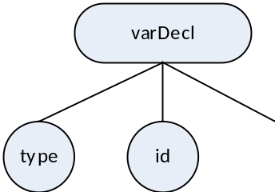

Processing variable declarations (basic types)
COMP 442/6421 – Compiler Design
Variable declaration (basic type)
sizeof(int) = 32 bits (4 bytes)
sizeof(float) = needs to be encoded (non-native)
(assumption is 8 bytes)
Implementation as a visitor method (non-array):
// label-based code generation for a VarDeclNode
public void visit(VarDeclNode node){
// First, propagate accepting the same visitor to all the children
// This effectively achieves Depth-First AST Traversal
for (Node child : node.getChildren() )
child.accept(this);
// Then, do the processing of this nodes' visitor
if (node.getChildren().get(0).getData() == "int")
moonDataCode += " % space for variable " + node.getChildren().get(1).getData() + "\n";
moonDataCode += String.format("%-7s" ,node.getChildren().get(1).getData()) + " res 4\n";
}
int a;
int b;
int c;
% label-based code:
% space for variable a
a res 4
% space for variable b
b res 4
% space for variable c
c res 4
Joey Paquet, 2000-2026

Slide 30
Processing variables declarations (composite data structures)
COMP 442/6421 – Compiler Design
All variables need to be declared so that they are of fixed size. This is why array dimensions need to be constants.
This restriction comes from the fact that the memory allocated to the array has to be set at compile time, and be fixed throughout the execution of the program.
When processing an array declaration, a sufficient amount of memory is allocated to the variable depending on the size of each element and the total cardinality of the array.
Similarly for objects, memory is assigned for all the data members available to objects of their class.
Addressing is stored in the symbol table. This is either a Moon label used to refer to the starting address of a data element, or an offset computed from the size of all the data elements coming before it in the current scope. The size of the entire data structure also needs to be stored in the symbol table. This facilitates code generation of array indexing or object member access during code generation, as well as the offset calculation of other variables coming after this one in the current scope.
Variables of dynamic size are generally implemented using pointers, dynamic memory allocation and a heap. This requires the implementation of a complex runtime heap memory management system to execute the programs. For simplicity, we don’t have them in the project.
Joey Paquet, 2000-2026

Slide 31

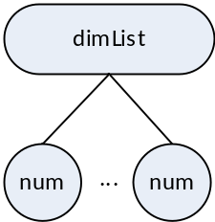
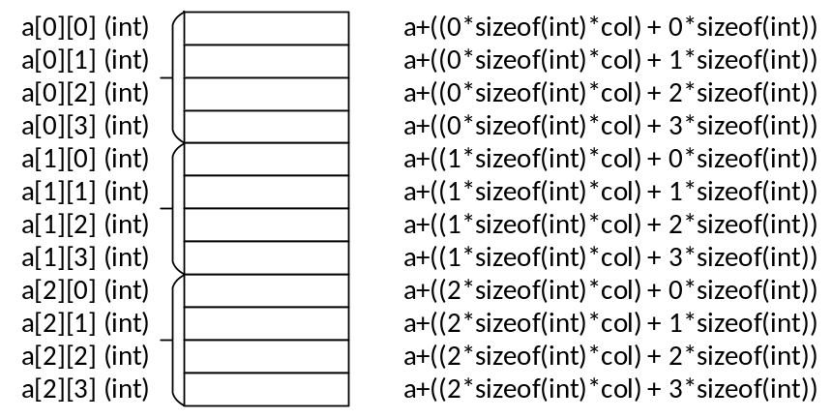
Processing variable declarations (arrays)
COMP 442/6421 – Compiler Design
Variable declaration (arrays)
sizeof(array) = sizeof(type)
* num₁
* num₂
…
* num_{n}
int a[3][4];
int b[2];
int c[2][2][2];
% label-based code:
% space for variable a
a res 48
% space for variable b
b res 8
% space for variable c
c res 32
Joey Paquet, 2000-2026

Slide 32
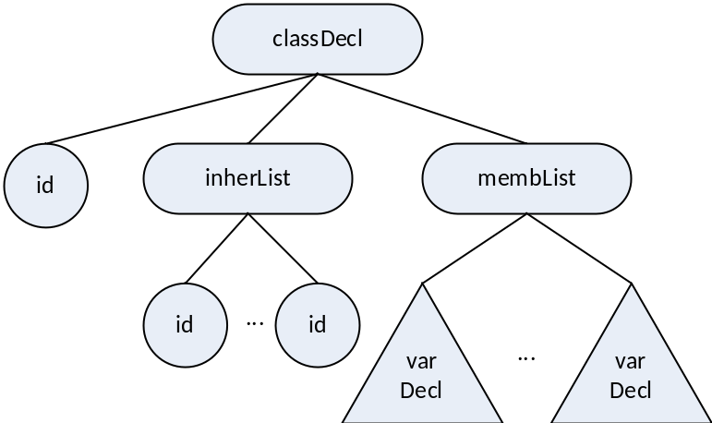
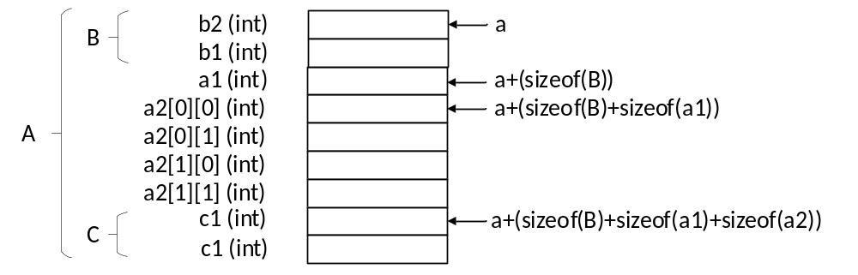
Processing variable declarations (objects)
COMP 442/6421 – Compiler Design
Variable declaration (objects)
sizeof(object) = for each inherited class
size += sizeof(inherited class)
for each member variable
size += sizeof(member)
class A : B {
int a1;
int a2[2][2];
C a3;
}
class B {
int b1;
int b2;
}
class C {
int c1;
int c2;
}
program {
A a;
}
% label-based code
% space for variable a
a res 36
Joey Paquet, 2000-2026

Slide 33
Processing expressions/assignment statements
COMP 442/6421 – Compiler Design
Semantic records contain the type and location for variables (i.e. labels in the Moon code, or offsets) or the type and value for constant factors.
Semantic records are created at the leaves of the tree when factors are recognized and their information is retrieved, e.g. from the symbol table record for variables, or from the token contained in the AST for literal values.
Some of the information in these semantic records needs to be migrated up for processing of (for example):
  Semantic checking, e.g. check if operands’ types are valid for the operator.
  Semantic translation, generate code, or reserve memory/calculate offsets.
When processing expressions, the type of all sub-expressions should be determined and stored in a semantic record made accessible in the root node of the subtree, so that it can be accessed by their parent node.
Similarly, temporary variables need to be created/allocated to store each temporary result for a subtree. Either a label is created or an offset is calculated for them and also made available to the parent node. A record in the parent function’s symbol table can also be created.
Joey Paquet, 2000-2026

Slide 34
Processing expressions/assignment statements
COMP 442/6421 – Compiler Design
Each time an operator node is traversed, its corresponding semantic checking and translation is done (possibly implemented on separate phases/traversals) and its subresult is stored in a temporary memory location for which you have to allocate some memory and generate a label or compute its offset.
Alternatively, an entry can then be inserted in the symbol table for each intermediate result generated. If so, it can then be used for further reference when doing semantic verification and translation in further AST traversal.
=====================================================
| table: global scope size: 0 |
=====================================================
| func | program | void |
| =====================================================
| | table: program scope size: 40 |
| =====================================================
| | var | a | int | 4 | 0 |
| | var | b | int | 4 | 4 |
| | var | c | int | 4 | 8 |
| | litval | t1 | int | 4 | 12 |
| | litval | t2 | int | 4 | 16 |
| | litval | t3 | int | 4 | 20 |
| | tempvar | t4 | int | 4 | 24 |
| | tempvar | t5 | int | 4 | 28 |
| | litval | t6 | int | 4 | 32 |
| | tempvar | t7 | int | 4 | 36 |
| =====================================================
=====================================================
program{
int a;
int b;
int c;
a = 1;
put(a);
b = 2;
put(b);
c = 3;
put(c);
a = a + b * c;
put(a + 6);
} // result = 13
Joey Paquet, 2000-2026

Slide 35
Processing expressions/assignment statements
COMP 442/6421 – Compiler Design
The code is generated sequentially as the tree is traversed:
Subtree | label-based Moon code
t1 = b*c | lw r1,b(r0) lw r2,c(r0) mul r3,r1,r2 sw t1(r0), r3
t2 = a+t1 | lw r1,a(r0) lw r2,t1(r0) add r3,r1,r2 sw t2(r0), r3
x = t2 | lw r1,t2(r0) sw a(r0),r1
=
a
+
a
*
b
c
Joey Paquet, 2000-2026

Slide 36
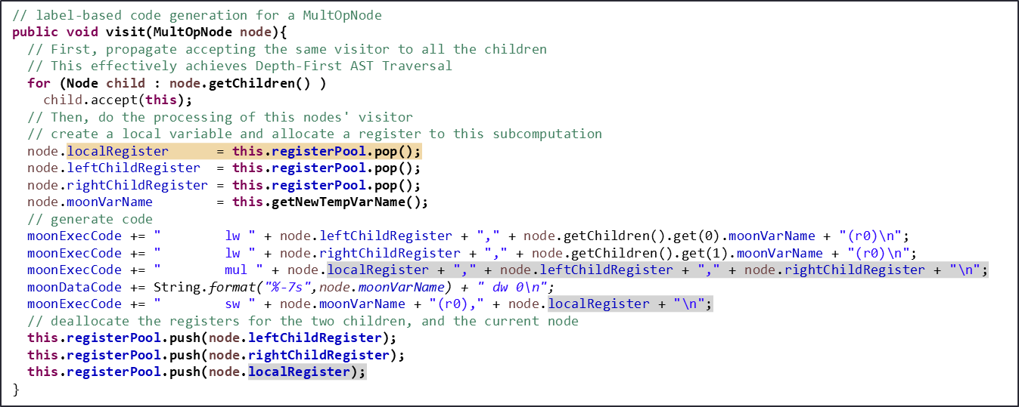
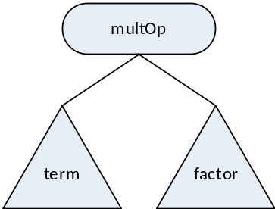
Processing expressions/assignment statements
COMP 442/6421 – Compiler Design
Processing a multiplication node
This uses a simple stack of strings to manage the register allocation.
Expects the Moon labels to be stored in the nodes.
  Here, for variables, Moon labels are the same as variable names, not always the case.
  In cases where the factor subtree is a tree, its result needs to be stored as a temporary value. Here, temporary results are stored in labeled memory cells. If using a stack mode of operation, the temporary memory location’s offset needs to be used to get to the stored value before it can be loaded.
Joey Paquet, 2000-2026

Slide 37
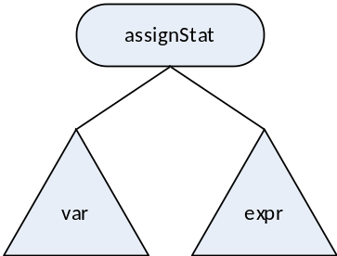
Processing expressions/assignment statements
COMP 442/6421 – Compiler Design
Processing an assignment statement node
// label-based code generation for a AssignStatNode
public void visit(AssignStatNode node){
// First, propagate accepting the same visitor to all the children
// This effectively achieves Depth-First AST Traversal
for (Node child : node.getChildren() )
child.accept(this);
// Then, do the processing of this nodes' visitor
// allocate local register
node.localRegister = this.registerPool.pop();
//generate code
moonExecCode += " lw " + node.localRegister + "," + node.getChildren().get(1).moonVarName + "(r0)\n";
moonExecCode += " sw " + node.getChildren().get(0).moonVarName + "(r0)," + node.localRegister + "\n";
//deallocate local register
this.registerPool.push(node.localRegister);
}
Joey Paquet, 2000-2026

Slide 38
Processing expressions/assignment statements
COMP 442/6421 – Compiler Design
A solution needs to be implemented for:
  Register allocation : many assembly code operations use registers. You need a facility to allocate registers for operations and deallocate them after they have been used.
  Moon tag name generation: If you want to use Moon tags for your temporary variables, you can implement that as a method of the visitor that implements the phase that uses name tag generation. Note that variable names in your source program are potentially not unique across different scopes. The Moon ASM language assumes unique tag names. So you need to create unique names in you tag generation.
In this way, these facilities are local to this visitor and are hidden from other visitors. Which is good modularity.
public class CodeGenerationVisitor extends Visitor {
public Stack<String> registerPool = new Stack<String>();
public Integer tempVarNum = 0;
public String moonExecCode = new String(); // moon instructions part
public String moonDataCode = new String(); // moon data part
public CodeGenerationVisitor() {
// create a pool of registers as a stack of Strings
// assuming only r1, ..., r12 are available
for (Integer i = 12; i>=1; i--)
registerPool.push("r" + i.toString());
}
public String getNewTempVarName(){
tempVarNum++;
return "t" + tempVarNum.toString();
}
…
}
Joey Paquet, 2000-2026

Slide 39
Conclusions
COMP 442/6421 – Compiler Design
Most compilers build an intermediate representation of the parsed program, normally as an abstract syntax tree.
These will allow high-level optimizations to occur before the code is generated.
In the project, we are outputting Moon code, which is an intermediate language.
Moon code could be the subject of low-level optimizations.
Semantic actions are triggered upon reaching certain node types when the AST is traversed. This generally requires a double dispatch mechanism, which is not available in most languages.
The Visitor pattern is a very appropriate solution to:
  Achieve double dispatch
  Allow great modularity by grouping semantic actions in different phases.
  Decorate the AST nodes with accumulated information used by further phases.
  Store information internally to the current visitor, so that other visitors are not cluttered with information that is not pertinent to them.
Joey Paquet, 2000-2026

Slide 40
References
COMP 442/6421 – Compiler Design
Fischer, Cytron, LeBlanc. Crafting a Compiler. Chapter 7, 8, 9, 10, 11. Addison-Wesley, 2010.
Wikipedia. Reverse Polish notation.
Wikipedia. Directed Acyclic Graph.
Dijkstra, E.W. (1961). Algol 60 translation : An algol 60 translator for the x1 and making a translator for algol 60. Stichting Mathematisch Centrum. Rekenafdeling. Stichting Mathematisch Centrum.
Joey Paquet, 2000-2026

