Slide 1
Blockmon

Slide 2
Description
Monitoring and notification of Cardano transactions. The service accepts transactions hash over a simple HTTP PUT. It then keeps track of them on the blockchain and sends callback notifications with transaction details once it gets updated on the ledger.
Problem solved
Network congestion and size of the transaction are variables that determine how soon it gets added to a block in Cardano. A service that keeps track of transaction will improve efficiency. The feature can be used to chain events with confirmation of transaction and the contents of those transactions. The service can be deployed by the user and be scaled as per requirement.

Slide 3
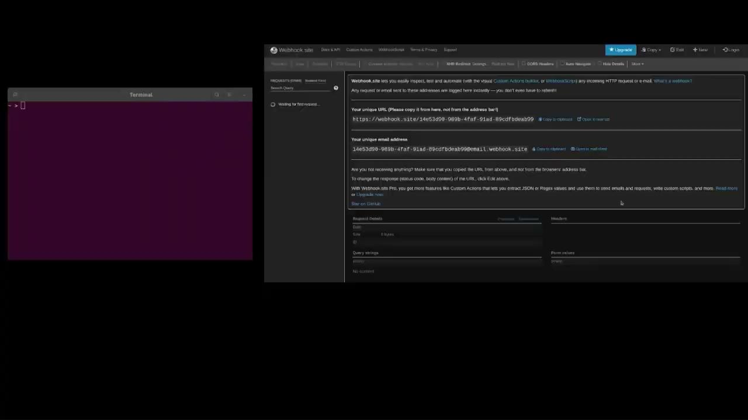
Demo

