Slide 1

CARDANO INDIA DEVELOPERS COMMUNITY
Meshjs with Cardano Wallet

Slide 2
CARDANO INDIA DEVELOPERS COMMUNITY
What is Mesh Js?
Ans :- Mesh is an open-source library providing numerous tools to easily build powerful dApps on the Cardano blockchain.
Why use Mesh js on cardano?
Ans:- Mesh is developed closely to network updates. By using Mesh, your application will always be ready for the latest network changes, so you can focus on building your application.

Slide 3
CARDANO INDIA DEVELOPERS COMMUNITY
What is UTXOs?
Ans:- In cryptocurrencies, an unspent transaction outputs (UTXOs) represents some amount of digital currency which has been authorized by one account to be spent by another.
What is mesh Provider?
Ans:- Providers are services provided by the Cardano developer community, to help you ship your apps faster. e.g:-(Blockfrost, Tangocrypto,Koios,Ogmios)

Slide 4
CARDANO INDIA DEVELOPERS COMMUNITY
What is an unsigned transaction?
Ans:- Unsigned transactions don't require a signature and don't include any information about who submitted the transaction. With an unsigned transaction, there's no economic deterrent to prevent spam or replay attacks.
What is a signed transaction?
Ans:- Transaction Signing is a security step that controls and verifies transaction credentials by creating a one-time confirmation code for a single transaction via Digital Secure Key or Secure Key.

Slide 5
CARDANO INDIA DEVELOPERS COMMUNITY
Wallet in blockchain?
Ans:- A blockchain wallet is a cryptocurrency wallet that allows users to manage different kinds of cryptocurrencies
There are two types of wallet
a) App Wallet
b) Browser wallet

Slide 6
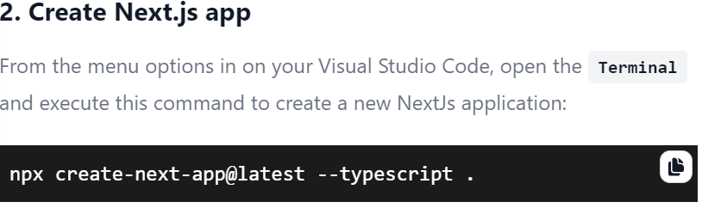
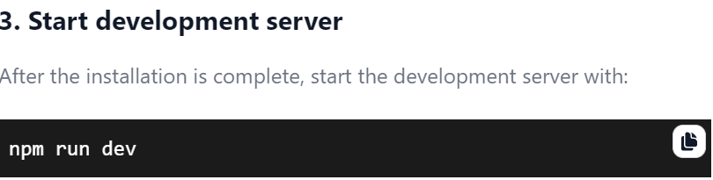
CARDANO INDIA DEVELOPERS COMMUNITY
For developing : Next js, cardano wallet
Step-1:-(system setup)
Visual studio code, Node.js (Node.js is a cross-platform JavaScript runtime environment that runs on the V8 engine and executes JavaScript code. Install the Long-Term Support)
Step-2:-(setup next.js)

Slide 7
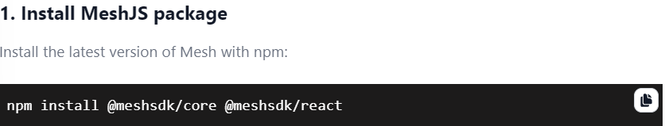
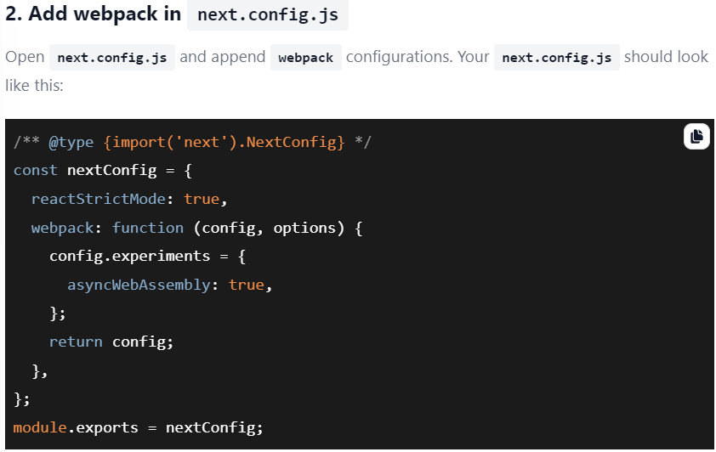
CARDANO INDIA DEVELOPERS COMMUNITY
Step:-3( Setup Mesh)

Slide 8
Thanks To You All
CARDANO INDIA DEVELOPERS COMMUNITY

