Slide 1

ON-CHAIN VOTING PORTAL
FOR COLLEGE ELECTIONS

Slide 2

ABOUT
01
Problem
Traditional voting systems in college elections are often susceptible to fraud, tampering, and lack of transparency. By leveraging blockchain technology, this project aims to solve these issues by offering a decentralized voting platform where votes are securely recorded on-chain. The immutability and transparency of the blockchain ensure trust in the election process, allowing students to vote confidently knowing their votes will be accurately counted.
02
Solution
A on-chain voting system built on the Cardano blockchain for securely conducting college elections. It ensures that votes are recorded transparently on-chain, allowing for verifiable results and reducing the risk of tampering. The front-end is built using Next.js, and Mesh.js is used to integrate Cardano blockchain functionalities, while Firebase handles off-chain data storage.

Slide 3

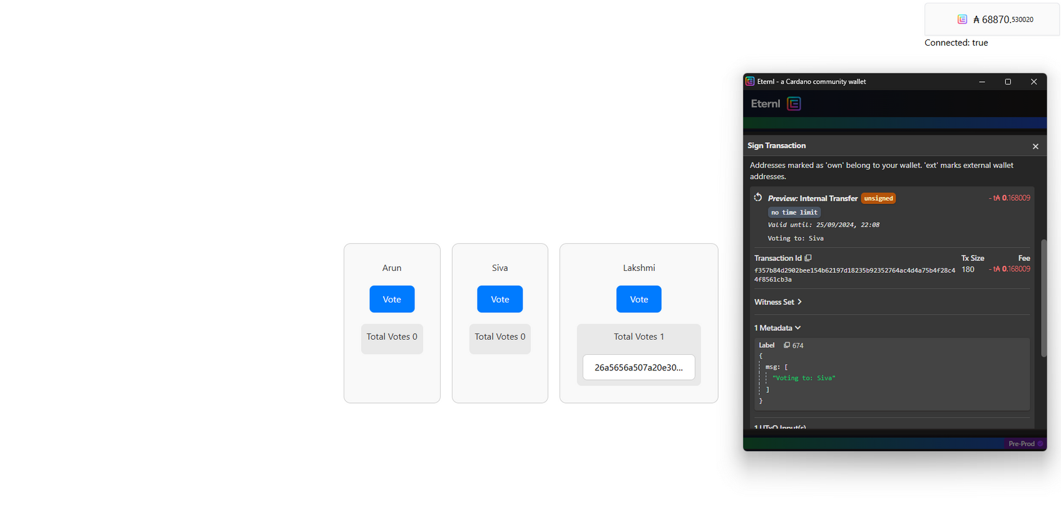
ON-CHAIN YOUR CANDIDATE
Connect Wallet -> Vote and That’s it!

Slide 4

THANK YOU
@tahaaaaa13

