Slide 1

Workshop 07: Statistical Learning II: A Practical Course in Deep Learning for Statisticians: Neural Network Fundamentals with Healthcare Applications Using Tensor Flow
Evan Paul Carey
Saint Louis University
https://github.com/evan-paul-carey/deep-learning-workshop

Slide 2
Course outline
Overview of deep learning
Introduction to deep learning frameworks
Regression as a NN
NN fundamentals
Applied universal function approximation
Regularization
Applied regression problem
Recurrent NN and Convolutional NN extensions
Medical extensions

Slide 3
Who are you and what is deep learning?

Slide 4
Instructor: Evan Carey
Assistant professor of Health Data Science @ Saint Louis University
Epidemiologist/Biostatistician/Health data scientist @ Department of Veteran Health Affairs
MS Applied biostatistics, PhD Epidemiology
Interest in answering useful questions using big healthcare data.
https://github.com/evan-paul-carey/deep-learning-workshop
Evan.carey@va.gov
Evan.carey@health.slu.edu

Slide 5
Attendee poll
Raise your hand if you have had coursework/training in general linear models with p-values ☺
Raise your hand if you have had coursework/training in machine learning approaches to generating predictive algorithms ☺
Raise your hand if you have had coursework/training in deep learning models with Tensorflow ☺

Slide 6



Statistical learning
$$x_{1}$$
$$x_{2}$$
y
$$x_{3}$$
Traditional inferential statistics / Bayesian inference
Goal: approximate the data generating process while make inference on uncertainty.
Machine learning
Goal: create an algorithm that predicts y with the highest accuracy.

Slide 7
Deep learning as a subset of ML
Deep learning is a subset of the field of ML.
Similar idea/goal:
Transform inputs into meaningful representations (outputs)
Given an image, transform it into a prediction of ‘Cat or not cat’
Given demographics, medical comorbidities, and recent clinical utilization, predict total cost of care next year.
Given demographics, medical comorbidities, and recent clinical utilization, predict probability of mortality in the next 6 months.

Slide 8
Deep learning versus ‘other ML’ approaches
One fundamental application difference is the degree of feature engineering required.
Under deep learning frameworks, we can flexibly add inputs. Since we model ‘hidden units’ (more on this later), we can hopefully extract meaningful feature engineering directly from the labelled data.
Why didn’t we do this prior to the current deep learning craze?

Slide 9
Why deep learning now?
Deep learning has become exceptionally popular in the last 10 years.
Why do you think that is?

Slide 10
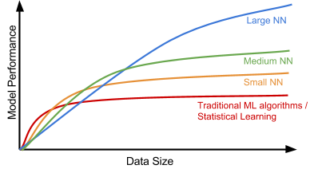
The potential of deep learning
Compute costs
Source: adapted from Andrew Ng’s course videos.

Slide 11




Popular deep learning frameworks
Tensorflow
Associated with Google
Pytorch
Younger than Tensorflow (1.0 released
October 2018)
Growing quickly in popularity
Backed by Facebook
Microsoft Cognitive Toolkit (CNTK)
Microsoft solution
Apache MXNet
Used by Amazon

Slide 12
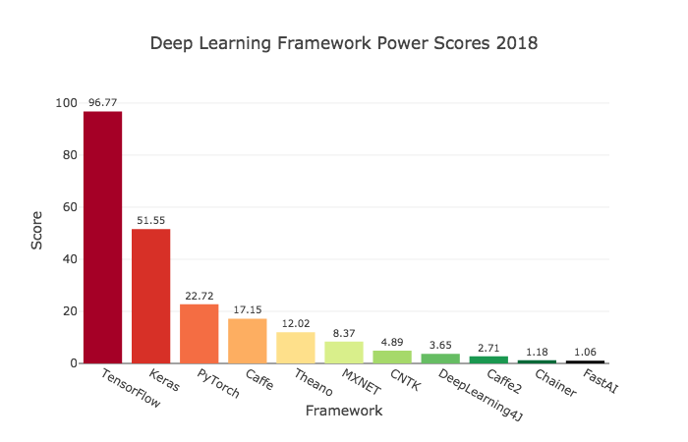
https://towardsdatascience.com/deep-learning-framework-power-scores-2018-23607ddf297a

Slide 13

“Keras is a high-level neural networks API, written in Python and capable of running on top of TensorFlow, CNTK, or Theano. It was developed with a focus on enabling fast experimentation. Being able to go from idea to result with the least possible delay is key to doing good research.”
- Keras documentation
Works on CPU and GPU
Allows you to easily specify models
Supports CNN and RNN
Works with Python 2.7-3.6
User friendly API for deep learning.

Slide 14
+
Tensorflow has adopted and integrated a version of Keras directly into TF!
Tensorflow.keras =/= keras
Although keras was not originally tied to Tensorflow, future development will be tied to tensorflow. More info here:
https://www.pyimagesearch.com/2019/10/21/keras-vs-tf-keras-whats-the-difference-in-tensorflow-2-0/

Slide 15
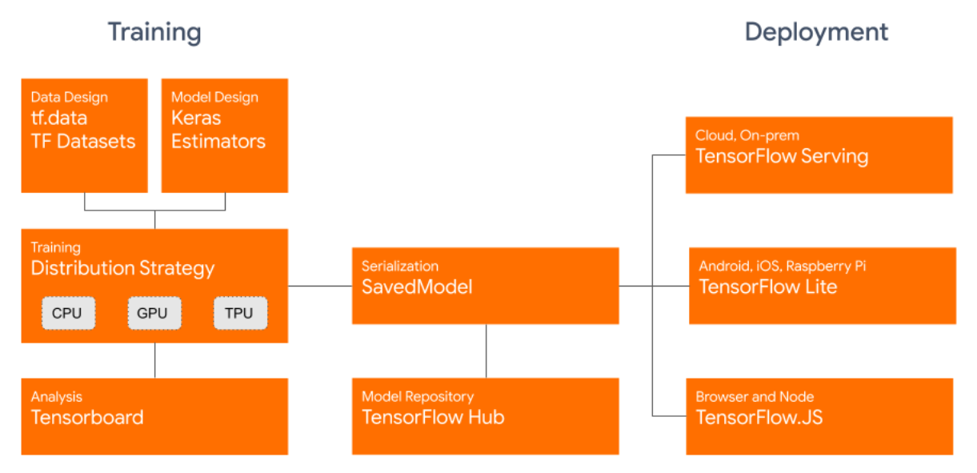
Tensorflow 2.0 available as of Sept 30, 2019 (oh my.)
https://blog.tensorflow.org/2019/09/tensorflow-20-is-now-available.html

Slide 16



Linear regression as a form of (shallow) deep learning.
$y_{i}=β_{0}1+β_{1}x_{1}+β_{2}x_{2}+β_{3}x_{3}+e$
$$x_{1}$$
$$x_{2}$$
y
$$x_{3}$$
Input layer
Hidden layer
Output

Slide 17








Construct a graph for this feed forward NN:
For every hidden layer:
Add a weight for each previous connected layer, plus one an offset weight.
Sum these weights (betas) times inputs plus offset (affine function)
Output some function of this sum.
$$x_{1}$$
$$β_{1}$$
$y=β_{0}1+β_{1}x_{1}+β_{2}x_{2}+β_{3}x_{3}$
$$x_{2}$$
$$β_{2}$$
y
$$β_{3}$$
$$x_{3}$$
$$β_{0}$$
Input layer
Hidden layer
Output
Notes:
What are we missing to call this an analog of linear usual linear regression?

Slide 18







Logistic regression as a form of deep learning.
$$x_{1}$$
$$β_{1}$$
$$x_{2}$$
$$β_{2}$$
y
$$β_{3}$$
$$x_{3}$$
$$β_{0}$$
Single hidden layer – identity link, sum of weights (betas) times inputs plus offset
Output layer – logit function (sigmoid function)
Notes:
Whats missing here again to be a true analog for logistic regression?

Slide 19
Loss functions and optimization
What is the loss function for linear regression?
Mean squared error (least squares regression).
What about other loss functions?
Mean absolute error?
What is the optimization algorithm/approach for typical linear regression (like `lm()` in R)?

Slide 20



Linear regression as a form of deep learning?
$$x_{1}$$
$$x_{2}$$
y
$$x_{3}$$
Input layer
hidden layer with 3 neurons
Output layer

Slide 21
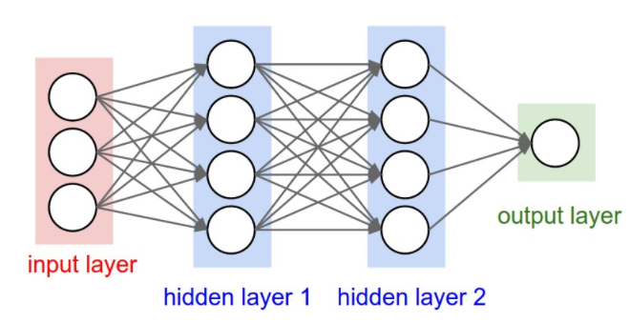
Example feed forward artificial neural network (ANN)
A three-layer artificial neural network.
(Image source: http://cs231n.github.io/convolutional-networks/#conv)

Slide 22
Deep learning goal – estimate the weights!
Input data (X)
Hidden layer (data transformation)
Hidden layer (data transformation)
Output (Y)
Weights
Weights
Given a model architecture and observed data, estimate the weights.
How do we know which weights are best?
optimization
How do we avoid overfitting the training data?
regularization

Slide 23
Input data (X)
Hidden layer (data transformation)
Hidden layer (data transformation)
Output (Y)
Weights
Weights
How do I know how good my current value of weights are?
Flow input data forward through the network (forward propagation)
Calculate cost (loss) function value, maybe squared error?
How do I know which direction to modify my weights to get a ‘better’ cost function?
Estimate each gradient (maybe the 2nd order derivative too)
Backpropagation is used to adjust the weights across this complex function space.
Notes:
Optimization of weights

Slide 24
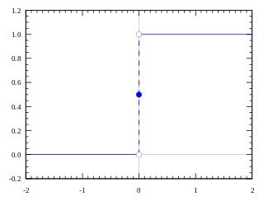
Activation functions more generally.
In a NN, each neuron:
Receives values from the prior connected neurons, modified by weights and an offset
Linearly sums the inputs
Applies an activation function (potentially non-linear transformation of the sum of the inputs)
Classic neuron – On or Off (firing or not firing)
But what about other functions?
Step function:
Value of 1 above threshold
Value of 0 below threshold
Graphs from - https://medium.com/the-theory-of-everything/understanding-activation-functions-in-neural-networks-9491262884e0

Slide 25
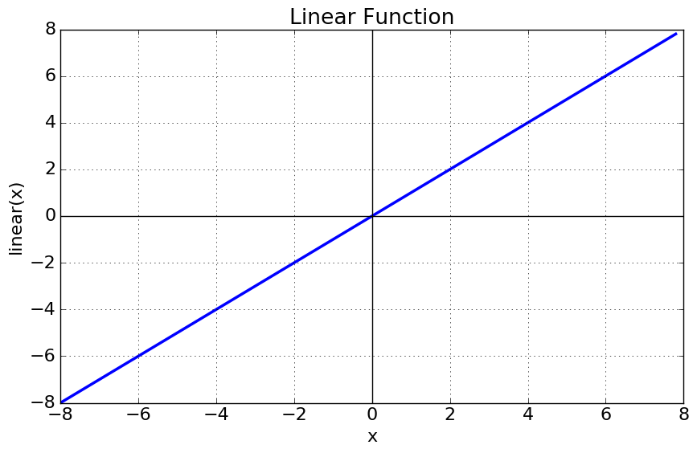
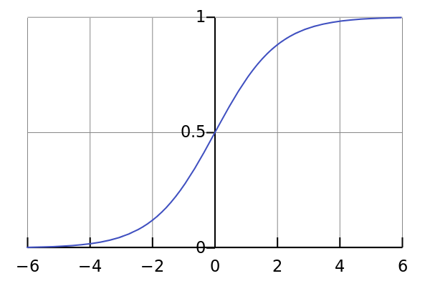
Linear function:
Simple linear sum of inputs
Sigmoid function:
Constrains output to be between 0 and 1
Logistic regression!
Graphs from - https://medium.com/the-theory-of-everything/understanding-activation-functions-in-neural-networks-9491262884e0

Slide 26
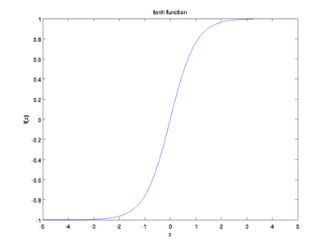
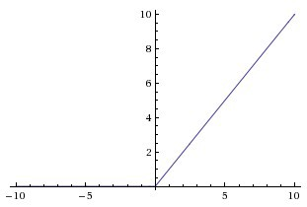
Tanh function:
Scaled sigmoid
Rectified Linear Unit function (relu):
0 unless above threshold
Linear thereafter
Graphs from - https://medium.com/the-theory-of-everything/understanding-activation-functions-in-neural-networks-9491262884e0

Slide 27
Using an ANN to approximate (almost) any function
The universal approximation theorem tells us an ANN feed forward network with a finite number of neurons and a single hidden layer can approximate any continuous function.
What does finite mean ?
ReLU is often used these days for hidden layers and has been shown to perform well.
https://en.wikipedia.org/wiki/Universal_approximation_theorem

Slide 28
Choosing the ANN architecture
When we design an ANN, we must design the architecture.
In practice, this means specifying:
The number of hidden layers (the depth)
The number of units per hidden layer (the width)
The activation functions for each layer. ReLU is common and a good starting point!

Slide 29
Move to notebooks!
02_keras_deep_learning_intro.ipynb

Slide 30
Regularization for deep Learning

Slide 31
Why do we need to regularize our models (review)?
Remember our goal…
maximize prediction on data we can see?
Or maximize prediction on data we can’t see?
Regularization hurts our training error.
But hopefully it improves our validation error!
We are introducing a lot of flexibility to the model through a deep/wide neural network…
The best fitting model in practice is typically a flexible model, regularized appropriately.
Regularization is “any modiﬁcation we make to a learning algorithm that is intended to reduce its generalization error but not its training error.”
- Chapter 5, Deep Learning Book, Ian Goodfellow

Slide 32
How do I track generalization error?
Generalization error is inherently unobservable.
We need creative approaches to hold out samples (validation / test) to replicate the notion of ‘out of sample data’.
Hold out across time units, or clusters…
After constructing a validation set, we can use to validate hyperparameters.
We can also track our estimate of training and generalization error across epochs.

Slide 34
L1 / L2 Penalties – parameter norm penalties.
Typically we penalize the weights but not the bias terms of the affine transformation for each neuron.
We will typically use the same weight across the network, although we could consider optimizing a different weight for each neuron with input(s).
This would be expensive (large hyper-parameter space to search).
L2 penalty
Like ridge regression. Reduces correlated inputs, but leaves weights in the model as small values.
L1 penalty
Like LASSO regression. Eliminates some weights, induces sparsity.

Slide 35
L1/L2 regularizers in keras
kernel_regularizer:
This will regularize the weights matrix (the Beta’s)
activity_regularizer:
This will regularize the output of the neuron (the activation function output)
bias_regularizer:
This will regularize the bias term for the neuron

Slide 37
Dropout (figure from reference)
Srivastava N, Hinton G, Krizhevsky A, Sutskever I, Salakhutdinov R. Dropout: a simple way to prevent neural networks from overfitting. The Journal of Machine Learning Research. 2014;15(1):1929–1958.
Notes:
How do I pick dropout probabilities? Hyperparameter. Author show

Slide 38
How to pick the dropout probability?
Srivastava N, Hinton G, Krizhevsky A, Sutskever I, Salakhutdinov R. Dropout: a simple way to prevent neural networks from overfitting. The Journal of Machine Learning Research. 2014;15(1):1929–1958.

Slide 39
Boostrap aggregating (bagging)
Also called ‘bagging’
Fit multiple different models on different resamples from the dataset.
Resample the dataset multiple times with replacement.
Fit a model on each resample.
If the different members make ‘errors’ in different ways, then the group vote will be stronger than any individual vote.
Deep learning is inherently stochastic in nature…random parameter initialization, random mini-batch selection…

Slide 41
Move to notebooks ☺
03_deep_learning_regression.ipynb

Slide 42
Deep Learning Extensions: RNN and CNN

Slide 43
Feed-forward ANN review
X
H1 (w=64)
H1 (w=64)
y
Do these networks have any ‘memory’ of past inputs or hidden layer outputs?

Slide 44
Modeling sequence data
Consider the following data points:
Age, race, gender
Comorbidities (potentially time-varying)
Longitudinal medication exposure (sequence data)
Emergency department visits
Analytic goal –
Create a risk model that predicts emergency department utilization.

Slide 45
Recurrent Neural Networks
RNN’s are useful for processing sequences of data.
Feed forward struggle to use past values in additional to current values, unless we overtly include them as separate inputs.
The idea is that the RNN unit will ‘remember’ prior values (prior in time or more generally any index order)
A simple RNN –
In keras, this is the the ‘SimpleRNN’ layer
y
Simple RNN
X

Slide 46
RNN Unrolled
Each simple RNN is a function of current X, and the prior RNN output.
In theory, all the information from prior X’s could be included in the final output as we train the model.
In practice, this doesn’t work out.
Why?
Y_{t-1}
Y_{t}
Y_{t+1}
Simple RNN
Simple RNN
Simple RNN
X_{t-1}
X_{t}
X_{t+1}

Slide 47
Vanishing gradient issue with simple RNN.
A simple RNN has a problem with vanishing gradients across earlier time-steps.
In theory the network could learn everything, but in practice it fails dues to vanishing gradients of something optimized repetitively…
Occasionally the gradients will explode instead of vanish, causing optimization issues.

Slide 48
Long Short-Term Memory (LSTM)
Developed by Hochreiter, Schmidhuber, and Bengio in 1997.
Allows past information to be injected at future times, without being subjected to a vanishing gradient.
Each LSTM RNN layer is a function of:
Current X input
Prior LSTM output (t-1)
‘Carry’ information from prior time point

Slide 49
LSTM Diagram
Y_{t-1}
Y_{t}
Y_{t+1}
carry
carry
LSTM RNN
LSTM RNN
LSTM RNN
X_{t-1}
X_{t}
X_{t+1}

Slide 50
Other RNN layers available in keras
Gated recurrent unit (GRU)
Published in 2014
Simpler / faster than an LSTM
Less capacity though…
Stacking recurrent NN layers?
Each layer should return the full sequence (not just the last timestep value)
Stacking multiple LSTM layers is expensive…

Slide 51
1D- Convolutions
Hidden layer
Input
Time →

Slide 52
1D- Convolutions
Hidden layer
Input
Time →

Slide 53
1D- Convolutions
Hidden layer
Input
Time →

Slide 54
1D- Convolutions
We must specify:
The window size (kernel_size in keras)
The number of convolutions (filters in keras)
Activation function
These can be combined with recurrent layers like GRU
Use the 1d-Convolutions for dimensionality reduction
Use the GRU (or LSTM) to persist information across time points.

Slide 55
Deep learning review
General deep learning approach:
Start simple and include a baseline (null information model)
Increase complexity and then regularize appropriately, checking for overfitting behavior graphically.
Continue to increase model capacity until you can no longer control overfitting via regularization
Keep best model.
When and why to try deep learning?

Slide 56
Exciting Medical Applications

Slide 57
Estimating heterogenous treatment effects
Estimating the conditional average treatment effect (CATE)
This require a high capacity model (potentially at the expense of model clarity)
Non DL approaches include:
Linear model based approaches (interactions)
Tree based methods
But what about data structure complexity?
Time series within the data
Free text
Chen R, Liu H. Heterogeneous Treatment Effect Estimation through Deep Learning. arXiv:181011010 [stat]. October 2018. http://arxiv.org/abs/1810.11010. Accessed July 19, 2019.

Slide 58
Medical word embeddings
Using clinical text from EMR’s is challenging under traditional statistical learnings frameworks.
NN can use text as inputs, then transform to lower dimensional embeddings for subsequent use in the model (NLP).
Embeddings trained on big datasets can be made available, then incorporate into local (smaller) datasets for use. Weights can be updated with the smaller datasets (transfer learning!) .
Zhang Y, Chen Q, Yang Z, Lin H, Lu Z. BioWordVec, improving biomedical word embeddings with subword information and MeSH. Scientific Data. 2019;6(1):1-9. doi:10.1038/s41597-019-0055-0

Slide 59
Deep learning limitations
Deep learning is not better for many (most?) problems utilizing clinical data.
Deep learning is expensive and complex, often for no gain in predictive power.
Deep learning may be harder to interpret than other approaches.
Deep learning requires large amounts of labelled data, which is challenging in the context of observational medical data.
Chen D, Liu S, Kingsbury P, et al. Deep learning and alternative learning strategies for retrospective real-world clinical data. npj Digital Medicine. 2019;2(1):1-5. doi:10.1038/s41746-019-0122-0

Slide 60
More Tensorflow
The tensorflow website has some great tutorials, with many more being developed as we speak. Check these out!
https://www.tensorflow.org/learn

