Slide 1


Slide 2

hello!
I am Sabitha Radhakrishnan
Thank you for your time

Slide 3
UPER
Understand
Plan
Execute
Refactor

Slide 4
Problem
Design the website design and layout of the pages
Subject matter knowledge(inventory etc)
Technical knowledge (State Managements, Material UI)
Focus on clean code and commenting
Create this presentation

Slide 5
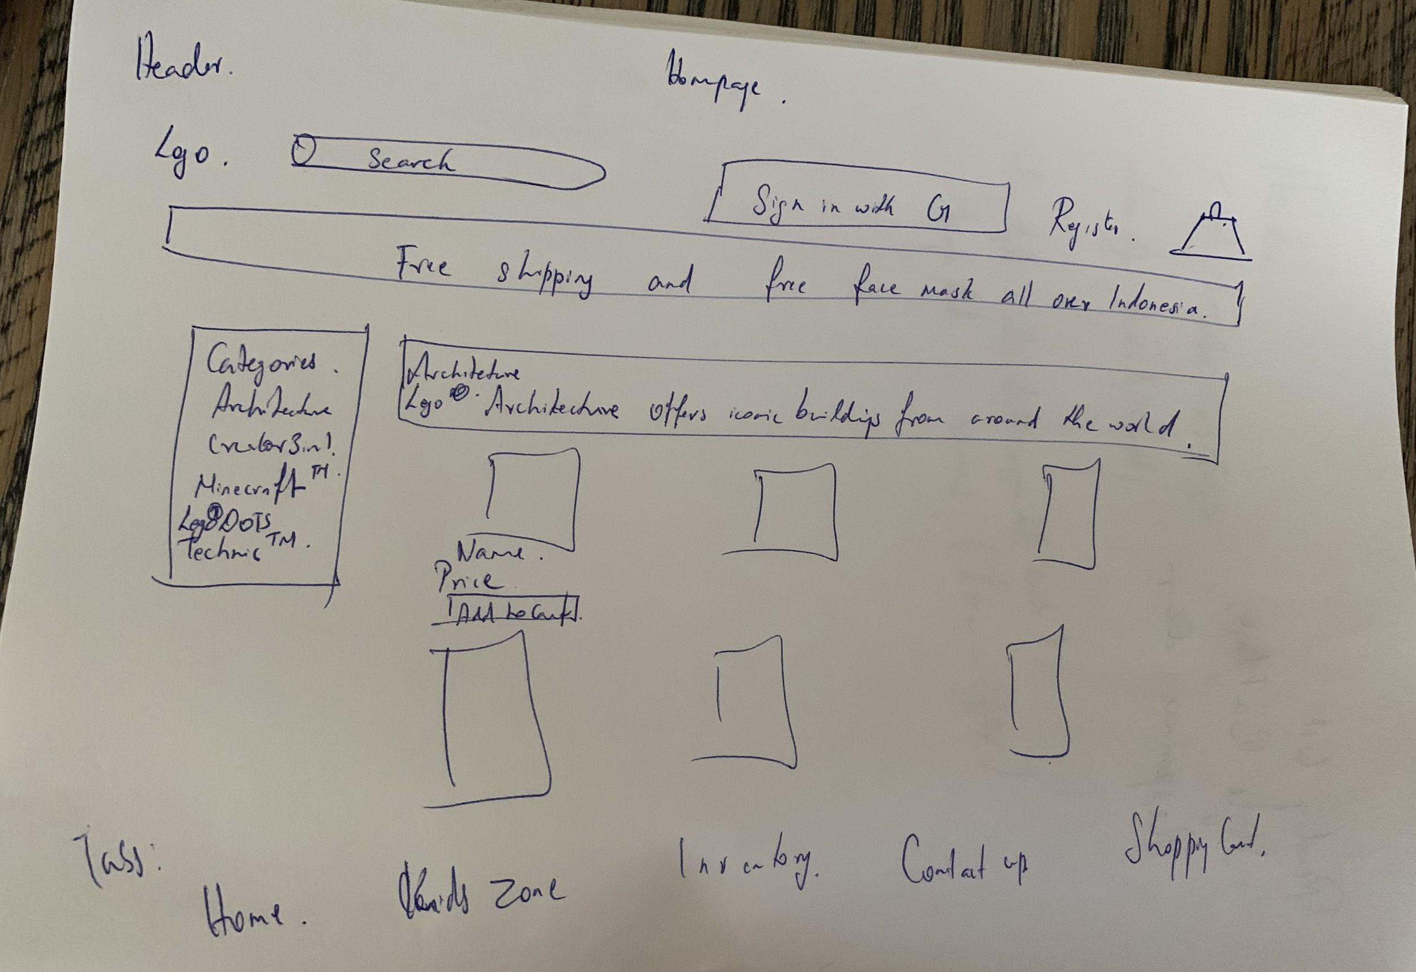
Plan
Store View

Slide 6
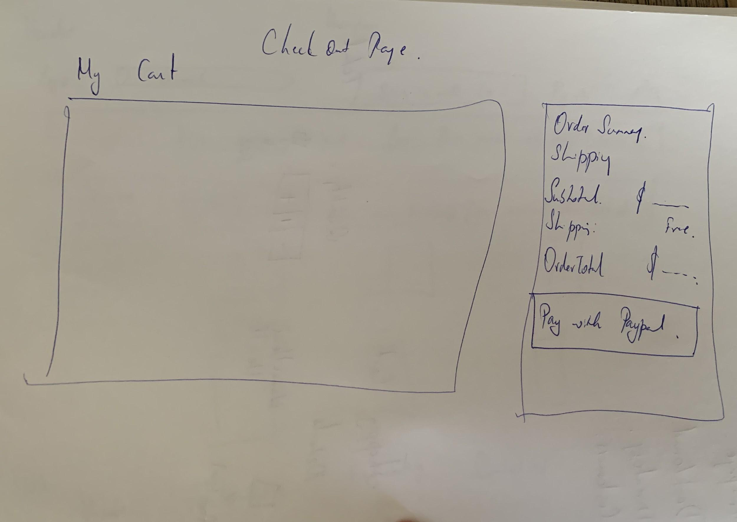
Plan
Checkout Page

Slide 7
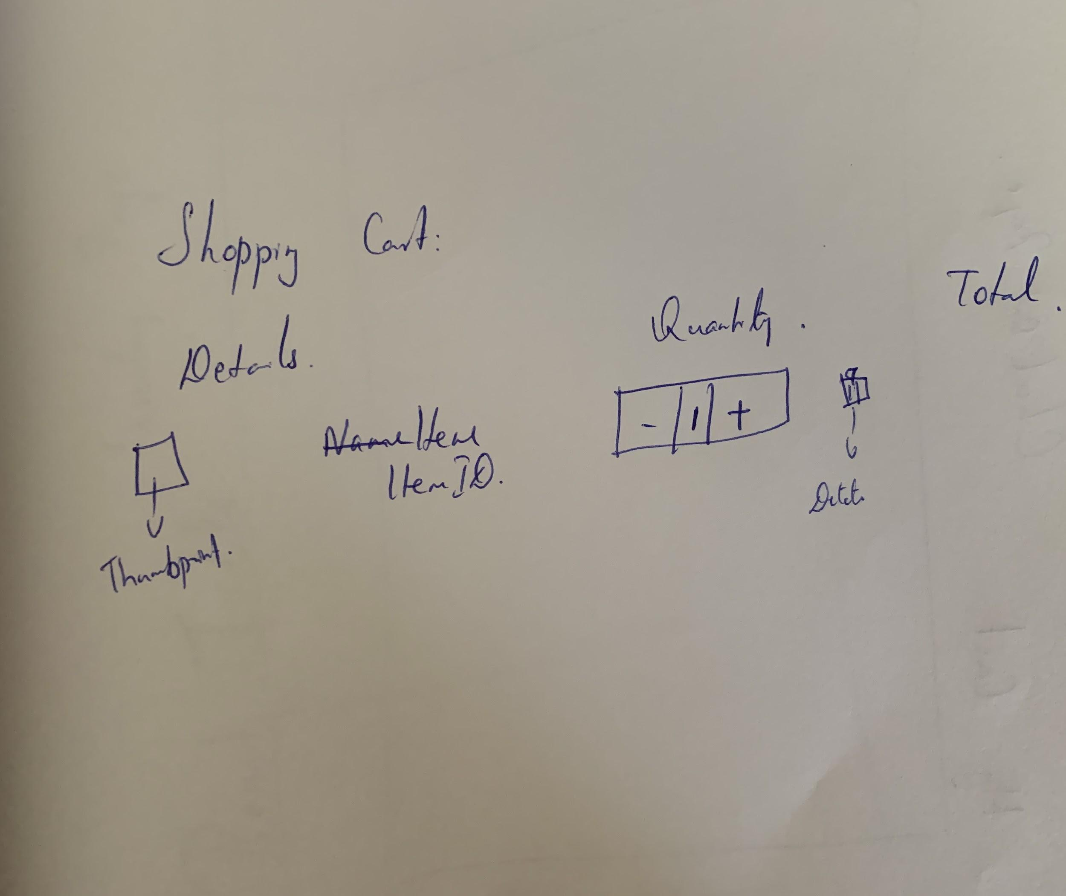
Plan
Cart View

Slide 8
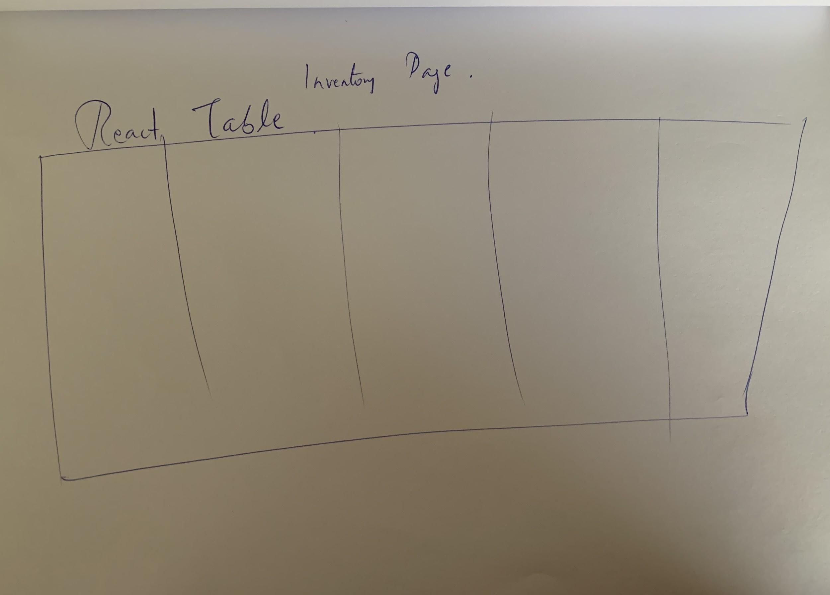
Plan
Inventory

Slide 9
Strategy
Design
Learn Material UI
Setup Header, Footer
Setup Navigation
Functionality-Stories
Create context
Display products
Display Inventory table
Add cart
Update Inventory
Integrate paypal
Search
Adjust inventory

Slide 10
Execute
Setup Shop
Setup Header, Nav & Footer
Setup cart

Slide 11
Refactor
Card Component
Chose to render products as Maerial-UI’s Card Component
Table Component
Chose to render inventory, Cart and Payments as Material-UI table
React
Lifted up state of properties using context
Once I got the handle on things wrote code back up again from scratch.

Slide 12
Credits
Special thanks to the people who made and released these awesome resources for free.
Important React State Management Tutorial | Context Api | React Tutorial For Beginners - YouTube
Material UI - YouTube important playlist

Slide 13
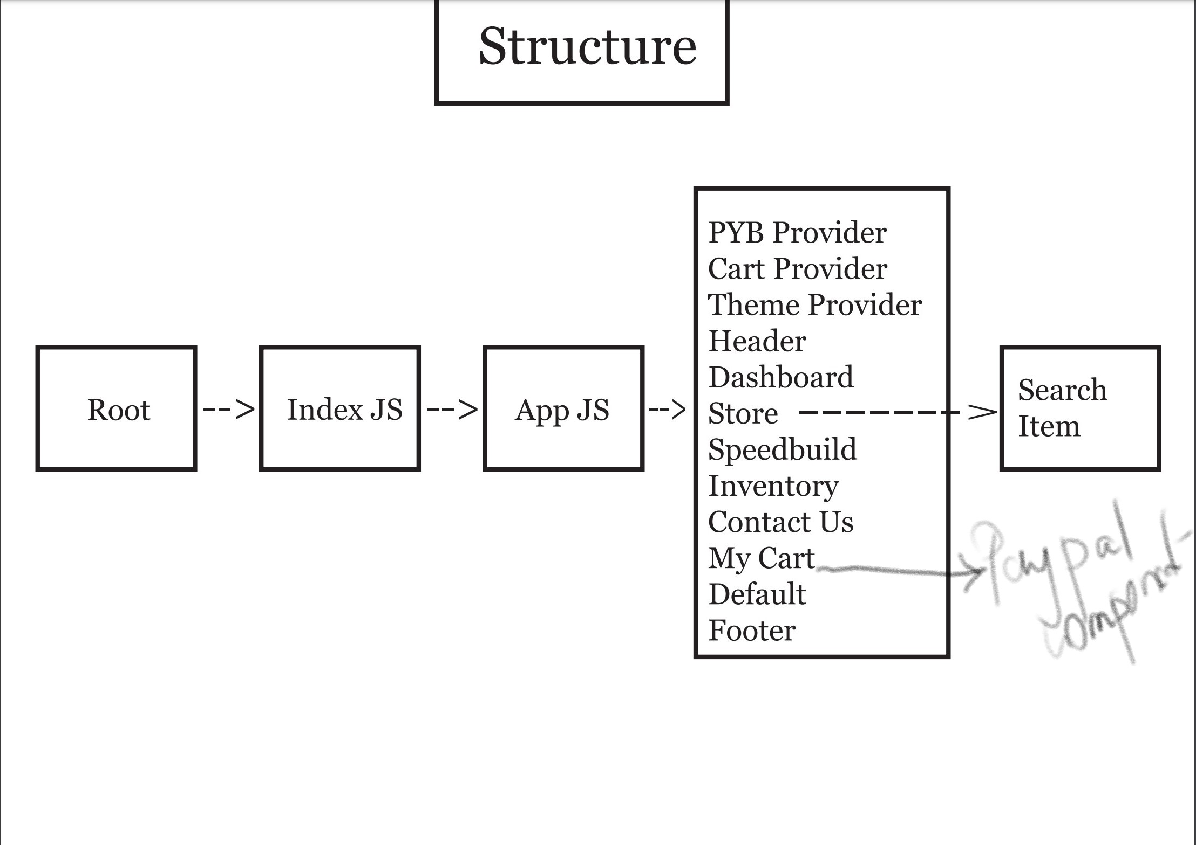
Component Tree

Slide 14
thanks!
Any questions?
?

