Slide 1

CareerSync AI
AI-Assisted Recruitment & Candidate Matching Platform
5th Semester Software Group Project · B.Tech Information Technology · CHARUSAT University | 2026–27
Explainable
Deterministic
Human-in-the-Loop
Evidence-backed evaluation
Reproducible scoring rules
Recruiter retains final authority
Privacy-Aware
Auditable
Blind Mode & controlled PII reveal
Sensitive actions are recorded

Slide 2
The Recruitment Challenge
THE PROBLEM SPACE
Volume
Transparency
Privacy
Hundreds of resumes per role create an unsustainable screening workload.
Recruiters need evidence for fit, not just a ranked list.
Candidate PII must be protected and tightly controlled.

Slide 3
End-to-End Platform Workflow
THREE PLATFORM ROLES
COMPLETE 8-STEP WORKFLOW
Recruiter
01
Creates jobs, defines requirements, configures weights, reviews ranked candidates, inspects evidence, and makes the final hiring decision.
Job Creation
Recruiter creates job and defines structured requirements
Candidate
02
Creates profile, uploads resume, applies for jobs, and tracks application status throughout the process.
NLP Extraction
Skills, qualifications, and experience extracted
Admin
03
Manages platform operations and system access across all user types.
Semantic Retrieval
Relevant resume evidence retrieved via semantic search
04
Human Decision
Recruiter makes the final hiring decision

Slide 4
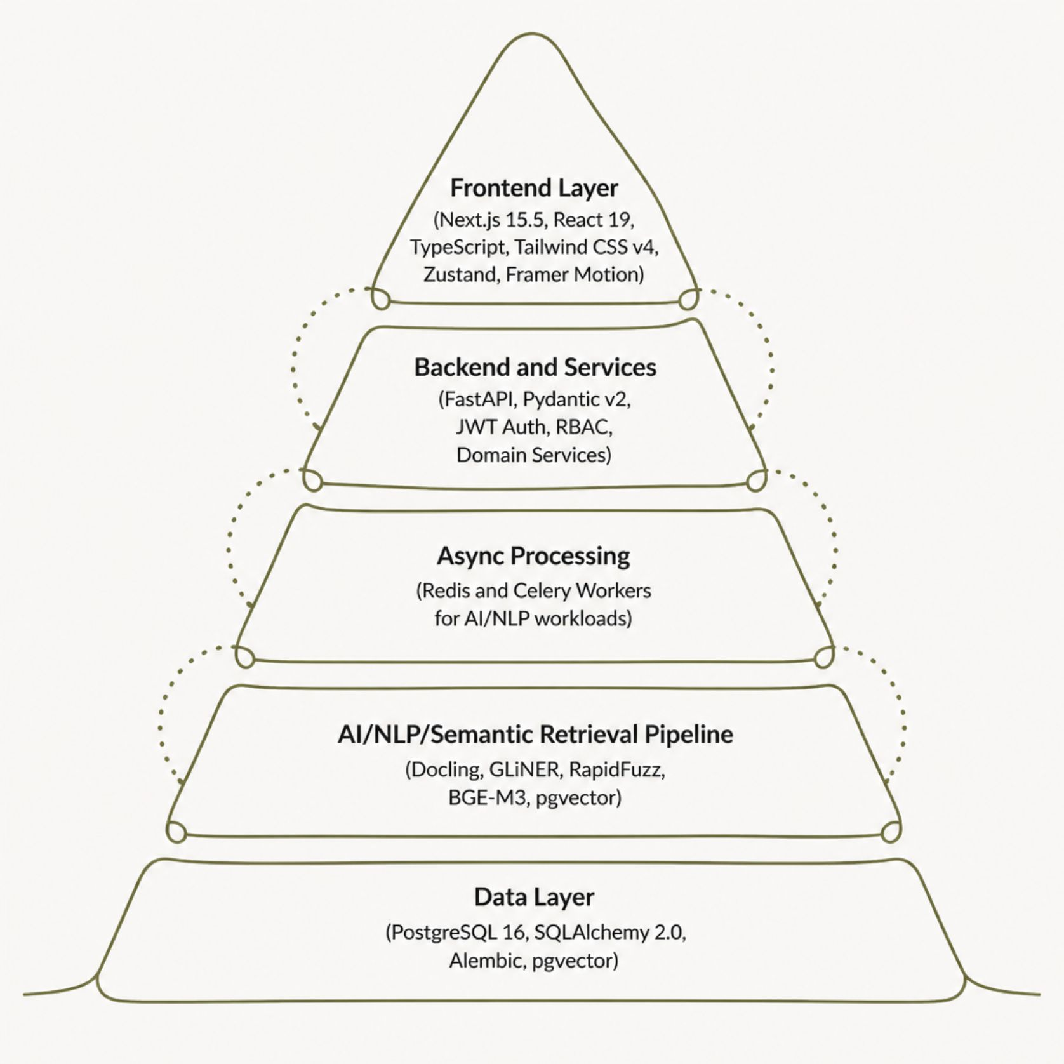
Proposed System Architecture: Modular Monolith + Async AI
FRONTEND PORTALS
Recruiter Portal
Applicant Portal
Dashboard ·
Job management
Candidate ranking Inspector
Comparison tool
Weight simulator
Profile
Resume upload
Applications
Status tracking

Slide 5

AI/NLP + Semantic Retrieval Pipeline: Resume to Evidence
Skill Normalization
Document Processing
Entity Extraction
Embedding & Retrieval
TECHNOLOGY ROLES
Docling
GLiNER
BGE-M3
pgvector
Layout-preserving document parsing
Zero-shot named entity recognition
Multilingual dense embeddings
Vector similarity search in PostgreSQL
RapidFuzz
Fuzzy string matching & skill normalization

Slide 6

Deterministic Scoring & Transparent Ranking
OVERALL SCORING FORMULA
Score = (Wskills × Sskills) + (Wexp × Sexp) + (Wedu × Sedu) + (Wsem × Ssem)
All weights must sum to exactly 100%. Recruiters configure weights via the Weight Simulator in the recruiter dashboard.
FOUR SCORING DIMENSIONS
Skills
Experience
Education
Semantic
Deterministic rules govern the final ranking. Semantic retrieval and NLP provide the evidence inputs — they do not replace the scoring logic.

Slide 7
Software Engineering Foundation & Current Status
✓ Frontend — Complete
◑ Backend API — In Progress
Next.js 15.5 · React 19 · TypeScript · Tailwind CSS v4 · Zustand · Framer Motion
Recruiter dashboard, job management, candidate ranking, inspector, comparison, weight simulator; Applicant portal, theme system, motion system, service/mock architecture
Python 3.11+ · FastAPI · Pydantic v2 · SQLAlchemy 2.0 · JWT · RBAC
API development, domain services, and business logic under active development; Frontend ↔ backend integration in progress
◑ AI/NLP Workers — Next Phase
Redis/Celery worker setup; Docling, GLiNER, RapidFuzz, BGE-M3 integration
Semantic retrieval implementation and end-to-end testing

Slide 8

CareerSync AI: Evidence Before Decisions
FIVE CORE PRINCIPLES
Explainable
Deterministic
Every evaluation connects back to a specific resume evidence snippet with page and section reference
Explicit, auditable scoring rules make candidate evaluation reproducible across runs
Resume & Requirements
Privacy-Aware
Blind Mode and controlled PII reveal minimize unnecessary exposure of candidate identity
THE COMPLETE PIPELINE
Human
Decision
Auditable
Sensitive actions — including PII reveal — are logged in the AuditTrail for accountability
Human-in-the-Loop
Semantic
Retrieval
AI provides decision support; the recruiter retains complete final authority over every hiring decision

