Slide 2
Vision
Encoder
Action
Encoder
Attention Layers
Mistral 7B
Joint Quantization
Projector
Vision
Decoder
Action
Decoder

Slide 3
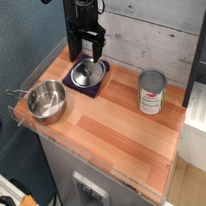
[∆x, ∆θ,Grip]
Dinov2-Enc.
MLP-Enc.
Attention Fusion Module
Mistral 7B
Joint Codebook
.
.
.
Tokenizer & text embed
Joint Encoder
Task: "move the silver pan …"
Scene: “A robot arm stands beside a silver pan ..."
Plan: “Robot arm descends towards pan; …"
CNN-Dec.
MLP-Dec.
[∆x, ∆θ,Grip]
Discriminator

