Slide 1

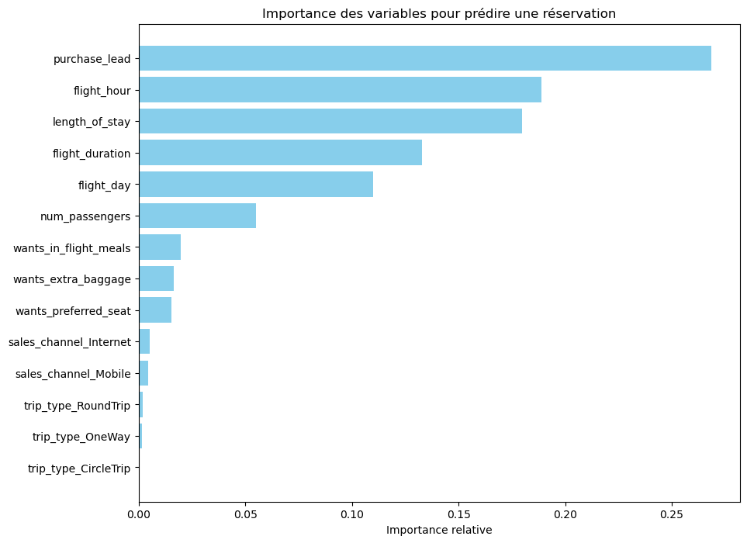
PREDICTIVE MODELING OF CUSTOMER BOOKINGS
1. Model Performance & Evaluation
Overall Accuracy: 84.9% (The model correctly identifies booking intent for 8 out of 10 customers).
Stability: Successfully validated through Cross-Validation (mean score of 68%), ensuring the model generalizes well to new, unseen data.
Class Handling: Adjusted for data imbalance (15% conversion rate) using balanced class weights to ensure high-quality predictions for actual buyers.
2. Key Predictive Findings (Top 3 Insights)
Purchase Lead (26.8%): The time between searching and the flight is the strongest indicator of booking completion.
Flight Hour (18.9%): Customer engagement timing significantly correlates with higher conversion rates.
Length of Stay (17.9%): Shorter to medium-duration trips show a much higher probability of being finalized compared to long-term stays.
3. Strategic Recommendations
Targeted Marketing: Direct advertising budget toward customers with "Purchase Lead" profiles that match our high-conversion segments.
Personalization: Implement real-time personalized offers for customers searching during peak conversion "Flight Hours."
Conversion Optimization: Simplify the booking path for flight routes and durations identified as "High Intent" by the model.
Model based on a RandomForest algorithm trained on 50,000 rows of data.

