Slide 1
DNS Strong Consistency

Slide 2
Problem: DNS consistency
DNS resolution is crucial in Internet
Essentially DNS service should behave like a single-server K-V database
Each client sends queries to this virtual database and update it
Ideally it should reach strong consistency
Real-world: DNS keeps consistency by TTL (Time-To-Live) mechanism
If a cache’s record expires, the server discards it and fetches a new one
Thus it reaches weak consistency (eventual consistency)
Works pretty well now because a domain name’s corresponding IP address is rarely changed

Slide 3
What if IP addresses change quickly?
For example: domain zone where most servers are mobile devices
Lots of DNS responses would be wrong
Strong consistency is needed in this scenario
strong consistency: if an update is commited, all subsequent read & write must see the modification

Slide 4
Existing Solutions
DNScup: use lease technique to dynamically update TTL
ECO-DNS: use mathematical analysis to optimize TTL
DDNS (Dynamic DNS): implemented by some companies (e.g. MS), specified by RFC2136. A straightforward solution
All solutions are not proved to reach strong consistency

Slide 5
Our Solution: DNS on CRAQ
Use CRAQ (Chain Replication with Apportioned Queries) proposed in distributed systems field
Aims at object-storage
Good for read-most workloads
Easy to implement
Most importantly: reaches strong consistency

Slide 6
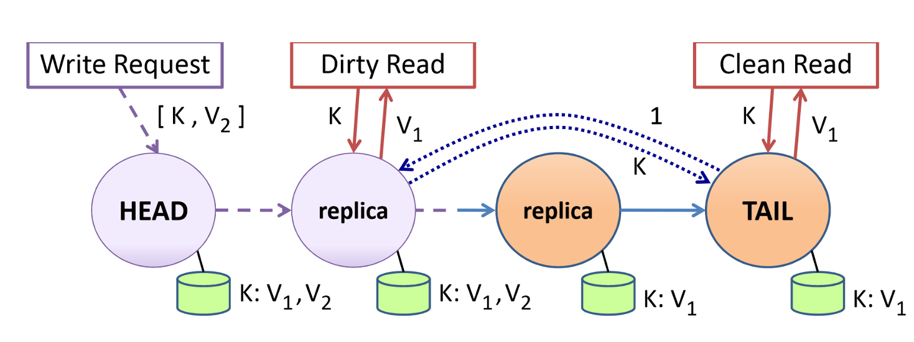
CRAQ

Slide 7
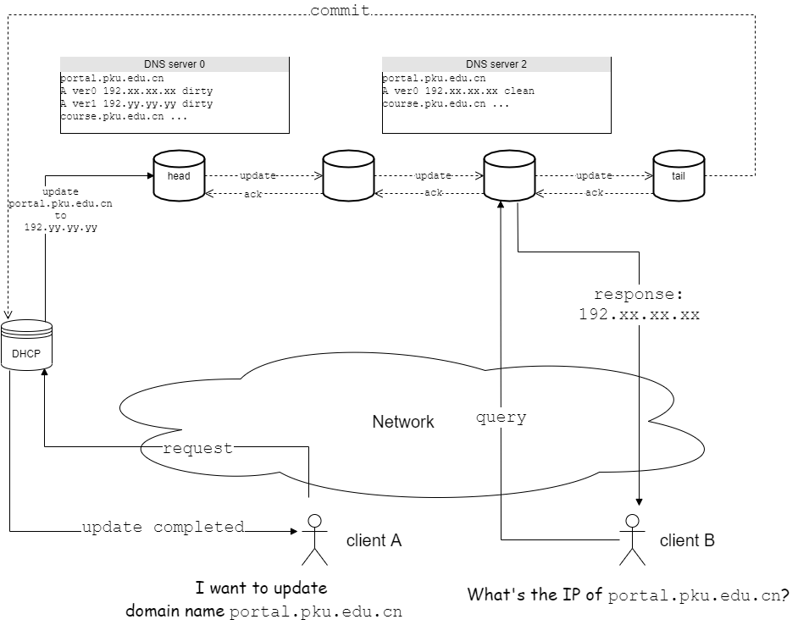
DNS on CRAQ

Slide 8
Evaluation
Rather difficult to test in real-world
Need update-frequent traces, which are rare
Can not deploy our own DNS server in real-world
Evaluation via emulation
DNS servers, DHCP server, clients can be emulated as processes/threads
Create intensive/rare update traces
Test correctness, hit rate, throughput and overhead

Slide 9
Reference List
T. Vu, A. Baid, Y. Zhang, T. D. Nguyen, J. Fukuyama, R. P. Martin, D. Raychaudhuri, "DMap: A Shared Hosting Scheme for Dynamic Identiﬁer to Locator Mappings in the Global Internet ", Proceedings of IEEE ICDCS 2012, Macau, June 2012.
A. Venkataramani, A. Sharma, X. Tie, H. Uppal, D. Westbrook, J. Kurose, D. Raychaudhuri, "Design Requirements for a Global Name Service for a Mobility-Centric, Trustworthy Internetwork", IEEE COMSNETS 2013
A. Sharma, X. Tie, H. Uppal, A. Venkataramani, D. Westbrook and A. Yadav, "A global name service for a highly mobile internetwork", In Proceedings of the 2014 ACM conference on SIGCOMM (pp. 247-258)
Xin Chen, Haining Wang and Shansi Ren, "DNScup: Strong Cache Consistency Protocol for DNS," 26th IEEE International Conference on Distributed Computing Systems (ICDCS'06), 2006, pp. 40-40, doi: 10.1109/ICDCS.2006.31.
C. Chen, S. Matsumoto and A. Perrig, "ECO-DNS: Expected Consistency Optimization for DNS," 2015 IEEE 35th International Conference on Distributed Computing Systems, 2015, pp. 256-267, doi: 10.1109/ICDCS.2015.34.
Terrace, J., & Freedman, M. J. (2019). Object storage on CRAQ: High-throughput chain replication for read-mostly workloads. In Proceedings of the 2009 USENIX Annual Technical Conference (pp. 143-158). (Proceedings of the 2009 USENIX Annual Technical Conference). USENIX Association.
https://datatracker.ietf.org/doc/html/rfc2136

Slide 10
Team
Zhou Yuhan zhouyuhan@pku.edu.cn

Slide 11
