Slide 1

Software Development: Data Structures (H16Y35)
Lecture 12a :Revision
c.nyssen@nescol.ac.uk ©NESCOL 2020

Slide 2

Welcome to Data Structures (H16Y35) Week 12
This week, we will look at what will be required for Outcome 1. This will consist of a closed-book multiple-choice test of 30 questions, of which you will be required to get 18 correct.

Slide 3
Questions that may arise….
2s complement and negative numbers
Unicode values
Data storage types and storage size requirements
Arrays, lists and indexing
Image, sound and video file types
XML data structures
Linked lists, hash tables, binary tree, binary search
Memory heap and memory allocation

Slide 4
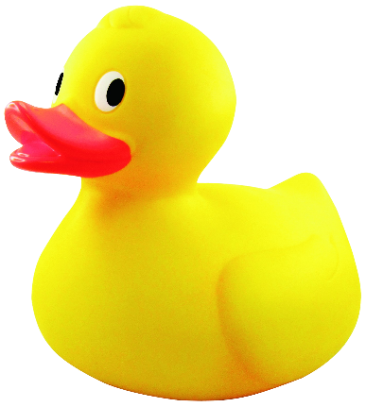
Data Typing
Python uses dynamic typing (sometimes called duck typing)
Stores type of object along with object
Java uses static typing (sometimes called strict typing)
Checks type of variable to see if it is valid
https://en.wikipedia.org/wiki/Type_system#Type_checking

Slide 5
Built-in data types
Python supports four different numerical types −
int (signed integers)
long (long integers, they can also be represented in octal and hexadecimal)
float (floating point real values)
complex (complex numbers)
Here are some examples of numbers −
int | long | float | complex
10 | 51924361L | 0.0 | 3.14j
100 | -0x19323L | 15.20 | 45.j
-786 | 0122L | -21.9 | 9.322e-36j

Slide 6

byte
The byte data type is an 8-bit signed two's complement integer.
It has a minimum value of -128 and a maximum value of 127 (inclusive).
The byte data type can be useful for saving memory in large arrays, where the memory savings actually matters.
They can also be used in place of int where their limits help to clarify your code; the fact that a variable's range is limited can serve as a form of documentation, or input verification.

Slide 7
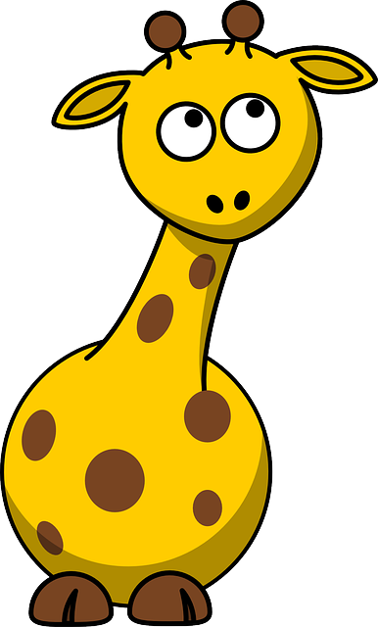
short
The short data type is a 16-bit signed two's complement integer.
It has a minimum value of -32,768 and a maximum value of 32,767 (inclusive).
As with byte, the same guidelines apply: you can use a short to save memory in large arrays, in situations where the memory savings actually matters

Slide 8

int
The int data type is a 32-bit signed two's complement integer.
It has a minimum value of -2,147,483,648 and a maximum value of 2,147,483,647 (inclusive).
For integral values, this data type is generally the default choice unless there is a reason (like the above) to choose something else.
This data type will most likely be large enough for the numbers your program will use, but if you need a wider range of values, use long instead.

Slide 9

long
The long data type is a 64-bit signed two's complement integer.
It has a minimum value of -9,223,372,036,854,775,808 and a maximum value of 9,223,372,036,854,775,807 (inclusive).
Use this data type when you need a range of values wider than those provided by int

Slide 10
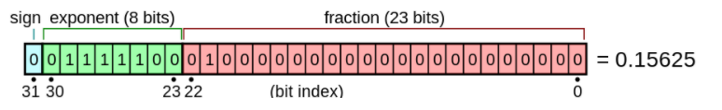
float
The float data type is a single-precision 32-bit floating point.
As with the recommendations for byte and short, use a float (instead of double) if you need to save memory in large arrays of floating point numbers.
This data type should never be used for precise values, such as currency.

Slide 11
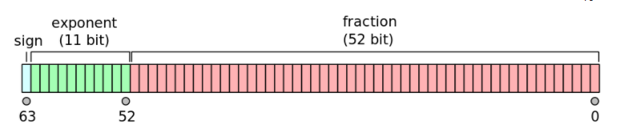
double
The double data type is a double-precision 64-bit floating point.
For decimal values, this data type is generally the default choice.
As with float, this data type should never be used for precise values, such as currency

Slide 12
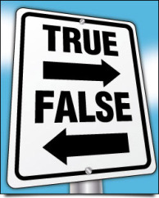
boolean
The boolean data type has only two possible values: true and false.
Use this data type for simple flags that track true/false conditions.
This data type represents one bit of information, but its "size" isn't something that's precisely defined

Slide 13
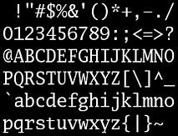
char
The char data type is a single 16-bit Unicode character
In Python there is no char, it is represented as a string of length 1

Slide 14
Summary
Type | Memory Size | Default value | Declaration
byte | 1 byte | 0 | byte a=9;
short | 2 bytes | 0 | short b=89;
int | 4 bytes | 0 | int c=8789;
long | 8 bytes | 0 | long=9878688;
float | 4 bytes | 0.0f | float b=89.8f;
double | 8 bytes | 0.0 | double c =87.098
char | 2 bytes | 'u0000' | char a ='e';
boolean | 1 byte | false | boolean a =true;

Slide 15

Complex data types
These are non-primitive data types:
String
Record
Table
1-dimensional array
2-dimensional array

Slide 16
String
String is a class built into the Java language defined in the java.lang package. It represents character strings.
Strings are immutable; that is, they cannot be modified once created. Whenever it looks as if a String object was modified actually a new String was created
String str = "This is string literal";

Slide 17
String in Python
Python does not distinguish between a string that is a single character or a large block of text.
Python has two different string-types.
byte-string - stores the text as a sequence of bytes (numbers) with one byte per character, can only work with 8-bit extended ASCII
Unicode string (UTF-16)- stores text internally using the unicode standard. They are slightly more complicated, because you must know the 'encoding' the text is stored in whenever you read the text in or save it out, but is more accurate and idiot-proof than the byte-string.

Slide 18
Records
A record is essentially a Java object that has instance variables only, but no instance methods.
The data items in a record are called the fields of the record.
Each item is referred to using a field name or in Java, the names of the instance variables. The distinguishing characteristics of a record are that the data items in the record are referred to by name and that different fields in a record are allowed to be of different types.

Slide 19
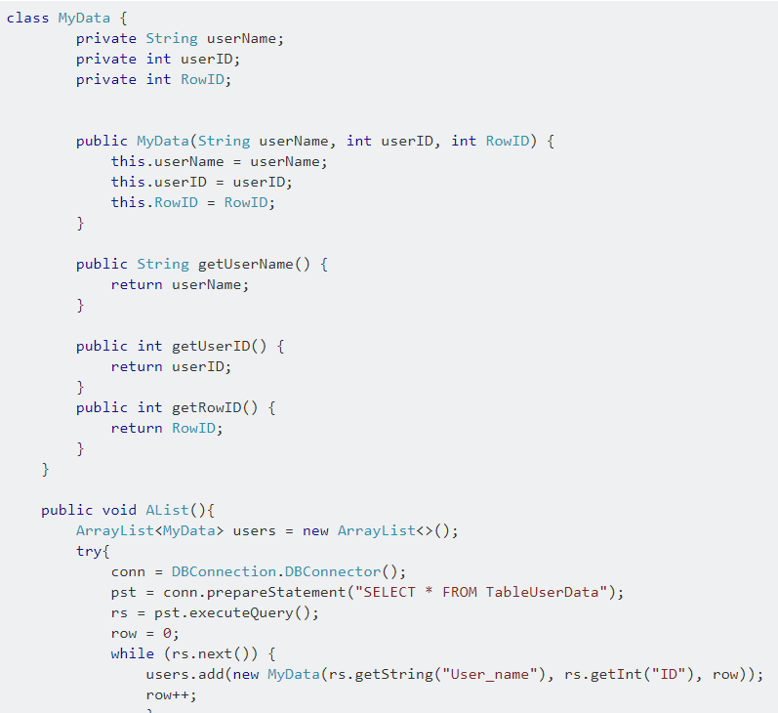
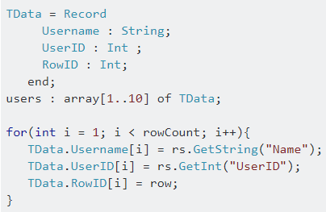
Record vs Class

Slide 20
Memory requirements
A user-defined type will need at least the sum of the memory requirements for each of the attributes within the complex type. There may well be additional requirements dependent on the construct used.
The amount of memory required for a table is dependent on the size requirements for each record and the number of records that need to be stored.

Slide 21
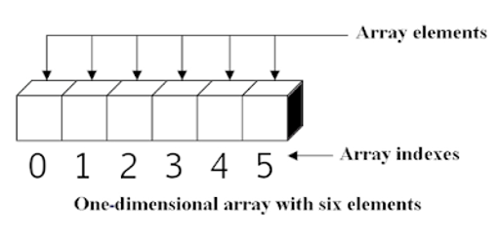
Arrays in Java
An array is a collection of elements where each element is the same type.
Element type can be primitive or Object
Each element is a single value
Individual array elements are accessed via an index.
Array index numbering starts at 0.

Slide 22
Creating an Array
Creating an array is a 2 step process
It must be declared (declaration does not specify size)
It must be created (ie. memory must be allocated for the array)
type[] arrayName;
note the location of the []
int[] grades; // declaration
grades = new int[5]; // Create array.
// specify size
// assign new array to
// array variable

Slide 23
Creating an Array
When an array is created, all of its elements are automatically initialized
0 for integral types
0.0 for floating point types
false for boolean types
null for object types
grades
0
array indices
0
1
0
int[] grades = new int[5];
2
0
3
0
Note: maximum array index is length -1
4
0

Slide 24
Creating an Array
Because array elements are initialized to 0, the array should be initialized with usable values before the array is used.
This can be done with a loop
Arrays have a length attribute which can be used for bounds checking
Elements are accessed using an index and []
int[] sequence = new int[5];
for (int i=0; i< sequence.length; i++)
{
sequence[i] = i * 25;
}
Array element being accessed. In this
case, it is being assigned a value.
array length: ensures loop
won't go past end of the array

Slide 25
Creating an Array
Another way of initializing lists is by using initializer lists.
The array is automatically created
The array size is computed from the number of items in the list.
type[] arrayName = {initializer_list};
int[] grades = {100, 96, 78, 86, 93};
String[] colours = { "Red", "Orange",
"Yellow", "Green",
"Blue", "Indigo",
"Violet"};

Slide 26
Creating an Array
Whenever an array is accessed, the index is checked to ensure that it within the bounds of the array.
Attempts to access an array element outside the bounds of the array will cause an ArrayIndexOutOfBounds exception to be thrown.
int[] sequence = new int[5];
sequence[0] = 50; // ok
sequence[1] = 60; // ok
sequence[-1] = 100; // Exception
sequence[5] = 30; // Exception

Slide 27
Creating an Array
Arrays with multiple dimensions can also be created.
They are created and initialized in the same way as single dimensioned arrays.
declaration syntax:
type[][] arrayName;
each [] indicates another dimension
int[][] grades = new int[20][5];
for(int i = 0; i< 20; i++)
for(int j = 0; j<5; j++)
grades[i][j] = 100;
String[][] colours = {{"Red", "Green", "Blue"},
{"Cyan", "Magenta", "Yellow"},
{"Russet", "Mauve", "Orange"}};

Slide 28
Mapping arrays to memory
Assuming our grades array starts at address A10016 and each address represents 2 bytes of storage, the array would be mapped to memory as shown below:
In order to perform this mapping, we need to know the start address, the size of the data type being stored and the addressable nature of the computer system (number of bytes associated with each unique address).
Fortunately, in practice, the system performs this mapping for us and as programmers we only need to know the array variable’s name and range of indexes.
Memory Address | Value | Index
A100₁₆ | 24 | 0
A101₁₆ | 31 | 1
A102₁₆ | 89 | 2
A103₁₆ | 99 | 3

Slide 29
Thanks For Watching

