Slide 1
IPHAS emitters in LAMOST Survey
Chen Jianjun NAOC
2017. 2.18 Kunming

Slide 2
IPHAS
2003~2008, IPHAS DR2, Barentsen+, 2014, 219M targets
Key facts
Isaac Newton Telescope (⌀ 2.5m)
Wide Field Camera (0.3 deg²)
Period: Aug 2003 - 2008
Filters: r, i, Hα
Depth ≈ 21 (r), 20 (i), 20 (Hα)
Area: |b| < 5°; 29° < l < 215°
Median seeing: 1.2"

Slide 3
IPHAS Ha Emitters
4853 Halpha emission line sources from IPHAS, Witham+, 2008,
IPHAS and the symbiotic stars I, II, III, Corradi, Rodriguez_Flores, etc, 2008,2010,2011
Follow up observing 62 IPHAS candidate symbiotic stars.
Confirm 20 new found symbiotic stars
Be, T-Tauri, WR stars

Slide 4
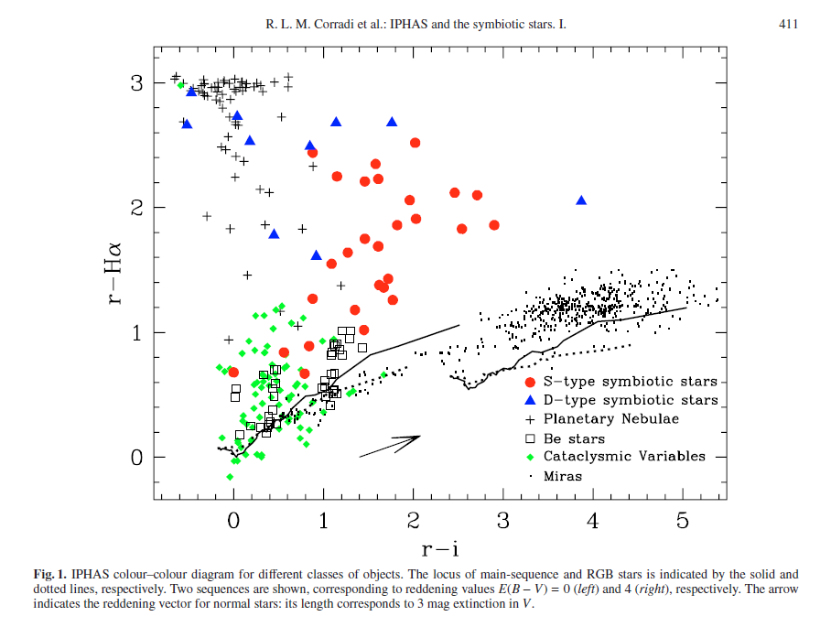
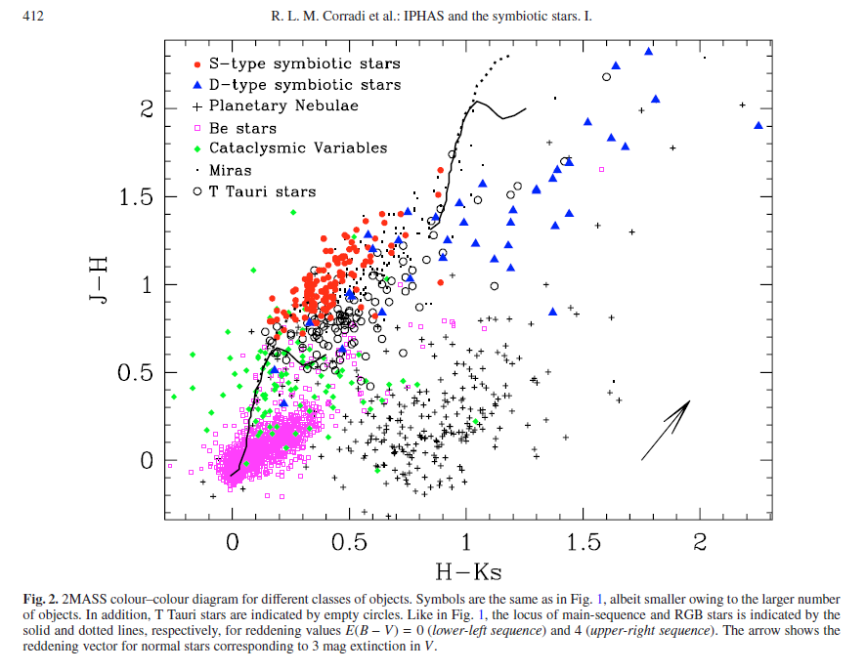
Target Selection

Slide 5
Crossmatch with LAMOST DRs
531 spectra Cross match Witham+2008 with LAMOST DR3, 687 spectra with LAMOST DR4
About 1/3 multiple observations
No match on 20 IPHAS new symbiotic targets
A few good spectra without Ha emission line
Fiber position
Line intensity variability
Selection error

Slide 6
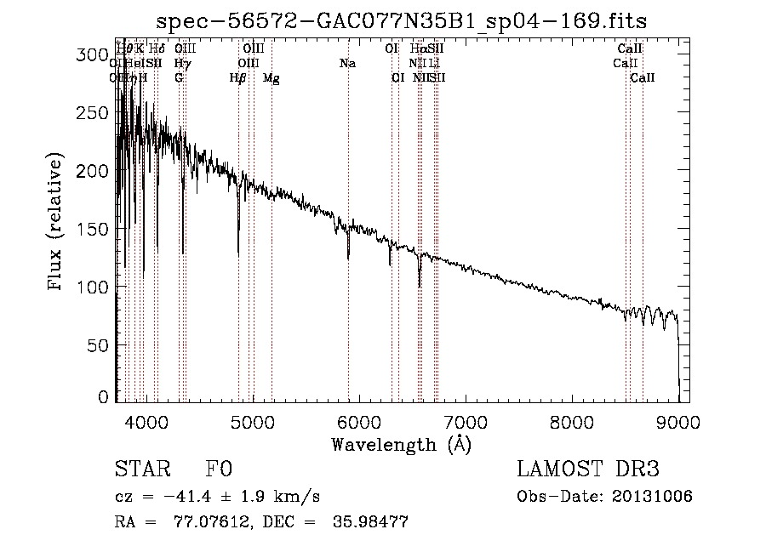
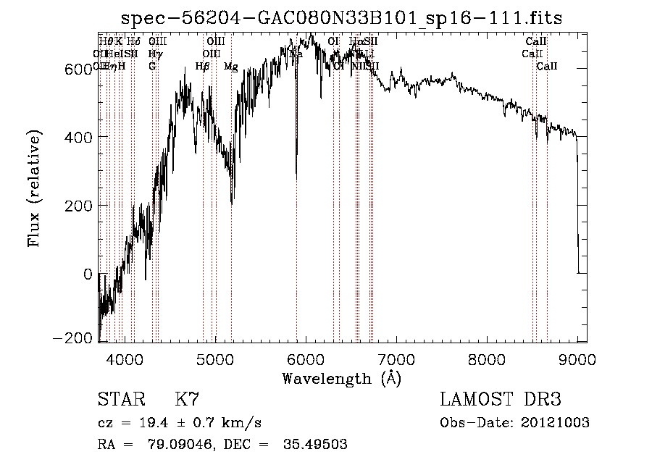
No Halpha emmsion

Slide 7
Ha emitters in LAMOST DR4
Quote: “… the only way to determine the completeness is to obtain spectra for a large, representative sample of objects (not just likely emitters)”
820K spectra in DR4 covers IPHAS sky area, and 29K Ha emitters found by our method
Ratio: 4853/219M vs. 29K/820K

Slide 8
Method to search emission line
Gaussian-type function to fit the line and calculate EW, FWHM, correlation, central wav, etc
Criteria set by the parameters: EW, FWHM, correlation, central wav range, and fitting window width, etc

Slide 9
Emitters in DR4/ Symbiotic
A cool giant and ionization condition high enough to produce at least HeII emission line (Allen, 1984)
Target on HeII 4868.
29K ➔ about 300
Eyes check profile and continuum, ➔about 30
Eyes check other lines, ➔ single digital

Slide 10
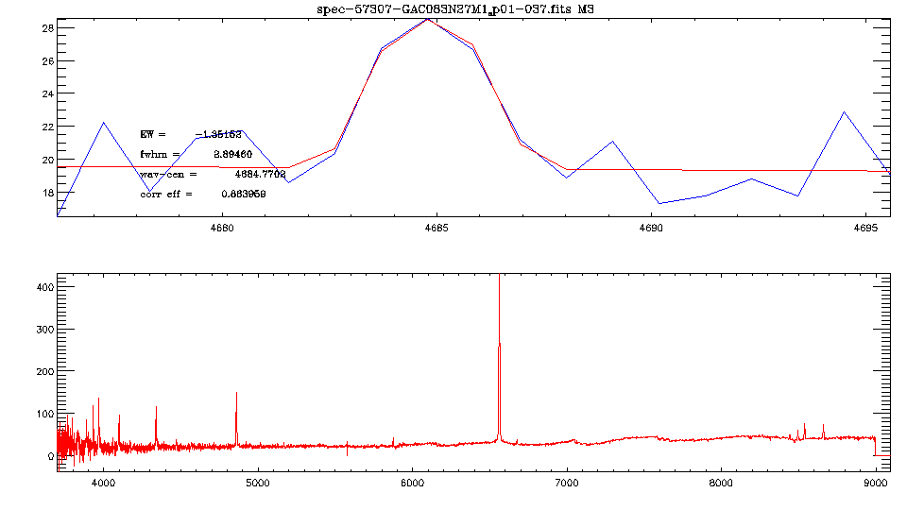
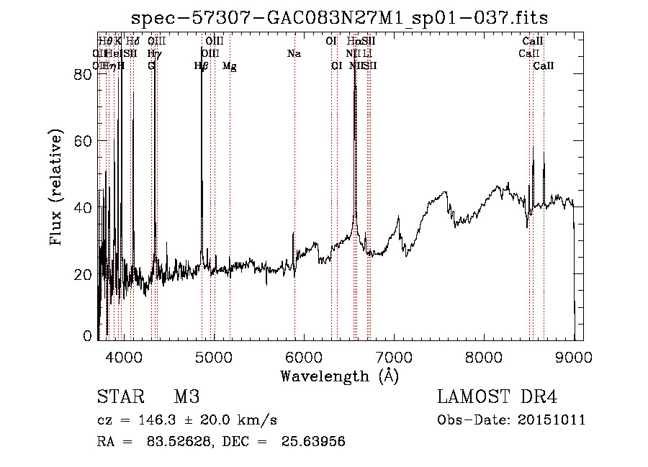
Emitters in DR4/ Symbiotic

Slide 11
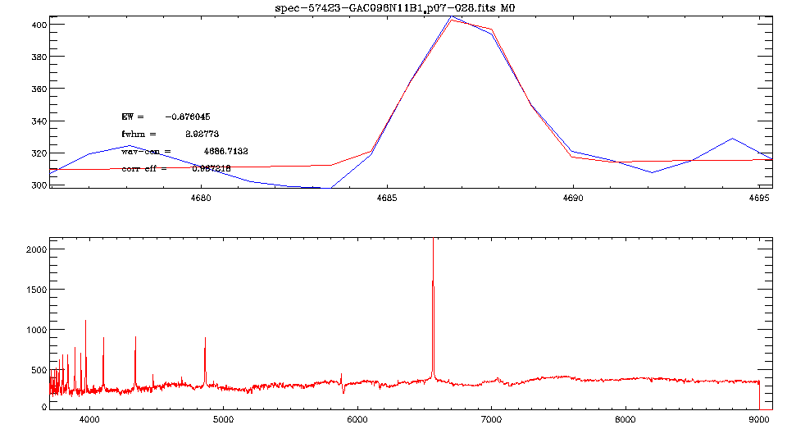
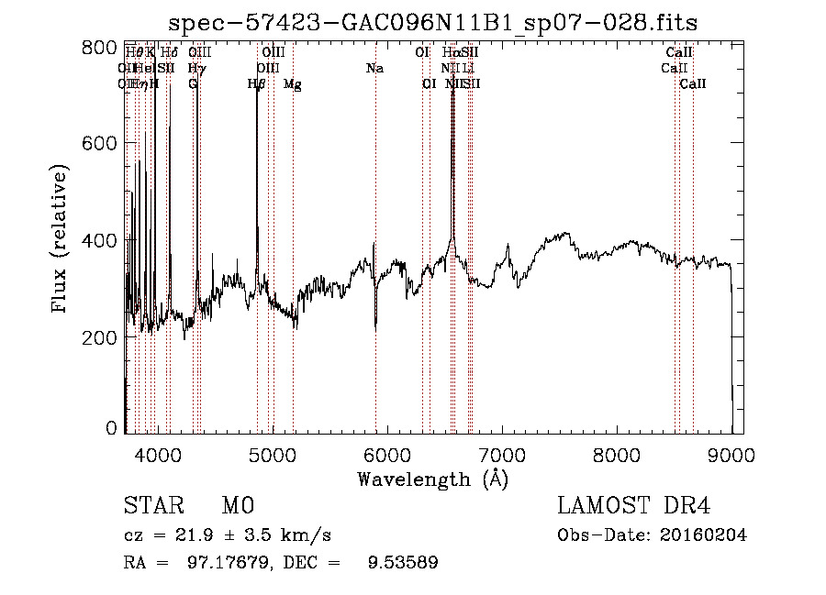
Emitters in DR4/ Symbiotic

Slide 12
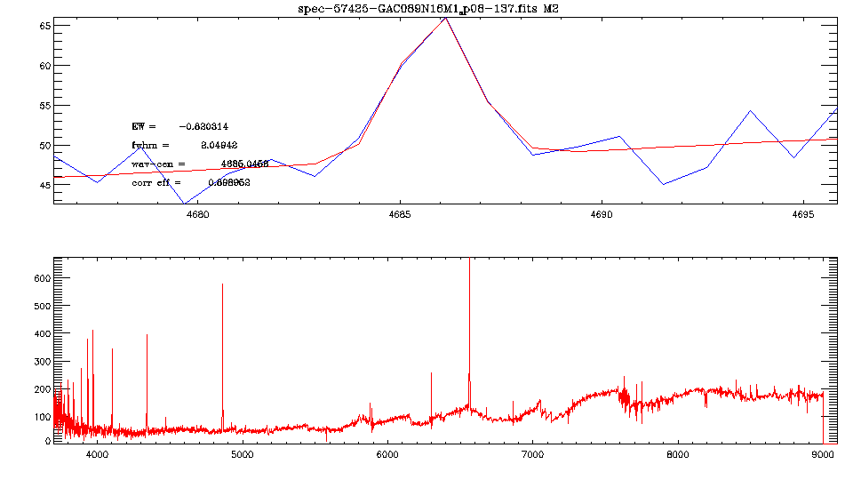
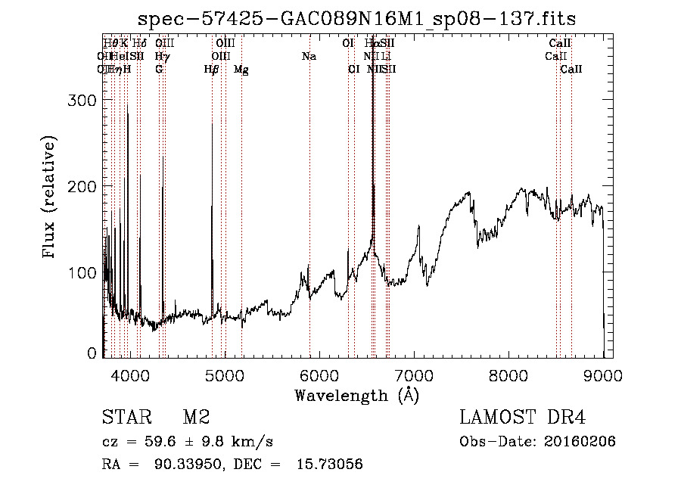
Emitters in DR4/ Symbiotic

Slide 13
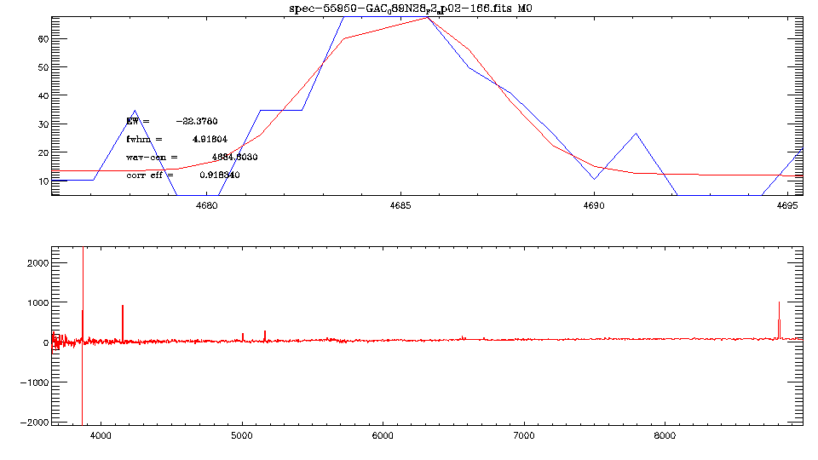
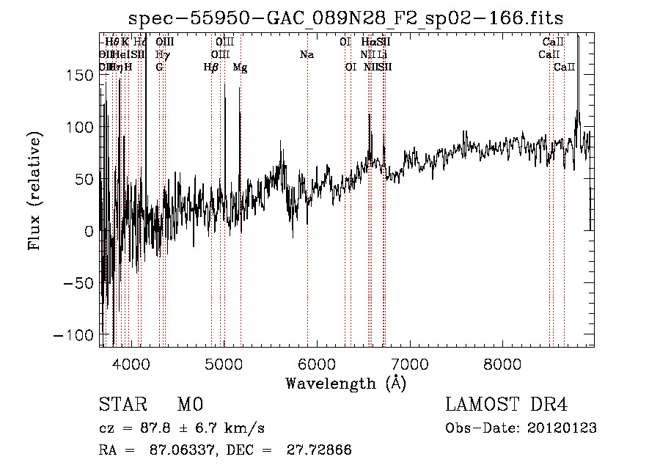
Emitters in DR4/ Symbiotic

Slide 14
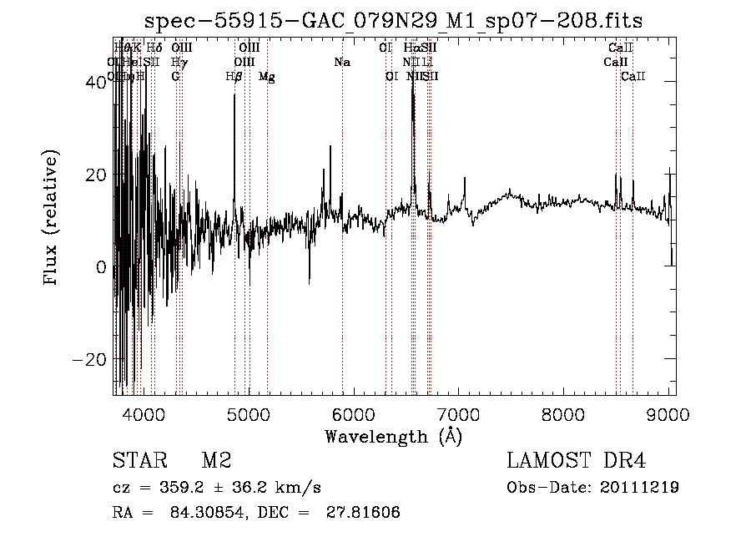
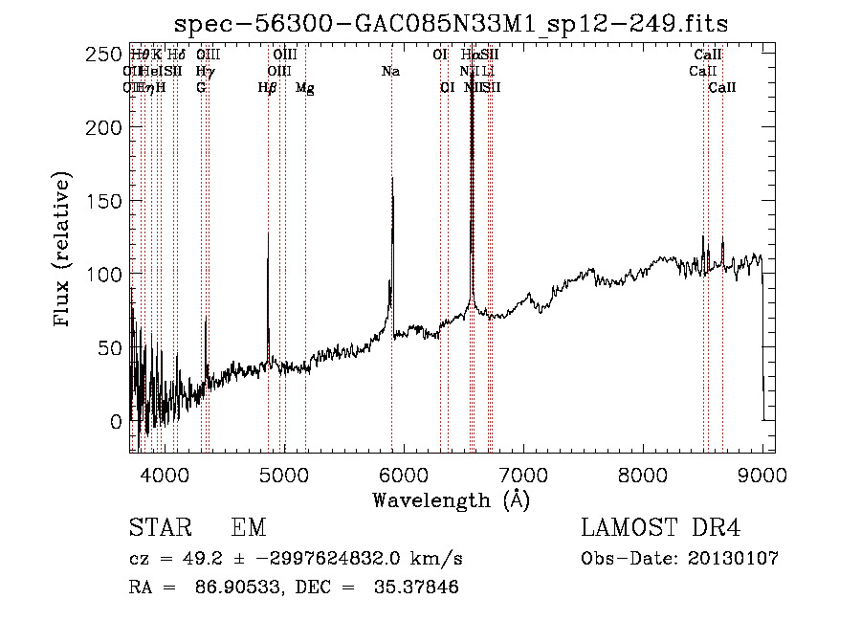
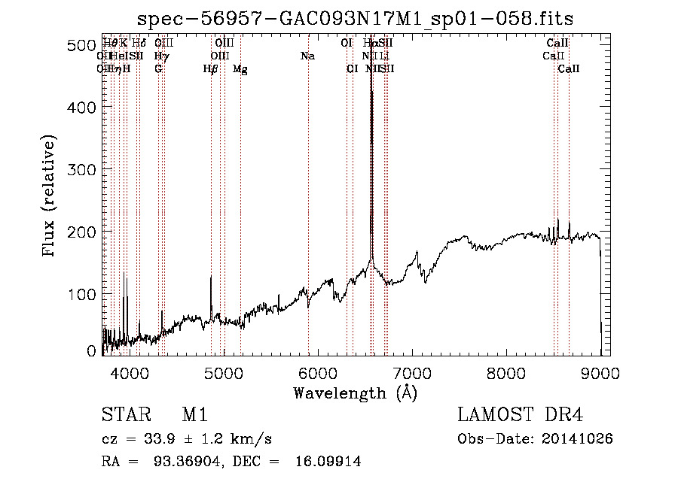
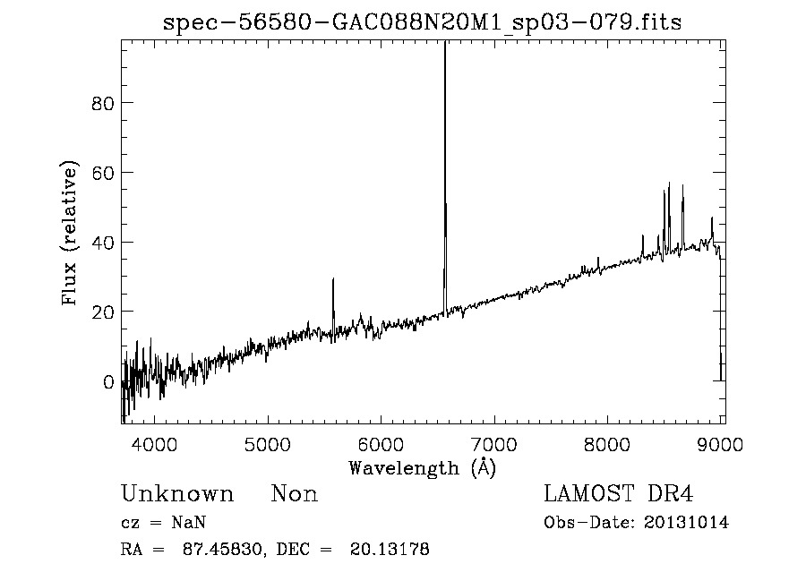
Emitters in DR4/ CTT

Slide 15
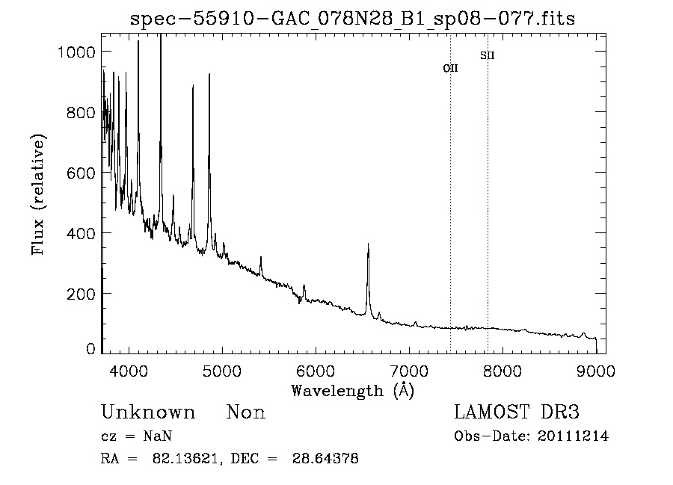
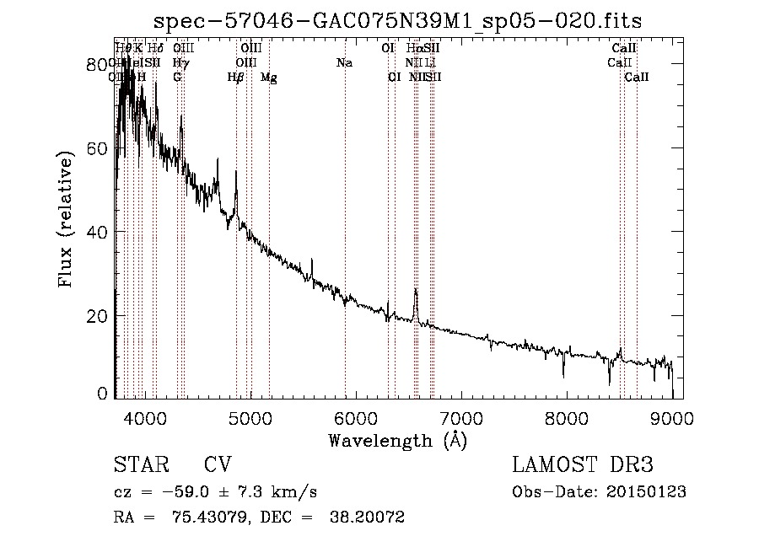
Emitters in DR4/ CV stars

Slide 16
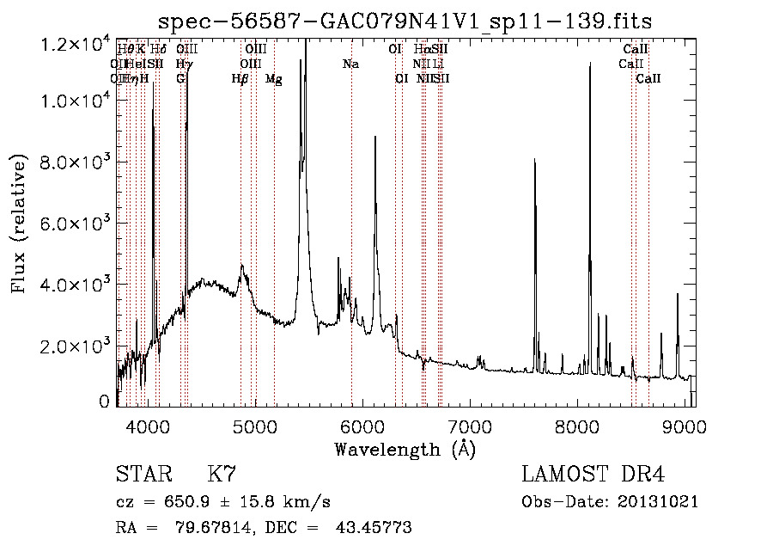
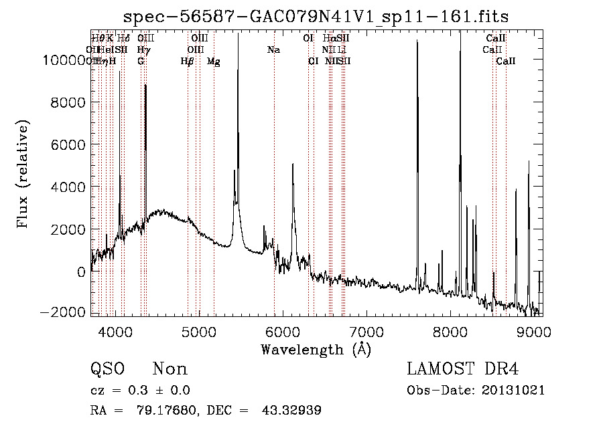
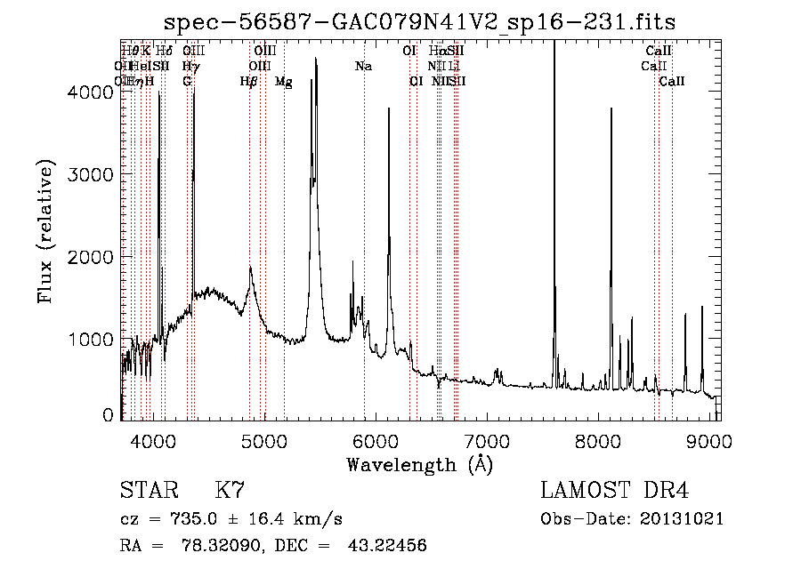
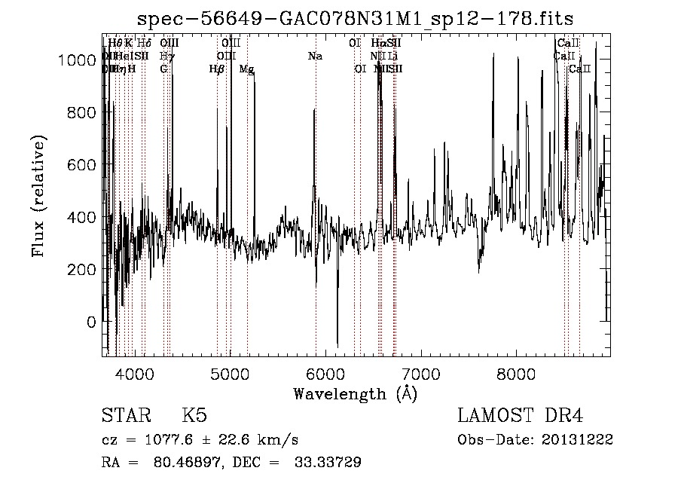
Emitters in DR4/ Wolf-Rayet

Slide 17
Summary
Cross match IPHAS emitters and LAMOST, to check IPHAS emitter selection error rate
A method to filter out LAMOST Ha emitters in IPHAS area, and check the completeness of IPHAS emitter selection
Classify sets of LAMOST emitters in IPHAS area, such as Symbiotic stars, CTT stars, CV stars, Wolf-Rayet stars, and many Be/Oe stars

Slide 18
Thanks!

