Slide 1




Macrosystems EDDIE: Climate change effects on lake temperatures
Carey, C.C., S. Aditya, K. Subratie, R. Figueiredo, and K.J. Farrell. 16 Oct 2024.
Macrosystems EDDIE: Climate Change Effects on Lake Temperatures.
Macrosystems EDDIE Module 1, Version 2.
http://module1.macrosystemseddie.org
Module development supported by NSF DEB 1245707, ACI 1234983, & EF 1702506
Notes:
Welcome the students to class. It might be helpful to go around the room and briefly discuss if anyone has experience programming or modeling. The point of this is to emphasize that most students are likely novices, and that asking lots of questions is ok because their peers are novices as well.
It is really important at this point to emphasize that there will be lots of new material covered during this module, and that going slowly and asking for help is very much encouraged!

Slide 2
Overview of today
Short overview of lake modeling and some background on the tools we will be working with
Activity A: Plot water temperatures from a lake model.
Activity B: Develop a climate scenario, generate hypotheses, and model how your lake responds.
Activity C: Create a custom coding function and use a for-loop to run many lake model simulations.
Notes:
Quick road map of what will be covered in the PowerPoint

Slide 3

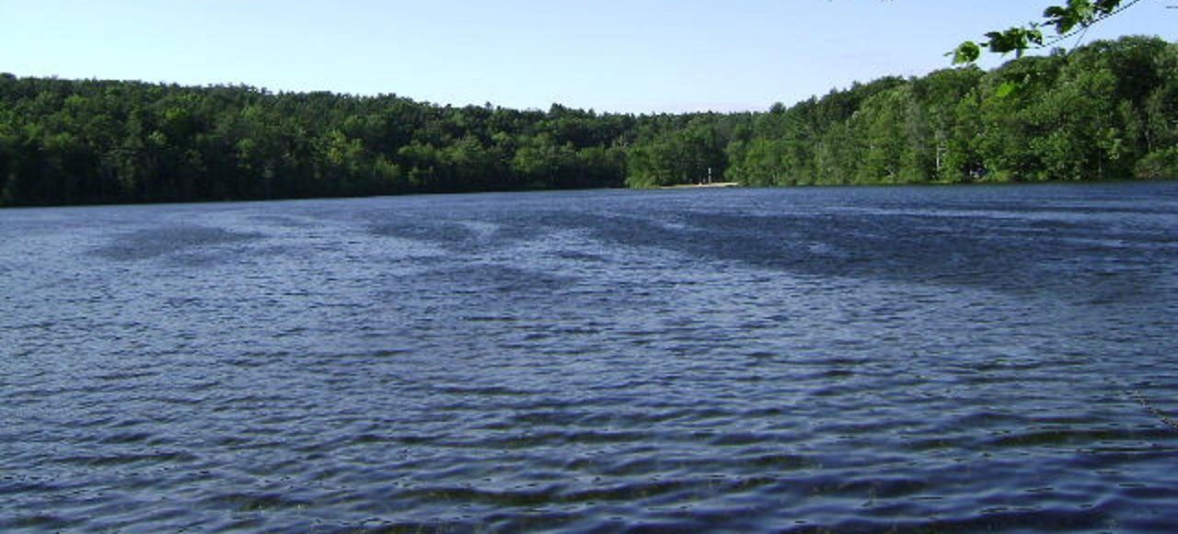
Lakes are changing worldwide…
In response to altered climate, some regions are experiencing different temperature, precipitation, and wind conditions than in the past.
Because of their position in the landscape and their thermal inertia, lakes can be powerful indicators of climate change.
Image: Wikimedia commons
Image: Wikimedia commons
Notes:
Why do we want to know how climate change is affecting lakes?
Because there is lots of variability in how climate change is occurring globally and lakes provide critical ecosystem services for humans, so we need to explore many different climate scenarios.

Slide 4
Our focal question:
How will lake thermal structure change in response to
altered climate?
Image modified from: Figure 44.10 in “Ecology and the Biosphere” (Candela Learning)
Notes:
Today, we are going to focus specifically on lake thermal structure.
Question to ask the students on this slide: what is lake thermal structure?

Slide 5
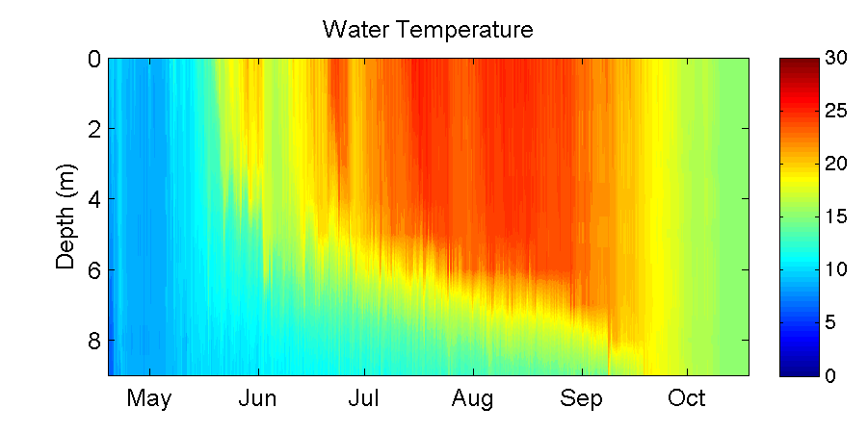
What is lake thermal structure?
Epilimnion
Thermocline
Hypolimnion
Lake Sunapee, NH, USA: data from Lake Sunapee Protective Association buoy, 2012
Notes:
Here are lake temperature data from Lake Sunapee, a large dimictic lake in New Hampshire, USA, from 2012.
Tell the students how time is on the x-axis, and depth is on the y-axis (from the surface to the sediments at 9 m depth), with color referring to the temperature, from cold 0ºC (blue) to very warm 30ºC (red). These are called heat maps or thermal plots, and we will be making lots of these figures in the module.
When we say ‘lake thermal structure,’ we are referring to both the magnitude of the water temperature in the lake at multiple depths, as well as the stratification pattern.
If a lake is thermally stratified, it exhibits distinct layers of water on a density gradient. In the summer, warmer water on top is less dense than colder water on bottom. Maximum density of water is at ~4ºC: water at 25ºC is substantially less dense than colder water, hence why it is at the surface of the lake.
Talk through the changes in thermal profiles over time in the context of water density differences among lakes.
Note! We are focusing here on thermal stratification, not chemical stratification. Density gradients due to differences in water chemistry (e.g., salinity) can be a major factor altering stratification in some lakes, but we are focusing on thermal density gradients in this module.
We are now going to introduce some terminology:
Isothermal means that the lake has the same temperature along the water depth profile, as indicated by the same color from the lake’s surface to the bottom at a certain point in time. When the water is isothermal, we assume that it is mixing, bringing oxygen from the surface to the sediments, and nutrients from the sediments to the surface.
The epilimnion encompasses the zone of the lake from the surface down to the thermocline, or the depth of maximum temperature change.
The hypolimnion is the lake zone below the thermocline.

Slide 6
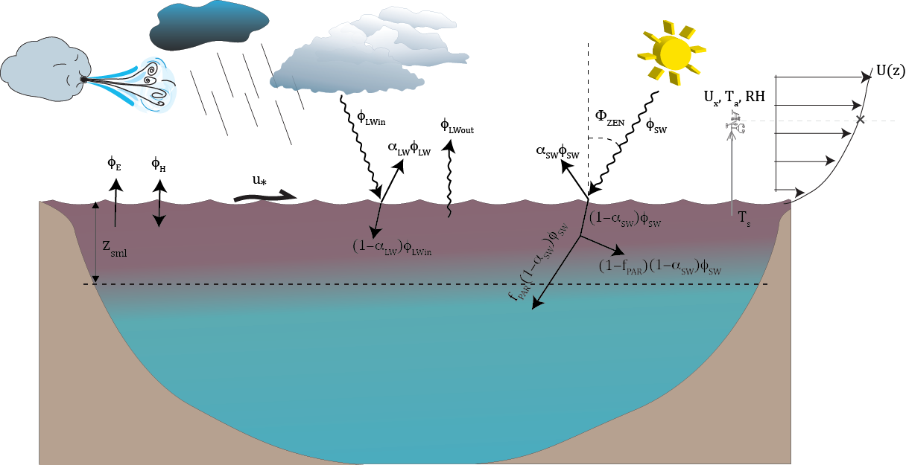
What are the drivers of thermal structure?
Solar radiation
Air temperature
Wind
Precipitation
Inflow & outflow streams
All of these factors will interact to control water temperature, thermocline depth, mixing, and more!
Figure: Hipsey et al. 2014
Notes:
Water temperature is regulated by several factors, namely, solar radiation, air temperature, wind, precipitation, and inflow/outflow streams.
All of these will interact to control thermal structure. The depth of the thermocline is regulated by solar radiation and wind-driven mixing.

Slide 7
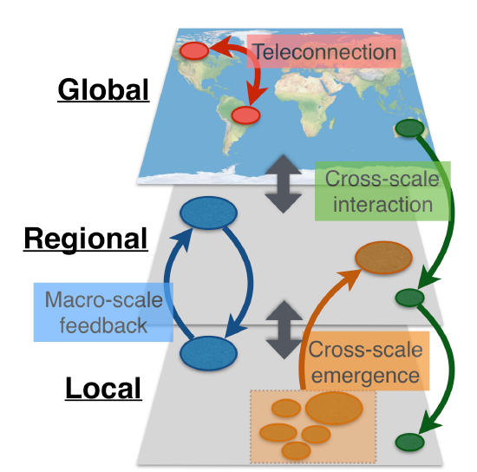
Using a macrosystems ecology approach to study lake thermal structure
Drivers of lake thermal structure occur at both local and regional scales
Local = e.g., inflow streams
Regional = e.g., air temperature
Macrosystems ecologists study ecological dynamics and feedbacks at multiple interacting spatial and temporal scales
We can study local and regional drivers using high-frequency sensor data + simulation models
Figure modified from: Heffernan et al. 2014
Notes:
Drivers of lake thermal structure occur at both local and regional scales: e.g., the temperature of inflowing streams and groundwater is a local factor, whereas weather/climate patterns tend to be regional.
A macrosystems ecology approach can be used to address ecological dynamics and feedbacks across multiple spatial and temporal scales.
In the case of lake thermal structure, a macrosystems approach combines high frequency sensor data and simulation models to compare the effects of local and regional drivers.

Slide 8


Models to understand multiple drivers
How can we test the effects of drivers from different scales on lake thermal structure?
Impossible to experimentally manipulate all possible drivers in a lake!
Simulation modeling allows us to explore what would happen if we changed one driver, or multiple drivers at once
For example, how would lake thermal structure change if air temperatures were 2°C warmer than they are now? 4°C? 6°C?
What if rain also increased 50% on those lakes?
+2°C
+4°C
+6°C
Notes:
To study the effects of climate change on lakes, researchers use models, because it is impossible to manipulate factors such as solar radiation and wind on real lakes at the whole-lake scale in a controlled way.
However, simulation modeling allows us to test how changes in one or more drivers alters lake structure.

Slide 9



GLM: General Lake Model
Authors: Matt Hipsey, Louise Bruce, and David Hamilton
The General Lake Model (GLM) is an open-access model for simulating lake dynamics. It simulates vertical stratification and mixing and accounts for the effect of inflows/outflows, surface heating and cooling.
GLM has been designed to be an open-source community model developed in collaboration with members of the Global Lake Ecological Observatory Network (GLEON) to integrate with lake sensor data.
Available from: http://aed.see.uwa.edu.au/research/models/GLM/
Notes:
The model we are going to use is GLM (the General Lake Model), developed in 2012 as an open-source model by researchers in GLEON, the Global Lakes Ecological Observatory Network.
GLM gives us the opportunity to do climate change experiments, in which we modify different climate conditions and study their effects on the lake.

Slide 10
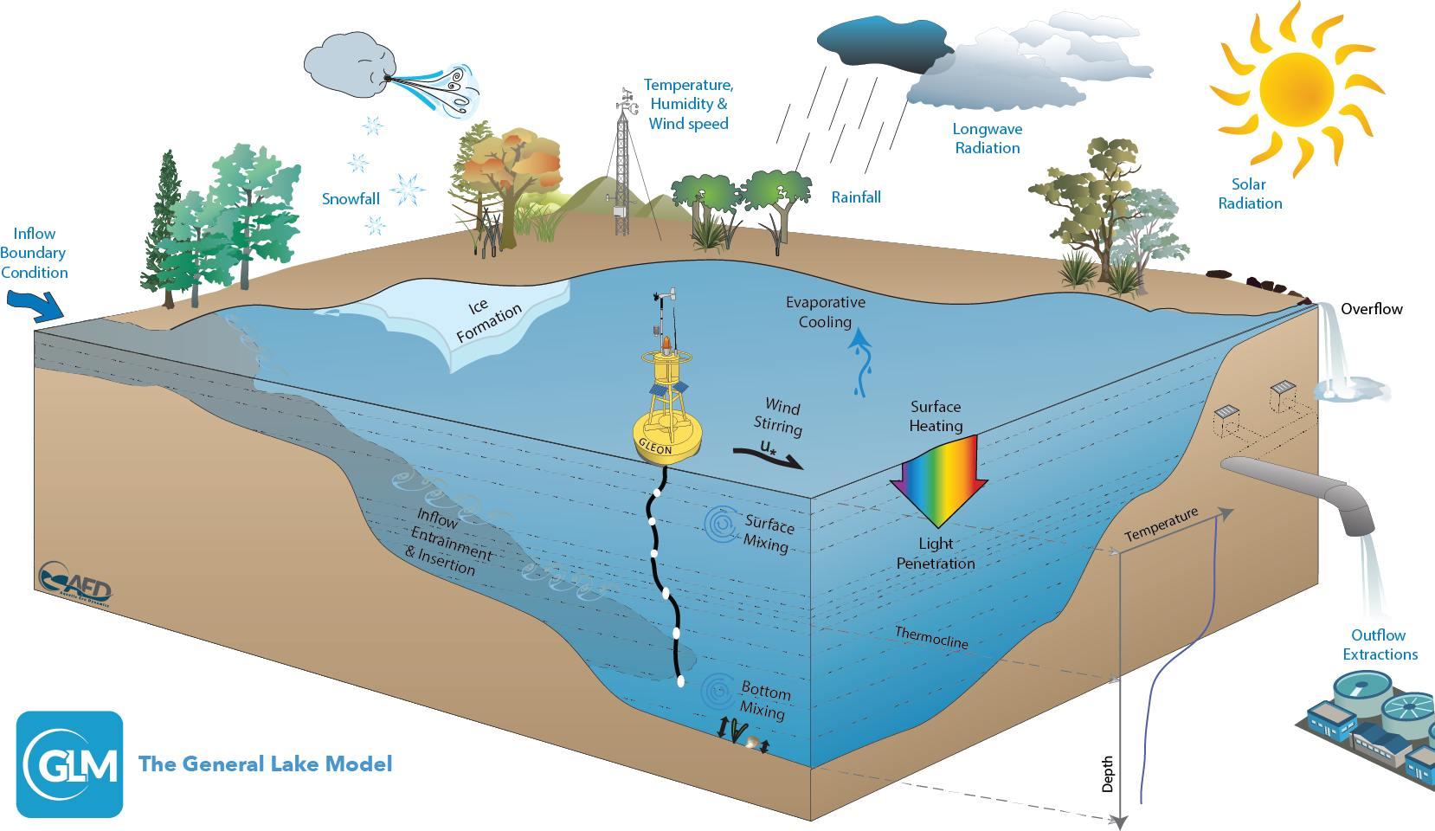
Figure: Hipsey et al. 2014
Notes:
GLM is a lake physics model, which uses climate forcing data as input (e.g., inflows, snow, wind, temperature, humidity, radiation) and models lake thermal structure, with lake temperatures as output.
GLM has a water quality model that also models water chemistry and food webs (AED), but for today, we are going to focus on lake physics.

Slide 11
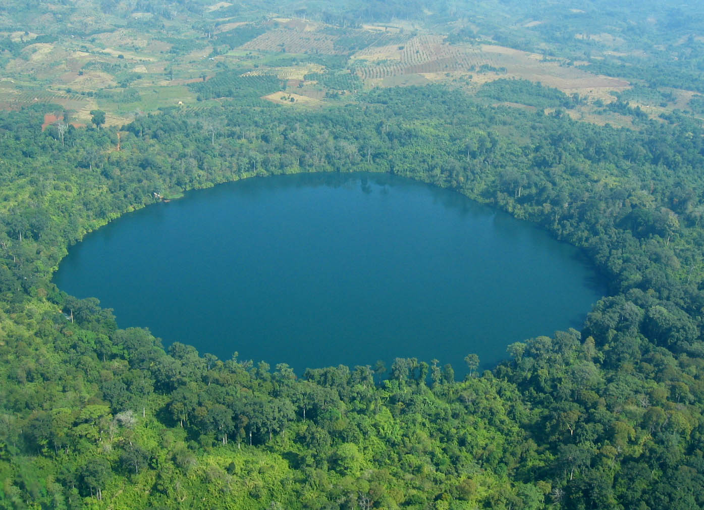
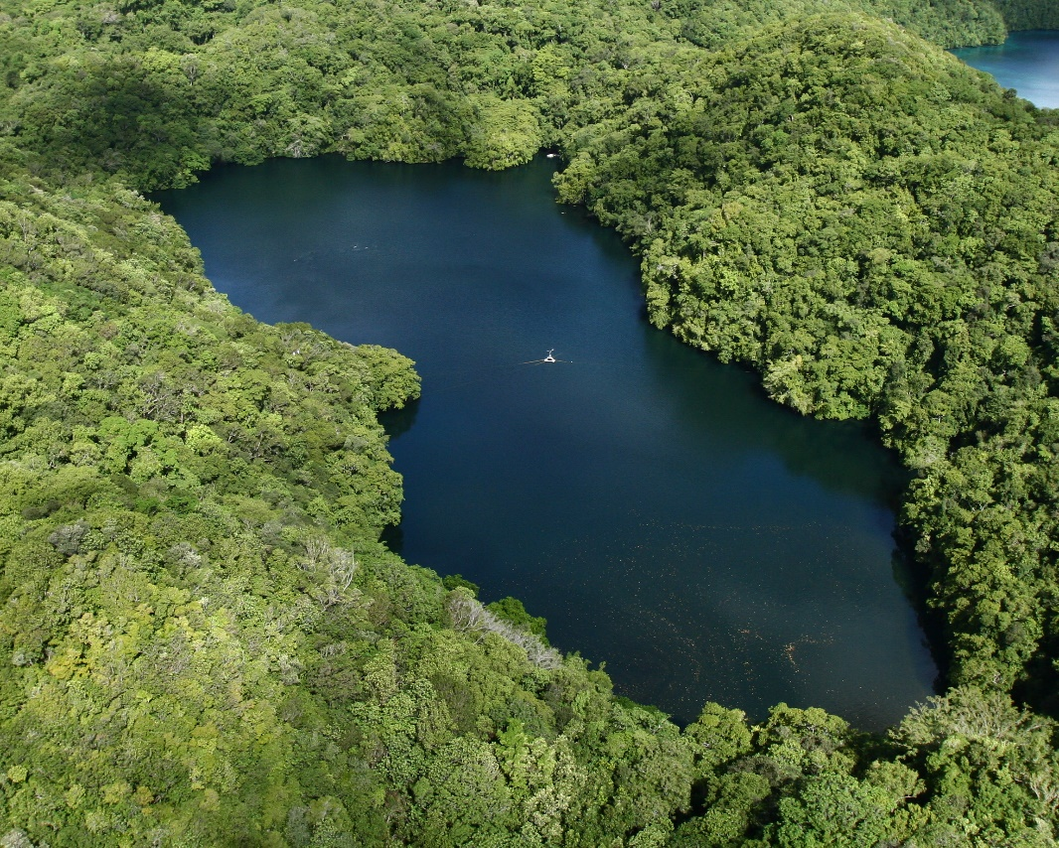
Basic structure of the model
You need to create a new folder (directory) on your computer.
Within this folder, you will have:
A high-frequency meteorological CSV file (‘met file’) that forces the model
e.g., “met_hourly.csv”
An ‘nml’ text file that acts as a ‘master’ script
glm2.nml
High-frequency Inflow/outflow CSV files that specify the temperature and flow rate of connected streams
Today we’re studying a closed lake without inflows or outflows
Images: Wikimedia commons
Notes:
GLM requires a separate new folder/directory on each student’s laptop, which will be downloaded as an RStudio project.
Within this folder will be:
1) a CSV (comma-separated values) file, which has the climate driver data (also referred to as a ‘met’ file; or a file with the meteorological data),
2) an .nml file, which can be opened as a text file, that acts as a master script to the GLM model (it contains parameters for how the model should work, tells the model basic info on the lake, such as depth, latitude, time period of the simulation, etc.), and
3) any inflow/outflow CSV files that specify the temperature and flow rate of the connected streams.
For the purpose of today, we are only going to have an .nml file and met .CSV file in our directory and assume that our model lake has no inflows or outflows.

Slide 12
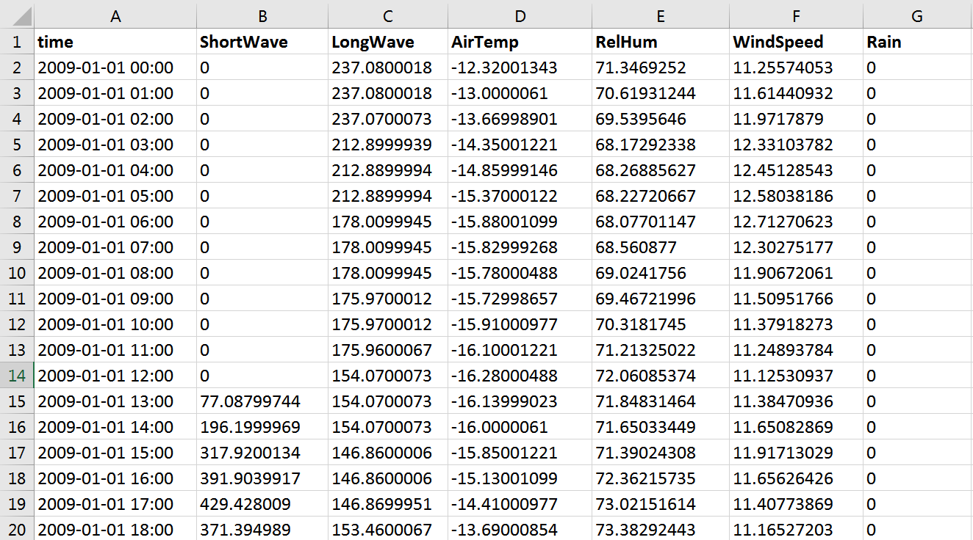
Example met file
Notes:
Here is an example met file, with columns for time step, shortwave radiation, longwave radiation, air temperature, relative humidity, wind speed, rain, and snow.
This met file is on an hourly time step.
Note the DateTime structure of the time column: GLM requires this exact format of YYYY-MM-DD hh:mm:ss. GLM also requires that the column headers are spelled exactly like what is in this file (and are capitalization-specific).

Slide 13
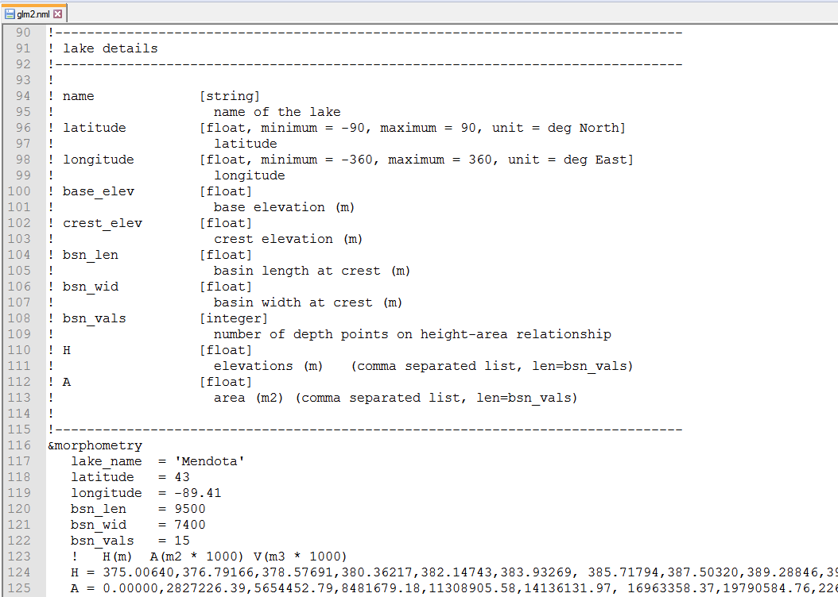
Example .nml file
Notes:
Here is an example .nml file, which goes through many required pieces of information, such as what the name of the lake being modeled is, its latitude/longitude, the time period being modeled, etc.
Fun fact: nml stands for “namelist” in the Fortran programming language.

Slide 14

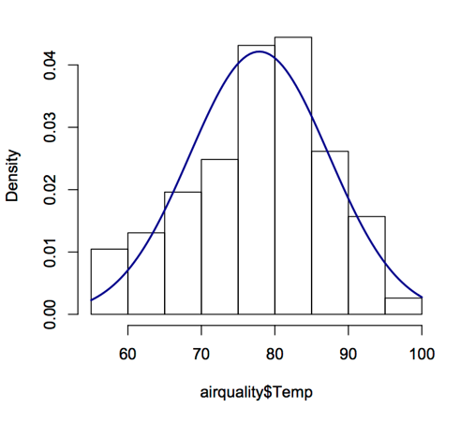
We will run GLM using R
R is a statistical environment that can run on different computer operating systems (PC, Mac, Linux)
R is reproducible, free(!), and easy to download
R can run stats, make figures, and do a suite of different analyses in many disciplines
Many packages for R to merge with other tools (including GLM!)
R is the programming language of choice for most ecologists
Notes:
We are going to run GLM in R, a programming language and statistical environment that is used for running statistics, making figures, and doing lots of different analyses.
Within R, you can download lots of different software ‘packages’ for different types of analyses.
The benefit to R is that it is free, runs on all operating systems, and is reproducible- i.e., any code that you write can be saved and run later, and you know exactly what you did!

Slide 15




GLM-associated R packages
GLMr: holds the current version of the GLM model and allows you to run GLM on any operating system
glmtools: has different functions for analyzing and plotting GLM output from GLMr
Developed by Jordan Read and Luke Winslow
Available from: https://github.com/GLEON & https://github.com/USGS-R/glmtools
Notes:
There are two packages that we need to run GLM in R: GLMr and glmtools.
GLMr runs the model and glmtools gives you different functions for analyzing the model.
These two packages were written by Jordan Read and Luke Winslow at USGS, and can be downloaded from their Github websites.

Slide 16
Learning objectives of today’s module
Set up and run the General Lake Model (GLM) in the R statistical environment to simulate lake thermal structure
Understand how GLM configuration files, high-frequency driver data, and output files are organized and used
Modify the input meteorological data for one GLM model to simulate the effects of different climate scenarios on lake thermal structure
Interpret model output from GLM simulations to understand how changing climate will alter lake thermal characteristics
Create a custom coding function and use a for-loop to set up and run many model simulations with varying input meteorological data
Explore the application of R functions and for-loops for modeling climate change effects on lakes
Notes:
Learning objectives!
Talk through these with the students one by one: use the embedded animations to sequentially show each of the six bullet points.
Most importantly, the goal here is to have students develop their own hypotheses for how climate change can affect lakes, and then test their hypotheses by creating a climate scenario and forcing the lake with that scenario.
They will then make mini-presentations to share their model findings with the class before learning new coding skills (functions, for-loops) to run many model simulations with different climate scenarios.

Slide 17
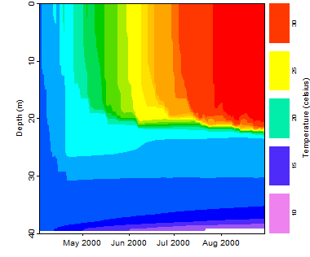
Activity A
With a partner (work in pairs):
Download the zipped folder containing the R Markdown (.Rmd) file and other files to run this module. Extract to your Desktop
Download GLM files and R packages onto your computer
Run the model and look at the thermal output
Examine how your model output compares to the observed field data for your lake
Notes:
Introduce Activity A, which has four objectives (have students work in pairs).
Download the zipped folder containing the R Markdown (.Rmd) file and other files to run this module. Extract to your Desktop
Download GLM files and R packages onto your computer
Run the model and look at the thermal output
Examine how your model output compares to the observed field data for your lake
At this point, stop the PowerPoint and let the students get started on Activity A.

Slide 18
Activity B
Develop a climate scenario for any region and explore how it will affect lake thermal structure
Develop a hypothesis about how climate change (e.g., altered temperature) may alter lake thermal structure
Create a corresponding meteorological input file
Run your model and examine the lake’s response:
How does your scenario alter the temperature profile in your lake over time?
How does the thermocline depth change?
How does the timing of stratification and evaporation change?
Compare the modeled output to the observed data
Create a few figures to highlight your climate scenario and share with the class!
Notes:
Introduce Activity B, which has two objectives:
Develop a climate scenario for any region and explore how it will affect lake thermal structure.
Create figures to share with the class that demonstrate the model output for the climate scenario.

Slide 19
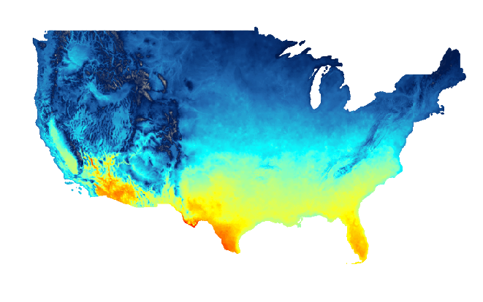
Need ideas for a climate scenario?
Check out climatedata.us
Temperature & precipitation predictions for US across the year under different emission scenarios
For global projections, try: climatemodels.uchicago.edu/maps
Image: climatedata.us
Notes:
Students might find this website helpful for thinking through predicted climate change in their home region, or other areas. Note that on this second site, students will need to first enter the starting year, and press “Download map”, then the target year for their climate scenario, and press “Download map” again, then click “Calculate anomalies” to estimate the temperature offset they should use when manipulating the data file. Also note that the Climate Model Mapper represents the RCP 8.5 (comparatively high emissions) scenario.
At this point, challenge the students to directly create a hypothesis for how some component of climate change may alter lake thermal structure. This can involve how an extreme event (e.g., a tornado! Hurricane! Superstorm blizzard!) or a more gradual change (e.g., +2ºC increase of observed air temperature) affects water temperature and thermal stratification.
The important take-home message here is that students need to 1) first discuss how they expect a climate scenario to affect lakes, 2) design a climate scenario to test their hypothesis, and 3) explore if the model output from their scenario supports or contradicts their hypothesis.

Slide 20
Converting units?
As you edit the met_hourly file to create your climate scenario, keep the following units in mind!
Variable | Unit | Example | Conversion
AirTemp | °C | 20.05
WindSpeed | meters · sec⁻¹ | 1.87 | To convert from miles per hour, multiply by 0.447
Rain | meters · day⁻¹ | 0.000592 | To convert from inches per day, multiply by 0.0254

Slide 21
Activity C
How do you run many lake simulations using different climate scenarios? Is there a more efficient way to run and analyze lots of different simulations rather than running the code manually?
YES! by using R functions and for-loops
A function contains code that does a specific task
You can create a function to perform any task you like in R!
A for-loop runs a section of code repeatedly
You can start the for-loop and let your computer run many lake simulations while you…. Have a snack! Take a nap! (Etc.)
Notes:
Introduce Activity C.
On this slide, emphasize that it is feasible to manually run code edit a met file and .nml to create one scenario, but what if you want to run many scenarios that are slightly different? (e.g., a first scenario that is +2ºC, a second scenario that is +2.1ºC, a third scenario +2.2ºC).
It is not feasible to manually run code to edit many, many met files and run all the corresponding model simulations.
Fortunately, there are coding techniques to create many scenarios and run many lake models while you do something else!
A function contains code that does a specific task, and you can create a function to perform any task you like in R. When you want to run the code in the function, all you have to do is type the name of the function, rather than copying and re-running large sections of code.
A for-loop runs a section of code repeatedly. You can start the for-loop and let your computer run many lake simulations while you do something else!

Slide 22
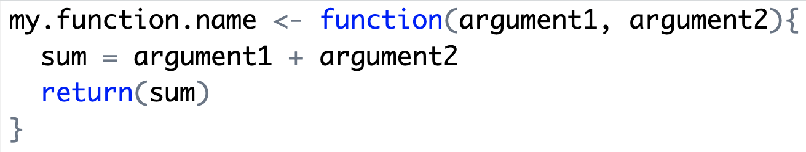
Custom functions in R
First, define the function
Give your function a descriptive name that is relevant to the task it performs
The inputs you provide to your function are called “arguments”
The code in the curly brackers {} is run every time the function is called; a function can be as simple or complex as you like!
’return’ indicates that we want ‘sum’ to be the output of the function
Notes:
To build your own custom function in R, you first need to define the function. You should give your function a descriptive name that is relevant to the task it performs. Then, you list the arguments, or inputs, that are needed to execute the code inside the function. Any code inside the curly brackets will be run every time the function is called; a functions can be as simple or complex as you like! The ‘return’ command tells the function what its output should be.

Slide 23
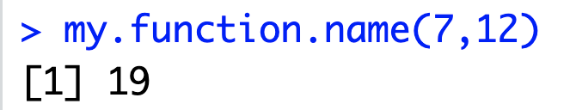
Custom functions in R
Then you can call the function!
1. Type the name of your function, followed by parentheses ()
2. Supply the arguments (argument1 = 7, argument2 = 12)
3. When you run the function, you will get an output (‘sum’)
Notes:
Once you have defined the function, you can “call” it, or run it. To call the function, you type the function name, followed by parentheses. Inside the parentheses, provide the function arguments. You can just provide the values of the arguments, but if you do this, make sure you provide the arguments in the correct order, which is the same order they were in when you originally wrote the function. To avoid having to worry about whether your arguments are in the correct order, you can also name them when you type them (e.g., argument1 = 7). When you run in the function in R, you will get an output corresponding to what you asked the function to return when you defined it.

Slide 24
Custom functions to create climate change scenarios
In Activity C, you will complete a demonstration of how a custom function can be used to create many lake climate change scenarios
Then, you will have the opportunity to build a custom function to create your own set of scenarios!
Image: climatedata.us
Images: Wikimedia commons
Notes:
In Activity C, you will be building custom functions to create climate change scenarios. You will first complete a demonstration of how a custom function can be used to create many lake climate change scenarios. Then, you will have the opportunity to build a custom function to create your own set of scenarios!

Slide 25
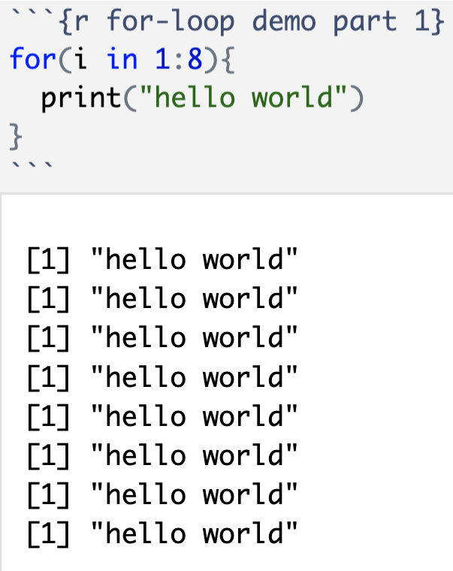
For-loops in R
For-loops run a section of code repeatedly
This line specifies how many times to repeat the code (start at 1 and go to 8 repetitions)
All the code in curly brackets {} will be run for every iteration of the for-loop
Here is the for-loop output: we have printed “hello world” eight times!
Notes:
The other key coding skill we will be learning and applying in Activity C is called a for-loop. For-loops run a section of code repeatedly. On the right of the slide is an example of a for-loop. The line of code boxed in orange specifies how many times to repeat the code (start at 1 and go to 8 repetitions). All the code inside the curly brackets will be run for every iteration of the for-loop. Finally, below the code is the for-loop output; here we have printed “hello world” eight times!

Slide 26
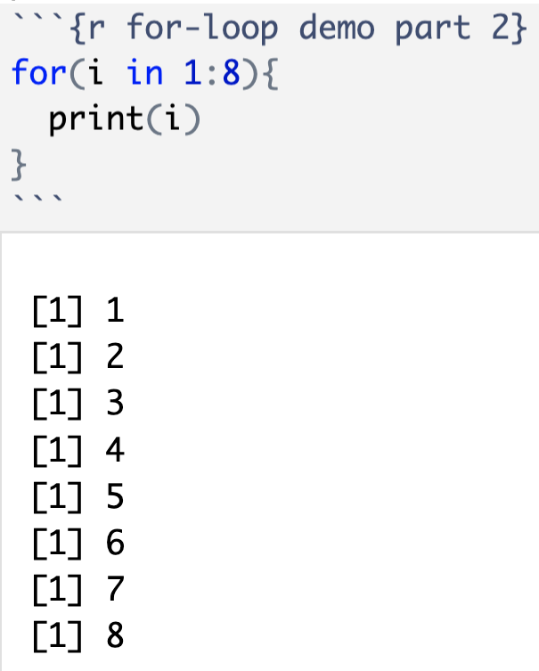
For-loops in R
Within a for-loop, indexing allows you to refer to a particular iteration, or individual code run, of the loop.
In this for-loop, the index is specified using the letter ‘i’. ‘i’ is a commonly used symbol for indexing in a for-loop in R
Here is the for-loop output: we have printed the value of ‘i’ eight times! Notice how the value of ‘i’ changes each time the for-loop runs
Notes:
Within a for-loop, indexing allows you to refer to a particular iteration, or individual code run, of the loop. For example, in this for-loop the index is specified using the letter ‘i’. ‘i’ is a commonly used symbol for indexing in a for-loop in R. This loop will print the value of i for eight iterations, from 1 to 8. Below the code is the output. Notice how the value of ‘i’ changes each time the for-loop runs. When you run your model simulations, changing the index will allow us to reference a different climate scenario each time the for-loop runs, so that we can run many lake simulations using different climate scenarios.

Slide 27
For-loops to run many lake model simulations
In Activity C, you will use a for-loop to run many lake model simulations using different climate change scenarios
Code to run lake model
Every iteration of the for-loop will run a different lake model simulation with a different climate scenario
Output for many lake model simulations!
The output of the for-loop will be many lake model simulations, allowing you to compare among climate change scenarios!
Notes:
In Activity C, you will use a for-loop to run many lake model simulations using different climate change scenarios. The code inside the curly brackets will run the lake model using a different climate scenario for each iteration of the loop. The for-loop output will be many lake model simulations, allowing you to compare among climate change scenarios.

Slide 28
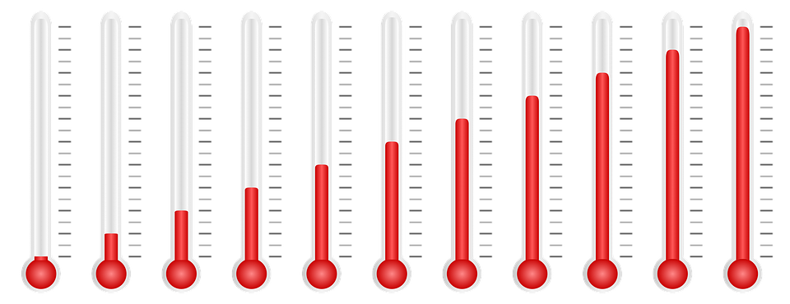
Activity C
Go through the demo in the R Markdown file which uses a custom function and a for-loop to run multiple air temperature scenarios
Once you have finished the demonstration, design your own simulation "experiment" with your partner to examine the effects of a set of climate change scenarios of your choice.
Create some figures from your simulation and share them with the class.
Image: Pixabay public domain
Notes:
Tell the students to return to their R Markdown files to run the demo for Activity C.
Depending on the amount of available time left in the teaching period, you could encourage students to create their own simulation experiment beyond the demo, which they can share with the other students, similar to Activity B.

Slide 29

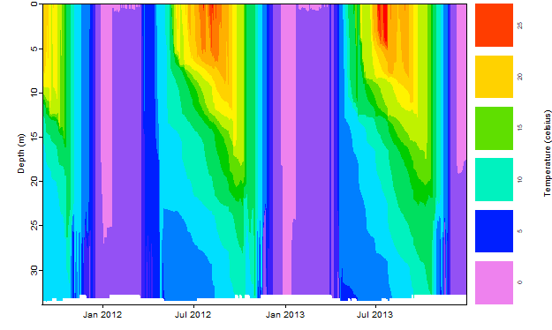

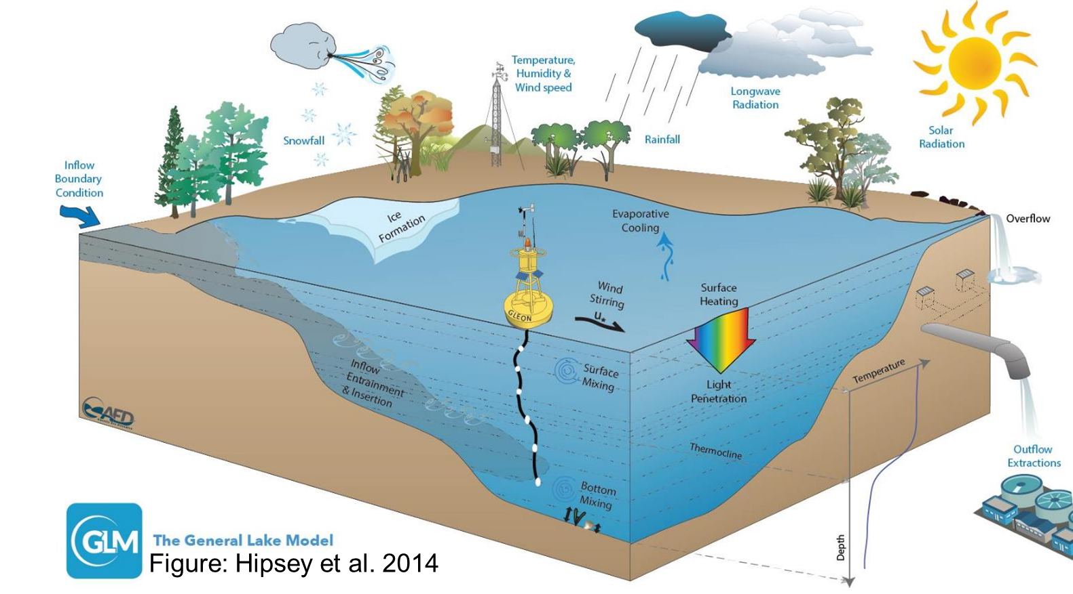
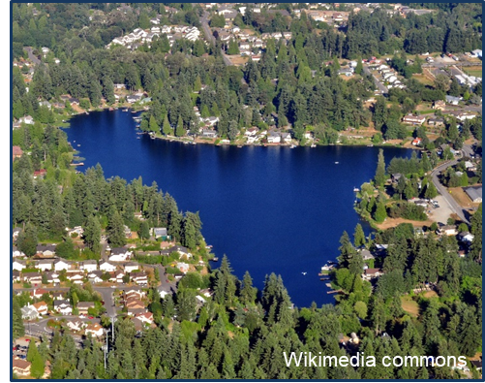
Thank you for participating!

