Slide 1



Macrosystems EDDIE: Getting Started + Troubleshooting Tips
Moore, T. N., Carey, C.C., Thomas, R. Q. 23 January 2021.
Macrosystems EDDIE: Introduction to Ecological Forecasting.
Macrosystems EDDIE Module 5, Version 1.
http://module5.macrosystemseddie.org
Module development supported by NSF DEB-1926050; NSF DBI-1933016
Notes:
Welcome the students to class.
It is really important at this point to emphasize that there will be lots of new material covered during this module, and that going slowly and asking for help is very much encouraged!

Slide 2

R Shiny Applications
Statistical environment
Interactive web app built using R.
Allows users to interact with data
Conduct their own analysis
Check-in:
Can you access the Shiny app or this module?
Copy and paste this link into your browser: https://macrosystemseddie.shinyapps.io/module5/
If this is not working contact us at MacrosystemsEDDIE@gmail.com and we will help you resolve this issue.

Slide 3
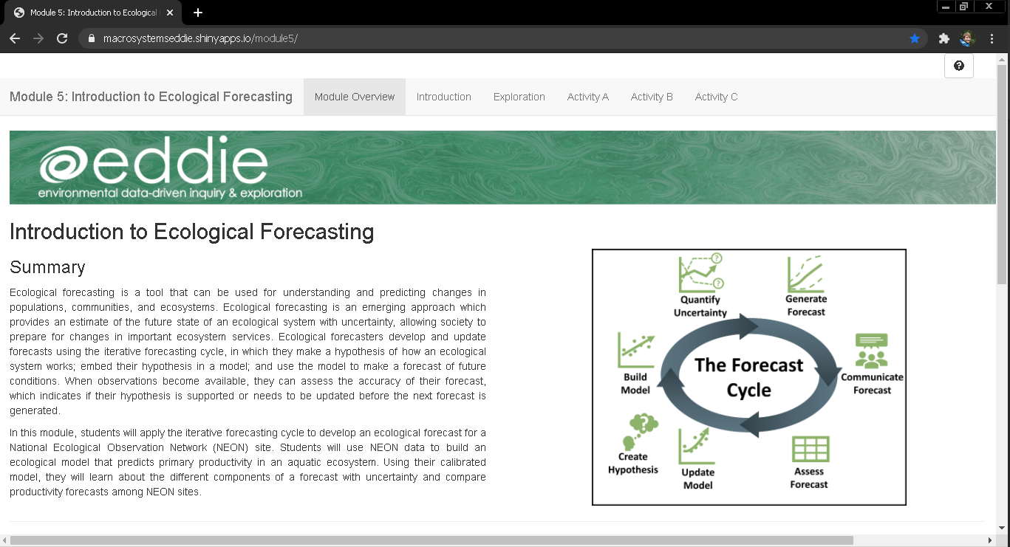
Landing Page of the Shiny App

Slide 4
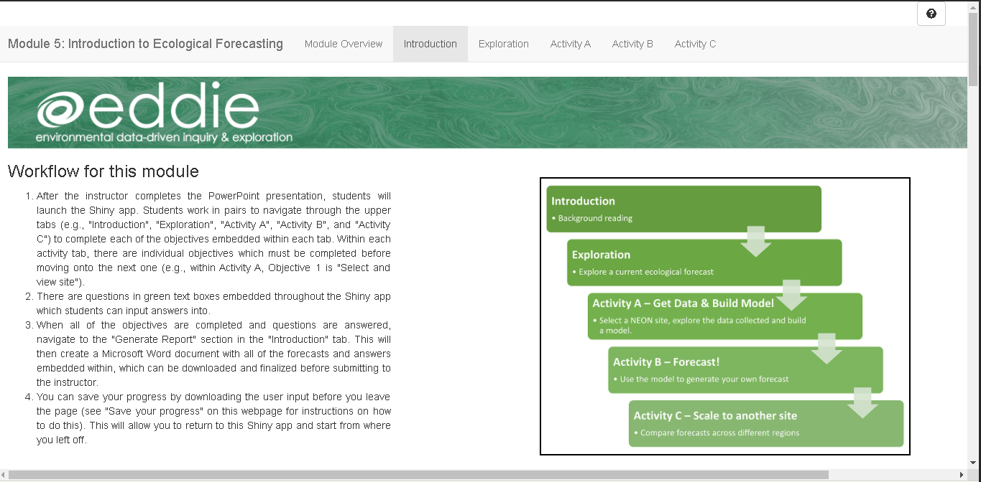

Navigating the Shiny App
Select a tab by clicking on it

Slide 5
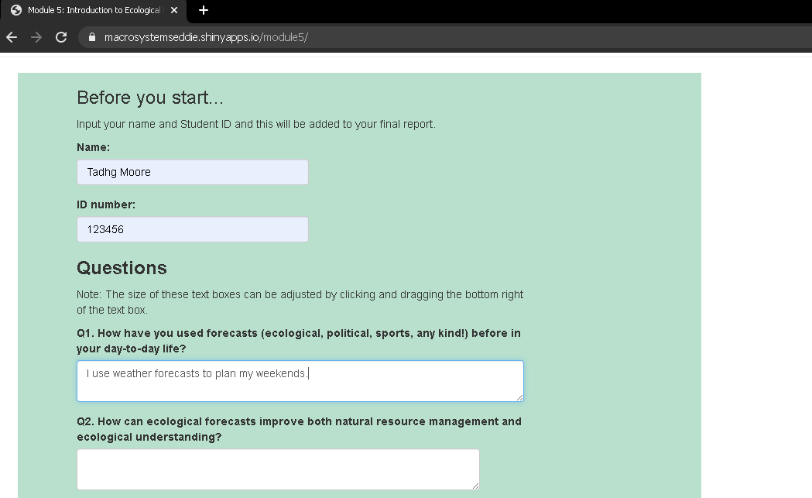
Answer questions
Type your answers into the text boxes

Slide 6
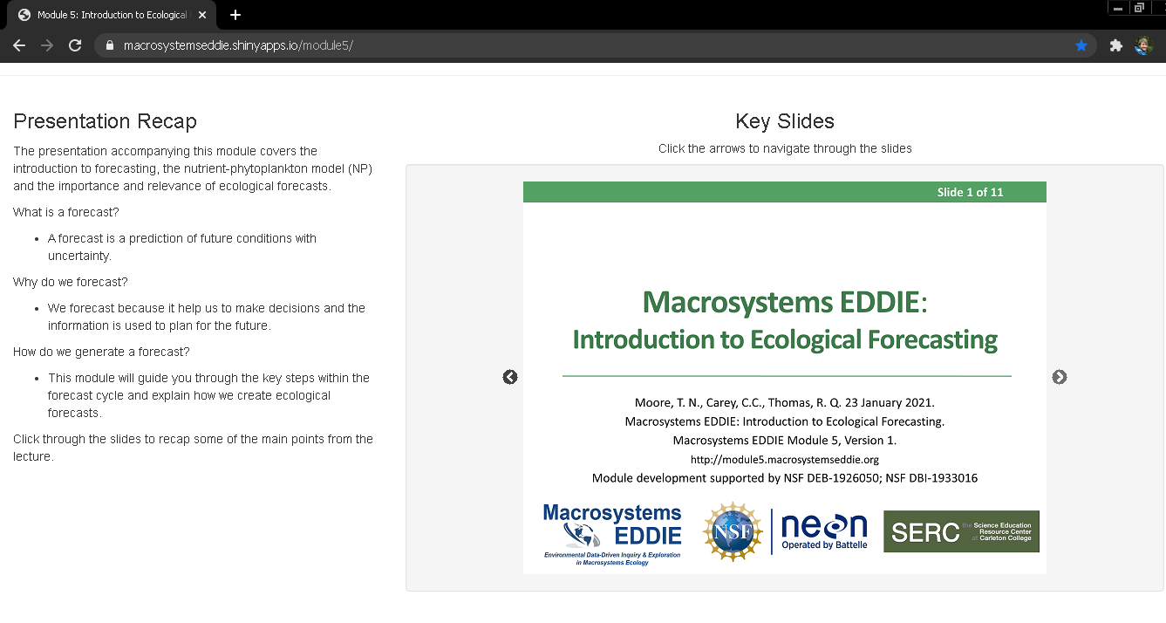
Navigate slides
Advance slides by clicking on the arrows

Slide 7
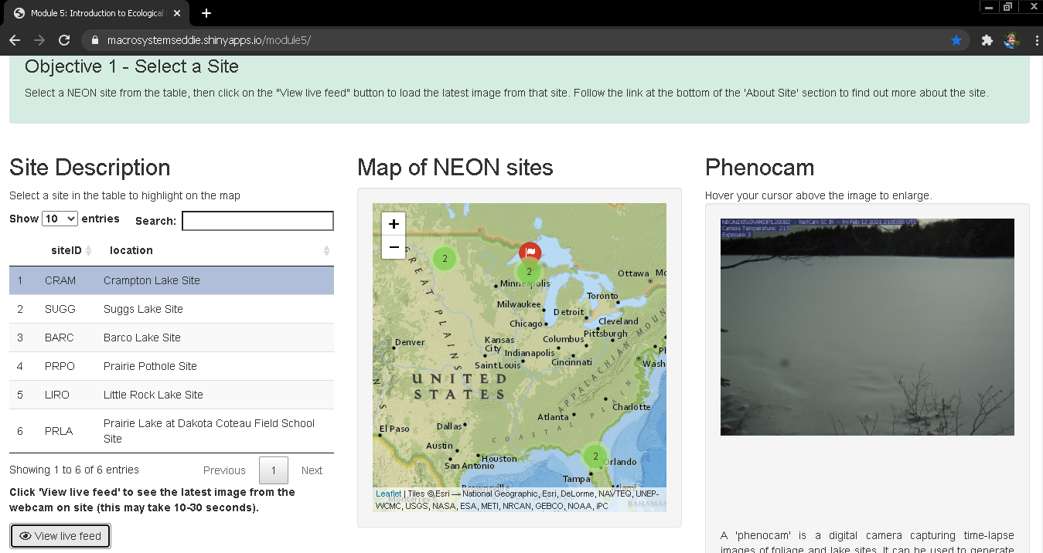
Interact with app
Select data table rows and click buttons

Slide 8
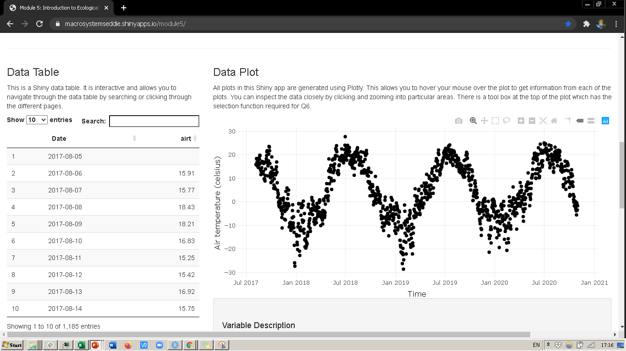
Interact with plots
Hover cursor over points or click and drag to zoom in
Hover cursor over plot to bring up options

Slide 9
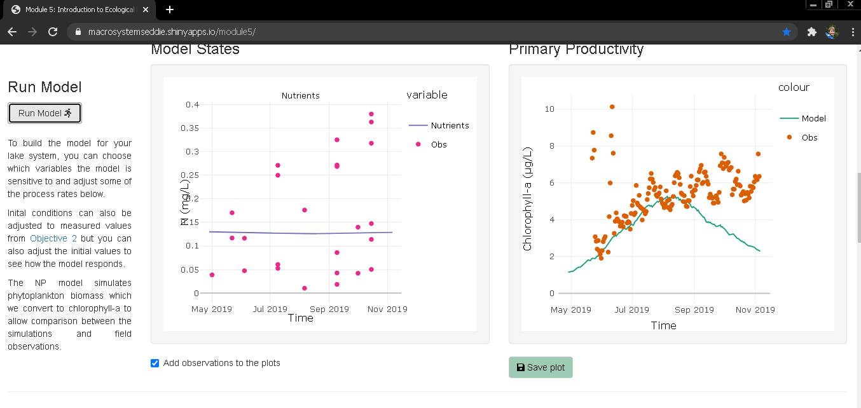
Saving plots
Save plots for downloading with your final report

Slide 10
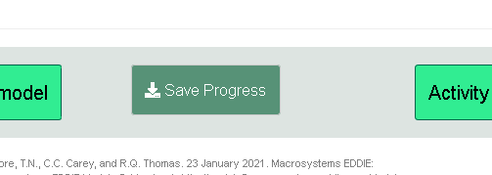
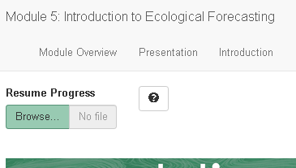
Saving & Resuming Progress
Saving Progress
Scroll to bottom of the page
Click on the “Save Progress” button. An ‘.eddie’ file will download. Your computer might prompt you to open this in R. This will not work, it only works for uploading to the Shiny app
Store this file somewhere safe on your computer
Resuming progress
Scroll to the top of the page
Upload the ‘.eddie’ file
This will populate your saved text answers and saved parameters

Slide 11
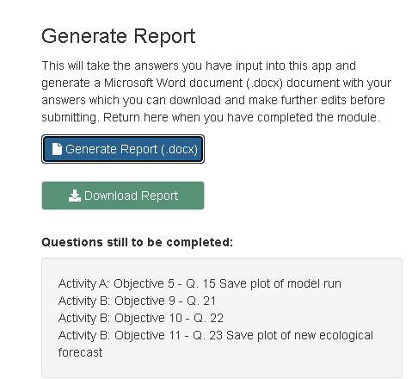
Downloading the Report
Navigate to the “Introduction” tab
Scroll down to “Save your progress” section
Click on the “Generate Report (.docx)” button.
Then the “Download Report” button will appear. Click this to download the report with answer and plots embedded within a Word document.
Notes:
Generating the student report.
Stop the presentation here and navigate to the Shiny App while screen sharing.
Briefly demonstrate how to navigate between Activity Tabs and objective tabs within each Activity.
Demonstrate the buttons regarding saving your progress and resuming your progress and the “Generate Report” feature.
Make sure to emphasize to students to read through the text carefully as there are instructions there if they get confused. Also encourage them to feel free to ask questions if they don’t understand what to do.
At this point send the students into breakout rooms of ~4 (2 pairs each) and let them get started on the Shiny App.
Identify if the saved report will be submitted as an assignment and which app questions need to be completed as part of the activity.

