Slide 1




Project EDDIE: Modeling climate change effects on lakes using distributed computing.
Carey, C.C., S. Aditya, K. Subratie, and R. Figueiredo. 1 May 2016. Project EDDIE: Modeling Climate Change Effects on Lakes Using Distributed Computing. Project EDDIE Module 4, Version 1. http://cemast.illinoisstate.edu/data-for-students/modules/lake-modeling.shtml.
Module development was supported by NSF DEB 1245707 and ACI 1234983.
Notes:
Names + background in experience in coding, computer science, modeling

Slide 2
Overview of today
Short powerpoint overview of lake modeling and some background on the tools we will be working with
Activity A: Plot water temperatures from a lake model.
Activity B: Develop a climate scenario, generate hypotheses, and model how your lake responds.
Activity C: Use distributed computing to run 100s of lake model simulations.
Notes:
! To indicate enthusiasm for teaching

Slide 3
Lakes are changing worldwide…
In response to altered climate, some regions are experiencing different temperature, precipitation, and wind conditions than in the past.
Because of their position in the landscape and their thermal inertia, lakes can be powerful indicators of climate change.

Slide 4
How will climate change affect lake thermal structure?
Notes:
Overarching question: What is thermal structure?

Slide 5
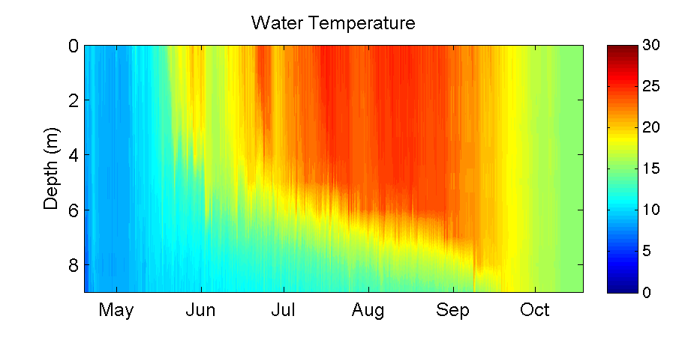
What is lake thermal structure?
Epilimnion
Thermocline
Hypolimnion
Lake Sunapee, NH, USA: data from Lake Sunapee Protective Association buoy, 2012
Notes:
Data from Lake Sunapee 2012

Slide 6
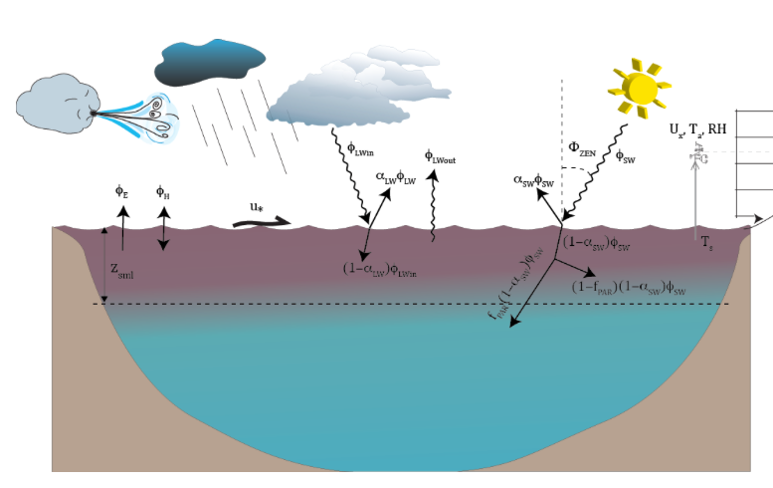
What are the drivers of thermal structure?
Solar radiation
Air temperature
Wind
Precipitation
Inflow and outflow streams
All of these factors will interact to control water temperature, thermocline depth, mixing, and more!
Figure from Hipsey et al. (2014)
Notes:
Solar radiation, air temp, wind, precip, inflow and outflow streams

Slide 7
GLM: General Lake Model
Authors: Matt Hipsey, Louise Bruce, and David Hamilton
Location: http://aed.see.uwa.edu.au/research/models/GLM/
Overview: The General Lake Model (GLM) is an open-access model developed for simulating lake dynamics. It simulates vertical stratification and mixing and accounts for the effect of inflows/outflows, surface heating and cooling.
GLM has been designed to be an open-source community model developed in collaboration with members of the Global Lake Ecological Observatory Network (GLEON) to integrate with lake sensor data.
Notes:
First developed in 2012

Slide 8
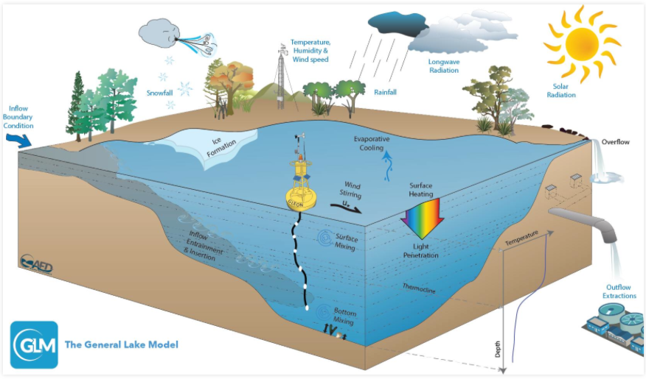
Figure from Hipsey et al. (2014)

Slide 9
Basic structure of the model
You need to create a new folder (directory) on your computer.
Within this folder, you will need:
a meteorological CSV file (‘met file’) that forces the model: e.g., “met_hourly.csv”
an ‘nml’ text file which acts as a ‘master’ script,
any inflow/outflow CSV files that specify the temperature and flow rate of connected streams.
Notes:
For us, no inflows/outflows

Slide 10
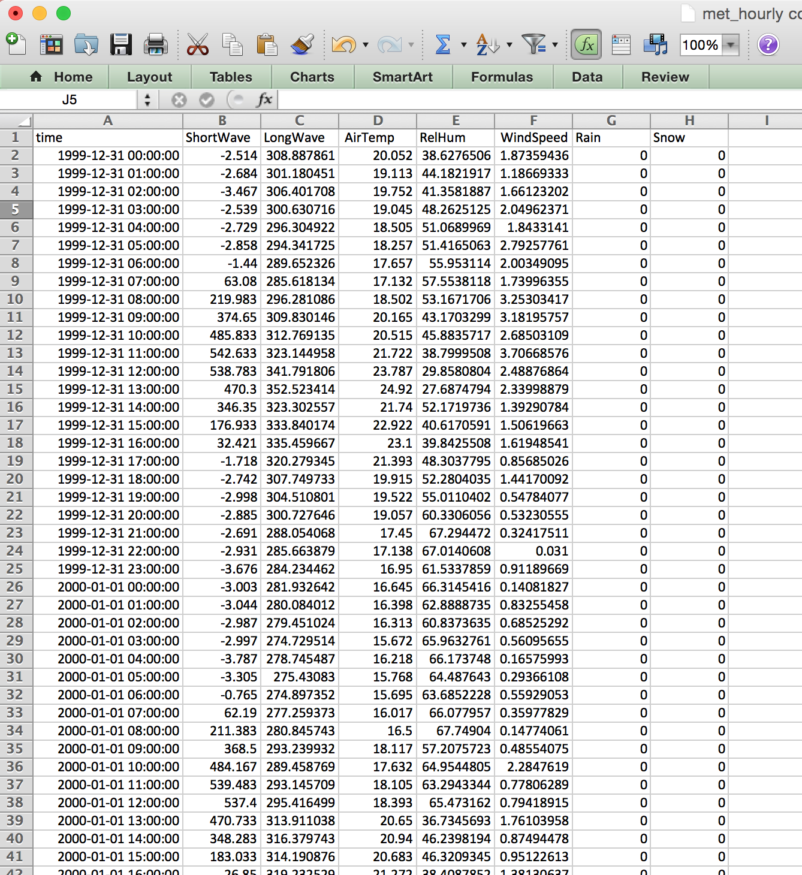
Example met file

Slide 11
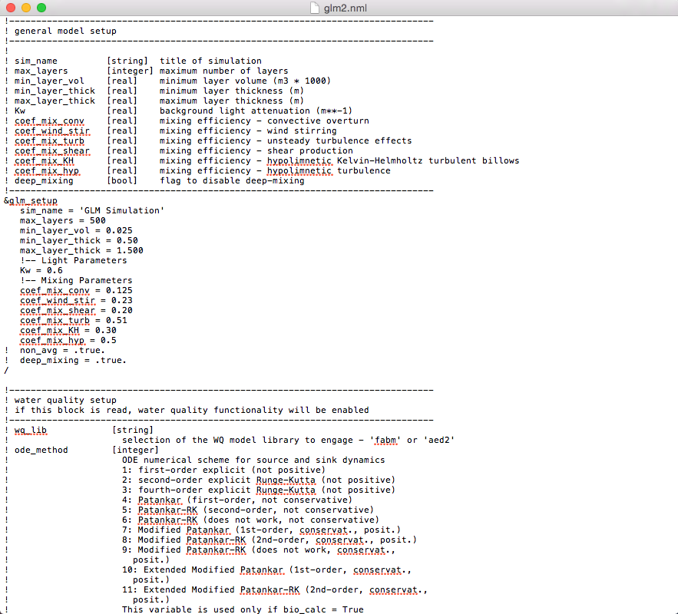
Example nml file

Slide 12
We will run this model in the R statistical environment
R can run on different computer operating systems (PC, Mac, Linux)
R is reproducible
R is free(!) and easily downloadable
R can run stats, make figures, and do a suite of different analyses in many disciplines
Many packages for R to merge with other tools (such as GLM)
The GLMr and glmtools packages allow you to run GLM directly from within R

Slide 13
GLM-associated R packages
GLMr: holds the current version of the GLM model and allows you to run GLM on any operating system
glmtools: has different functions for analyzing and plotting GLM output from GLMr
Developed by Jordan Read and Luke Winslow
Accessible at https://github.com/GLEON

Slide 14
Learning objectives of today’s module
Set up and run the General Lake Model (GLM) in the R statistical environment to simulate lake thermal structure.
Understand the structure and function of GLM configuration files, driver data, and output files.
Modify the input meteorological data for one GLM model to simulate the effects of different climate scenarios on lake thermal structure.
Interpret model output from GLM simulations to understand how changing climate will alter lake thermal characteristics.
Use the GRAPLEr R package to set up hundreds of model simulations with varying input meteorological data, and run those simulations using distributed computing.
Explore the application of distributed computing for modeling climate change effects on lakes.

Slide 15
Activity A
With a partner:
1) Download the GLM files and R packages successfully onto your computer (work in pairs)
2) Migrate the GLM example files onto a new directory on your computer
3) Run the model and look at the thermal output
4) Examine how your model output compares to the observed field data for your lake

Slide 16
Activity B
Develop a climate scenario for any region and explore how it will affect lake thermal structure
Develop a hypothesis about how climate change may alter lake thermal structure
Create a corresponding meteorological input file
Run your model and examine the lake’s response:
How does your scenario alter the temperature profile in your lake over time?
How does the thermocline depth change?
How does the timing of stratification and evaporation change?
Compare the modeled output to the observed data
Create a few figures to highlight your climate scenario and share with the class

Slide 17
Need ideas for a climate scenario?
Check out climatedata.us
Temperature & precipitation predictions for US across the year under different emission scenarios
Check out maca.northwestknowledge.net
Temperature, precipitation, wind, relative humidity, and shortwave radiation
Go to “Get the Data” → “Design-Your-Own CSV point data”, then edit latitude/longitude coordinates and use drop down menus to choose scenarios and year of predictions

Slide 18
Activity C
How do you run 100s of lake simulations quickly? Is there a more efficient way to submit and analyze lots of different simulations than editing met files manually?
YES! = GRAPLEr
An R package that allows you to create 100s of simulations, submit them to run via a suite of distributed computing tools, and then return the GLM output

Slide 19
GRAPLEr: a new R package
Authors: K. Subratie, S. Aditya, S.S. Mahesula, R. Figueiredo, C.C. Carey, and P.C. Hanson
Creates offsets for GLM met file variables (e.g., add +2ºC to all temperature values in a met file), submit the jobs via a Web service to run on other computers, and then analyze the output
See: github.com/GRAPLE/GRAPLEr/wiki

Slide 20
What is distributed computing?
A model of computing where multiple networked computers work together towards a single problem, dividing the problem into many parts that are solved by different computers.
Notes:
The GRAPLEr Web service divides the problem into many parts, HTCondor dispatches them to be solved by different computers, and IPOP provides the network.

Slide 21

GLM in your computer
get variables, plot
configure
nml,
csv
files
You
(keyboard)
Output.nc
file
R
GLM
run

Slide 22
GRAPLEr
Enter distributed computing:
Objective: to run 100s to 1000s of GLM jobs
Take each GLM run and dispatch to a different computer across the Internet
Shorten execution times for large numbers of runs (e.g., climate change offsets)
Distributed computing is not easy - but GRAPLEr makes it easy for you
Can submit jobs directly from R user interface

Slide 23

GRAPLEr under the hood
receive
Web service
HTCondor
send
Internet
You,
keyboard
R, plus
GRAPLEr
library
IPOP
overlay
network
UF
VT
GRAPLEr
UW
Other sites

Slide 24
GRAPLEr under the hood
Web service:
A server takes requests from you through R
IPOP network overlay
Aggregates computers across the Internet as if they belong to the same domain
HTCondor
Distributes GLM jobs to the computers connected by IPOP so they can run concurrently and finish faster

Slide 25
Activity C
Go through the GRAPLEr demo in the R script
Once you have finished the demonstration, design your own simulation "experiment" with your partner and use the GRAPLEr to examine the offsets of a meteorological variable and magnitude of your choice.
Create some figures from your simulation and share them with the class.

