Slide 1
Chapter 6
Database Design
(Review)

Slide 2
Review of E-R Model (1)
E-R Model
  Entity
  Attribute
    Identifier, Descriptor, Composite Attribute, Multi-Valued Attribute
  Relationship
    Card(E, R) = (x, y)
      single-valued/multi-valued participation
      mandatory/optional participation
    One-to-One, Many-to-Many, Many-to-One
Database Principles & Programming

Slide 3
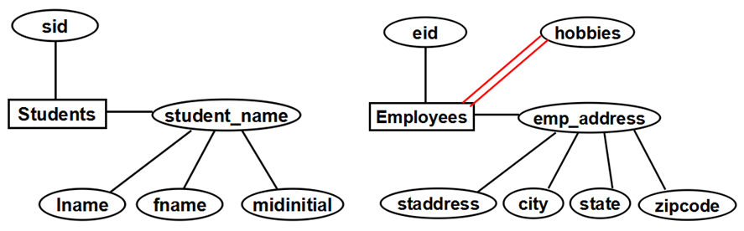
Examples of E-R diagrams (1)

Slide 4
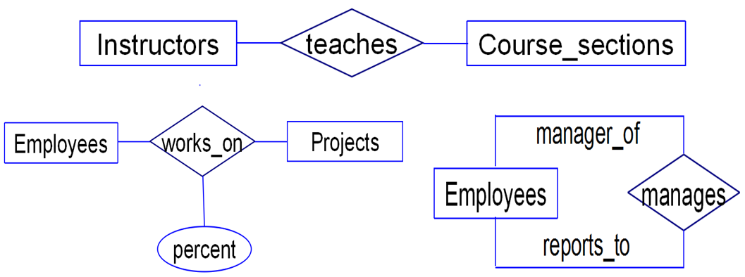
Examples of E-R diagrams (2)

Slide 5
Review of E-R Model (2)
Transform E-R Model to Relations
  Rule 1: Entity
  Rule 2: Multi-valued Attribute
  Rule 3: N-N Relationships
  Rule 4. N-1 Relationships
  Rule 5: 1-1 Relationships: Optional on one side
  Rule 6: 1-1 Relationships: Mandatory on both sides
Database Principles & Programming

Slide 6
Rule 3: N-N Relationships
  Employees(eid, straddr, city, ……)
  Projects(prid, proj_name, due_date)
  works_on(eid, prid, percent)
works_on
Employees
Projects
(1, N)
(0, N)
percent
Database Principles & Programming

Slide 7

Rule 4. N-1 Relationships
insid
secid
Instructors(insid, lname, ……)
Course_sections(secid, insid, course, …)
Database Principles & Programming

Slide 8
Rule 5: 1-1 Relationships: Optional on one side
ssn
DLno
having
Person
DrivingLicense
(0,1)
(1,1)
name
birthdate
validdate
class
Person(ssn, name, birthdate)
DrivingLicense(DLno, validdate, class, ssn)
Database Principles & Programming

Slide 9
Rule 6: 1-1 Relationships: Mandatory on both sides
ssn
scid
having
Student
StudentCard
(1,1)
(1,1)
name
department
class
Student(ssn, name, scid, department, class)
Database Principles & Programming

Slide 10
Review of E-R Model (3)
Cardinality of Attributes (x, y)
eid
hobbies
(1,N)
(1,1)
Employees
emp_address
(0,1)
(1,1)
(1,1)
(1,1)
(1,1)
staddress
city
state
zipcode
Database Principles & Programming

Slide 11
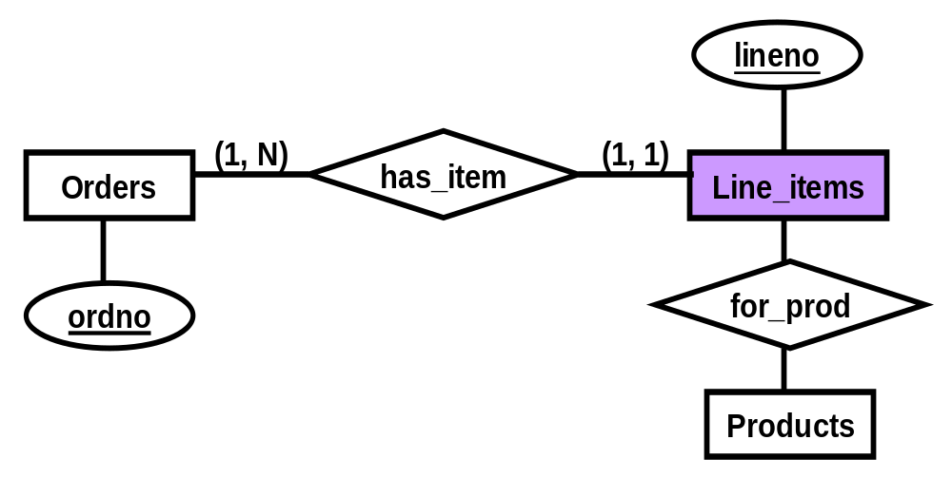
Review of E-R Model (4)
Weak Entities
Database Principles & Programming

Slide 12
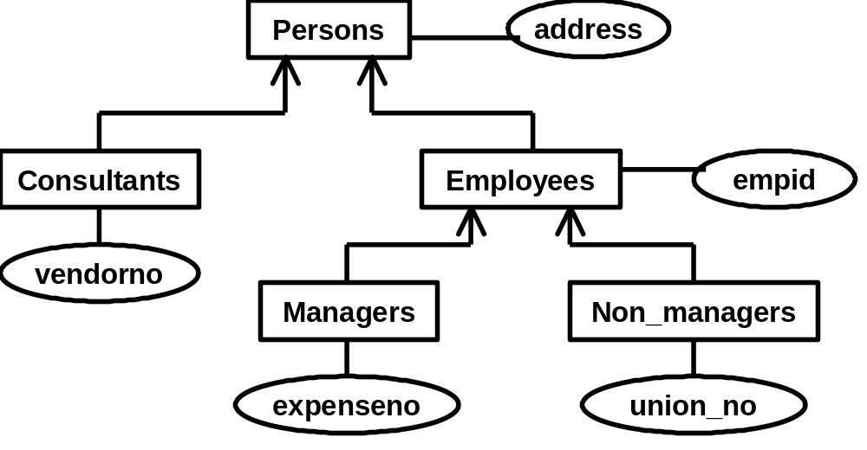
Review of E-R Model (5)
Generalization Hierarchies
Database Principles & Programming

Slide 13
6.4 Case Study
6.4.1 图书借阅管理
6.4.2 篮球联赛信息管理
6.4.3 聊天论坛管理
6.4.4 邮件信息管理

Slide 14
6.5 Normalization(规范化): Preliminaries
A Running Example
  Def. 6.5.1 Update Anomaly
  Def. 6.5.2 Delete Anomaly, Insert Anomaly
Normal Form (NF，范式)
Functional Dependency (FD)
  A→B (A functionally determines B, or B is functionally dependent on A)
  For any rows r₁ and r₂ in T,
    if r₁(A) = r₂(A) then r₁(B) = r₂(B).
Database Principles & Programming

Slide 15
（一对一）
（一对多）
（多对多）
A
B
A
B
A
B
X1
X2
X3
X4
Y1
Y2
Y3
Y4
X1
X2
X3
Y1
Y2
Y3
Y4
X1
X2
X3
Y1
Y2
Y3
A → B
B → A
B → A
(none)
Database Principles & Programming

Slide 16
6.6 Functional Dependencies
Armstrong’s Axioms
R1(自反规则)：If Y⊆X，then X → Y
R2(传递规则)：If X→Y and Y→Z，then X→Z
R3(增广规则)：If X → Y, then XZ → YZ
R4(合并规则)：If X→Y and X→Z，then X→YZ
R5(分解规则)：If X→YZ，then X→Y and X→Z
R6(伪传递规则)：If X→Y and WY→Z，then XW→Z
R7(聚积规则)：If X→YZ and Z→W，then X→YZW
Database Principles & Programming

Slide 17
Content of last
函数依赖
  Closure of a Set of FDs (函数依赖集的闭包 )
  FD Set Cover (函数依赖集的覆盖)
  Equivalence of two sets of FDS (函数依赖集的等价)
  Minimal Cover (最小覆盖)
  Closure of a Set of Attributes (属性集的闭包)
模式分解
  Lossless Decomposition (无损性分解)
  FD Preserved (依赖保持)
Superkey & Key
  Prime Attribute (主属性)
  Non-Prime Attribute (非主属性)
Database Principles & Programming

Slide 18
Content of last
三个范式的定义
  BCNF, 3NF, 2NF
四个算法
  Algorithm 6.6.12: 属性集闭包的计算
  Algorithm 6.6.13: 最小覆盖的计算
  Algorithm to Find Candidate Key
  Algorithm 6.8.8: An Algorithm to Achieve Well-Behaved 3NF Decomposition
Database Principles & Programming

Slide 19

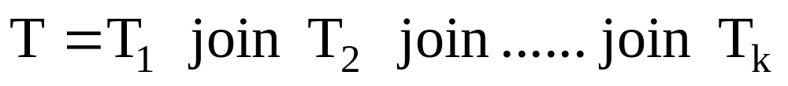
6.7 Lossless Decompositions
Def. 6.7.1 Decomposition of Table
table T ==> tables {T₁, T₂, ..., T_{k}}
Lossless Decomposition (无损性分解)
  Lossless-Join Decomposition (无损联接分解)
Database Principles & Programming

Slide 20
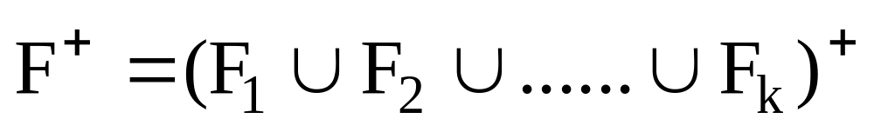
Content of next
FD Preserved (依赖保持)
设关系T上的函数依赖集为F，分解后的子关系T_{i}上的函数依赖集为F_{i}，则：
分解满足依赖保持性的定义如下：
Database Principles & Programming

Slide 21
Content of next
Superkey
  or
X is a superkey of T iff X→Head(T)
X is a superkey of T iff X⁺_{F} = Head(T)
PRIME ATTRIBUTE (主属性)
NON-PRIME ATTRIBUTE (非主属性)
Algorithm to Find Candidate Key
Database Principles & Programming

Slide 22
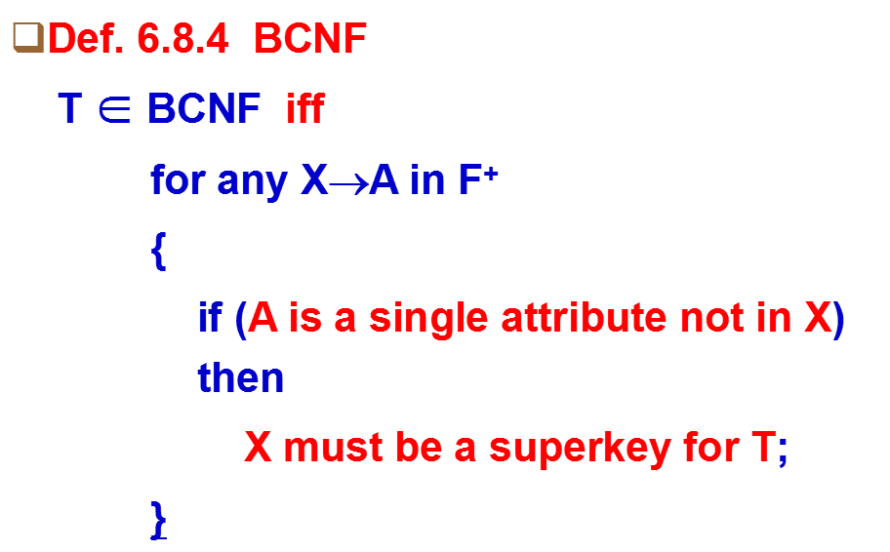
6.8 Normal Forms
Database Principles & Programming

Slide 23
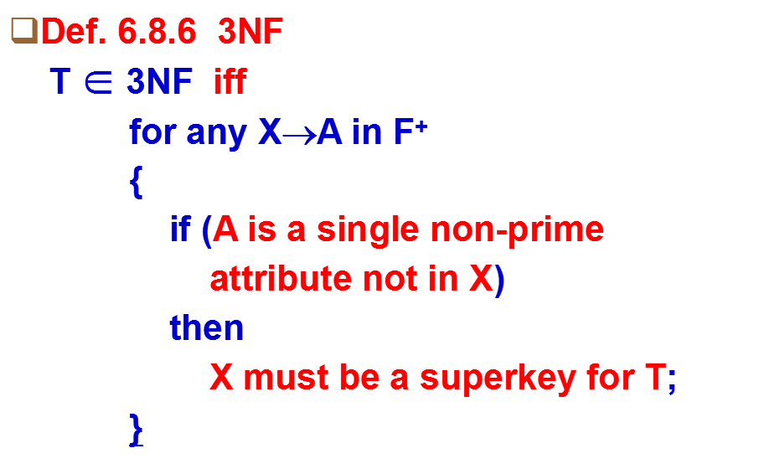
6.8 Normal Forms
Database Principles & Programming

Slide 24
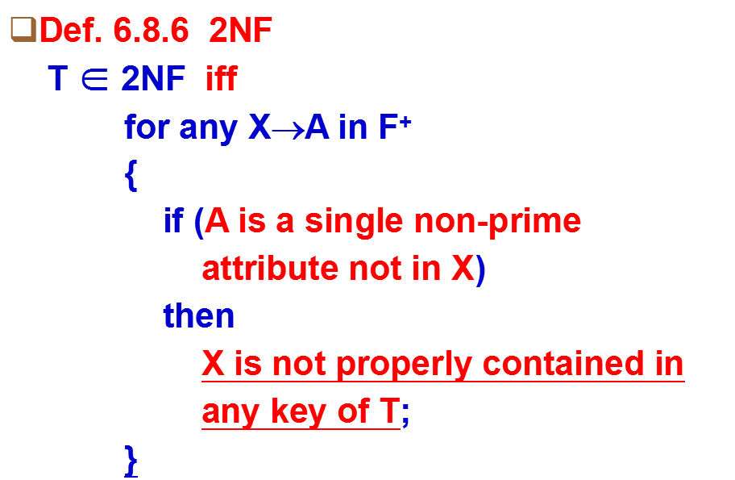
6.8 Normal Forms
Database Principles & Programming

Slide 25
BCNF和3NF定义的对比
BCNF
  for any FD X→A in F⁺ that lies in T (all attributes of X and A in T), if A is a single attribute not in X, then X must be a superkey for T
3NF
  for any FD X→A implied by F that lies in T, if A is a single non-prime attribute not in X, then X must be a superkey for T.
Database Principles & Programming

Slide 26
3NF和2NF定义的对比
3NF
  for any X→A implied by F that lies in T, if A is a single non-prime attribute not in X, then X must be a superkey for T.
2NF
  for any X → A implied by F that lies in T, if A is a single non-prime attribute not in X, then X is not properly contained in any key of T.
Database Principles & Programming

Slide 27
algorithm 6.6.12 Closure of a set of Attributes
  Input: X is a set of attributes, F is a set of FDs
  X⁺ := X;
  repeat {
      oldX⁺ := X⁺;
      for each Y→Z in F {
        if Y⊆ X⁺ then X⁺ := X⁺ ∪ Z;
      }
  } until ( oldX⁺ = X⁺ )
  return X⁺
Database Principles & Programming

Slide 28
step 1: From the set F of FDs, we create an equivalent set H of FDs, with only single attributes on the right side.
step 2: From the set H of FDs, successively remove individual FDs that are inessential in H.
step 3: From the set H of FDs, successively replace individual FDs with FDs that have a smaller number of attributes on the left-hand side, as long as the result does not change H⁺.
step 4: From the remaining set of FDs, gather all FDs with equal left-hand sides and use the union rule to create an equivalent set of FDs M where all left-hand sides are unique.
6.6.13：最小覆盖计算
Database Principles & Programming

Slide 29
An Algorithm to Find Candidate Key
  Given a table T with a set F of FDs
  set K := Head(T) ;
  for each attribute A in K {
      compute (K - A)_{F}⁺ ;
      if (K-A)_{F}⁺ contains all the attributes in T
      then {
        set K := K - { A } ;
      }
    }
  return K;
Database Principles & Programming

Slide 30
关键字的计算（优化）
设有关系模式R，Head(R)是关系R的属性集合，F是关系R上的最小函数依赖集。
根据F中的函数依赖，可以将属性集合Head(R)划分为以下的三个子集：
  只在函数依赖的左边出现过的属性的集合 U_{L} （包括没有出现在任何函数依赖中的属性）
  只在函数依赖的右边出现过的属性的集合 U_{R}
  在两边都出现的属性的集合 U_{A}
其中：
  U_{L} 中的属性是每一个关键字的组成部分
  U_{R} 中的属性不可能出现在任何一个关键字中
  在关键字计算算法中，只需要针对 U_{A} 中的属性进行FOR循环计算就可以了。
优化后的算法如下：

Slide 31
An Algorithm to Find Candidate Key
input: 关系T的属性集合Head(T) 及 U_{R}, U_{A}
最小函数依赖集F
output: 关系T的一个候选关键字
    set K := Head(T) - U_{R} ;
    for each attribute A in U_{A} {
      compute (K - A)_{F}⁺ ;
      if (K-A)_{F}⁺ contains all the attributes in T
      then set K := K - { A } ;
    }
    return K;
Database Principles & Programming

Slide 32
Algorithm 6.8.8
  replace F with minimal cover of F;
  S = Φ;
  for all X→Y in F
      if, for all Z∈S, X ∪ Y ⊈ Z
      then S = S ∪ Heading(X ∪ Y )
    end for
  If, for all candidate keys K for T:
      for all Z∈S, K ⊈ Z
  then choose a candidate key K and set S = S ∪ Heading(K)
Database Principles & Programming

