Slide 1
Chapter 7
Integrity, Views, Security, and Catalogs

Slide 2
from Database Design to Physical Form
  CREATE TABLE
    integrity constraints (完整性约束)
  CREATE VIEW
  Security
    The GRANT & REVOKE statements
  Catalogs
    Schemas
Integrity,Views,Security,and Catalogs

Slide 3
7.1 Integrity Constraints
CREATE TABLE
  Create Table Statement
  Integrity
    Column Constraints
    Table Constraints
  Referential Integrity: Foreign Key
  Trigger
ALTER TABLE
DROP TABLE
Integrity,Views,Security,and Catalogs

Slide 4
Example: CREATE TABLE statement
  CREATE TABLE customers (
      cid char(4) not null,
      cname varchar(13),
      city varchar(20),
      discnt real,
      primary key(cid) );
Integrity Constraints
    cid
      primary key attribute
      min-card is 1
    cname, city, discnt
      min-card is 0, so can enter a tuple with no value
Integrity,Views,Security,and Catalogs

Slide 5
Figure 7.1: Basic SQL Syntax for Create Table
  CREATE TABLE [schema.]table
  (relational_properties);
relational_properties:
{ column datatype [DEFAULT expr]
  [ col_constraint { , col_constraint } ] }
|
[ table_constraint { , table_constraint } ]

Slide 6
Def.7.1.1 Clauses of the Create Table Command (Figure 7.1)
    schema name & table name
    column defintion
    table constraints
column definition:
    column name & data type
    an optional DEFAULT clause
      DEFAULT { default_constant | NULL }
    column constraints (in a single column)
Integrity,Views,Security,and Catalogs

Slide 7
Def.7.1.1 Clauses of the Create Table Command
schema name & table name
column defintion
table constraints
column name & data type
an optional DEFAULT clause
integrity constraint in a single column
integrity constraints in multiple columns
Integrity,Views,Security,and Catalogs

Slide 8
Integrity Constraint (Figure 7.1, pg. 411)
  Integrity Constraints in a single column
NOT NULL |
[CONSTRAINT constraint_name] <constraint>
<constraint> is
UNIQUE
| PRIMARY KEY
| CHECK ( search_condition )
| REFERENCES table_name [ ( column_name ) ]
  [ON DELETE CASCADE|RESTRICT|SET NULL]
  [ON UPDATE CASCADE|RESTRICT|SET NULL]
Integrity,Views,Security,and Catalogs

Slide 9
Integrity Constraints in multiple columns (table constraints)
<table constraints> is
  UNIQUE ( colname { , colname ... } )
  | PRIMARY KEY ( colname { , colname ... } )
  | CHECK ( search_condition )
  | FOREIGN KEY ( colname { , colname ... } )
  REFERENCES tab_name [ (colname {, ...}) ]
  [ON DELETE CASCADE|RESTRICT|SET NULL]
  [ON UPDATE CASCADE|RESTRICT|SET NULL]
Integrity,Views,Security,and Catalogs

Slide 10
Def.7.1.2 Column Constraints
NOT NULL vs. DEFAULT NULL
Constraint name
  optional，we can later drop the constraint with an ALTER TABLE command
UNIQUE vs. NOT NULL
  candidate key: UNIQUE and NOT NULL
不使用DEFAULT定义成分，属性的缺省值为NULL。
NOT NULL和DEFAULT NULL是一对矛盾的定义，不能用于同一个属性的定义。
只有当属性值不是NULL时，UNIQUE才保证其属性值在表中的唯一性。
因此，UNIQUE+NOT NULL才能实现候选关键字的定义。
Integrity,Views,Security,and Catalogs

Slide 11
Def.7.1.2 Column Constraints (cont.)
PRIMARY KEY vs. NOT NULL
PRIMARY KEY定义中自动隐含着NOT NULL约束！
REFERENCES
  FOREIGN KEY vs. PRIMARY KEY
  values of foreign key
  CASCADE | RESTRICT | SET NULL
外关键键的取值必须来自被引用表中的主关键字。
可以在外键的定义中使用ON DELETE或ON UPDATE子句，以便在下述情况下确保外键取值的正确性：当被引用表中的某个元组被删除或者其主关键字值被修改时。
CHECK
可以通过一个逻辑表达式来定义该属性的取值约束！

Slide 12
Def.7.1.3 Table Constraints
  Constraint name
  UNIQUE vs. NOT NULL
    candidate key: UNIQUE and all attributes is NOT NULL
  PRIMARY KEY vs. NOT NULL
  FOREIGN KEY
    FOREIGN KEY vs. PRIMARY KEY
    values of foreign key
    CASCADE | RESTRICT | SET NULL
  CHECK

Slide 13
7.1 Integrity Constraints
Example 7.1.2 (Figure 7.2, pg. 415)
  create table customers (
    cid char(4) not null,
    cname varchar(13),
    city varchar(20),
    discnt real constraint discnt_max
        check(discnt <= 15.0),
    primary key(cid)
  );
Integrity,Views,Security,and Catalogs

Slide 14
7.1 Integrity Constraints
create table orders(
  ordno integer not null,
  month char(3),
  cid char(4) not null,
  aid char(3) not null,
  pid char(3) not null,
  qty integer not null constraint qtyck check( qty >= 0 ),
  dollars float default 0.0 constraint dollarsck check ( dollars >= 0.0 ),
  primary key ( ordno ),
  constraint cidref foreign key (cid) references customers,
  constraint aidref foreign key (aid) references agents,
  constraint pidref foreign key (pid) references products );
dollars float default 0.0
constraint dollarsck
check ( dollars >= 0.0 ),
constraint cidref
foreign key (cid) references customers,
Integrity,Views,Security,and Catalogs

Slide 15
7.1 Integrity Constraints
we can create table orders by following statement
  create table orders (
    ordno integer not null,
    month char (3),
    cid char (4) not null references customers,
    aid char (3) not null references agents,
    pid char (3) not null references products,
    qty integer not null constraint qtyck check ( qty >= 0 ),
    dollars float default 0.0 constraint dollarsck check ( dollars >= 0.0 ),
    primary key (ordno) );
cid char (4) not null references customers,
Integrity,Views,Security,and Catalogs

Slide 16
7.1 Integrity Constraints
Primary Keys, Foreign Keys, and Referential Integrity
ordno | month | cid | ......
1011 | jan | c001 | ......
1019 | feb | c001 | ......
1017 | feb | c001 | ......
1023 | mar | c001 | ......
1022 | mar | c001 | ......
1013 | jan | c002 | ......
1026 | may | c002 | ......
1015 | jan | c003 | ......
1014 | jan | c003 | ......
1021 | feb | c004 | ......
1016 | jan | c006 | ......
1020 | feb | c006 | ......
1024 | mar | c006 | ......
Primary key
cid | cname | city | discnt
c001 | ... | ... | ...
c002 | ... | ... | ...
c003 | ... | ... | ...
c004 | ... | ... | ...
c005 | ... | ... | ...
c006 | ... | ... | ...
Foreign key
Integrity,Views,Security,and Catalogs

Slide 17
7.1 Integrity Constraints
Def.7.1.4 Foreign Key, Referential Integrity
Foreign Key
  A set of columns F in table T1 is defined as a foreign key of T1 if the combination of values of F in any row is required to either contain at least one null value, or else to match the value combination of a set of columns P representing a candidate or primary key of a referenced table T2.
Integrity,Views,Security,and Catalogs

Slide 18
7.1 Integrity Constraints
Referential Integrity
  the columns of F in any row of T1 must either
have null values in at least one column that allows null values, or
have no null values and be equal to the value combination of P on some row of T2.
Integrity,Views,Security,and Catalogs

Slide 19
Example
  primary key: red character
  foreign key: underline
EMPLOYEE ( fname, lname, ssn, address, salary,
        superssn, dno )
DEPARTMENT ( dname, dno, ssn, mgrstartdate )
DEPT_LOCATION ( dno, dcity )
PROJECT ( pname, pno, pcity, dno )
WORKS_ON ( ssn, pno, hours )
DEPENDENT(ssn, dependent-first-name, sex, bdate,
        relationship)
Integrity,Views,Security,and Catalogs

Slide 20
Example of foreign key
EMPLOYEE:
  Emp ( fname, lname, ssn, address, salary, superssn, dno )
DEPARTMENT:
  Dept ( dname, dno, ssn, mgrstartdate )
  CREATE TABLE Dept (
    dno char(4) PRIMARY KEY, ……);
  CREATE TABLE Emp (
    ssn char(8) PRIMARY KEY,
    dno char(4) REFERENCES Dept,
    ……);
在对Emp表进行数据的增、删、改操作时，保证外键dno的引用完整性。
Integrity,Views,Security,and Catalogs

Slide 21
Example of foreign key
但在对Dept表进行数据的增、删、改操作时，不能保证Emp表中外键dno的正确性。
  CREATE TABLE Emp (
    ssn char(8) PRIMARY KEY,
    dno char(4) REFERENCES Dept,
    ……);
  CREATE TABLE Emp (
    ssn char(8) PRIMARY KEY,
    dno char(4)
    REFERENCES Dept ON DELETE RESTRICT,
    ……);
如果某部门中有职工，那么将不允许在Dept表中删除该部门元组，从而保证了Emp表中外键dno的引用完整性。
Integrity,Views,Security,and Catalogs

Slide 22
Example of foreign key
  CREATE TABLE Emp (
    ssn char(8) PRIMARY KEY,
    dno char(4) REFERENCES Dept,
    ……);
  CREATE TABLE Emp (
    ssn char(8) PRIMARY KEY,
    dno char(4)
    REFERENCES Dept ON DELETE CASCADE,
    ……);
如果某部门中有职工，那么在Dept表中删除该部门元组的同时，将从Emp表中删除该部门的所有职工。
Integrity,Views,Security,and Catalogs

Slide 23
Example of foreign key
  CREATE TABLE Emp (
    ssn char(8) PRIMARY KEY,
    dno char(4) REFERENCES Dept,
    ……);
  CREATE TABLE Emp (
    ssn char(8) PRIMARY KEY,
    dno char(4)
    REFERENCES Dept ON DELETE SET NULL,
    ……);
如果某部门中有职工，那么在Dept表中删除该部门元组的同时，在Emp表中将该部门所有职工的dno置为NULL。
Integrity,Views,Security,and Catalogs

Slide 24
Foreign Key Constraints: Product Variations
(Figure 7.6)
 | ORACLE INFORMIX | DB2 UDB | X/Open Full SQL-99
ON DELETE ... | CASCADE SET NULL | NO ACTION CASCADE SET NULL RESTRICT | NO ACTION CASCADE SET NULL SET DEFAULT RESTRICT
Without ON DELETE | NO ACTION effect | NO ACTION effect | NO ACTION effect
Integrity,Views,Security,and Catalogs

Slide 25
7.1 Integrity Constraints
The Alter Table Statement
  change the table structure & integrity constraints
  Figure 7.7 ~ 7.9 (pg. 423)
    column
      Add
      Drop
      Modify
    constraints
      Add
      Drop
Integrity,Views,Security,and Catalogs

Slide 26
7.1 Integrity Constraints
Database Trigger
A database trigger is procedural code that is automatically executed in response to certain events on a particular table or view in a database.
The trigger is mostly used for maintaining the integrity of the information on the database. For example, when a new record (a new worker) is added to the employees table, new records should also be created in the tables of the taxes, vacations and salaries.

Slide 27
7.1 Integrity Constraints
Trigger (Figure 7.10, pg. 425) (触发器)
CREATE TRIGGER trigger_name { BEFORE|AFTER }
  { INSERT | DELETE
  | UPDATE [ OF colname { , colname ... } ] }
  ON table_name
  [ REFERENCING corr_name_def { , ...... } ]
  [ FOR EACH ROW | FOR EACH STATEMENT ]
    [ WHEN ( search_condition ) ]
    { statement
    | BEGIN ATOMIC statement; { ... } END
Integrity,Views,Security,and Catalogs

Slide 28
7.1 Integrity Constraints
The corr_name_def that defines a correlation name follows:
  { OLD [ ROW ] [ AS ] old_row_corr_name
    | NEW [ ROW ] [ AS ] new_row_corr_name
    | OLD TABLE [ AS ] old_table_corr_name
    | NEW TABLE [ AS ] new_table_corr_name }
Integrity,Views,Security,and Catalogs

Slide 29
CREATE TRIGGER trigger_name { BEFORE | AFTER }
  { INSERT | DELETE
  | UPDATE [ OF colname { , colname ... } ] }
  ON table_name
  [ REFERENCING corr_name_def { , ...... } ]
  [ FOR EACH ROW | FOR EACH STATEMENT ]
  [ WHEN ( search_condition ) ]
    { statement
    | BEGIN ATOMIC statement; { statement; ... } END
触发事件
触发方式
结果事件

Slide 30
four types of triggers
For Each Row Type
  This trigger gets executed once for each row of the result set affected by an insert/update/delete
  before/after
For Each Statement Type
  This trigger gets executed only once for the entire result set, but fires each time the statement is executed.
  before/after

Slide 31
Example 7.1.5
  Use a trigger to CHECK that the discnt value of a new customers row does not exceed 15.0.
create trigger discnt_max
  after insert on customers
  referencing new as x
  for each row when ( x.discnt > 15.0 )
  begin
    raise_application_error(-20003, “invalid discount attempted on insert”);
  end;
Integrity,Views,Security,and Catalogs

Slide 32
Example 7.1.6: 删除一个客户元组时，需要将该客户所有订单上的cid置为空值(set null)
create trigger foreign_cid
  after delete on customers
  referencing old as old_custom
  for each row
  begin
    update orders
      set cid = null
      where cid = :old_custom.cid ;
  end;
Integrity,Views,Security,and Catalogs

Slide 33
7.2 Creating Views
View
  idea ?
    The data retrieved by any SQL SELECT statement is in the form of a table.
    We want to use this TABLE in FROM clause of other Select statement.
  Method？
    Subquery in the FROM clause (Fig 3.11)
    Creating Views
Integrity,Views,Security,and Catalogs

Slide 34
7.2 Creating Views
View Table ( or View )
  Definition
    It is a table that results from a subquery, but which has its own name (table name & attributes name)
    It can be used in most ways as a Base Table created by SQL CREATE TABLE statement
Integrity,Views,Security,and Catalogs

Slide 35
7.2 Creating Views
View Table ( or View )
  Property
    no data storage in its own right, just window on data it selects from
    so, it is regarded as a Virtual Table
  Weakness
    limits to View Updates
Integrity,Views,Security,and Catalogs

Slide 36
Create View statement (Figure 7.13, pg. 434)
  CREATE VIEW view_name [(col_name {, …...})]
    AS subquery
    [ WITH CHECK OPTION ]
  List of column names
    Can leave out list of colnames if
      target list (Select clause) of subquery has colnames that require no qualifiers.
    Need to give names for expressions or for ambiguous colnames.
    Can rename column in any way at all.
Integrity,Views,Security,and Catalogs

Slide 37
Create View statement (cont.)
  CREATE VIEW view_name [(col_name {, …...})]
    AS subquery
    [ WITH CHECK OPTION ]
  subquery (Figure 3.1)
    no ORDER BY clause
  WITH CHECK OPTION
    will not permit an update or insert through a updatable view if they result in rows that would be invisible to the view Subquery.
Integrity,Views,Security,and Catalogs

Slide 38
Create View statement (cont.)
  CREATE VIEW view_name [(col_name {, …...})]
    AS subquery
    [ WITH CHECK OPTION ]
Nested View definition
  create a view based on other views
Integrity,Views,Security,and Catalogs

Slide 39
7.2 Creating Views
  CREATE VIEW view_name [(col_name {, …...})]
    AS subquery
    [ WITH CHECK OPTION ]
Executing of Create View statement
  The definition of the view is placed in the system catalogs as a distinct object of the database.
  No data is retrieved or stored.
Integrity,Views,Security,and Catalogs

Slide 40
7.2 Creating Views
  CREATE VIEW view_name [(col_name {, …...})]
    AS subquery
    [ WITH CHECK OPTION ]
Operations through Views
  query modification
    A query or update statement that accesses a view can be modified.
    So that the modified query or update actually performs accesses on base tables.
Integrity,Views,Security,and Catalogs

Slide 41
7.2 Creating Views
Privileges on Views
  The user creating the view becomes the owner of the view
  The owner is given update privileges on the view, assume:
    the view is updatable
    the user has the needed update privileges on the base table on which the view is defined.
Integrity,Views,Security,and Catalogs

Slide 42
7.2 Creating Views
Example 7.2.1 Create View
CREATE VIEW agentorders (ordno, month, cid, aid,
    pid, qty, charge, aname, acity, percent)
  AS SELECT o.ordno, o.month, o.cid, o.aid, o.pid,
      o.qty, o.dollars, a.aname, a.city, a.percent
    FROM orders o, agents a
    WHERE o.aid = a.aid;
Integrity,Views,Security,and Catalogs

Slide 43
7.2 Creating Views
CREATE VIEW agentorders (ordno, month, cid, aid,
    pid, qty, charge, aname, acity, percent)
  AS SELECT o.ordno, o.month, o.cid, o.aid, o.pid,
      o.qty, o.dollars, a.aname, a.city, a.percent
    FROM orders o, agents a
    WHERE o.aid = a.aid;
Example 7.2.2 Query on View
    SELECT sum (charge)
    FROM agentorders
    WHERE acity = 'Toledo';
Integrity,Views,Security,and Catalogs

Slide 44
7.2 Creating Views
Example 7.2.2 (cont.) Query Modification
  SELECT sum (charge)
  FROM agentorders
  WHERE acity = 'Toledo';
  SELECT sum(o.dollars)
  FROM orders o, agents a
  WHERE o.aid = a.aid and a.city = 'Toledo';
Integrity,Views,Security,and Catalogs

Slide 45
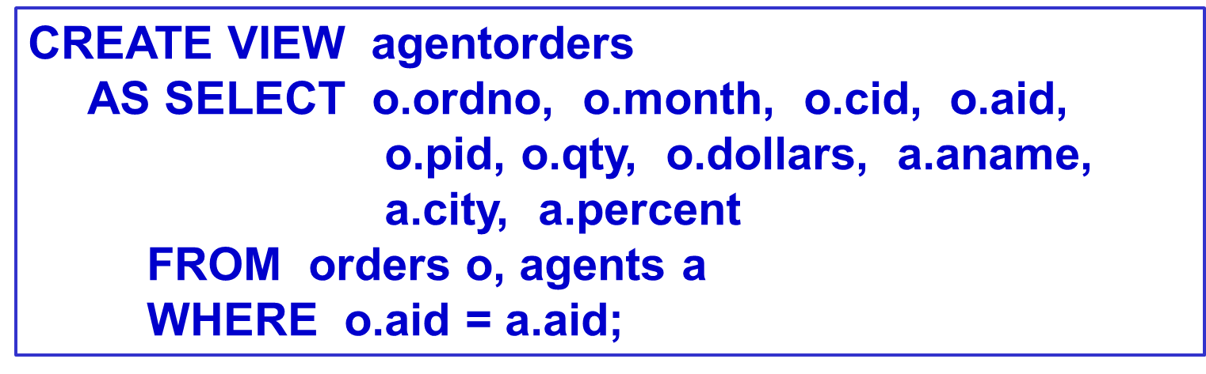
CREATE VIEW agentorders (ordno, month, cid, aid,
    pid, qty, charge, aname, acity, percent)
  AS SELECT o.ordno, o.month, o.cid, o.aid, o.pid,
      o.qty, o.dollars, a.aname, a.city, a.percent
    FROM orders o, agents a
    WHERE o.aid = a.aid;
Example: Agentorders view can be created by following statement.
Integrity,Views,Security,and Catalogs

Slide 46
Example 7.2.3: illegal view definition
CREATE VIEW cacities AS
  SELECT c.city, a.city
    FROM customers c, agents a, orders o
    WHERE c.cid = o.cid and a.aid = o.aid;
  legal view definition
CREATE VIEW cacities ( ccity, acity ) AS
  SELECT c.city, a.city
  FROM customers c, agents a, orders o
  WHERE c.cid = o.cid and a.aid = o.aid;
Integrity,Views,Security,and Catalogs

Slide 47
Exp 7.2.4 Create Views with ‘WITH CHECK OPTION’
Assume: No CHECK clause on discnt of customers
    CREATE VIEW custs AS
        SELECT *
        FROM customers
        WHERE discnt <= 15.0
        WITH CHECK OPTION;
Now cannot insert/update a row into custs with discnt > 15.0:
    This insert will fails.
insert into custs values(‘c009’, ‘AM’, ‘Kyoto’, 16.0);
Integrity,Views,Security,and Catalogs

Slide 48
Consider the update:
  update custs set discnt = discnt + 4.0;
  This update fails for customer c002 on the basis of the values of Figure 2.2
cid
cname
city
discnt
c001
TipTop
Duluth
10.00
c002
Basics
Dallas
12.00
c003
Allied
Dallas
8.00
c004
ACME
Duluth
8.00
c006
ACME
Kyoto
0.00
Note, this insert and update statement can execute on the base table customers.
Integrity,Views,Security,and Catalogs

Slide 49
7.2 Creating Views
Example 7.2.5 Nested Views
CREATE VIEW acorders (ordno, month, cid, aid,
    pid, qty, dollars, aname, cname)
  AS SELECT ao.ordno, ao.month, ao.cid, ao.aid,
      ao.pid, ao.qty, ao.charge, ao.aname, c.cname
    FROM agentorders ao, customers c
    WHERE ao.cid = c.cid;
Integrity,Views,Security,and Catalogs

Slide 50
7.2 Creating Views
Listing Defined Views
  In ORACLE
    select view_name from user_views;
    DESCRIBE { view_name | table_name };
Dropping Tables and Views
  When a view table is dropped, no rows are dropped.
DROP { TABLE table_name | VIEW view_name }
    { CASCADE | RESTRICT };
Integrity,Views,Security,and Catalogs

Slide 51
7.2 Creating Views
Updatable and Read-Only Views
  The problem
    How do we translate updates on the View into changes on the base tables?
  Figure 7.15 (next slide)
    Restrictions on the Subquery Clause for an Updatable View
Integrity,Views,Security,and Catalogs

Slide 52
A view table is said to be updatable when the following conditions hold for its Subquery clause.
The FROM clause of the Subquery must contain only a single table, and if that table is a view table it must also be an updatable view table.
Neither the GROUP BY nor HAVING clause is present.
The DISTINCT keyword is not specified.
The WHERE clause does not contain a Subquery that references any table in the FROM clause, directly or indirectly via views.
All result columns of the Subquery are simple column names: no expressions, no column name appears more than once.
Integrity,Views,Security,and Catalogs

Slide 53
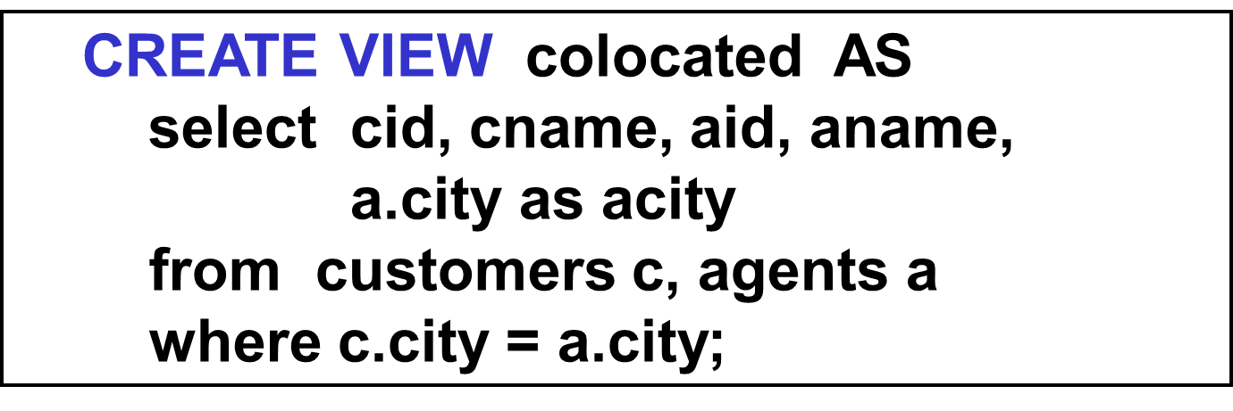
7.2 Creating Views
Example 7.2.6, 7.2.7 (read-only)
CREATE VIEW agentsales (aid, totsales)
  AS select aid, sum(dollars)
      from orders
      group by aid;
Integrity,Views,Security,and Catalogs

Slide 54
7.2 Creating Views
Updatable Views in ORACLE
  can update join views if
    join is N-1 (many-to-one), and
    columns of the view contains the primary key of the table on N side
Integrity,Views,Security,and Catalogs

Slide 55
example 7.2.1:
the view contains the primary key of the table on N side (orders)
CREATE VIEW agentorders (ordno, month, cid, aid,
    pid, qty, charge, aname, acity, percent)
AS SELECT o.ordno, o.month, o.cid, o.aid, o.pid,
    o.qty, o.dollars, a.aname, a.city, a.percent
  FROM orders o, agents a
  WHERE o.aid = a.aid;
join is many to one (orders to agents)
Integrity,Views,Security,and Catalogs

Slide 56
example 7.2.1:
CREATE VIEW agentorders (ordno, month, cid, aid,
    pid, qty, charge, aname, acity, percent)
AS SELECT o.ordno, o.month, o.cid, o.aid, o.pid,
    o.qty, o.dollars, a.aname, a.city, a.percent
  FROM orders o, agents a
  WHERE o.aid = a.aid;
we can only update the columns that map one-to-one with the orders table ( on N side )
not the aname, acity, or percent columns ( on 1 side ), and also not the aid column
Integrity,Views,Security,and Catalogs

Slide 57
7.2 Creating Views
  Display updatable column of this view
    select column_name, updatable
    from user_updatable_columns
    where table_name = ‘AGENTORDERS’
Integrity,Views,Security,and Catalogs

Slide 58
7.2 Creating Views
The Value of Views
  Views provide a way to make complex, commonly issued queries easier to compose.
  Views allow obsolete tables, and programs that reference them, to survive reorganization.
    program-data independence (数据独立性)
  Views add a security aspect to allow different users to see the same data in different ways.
Integrity,Views,Security,and Catalogs

Slide 59
7.3 Security
The Grant Statement in SQL
GRANT {ALL PRIVILEGES|privilege {, privilege … }}
  ON [ TABLE ] tablename | viewname
  TO { PUBLIC | user-name { , user-name … } }
  [ WITH GRANT OPTION ]
  used by the owner of a table
    the owner of a table has ALL PRIVILEGES on the table.
    other user can not access the table if it does not have the PRIVILEGES on the table.
  column privileges can be implemented through views.

Slide 60
The Grant Statement in SQL (cont.)
  privileges
    SELECT, DELETE, INSERT
    UPDATE [ col_name {, col_name ...} ]
    REFERENCES [ col_name {, col_name ...} ]
  PUBLIC
  WITH GRANT OPTION
GRANT {ALL PRIVILEGES|privilege {, privilege …}}
  ON [ TABLE ] tablename | viewname
  TO { PUBLIC | user-name { , user-name … } }
  [ WITH GRANT OPTION ]
Integrity,Views,Security,and Catalogs

Slide 61
Example 7.3.1, 7.3.2
  grant select on customers to eoneil;
  grant select, update, insert on orders to eoneil;
  grant all privileges on products to eoneil;
Example 7.3.3
  create view custview as
    select cid, cname, city from customers;
  grant select, delete, insert,
        update(cname, city) on custview
    to eoneil;
The user eoneil does not need these privileges on the base table customres.
Integrity,Views,Security,and Catalogs

Slide 62
7.3 Security
The SQL statement to revoke privileges
  revoke privileges earlier granted to a user.
REVOKE { ALL PRIVILEGES
        | privilege {, privilege …} }
  ON tablename | viewname
  FROM { PUBLIC | user-name {, user-name … }}
  { CASCADE | RESTRICT }
Integrity,Views,Security,and Catalogs

Slide 63
7.4 System Catalogs and Schemas
Idea
  data dictionary
    all objects created by SQL commands are listed as objects in tables maintained by the system.
  DBA visiting another site would look at catalog tables (meta-data) to find out
    what tables exist
    what columns in them
    ......
Integrity,Views,Security,and Catalogs

Slide 64
7.4 System Catalogs and Schemas
schema (模式)
  A schema is a collection of database objects (used by a user).
  Schema objects are the logical structures that directly refer to the database’s data.
user & schema
  A user is a name defined in the database that can connect to and access objects.
  Schemas and users help database administrators manage database security.
Integrity,Views,Security,and Catalogs

Slide 65
7.4 System Catalogs and Schemas
Schemas
Database
......
Schema A
Schema B
Schema C
Tables ...
Views ...
Columns ...
Indexs ...
.....
Integrity,Views,Security,and Catalogs

Slide 66




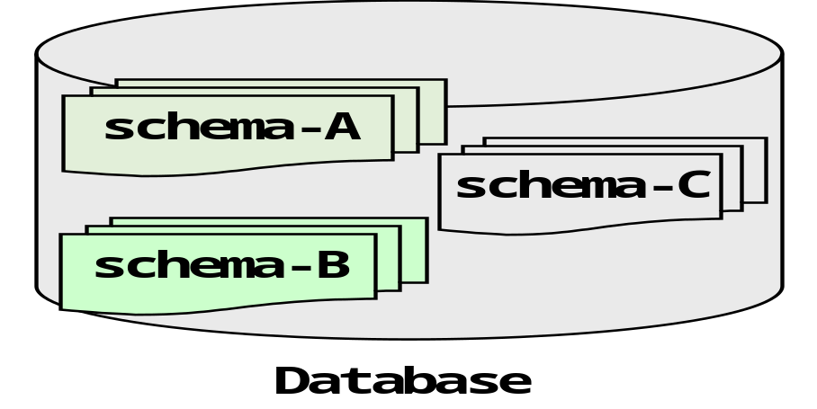
Architecture of Database System
End Users
数据库应用
DBAs
Internet/Intranet
Database Management System
数据库服务器
Database Principles & Programming

Slide 67
7.4 System Catalogs and Schemas
Oracle & schema
  一个用户对应一个schema
  在Oracle数据库中，在创建一个用户的同时为这个用户自动创建一个与用户名同名的schem并作为该用户的缺省shcema
  一个用户访问一个表时，如果没有指明该表属于哪一个schema，系统就会自动在表上加上缺省的sheman名。
  当一个用户想访问另外一个用户(即另外一个schema)下的表的时候，可以用 schemaname.tablename的形式来访问
Integrity,Views,Security,and Catalogs

