Slide 1
Exploring the Efficacy of Different Discursive Strategies of Marketing
of Bilibili Food Vloggers
Group3
November 2026

Slide 2












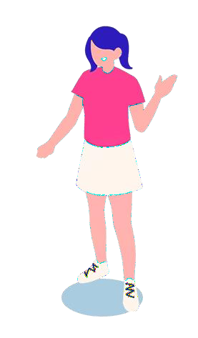












Background
This digital era has been witnessing the continuous use of the influence of various vloggers among which food vloggers might be considered as one of the most prominent groups.
According to a survey, over 70% of consumers said they would refer to food vloggers' recommendations when choosing a restaurant or food.
……

Slide 3


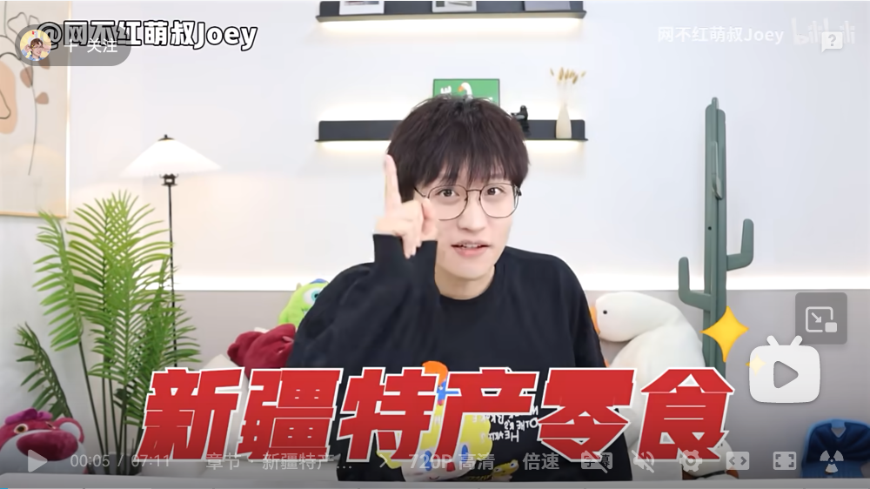
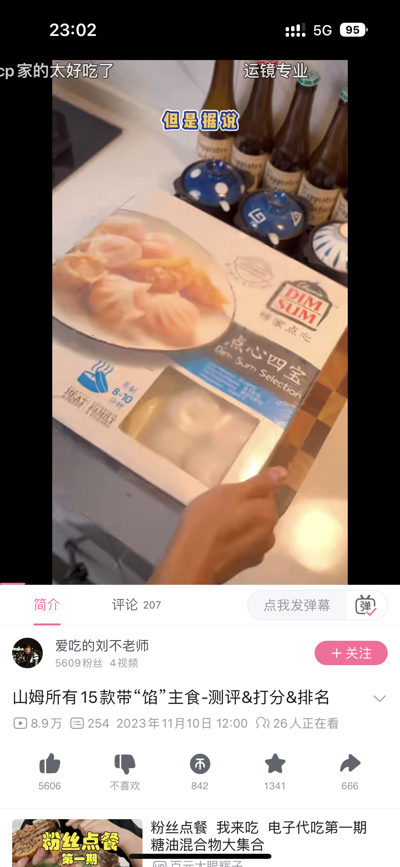

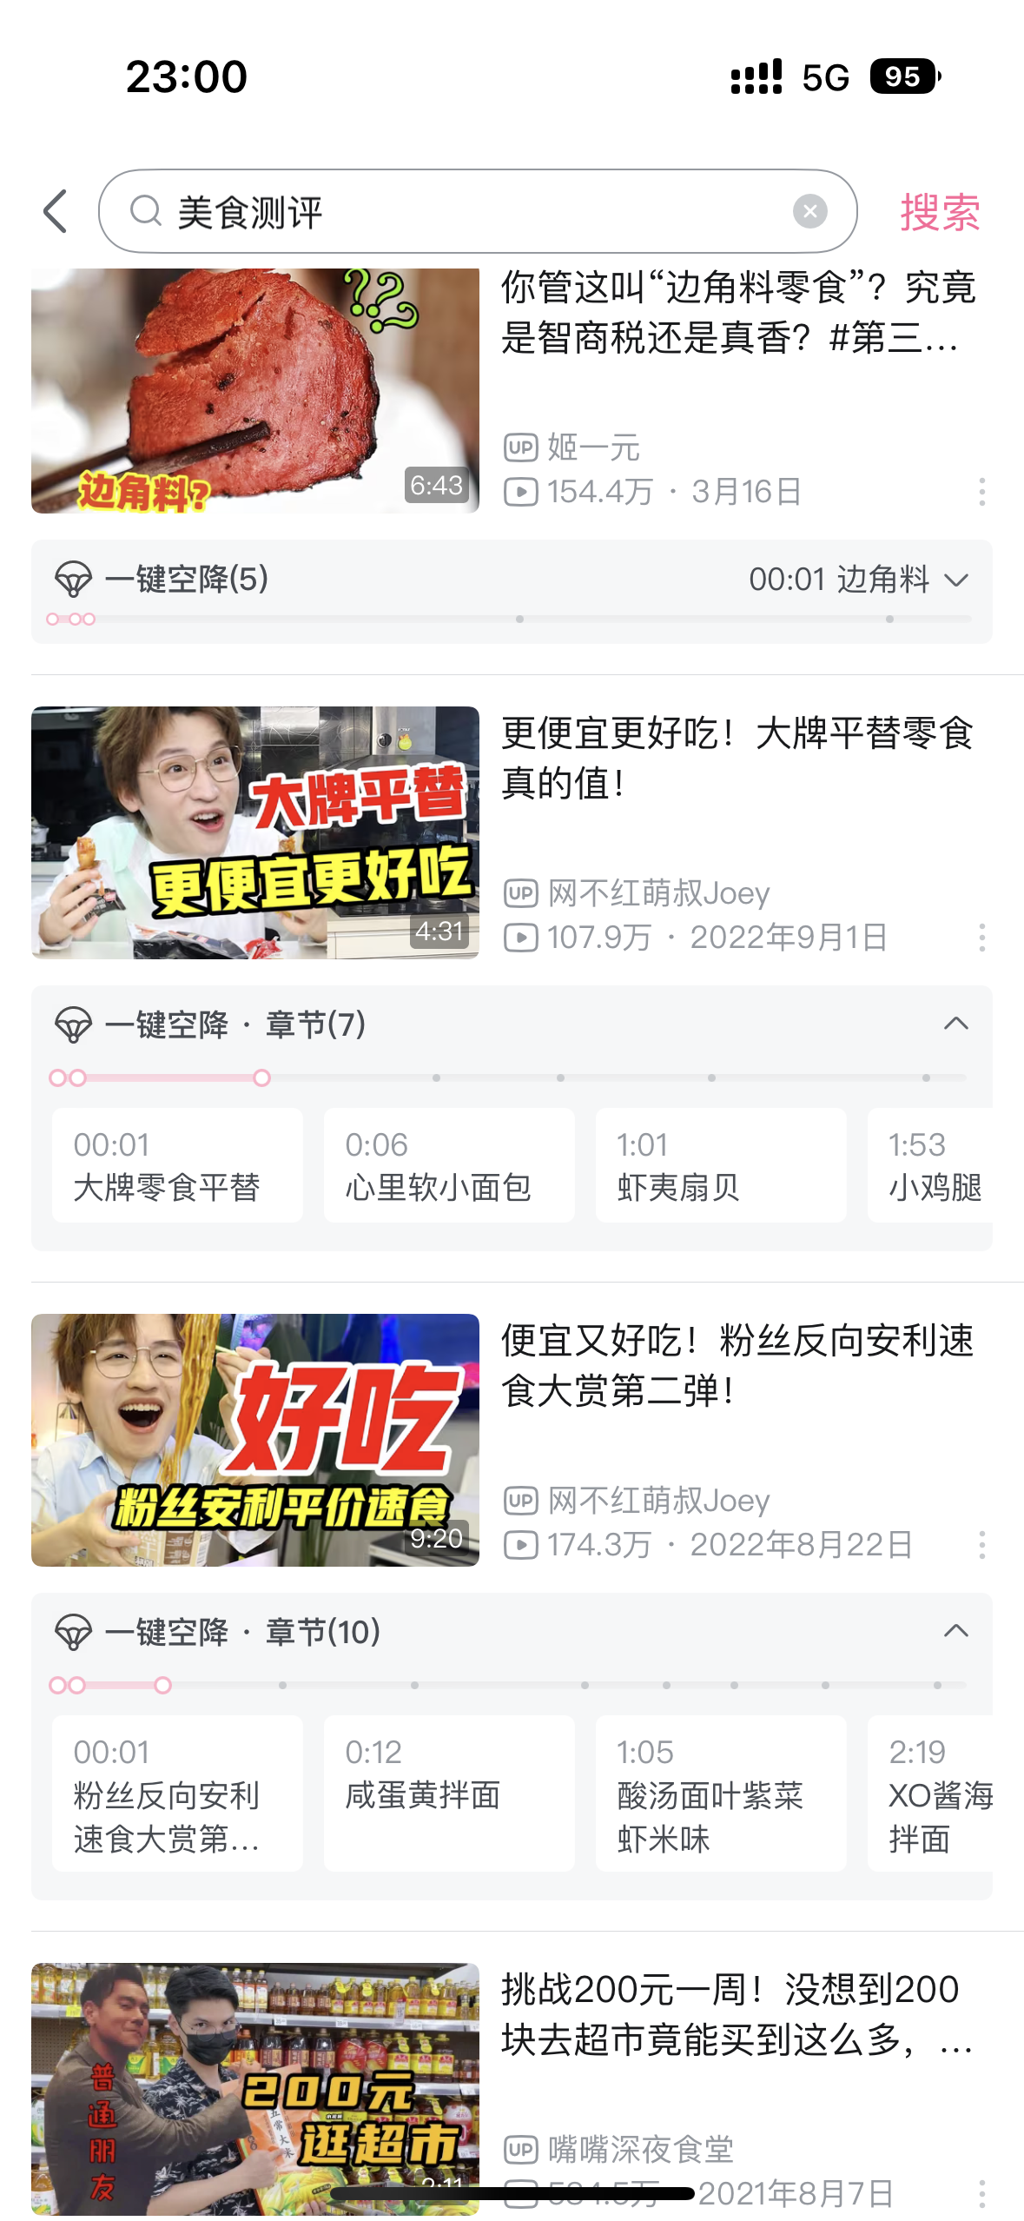



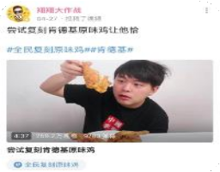
Bilibili has become a popular platform for many young people to share their food experience and feelings

Slide 4


Classification of Discursive Strategies
1
2
The organizational strategies of discourse
Questioning-based traffic generation
Background Insertion
Result Reproduction
Representational strategies of discourse
Rhetoric
Emotional Resonance
Multiple Interaction

Slide 5
The organizational strategies of discourse

Slide 6
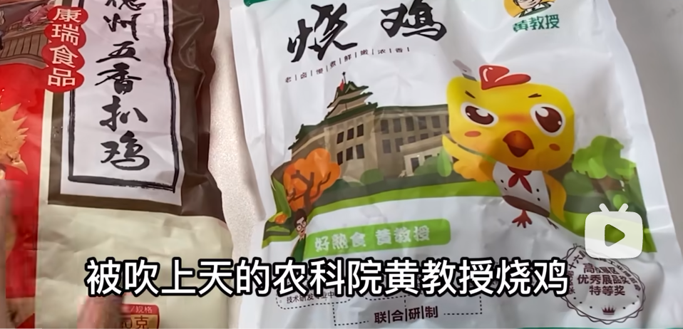
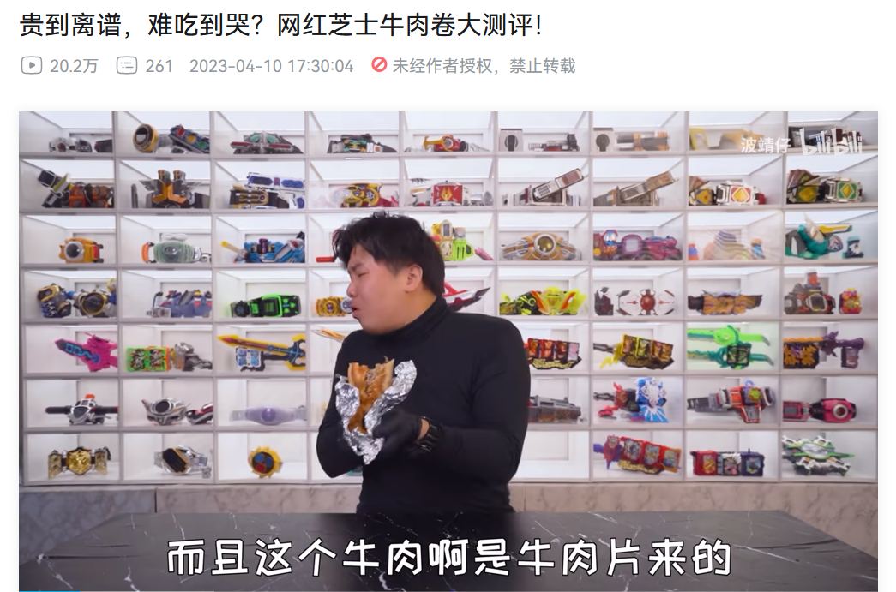
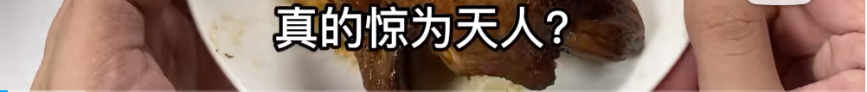
Question-based Traffic Generation
The utilization of inquisitive statements or questions to attract the attention and interest of target audiences with the purpose of increasing traffic.
Definition:
在下吃货小白：被吹上天的农科院黄教授烧鸡，真能吊打拼多多6.9的烧鸡吗?!
破产一哥呢：贵到离谱，难吃到哭？网红芝士牛肉卷大测评！
10

Slide 7

Question-based Traffic Generation
Vloggers with large fan base tend to use questioning in titles to gain more views for them, as this approach is not only simple but eye-catching.
94
7

Slide 8
Question-based Traffic Generation
Placing a background is necessary in the minds of most vloggers.
Compared to background insertion, the number of result reproduction is significantly reduced, only 71 times, which indicts a lack of integrity in some food evaluation videos in terms of organizational structure.
94
7

Slide 9




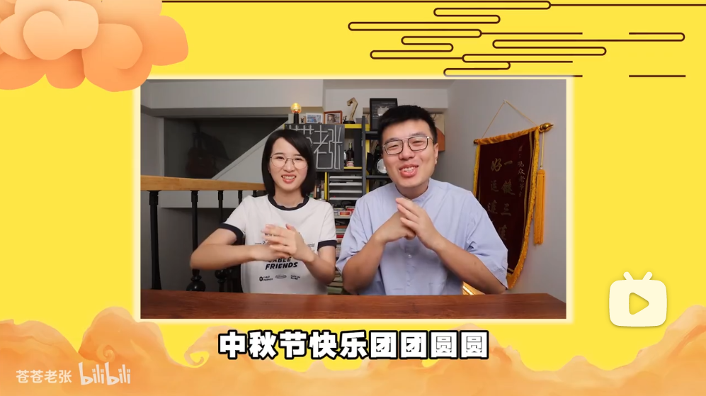
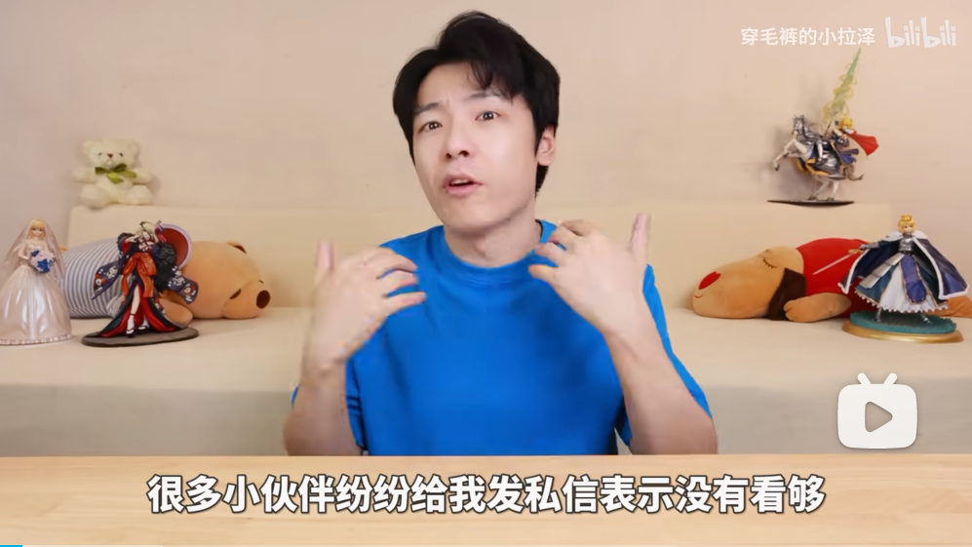
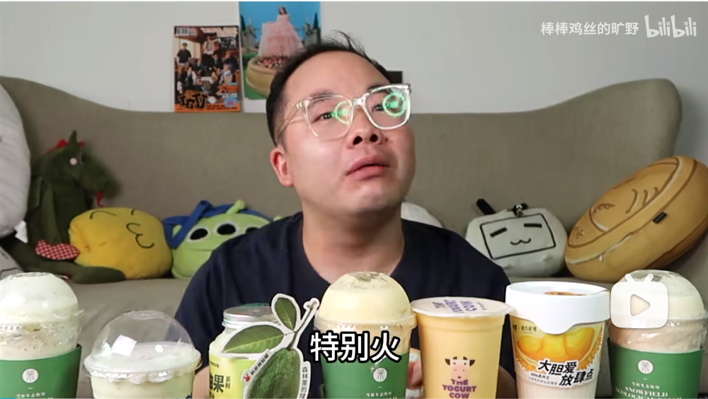
Background Insertion
Definition:
The so-called background insertion refers to the vlogger introducing a background at the beginning of the video before the evaluation begins, in order to explain the purpose of this video and lay the groundwork for the evaluation.
Adapt to the season
Comply with the requirements
Follow the trend

Slide 10
Result Reproduction
Result reproduction refers to the vlogger summarizing the evaluation content and results of this video at the end of the evaluation.
Definition:
Tip: Focus on how to attract potential viewers to click videos and be interested in finishing watching them, as well as give the result reproduction and help them do their purchases.
For example: “今天吃下来我比较推荐…”，“今天的红榜有…，黑榜有…"and so on.
Finding: Placing importance on the integrity of video structure has a certain impact on improving the quality and effectiveness of videos, but is not the decisive factor either.
10

Slide 11
The representional strategies of discourse

Slide 12
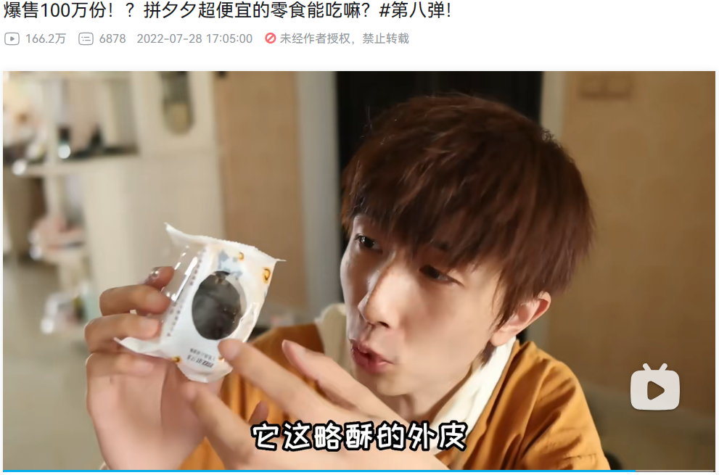
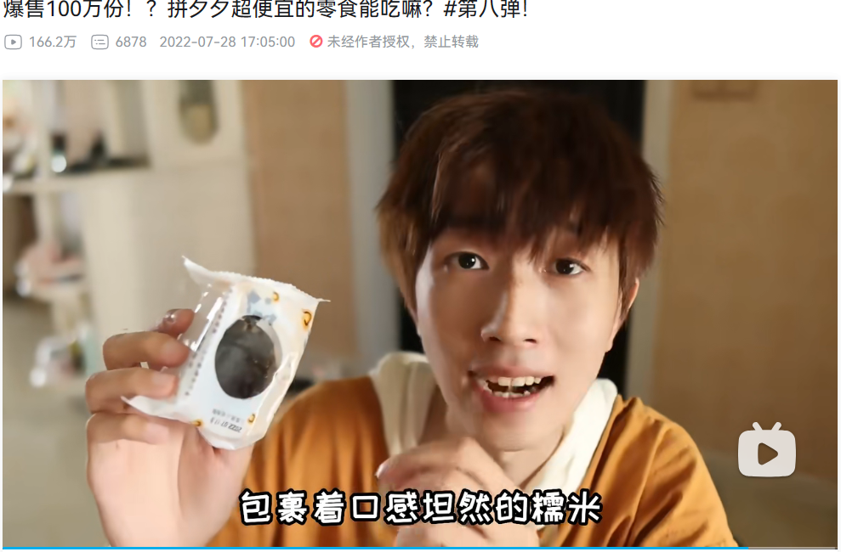
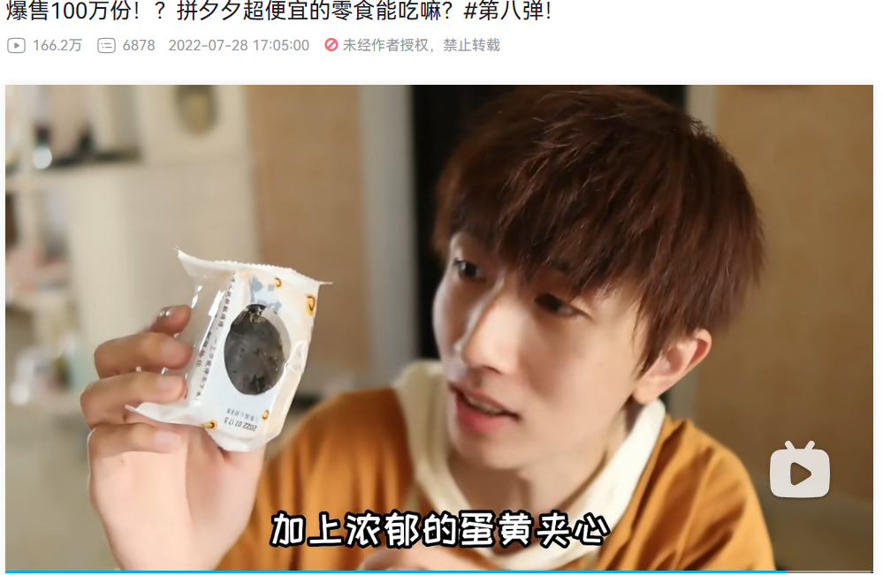
Description
Vividly portray the physical appearance and taste of the food.
Definition:
（1）姬一元：“略酥的外皮包裹着口感坦然的糯米，加上浓郁的蛋黄夹心”
（2）大胖和软软：“不甜不腻的很香的黄豆粉包裹着很有嚼劲的薄薄的面包，咬进去以后有很轻很轻的鲜奶油，鲜奶油下面有一层新鲜的红豆沙，红豆沙下面有一层麻薯”
（3）洋仔开箱a：“麻薯特别弹，外面就是饼干粉，吃起来黄油味道很足，不是很甜。蛋糕很凉，入口即化，奶香味很足，但吃起来不够细腻，入口的感觉不够绵密”

Slide 13
Description
Out of the 180 videos, 160 of them employed description
Widely used in culinary video reviews
Figure 7. Number of Videos on the Use of Rhetorical Devices in Food Evaluation on Bilibili

Slide 14
Description
11 are million fan vloggers
32 out of 33 videos employed analogy, accounting for approximately 96.97% .
Figure 8. The Usage Rate of Description in Videos of Million-followervloggers on Bilibili
Its frequency accounted for 59.23% of the total usage of rhetorical devices.
Figure 9. The Proportion of Rhetorical Devices Used by Million-followervloggers on Bilibili

Slide 15
Description
49 are less than one million fans vloggers
Vloggers with over one million followers are more aware of the significance of Description
Do not rely on them excessively like vloggers with fewer than one million followers
128 out of 147 videos employed analogy, accounting for approximately 87.07% .
Figure 10. Usage Rate of Video Description Rhetoric of Sub-million-follower Vloggers on
Its frequency accounted for 73.64% of the total usage of rhetorical devices.
Figure 11. Proportion of Rhetorical Devices Used by Sub-million-follower Vloggers on Bilibili

Slide 16
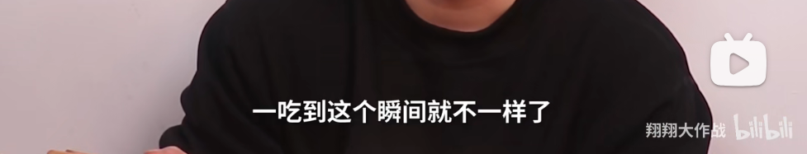
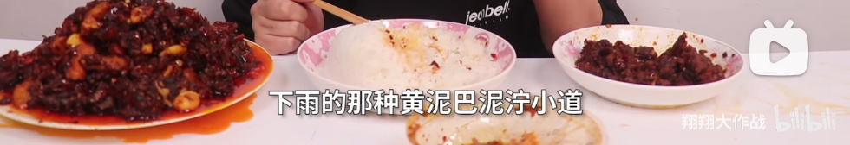

Analogy
Compare a concept or object with another concept or object through metaphor.
Definition:
（1）翔翔大作战：“一吃到这个瞬间就不一样了，就你刚刚走在下雨的那种黄泥巴泥泞小道，现在就已经开上八车道了”
（2）女胖胖：“这个才是真正的高配元素周期表吧；吃到嘴里跟和稀泥一样”
（3）小小就酱吃：“你们感受到那个拉伸时候那种撕拉了吗？你们摸过那种脸特别软的女孩子的脸吗，就是它一拉会弹起来然后duang就回去，这个就是那种感受”

Slide 17
Analogy
Out of the 180 videos, 70 of them employed analogy
The use of analogy is quite common
Figure 7. Number of Videos on the Use of Rhetorical Devices in Food Evaluation on Bilibili

Slide 18
Analogy
11 are million fan vloggers
21 out of 33 videos employed analogy, accounting for approximately 63.64% .
Vloggers with relatively larger followers tend to utilize analogy
A certain level of popularity and feasibility
Figure 12.The Proportion of Analogy Usage frequency among Million-follower Vloggers on Bilibili
49 are less than one million fans vloggers
49 out of 147 videos utilized analogy, making up approximately 33.33%
Figure 13.The proportion of Analogy Usage Frequency of Sub-million-follower Vloggers on Bilibili

Slide 19
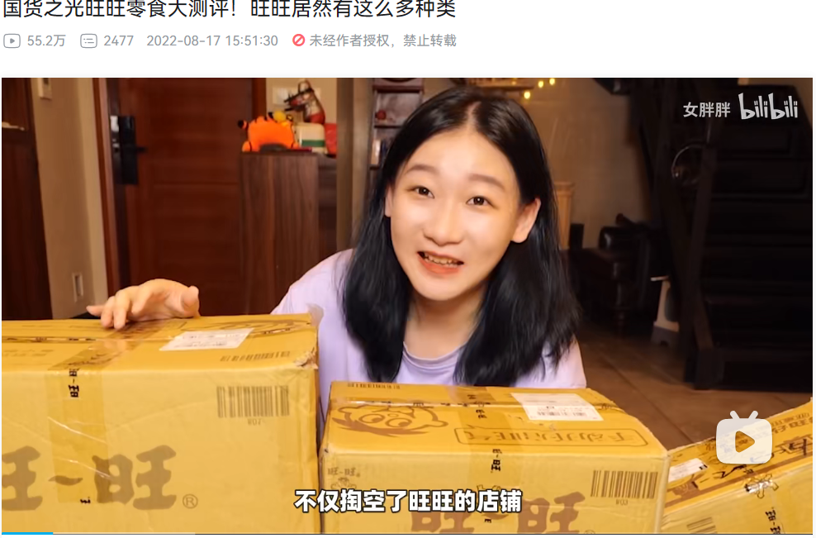
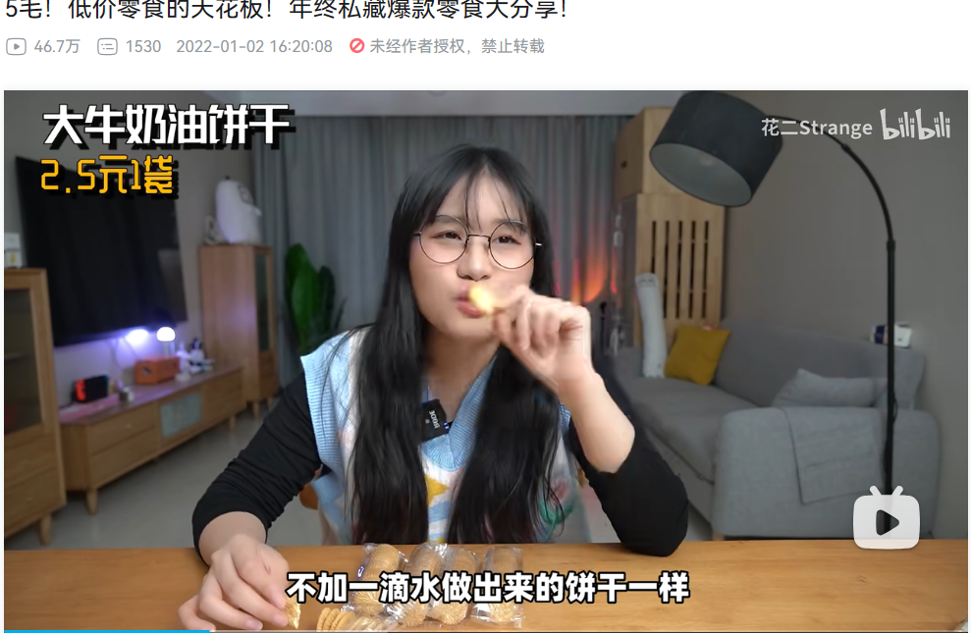
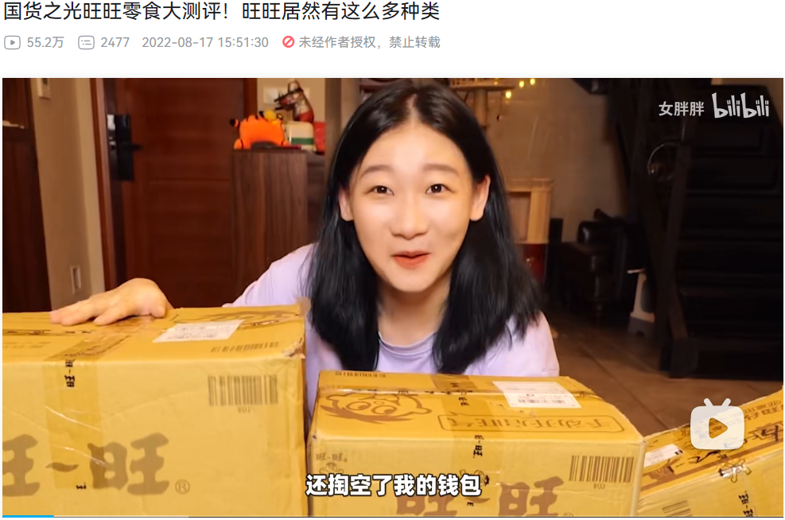
Hyperbole
Involve amplifying or magnifying certain features, emotions, or plotlines in expression.
Definition:
女胖胖：“不仅掏空了旺旺的店铺，还掏空了我的钱包”
花二Strange：“就好像是不加一滴水做出的饼干”

Slide 20
Hyperbole
Relatively less common
Figure 14. Proportion of Rhetorical Devices Used in Food Evaluation Videos
66 out of 829 instances of rhetorical devices used hyperbole, accounting for 7.96%.
Figure 7. Number of Videos on the Use of Rhetorical Devices in Food Evaluation on Bilibili
Out of the 180 videos, 42 of them employed hyperbole

Slide 21
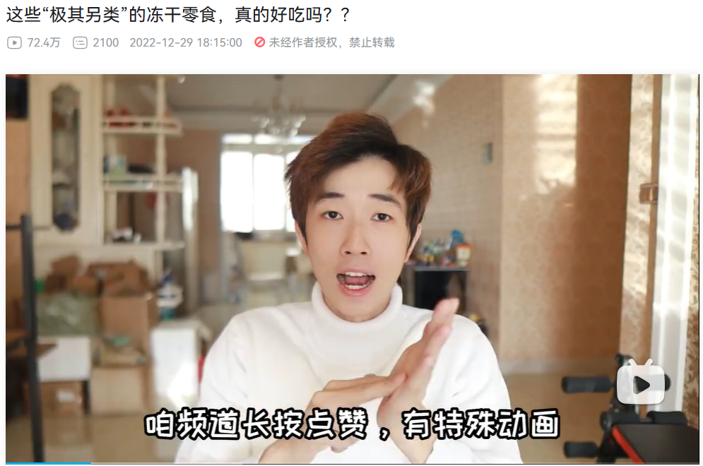
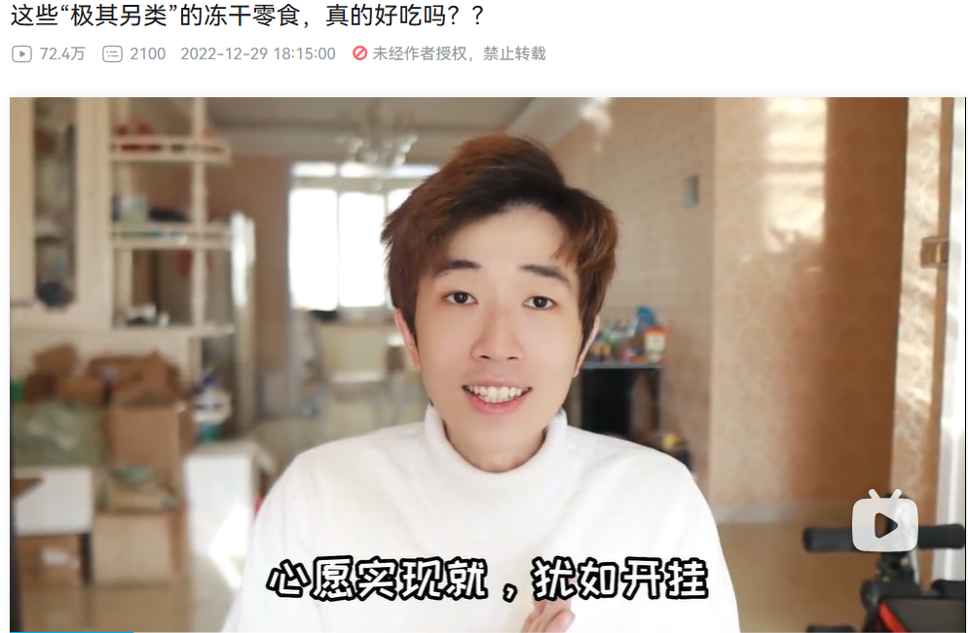
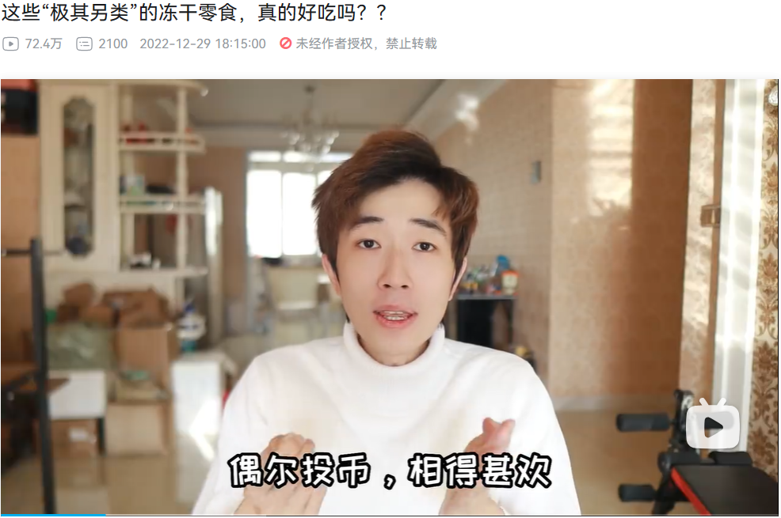
Rhyme
The matching of syllables with similar or identical end sounds.
Definition:
（1）姬一元：“咱频道长按点赞，有特殊动画，心愿实现，就犹如开挂，偶尔投币，相得甚欢，各种名次，一马平川”
（2）富贵的沙雕日记：“尝一口，这叫图个新鲜。尝一杯，这叫可以但没必要的具象化代言”
（3）林画同学：“属于咖啡界的许文强，新手小白也可以展翅飞翔”

Slide 22
Rhyme
Out of the 180 videos, 15 of them employed rhyme
Figure 7. Number of Videos on the Use of Rhetorical Devices in Food Evaluation on Bilibili

Slide 23
Rhyme
Figure 15. Comparison and Analysis of the Playback Volume and Rhyme Usage of Food Evaluation Videos on Bilibili
Regardless of the fan's number, videos incorporating rhyme received higher viewership compared to those without rhyme
A certain effect in enhancing the attractiveness and uniqueness
Viewers exhibit a certain preference for rhyme

Slide 24
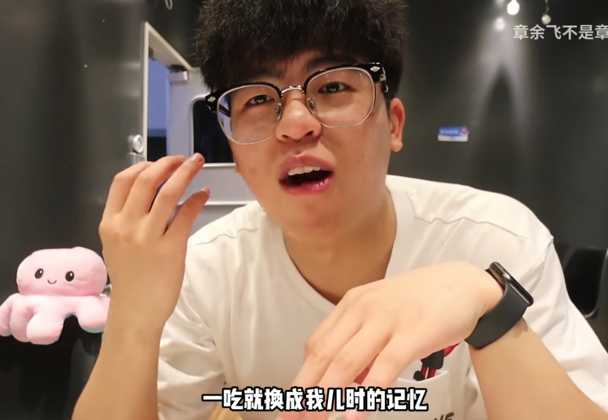
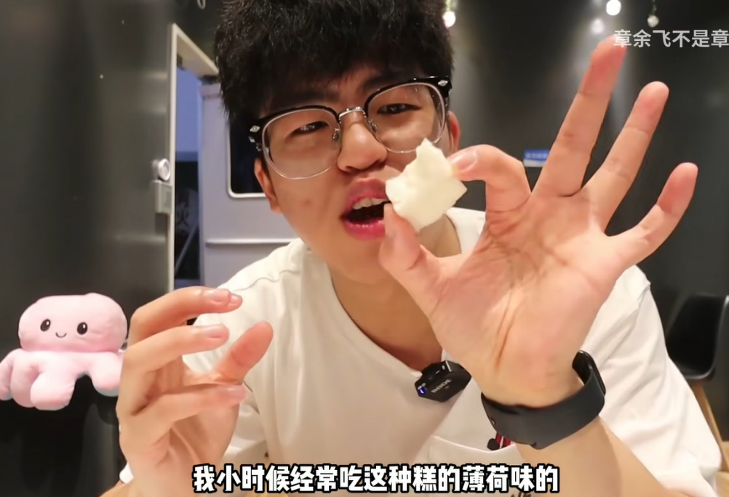
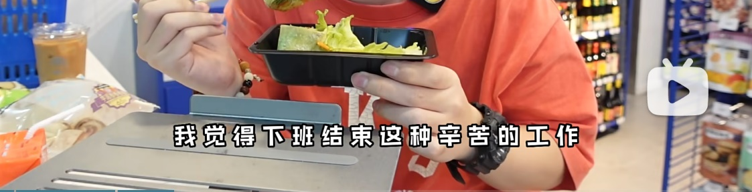
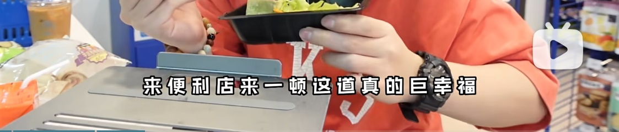
Emotional Resonance
The emotional resonance of representational strategy is often achieved by using emotional elements to arouse the resonance of viewers.
Definition:
Recall their own childhood memories of food;
Describe the special foods they ate in childhood;
Describe a good time sharing food with friends or family.
一支小皮皮：把罗森便利店八月的新品全部买一遍，需要多少钱呢
章余飞不是章鱼飞：杭州“排名第一的糕点店”，糕点都得靠抢，去晚了就买不到了！

Slide 25

Emotional Resonance
Of the 180 videos studied, 86 videos use emotional resonance, consisting of nearly half of the total videos.
The Portion of Emotional Resonance Strategy
Bilibili Food vloggers are aware of the effect of emotional resonance and actively use this strategy to attract viewers.
94

Slide 26
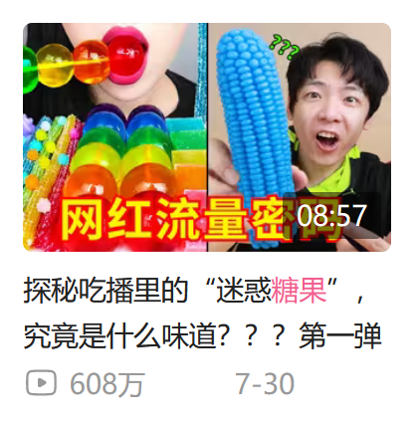
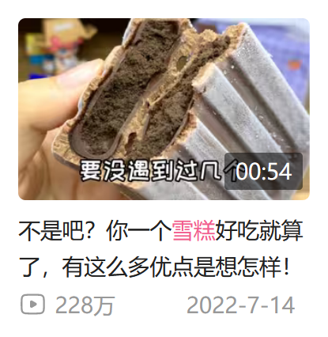
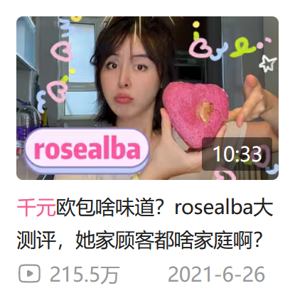

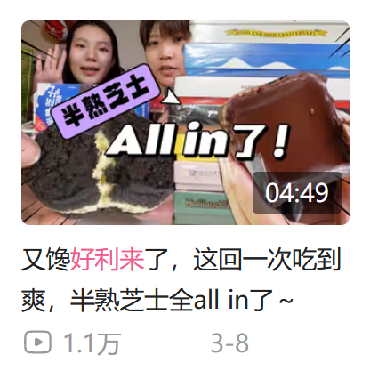
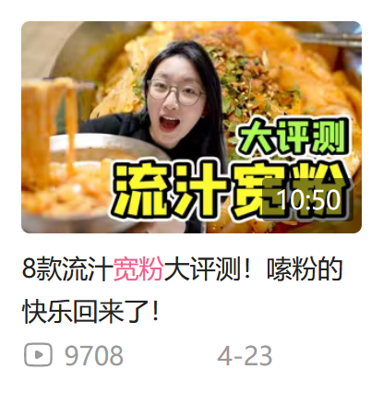
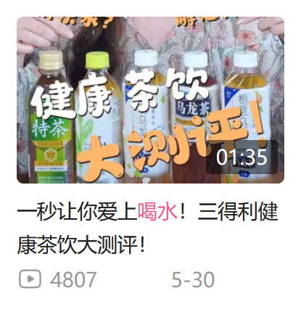
Emotional Resonance
TOP 3: use emotional resonance twice or more
The frequency of use of emotional resonance also plays a role.
Comparative analysis based on playback volume:
The top three vloggers use emotional resonance twice or more;
While vloggers with fewer likes and views only use it once.
This indicates there is a positive correlation between the frequency of the use of emotional resonance and viewers' feedback.
Fewer ones: only use emotional resonance once
6

Slide 27
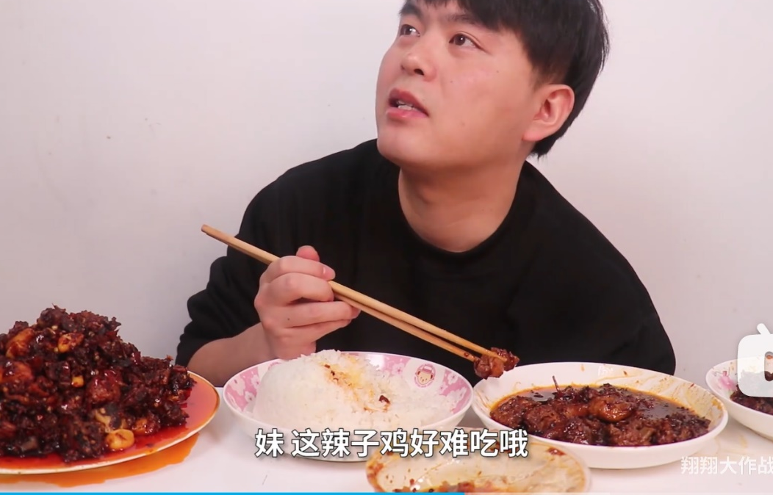
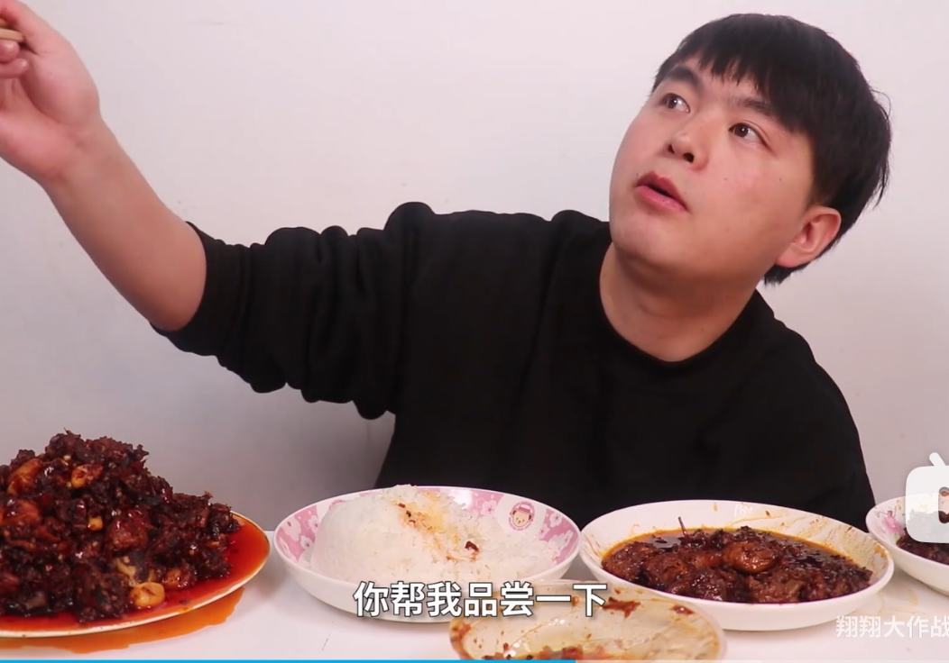
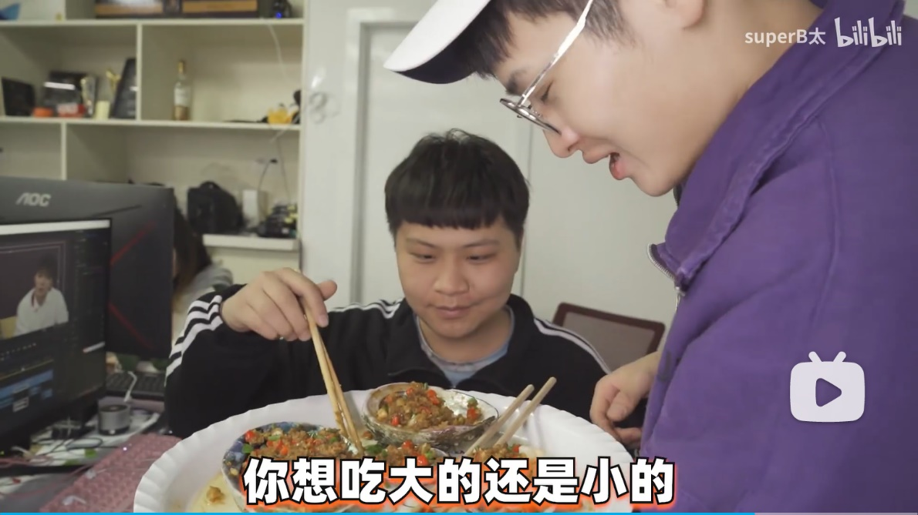
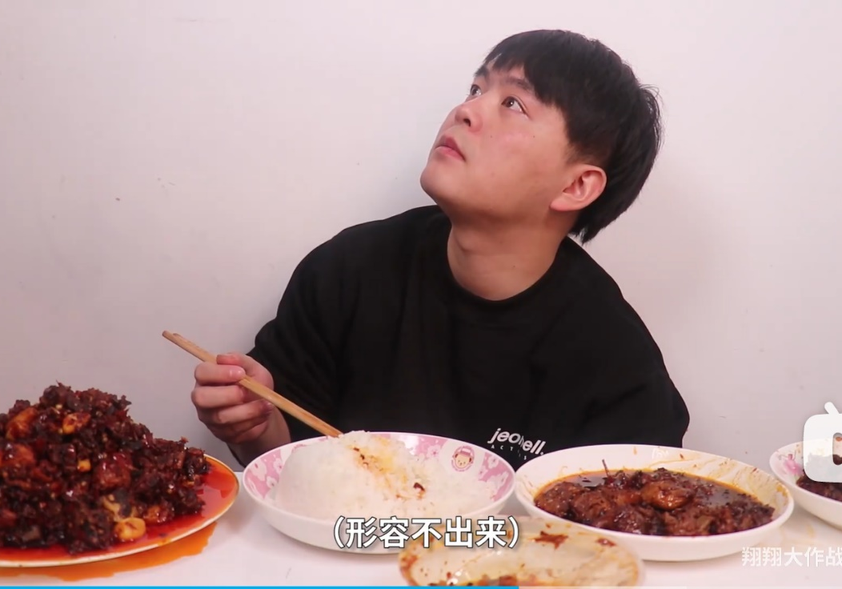
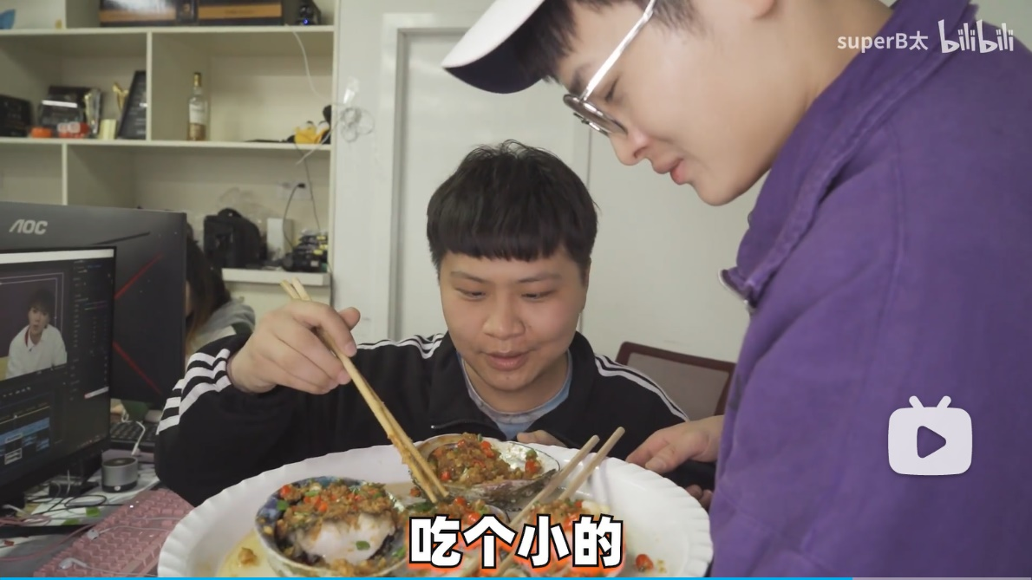
Multiple Interaction
Definition:
The interaction between the vlogger and a character outside the scene, which is usually the vlogger’s filming partner, in addition to the vlogger himself or herself.
superB太：你们有真正的认识过鲍鱼吗？黑金鲍，翡翠鲍，南非鲍，澳鲍...吃完感觉这辈子身体都硬朗了！
翔翔大作战：连贵州人都没吃过的贵州特产真的靠谱吗？

Slide 28
Multiple Interaction
Impartiality: reflecting the views of others, besides the vlogger himself, on the evaluation of the product.
Interestingness: often in the form of conversation, which can strengthen the emotional exchange and interaction between vloggers and viewers.
Bring diverse and interesting experiences to the viewers, enhancing the viewer’s trust in the vlogger and the evaluation product.
Viewers can better participate in the video content, strengthen the emotional exchange, and interact with the vloggers.
Notes:
In 23Q1
Interactive features such as bullet chats, comments, likes, bilibili moment posts and virtual gifting, etc.

Slide 29
Multiple Interaction
In 26 videos, this strategy was used a total of 257 times. Of these instances, interaction for the whole process 60 times, reflecting impartiality 78 times, and reflecting interestingness 119 times.
The proportion of Discourse Strategy Types Used in Multiple Interaction
60
78
94
119

Slide 30


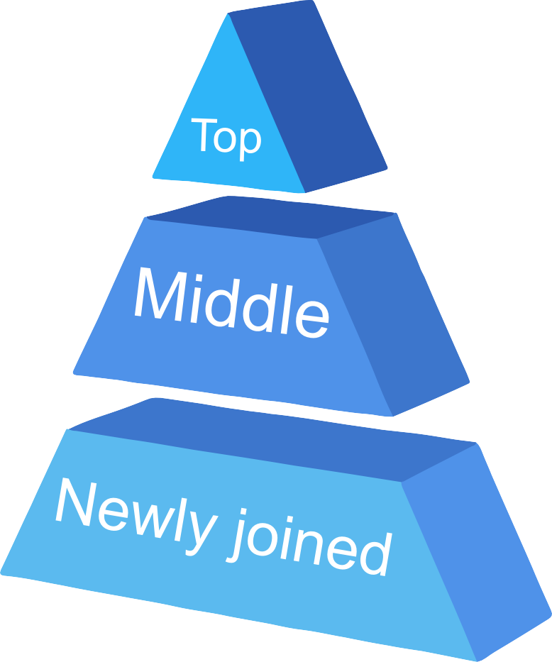


Multiple Interaction
Vloggers with different levels of follower numbers also have different preferences in using discourse strategies of multiple interaction types.
one
million
100,000
Followers
10,000
Followers
With one million followers
With 100,000 followers
With 10,000 followers
Proportion of different Follower-Level Vloggers Using Multiple Interaction Discourse Strategies

Slide 31



Findings
The Organizational Strategy of Discourse
Video structure integrity plays a role in improving video quality and effectiveness, but is not the sole determining factor.
Vloggers should prioritize attracting potential viewers to watch their videos, as well as providing results and assisting with purchases.
A well-structured video helps viewers follow the ideas and grasp different viewpoints.
When the video's conclusion has a clear direction, viewers are more likely to identify their needs and purchase the evaluated food.

Slide 32
Findings
The Representational Strategy of Discourse
1
2
Diversification of video content has a positive impact on enriching video content and improving video effectiveness.
By presenting different angles and dimensions of evaluation products, vloggers can cater to personalized needs and improve viewer engagement.
However, the proportion of rhetorical devices used by million-follower vloggers is lower compared to others.
They tend to employ various techniques like metaphors, hyperbole, and rhyme to make their videos more engaging.
They prioritize providing genuine and accurate evaluations to their viewers.

Slide 33
Recommendations & Conclusion
Vloggers should
Optimize the quality of their content to meet public needs,
Create personal characteristics,
Innovate discourse style to enhance interactivity,
Upgrade the food experience.
High-quality evaluation content promotes positive interactions among vloggers, viewers, and businesses.
An excellent food vlogger should prioritize video integrity and strive for diverse content.
Continuous innovation is key to standing out in the food reviewing field.

Slide 34


THANK YOU!
Group3
November 2026

