Slide 1
NGS data
11 September 2012, 11.00-12.30
Notes:
This introduces a first look at data produced by various NGS platforms, file formats like FASTA, FASTQ, SFF, BAM/SAM, interval tables. Also introduces software tools to deal with NGS data, might mention visual tools such as CLC and Geneious but show that command line tools have all functionality. Show periodic table of bioinformatics elements. Exercise: look at NGS data in a text editor, determine what FASTQ dialect

Slide 2
NGS file formats
Binary or text-based
High-volume, simple
Single sequence or pairwise aligned
With quality scores

Slide 3
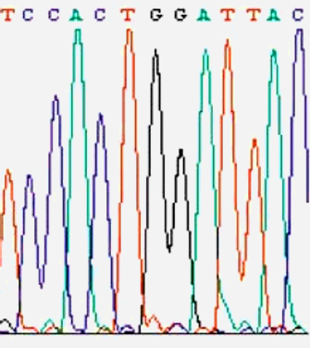
Phred scores
Phred quality scores are used for:
Assessment of sequence quality
Recognition and removal of low-quality sequence (end clipping)
Determination of accurate consensus sequences
Notes:
Phred's approach to base calling and calculating quality scores was outlined by Ewing et al.. To determine quality scores, Phred first calculates several parameters related to peak shape and peak resolution at each base. Phred then uses these parameters to look up a corresponding quality score in huge lookup tables. These lookup tables were generated from sequence traces where the correct sequence was known, and are hard coded in Phred; different lookup tables are used for different sequencing chemistries and machines. An evaluation of the accuracy of Phred quality scores for a number of variations in sequencing chemistry and instrumentation showed that Phred quality scores are highly accurate.[7]

Slide 4
Phred scores
Phred quality scores are defined as a property which is logarithmically related to the base-calling error probabilities.
Q = -10 log₁₀ P
Phred quality score Q | P of incorrect base call | Base call accuracy
10 | 1 in 10 | 90%
20 | 1 in 100 | 99%
30 | 1 in 1,000 | 99.9%
40 | 1 in 10,000 | 99.99%
50 | 1 in 100,000 | 99.999%

Slide 5

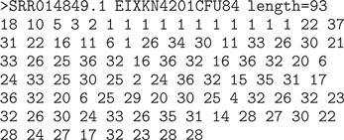
FASTA + Qual
The phred program introduced the *.qual format
Simply parallel FASTA files with Phred quality scores as integers

Slide 6
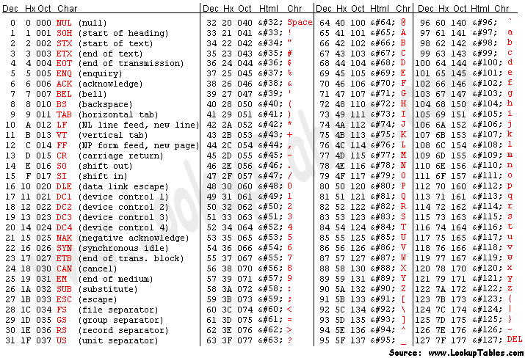
ASCII character codes

Slide 7
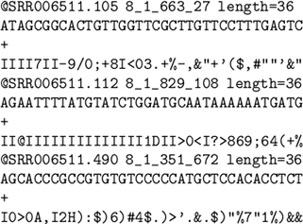
FASTQ
FASTQ formatted syntax:
@title (and description)
Sequence
+(Repeat of title line)
Quality lines map phred scores to ASCII characters
Different platforms map phred scores in different ways to ASCII
Notes:
Distinguish between different manufacturers

Slide 8
http://maq.sourceforge.net/fastq.shtml

Slide 9
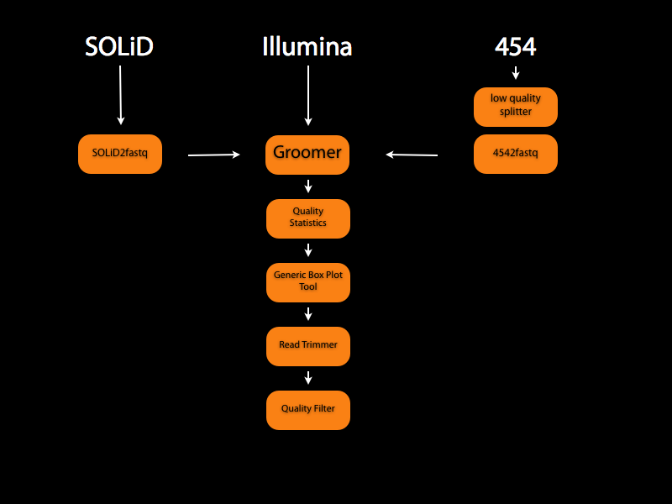
Notes:
https://main.g2.bx.psu.edu/u/dan/p/fastq

Slide 10
Standard Flowgram Format
Description
Tools
SFF file format is a container file for storing one or many 454 reads.
Binary format
Structure:
Common header with metadata
Read header
Read data
sffinfo - from 454
sff_extract - python
Bio::SFF - perl
sff2fastq - binary
SFF Workbench - graphical
Notes:
454 reads differ from standard sequencing reads in that the 454 data does not provide individual base measurements from which basecalls can be derived. Instead, it provides measurements that estimate the length of the next homopolymer stretch in the sequence (i.e., in "AAATGG", "AAA" is a 3-mer stretch of A's, "T" is a 1-mer stretch of T's and "GG" is a 2-mer stretch of G's). A basecalled sequence is then derived by converting each estimate into a homopolymer stretch of that length and concatenating the homopolymers.

Slide 11
SAM/BAM
Encodes reads aligned to a reference sequence
Textual (SAM) and binary representations (BAM)
Samtools, picard, EMBOSS

Slide 12
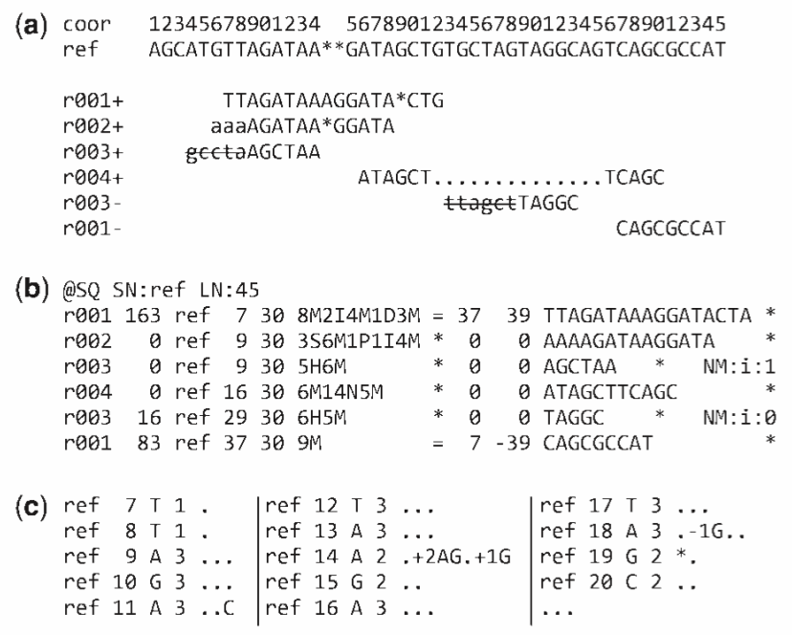
SAM/BAM format
Notes:
Example of extended CIGAR and the pileup output. (a) Alignments of one pair of reads and three single-end reads. (b) The corresponding SAM file. The ‘@SQ’ line in the header section gives the order of reference sequences. Notably, r001 is the name of a read pair. According to FLAG 163 (=1 + 2 + 32 + 128), the read mapped to position 7 is the second read in the pair (128) and regarded as properly paired (1 + 2); its mate is mapped to 37 on the reverse strand (32). Read r002 has three soft-clipped (unaligned) bases. The coordinate shown in SAM is the position of the first aligned base. The CIGAR string for this alignment contains a P (padding) operation which correctly aligns the inserted sequences. Padding operations can be absent when an aligner does not support multiple sequence alignment. The last six bases of read r003 map to position 9, and the first five to position 29 on the reverse strand. The hard clipping operation H indicates that the clipped sequence is not present in the sequence field. The NM tag gives the number of mismatches. Read r004 is aligned across an intron, indicated by the N operation. (c) Simplified pileup output by SAMtools. Each line consists of reference name, sorted coordinate, reference base, the number of reads covering the position and read bases. In the fifth field, a dot or a comma denotes a base identical to the reference; a dot or a capital letter denotes a base from a read mapped on the forward strand, while a comma or a lowercase letter on the reverse strand.

Slide 13
Commonly-used tools
samtools
bwa
GATK
picard
bowtie/tophat/cufflinks
fastqc

Slide 14
Integrated suites
CLC
Geneious

Slide 15
Open source and commercial

Slide 16
Graphical and command-line

Slide 17
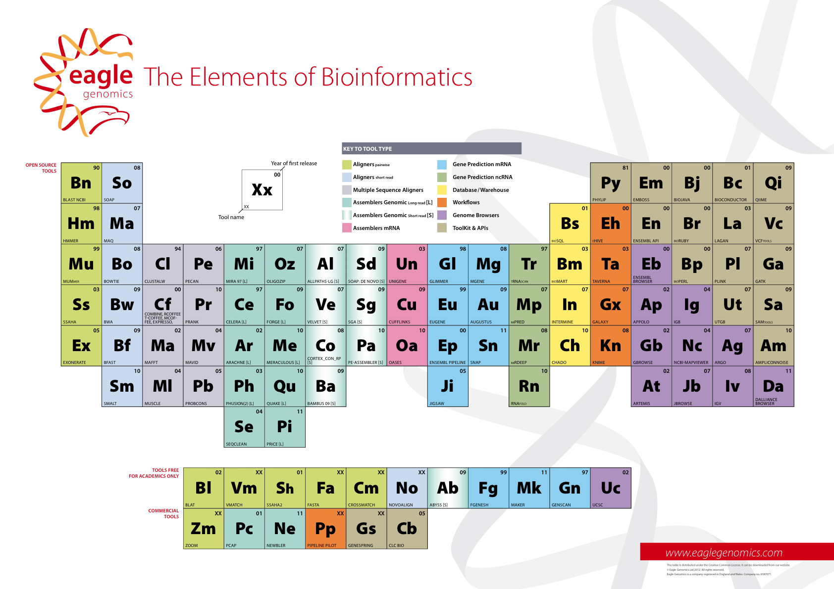
Periodic table of bioinformatics
Notes:
Introduces the

Slide 18
Exercise: FASTQ dialects
Notes:
For this exercise we need FASTQ files in the different encountered formats under git

