Slide 1
Parallelization
13 September 2012, 14.00-16.00
Notes:
Introduce parallelization, MPI, OpenMP, CUDA, CONDOR, CORBA, WS, Designing workflows so they can be parallelized using GNU make –j 4

Slide 2
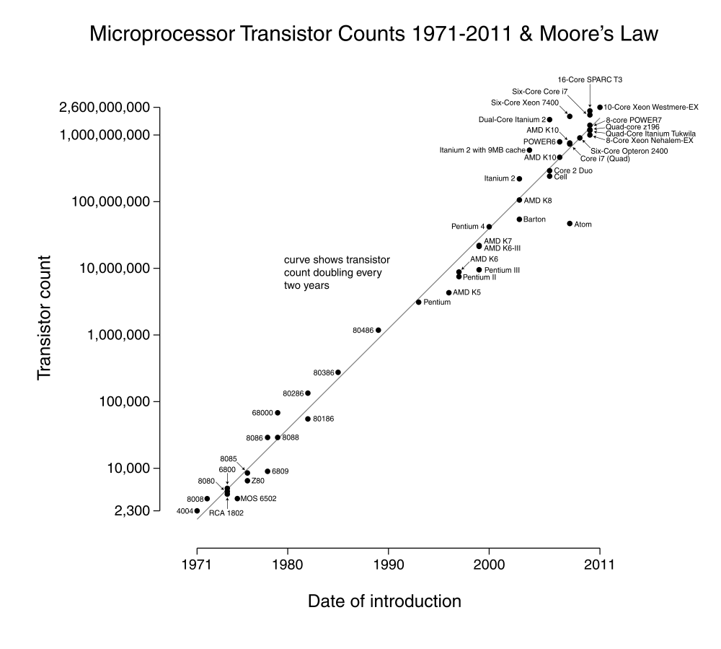
Moore's law
Moore's law is the observation that over the history of computing hardware, the number of transistors on integrated circuits doubles approximately every two years. The period often quoted as "18 months" is due to Intel executive David House, who predicted that period for a doubling in chip performance (being a combination of the effect of more transistors and their being faster).

Slide 3
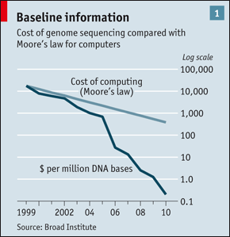
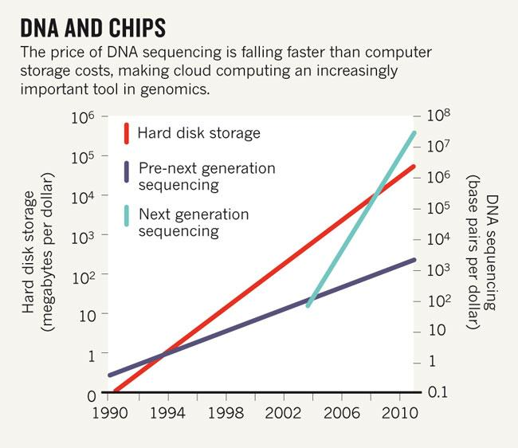
Moore’s (Kryder's) law and genomics

Slide 4
Trivial parallelization
Data volume grows faster than computing power or storage capacity
But we can throw more computers at the problem
If we can subdivide our problem into independent subproblems, parallelization is easy (trivial, even).

Slide 5
Examples of trivial parallelization
Next generation sequencing!
Align reads against a reference
BLAST sequences against a database
Anything where multiple files are all treated equally, independently:
Download files
Expand archives
Convert file formats

Slide 6
Harder to parallelize
If the state of one computation depends on that of another, parallelization is not trivial – but still possible, if the computations can communicate.
For example, multiple heated Markov chains in a Bayesian analysis (MC3) need to exchange information about what they've accepted.
There are different ways in which this information can be exchanged.

Slide 7
Threads
A thread is a sequence of instructions within a process.
Multiple threads can exist within the same process.
Threads can share resources (e.g. memory), hence exchange information.
On a multi-core CPU, threads can be executed in parallel.
Very portable, different implementations.

Slide 8
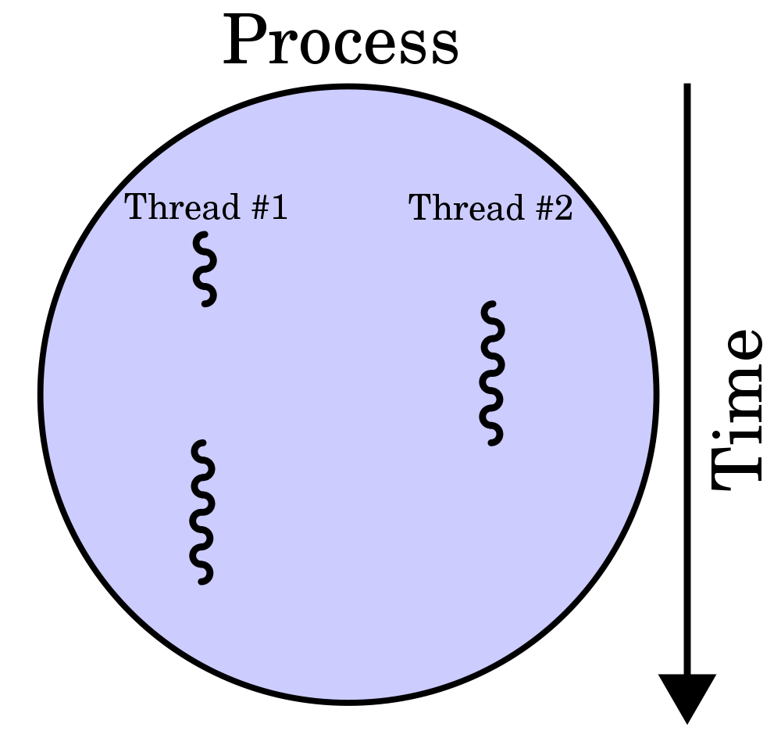
Threads

Slide 9
Threads example
use strict;
use threads;
my @threads;
for ( 1 .. 10 ) {
my $thr = threads->create(
sub{$_}
);
push @threads, $thr;
}
# …wait for @threads to finish…

Slide 10
GPU
A clever hack to use the computing power in graphics cards
Relatively cheap
Very hardware dependent (NVIDIA/CUDA)
Not very portable
Poor scripting language support

Slide 11
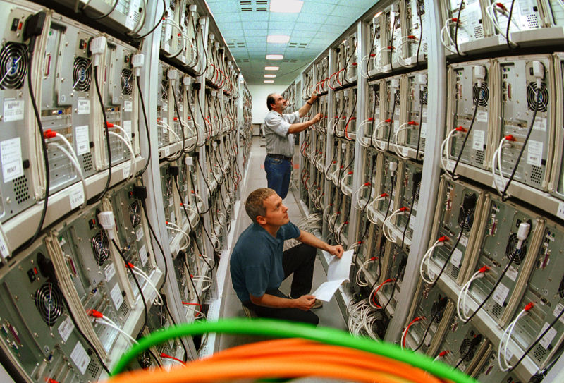
Clusters

Slide 12
Sun Grid Engine
Open Source Cluster management software
lots of computers called nodes connected to a common file system designed for high speed parallel read/write access
Users interact with ‘head’ nodes, jobs run on one or more job nodes
Users do not know or care which nodes run their job, must make sure Cluster Sys Admins install necessary programs on all nodes
All users share the same nodes, SGE makes it possible for Sys Admins to put prioritization schemes in place so that users can get exclusive access to certain nodes, etc.
All users jobs are submitted to a common queue
SGE control system then submits queued jobs to nodes based on availability, job specific resource requirements, prioritization, etc.

Slide 13
SGE Job Scripts
interpretive language (bash, perl, python, etc.) scripts
Contain special comments with hints to the SGE job control system
prioritization
logging
minimum memory/storage requirements
prerequisite jobs
should not redirect STDOUT or STDERR, the logging comment hints tell the SGE job control system where to send these outputs

Slide 14
SGE Head Node Commands
qsub $job_script
submits job script to the queue
qstat [options]
shows all jobs in the queue with their status (running, complete, error, etc.)
options allow you to filter jobs based on owner and status, or write the output in different formats (text, xml)
qdel [options]
removes jobs from the queue before or while they are running
options allow you to specify jobids, ownerids (you cant delete other people’s jobs, but you can pass your ownerid with a list of job ids to delete/kill all of your current jobs)

Slide 15
SGE Wrapper Script
src/sge_cluster_monitor.sh
runs on your machine
creates ‘job_dir’
copies files needed by job into job_dir
writes qsub script template for your job
scp job_dir head_node
ssh head_node qsub job_dir/job_script.sh
while (still running)
ssh head_node qstat
sleep
scp –r head_node:job_dir .
exit

Slide 16
MPI
Standard protocol ("message passing interface") implemented by multiple libraries
Communication is between processes
Unlike threads and GPU, can use less tightly-integrated hardware (i.e. clusters)
Can grow the cluster over time, add more "nodes"
Network latency is a bottleneck

Slide 17
MPI example
use strict;
use Parallel::MPI::Simple;
MPI_Init();
my $rank = MPI_Comm_rank(MPI_COMM_WORLD);
if ($rank > 0) {
my $msg = "Hello, I'm $rank";
MPI_Send($msg, 0, 123, MPI_COMM_WORLD);
}
else {
for my $i ( 1 .. MPI_Comm_size(MPI_COMM_WORLD) - 1 ) {
my $msg = MPI_Recv($i, 123, MPI_COMM_WORLD);
print "$rank received: '$msg'\n";
}
}
MPI_Finalize();

Slide 18
CORBA/COM
Communication between processes
Processes can run on different, loosely-coupled hardware
Old (pre-DNS) protocol
Should be portable, but different incompatible implementations
Network latency is a bottleneck

Slide 19
SOAP web services
Communication between processes
Based on text-based web standards
Some workflow tools (e.g. Taverna) use SOAP
Complex, fragile, incompatible implementations
Network latency is a bottleneck

Slide 20
RESTful web service
Communication between processes
Simple "protocol": basically web sites that exchange data instead of web pages
Based on web standards (HTTP) but not itself a standard, very ad hoc
Need to design (and document) data formats and methods yourself
Network latency is a bottleneck

Slide 21
Grids
Communication between processes
Like a cluster, but more distributed, e.g. "national grids"
Potentially more diverse, less reliably available hardware within one grid
Complex logic required for identifying and claiming resources ("queueing")
Network latency is a bottleneck

Slide 22
Condor
Example of a grid implementation
Can be used to leverage "sleeping" desktops, e.g. in an institution ("CPU scavenging")
Can identify and claim suitable hardware/OS combinations
Network latency is a bottleneck

Slide 23
Parallel make
Available in GNU make, with the –j <n> flag
Easy way of achieving trivial parallelization
No communication between processes
Very portable: can test it out on your laptop
Uses multicore hardware

Slide 24
Exercise: Parallelize Plasmodium Alignment
Copy me to a text file and run with and without –j 2 argument
Run the Plasmodium Makefile with 2 threads so that it produces SAI files in parallel before producing the sampe file
How much faster is the parallel invocation?
Can you spot the parallelization problem with the Makefile on the right?
.PHONY: all
all: t5 t4 t1
@echo Making $@
t1: t3 t2
touch $@
t2:
cp t3 $@
t3:
sleep 3 && touch $@
t4:
touch $@
t5:
touch $@

