Slide 1
NGS data
11 September 2012, 11.00-12.30
Notes:
This introduces a first look at data produced by various NGS platforms, file formats like FASTA, FASTQ, SFF, BAM/SAM, interval tables. Also introduces software tools to deal with NGS data, might mention visual tools such as CLC and Geneious but show that command line tools have all functionality. Show periodic table of bioinformatics elements. Exercise: look at NGS data in a text editor, determine what FASTQ dialect

Slide 2
NGS file formats
Binary or text-based
High-volume, simple
Single sequence or pairwise aligned
With quality scores

Slide 3
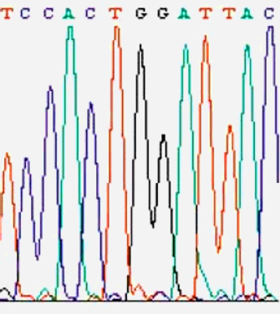
Phred scores
Phred quality scores are used for:
Assessment of sequence quality
Recognition and removal of low-quality sequence (end clipping)
Determination of accurate consensus sequences
Notes:
Phred's approach to base calling and calculating quality scores was outlined by Ewing et al.. To determine quality scores, Phred first calculates several parameters related to peak shape and peak resolution at each base. Phred then uses these parameters to look up a corresponding quality score in huge lookup tables. These lookup tables were generated from sequence traces where the correct sequence was known, and are hard coded in Phred; different lookup tables are used for different sequencing chemistries and machines. An evaluation of the accuracy of Phred quality scores for a number of variations in sequencing chemistry and instrumentation showed that Phred quality scores are highly accurate.[7]

Slide 4
Phred scores
Phred quality scores are defined as a property which is logarithmically related to the base-calling error probabilities.
Q = -10 log₁₀ P
Phred quality score Q | P of incorrect base call | Base call accuracy
10 | 1 in 10 | 90%
20 | 1 in 100 | 99%
30 | 1 in 1,000 | 99.9%
40 | 1 in 10,000 | 99.99%
50 | 1 in 100,000 | 99.999%

Slide 5

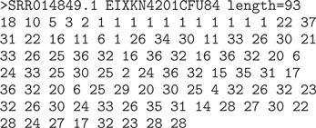
FASTA + Qual
The phred program introduced the *.qual format
Simply parallel FASTA files with Phred quality scores as integers

Slide 6
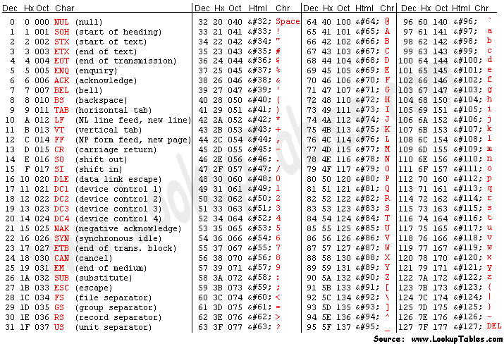
ASCII character codes

Slide 7
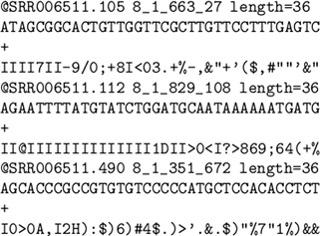
FASTQ
FASTQ formatted syntax:
@title (and description)
Sequence
+(Repeat of title line)
Quality lines map phred scores to ASCII characters
Different platforms map phred scores in different ways to ASCII
Notes:
Distinguish between different manufacturers

Slide 8
Standard Flowgram Format
Description
Tools
SFF file format is a container file for storing one or many 454 reads.
Binary format
Structure:
Common header with metadata
Read header
Read data
sffinfo - from 454
sff_extract - python
Bio::SFF - perl
sff2fastq - binary
SFF Workbench - graphical
Notes:
454 reads differ from standard sequencing reads in that the 454 data does not provide individual base measurements from which basecalls can be derived. Instead, it provides measurements that estimate the length of the next homopolymer stretch in the sequence (i.e., in "AAATGG", "AAA" is a 3-mer stretch of A's, "T" is a 1-mer stretch of T's and "GG" is a 2-mer stretch of G's). A basecalled sequence is then derived by converting each estimate into a homopolymer stretch of that length and concatenating the homopolymers.

Slide 9
SAM/BAM

Slide 10
Commonly-used tools
samtools
bwa
GATK
picard
bowtie/tophat/cufflinks
fastqc

Slide 11
Integrated suites
CLC
Geneious

Slide 12
Open source and commercial

Slide 13
Visual and command-line

Slide 14
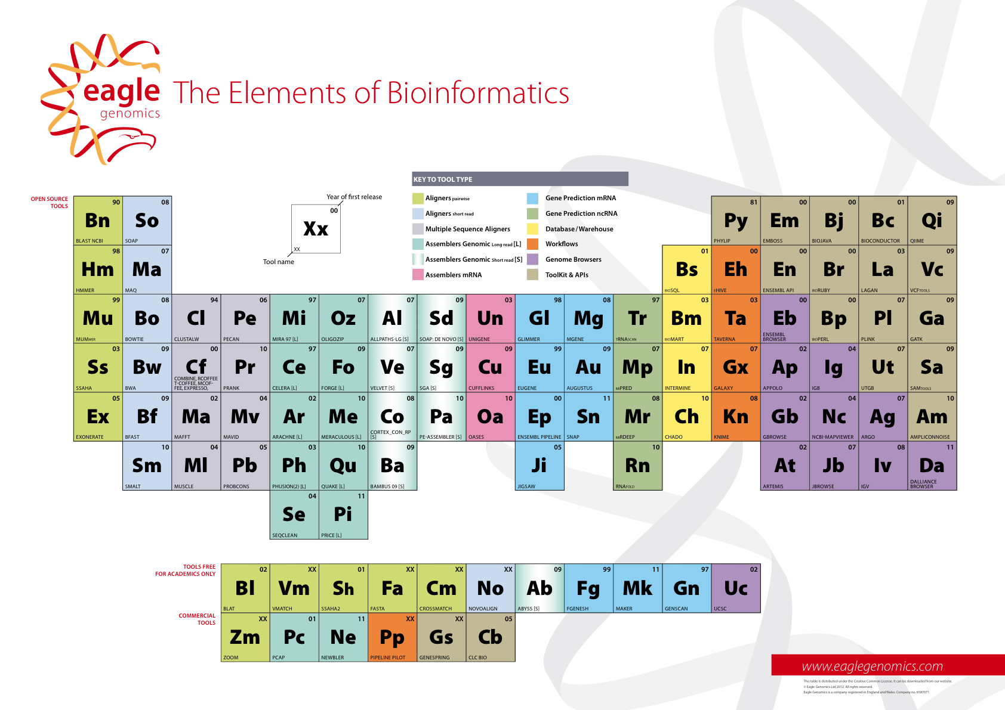
Periodic table of bioinformatics
Notes:
Introduces the

Slide 15
Exercise: FASTQ dialects
Notes:
For this exercise we need FASTQ files in the different encountered formats under git

