Slide 1
Cloud computing
13 September 2012, 16.30-18.00
Notes:
Introduce MapReduce. How to deploy, where to deploy. Exercise: do a simple MapReduce job.

Slide 2
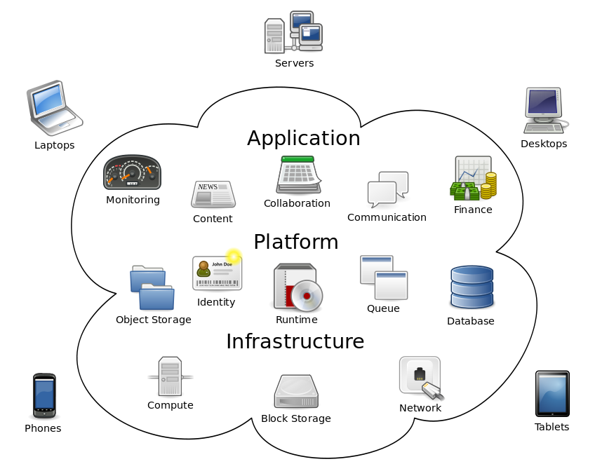
Cloud computing
In computation as a service, customers essentially rent the hardware and storage for as long or as short a time as they need to achieve their goals. Customers pay only for the time the rented systems are running and only for the storage they actually use.
http://en.wikipedia.org/wiki/Cloud_computing

Slide 3
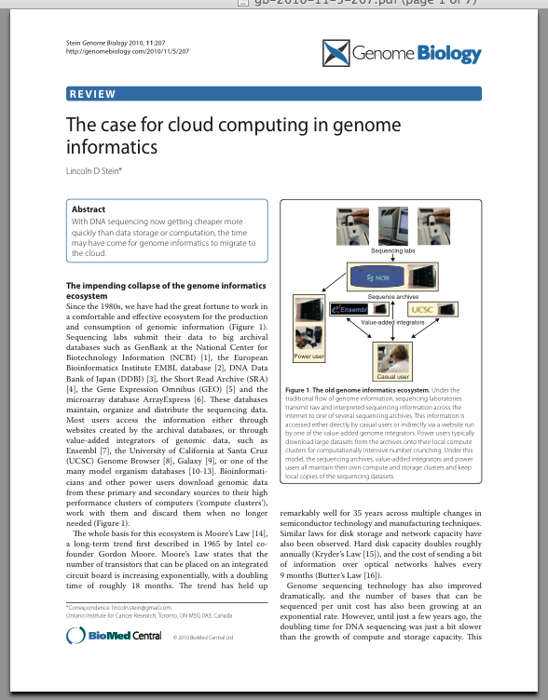
Cloud computing and genomics
Genomics data sets are so large (and growing) that storage becomes a bottleneck
Both data and computation will move into the cloud, next to each other

Slide 4
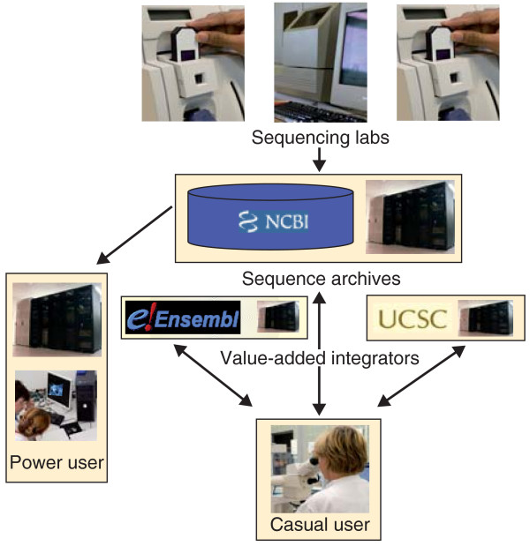
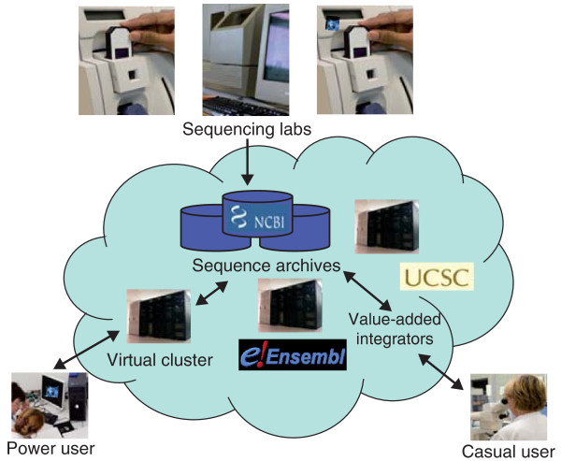
Co-located data, compute resources
"Old" genome informatics
"New" genome informatics
doi:10.1186/gb-2010-11-5-207

Slide 5
Typical components
Because "the cloud" is actually a federation of physical computers, some indirection is needed to make things work:
Distributed file system, i.e. a way for cloud applications to find their data without needing to know the underlying architecture
Scheduler, i.e. a way to distribute compute resources to different tasks
Compute engine, i.e. an API for parallel programming

Slide 6
Example cloud stack: Hadoop
Open source (as an Apache project), written in Java
Is available on various commercial cloud hosts
Components:
Distributed file system: HDFS (and others)
Scheduler: JobTracker (and others)
Programming model: MapReduce

Slide 7
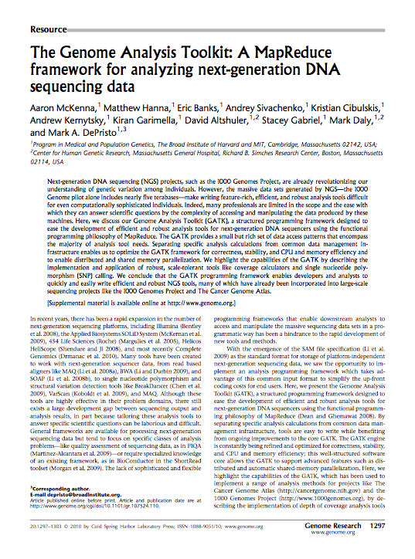
MapReduce
Popular programming model for cloud computing
Developed at Google (see research paper)
MapReduce is used by GATK
Implementations available in most programming languages

Slide 8
The MapReduce programming model
Two "list comprehension" steps:
Map – transforms the input (e.g. chunks of FASTQ data) into key/value pairs (e.g. identifiers and raw reads)
Reduce – receives one of the distinct keys produced by Map and all values that occurred with that key (e.g. paired ends), does something useful with the list of values, emits zero or more key/value pairs (e.g. identifier and some alignment score)

Slide 9
MapReduce example: word counts
function map(String name, String document):
// name: document name
// document: document contents
for each word w in document:
emit (w, 1)
function reduce(String word, Iterator partialCounts):
// word: a word
// partialCounts: aggregated partial counts list
sum = 0
for each pc in partialCounts:
sum += pc
emit (word, sum)
Notes:
GATK uses MapReduce

Slide 10
Exercises
Design a MapReduce algorithm for removing duplicate reads
Design a MapReduce algorithm for filtering multiplexed, adapter-barcoded reads
Notes:
The idea for ex 1 is that we can use the entire read as a KEY so that multiple, identical reads are chained to the same key. For ex 2 you'd have to pre-process your reads so that they are keyed on the adapter barcode

