Slide 1
Project organization
12 September 2012, 14.00-16.00
Notes:
Explore layout of projects. This is a very short presentation, but that will allow for spill-over from the installation session before lunch.

Slide 2
How research actually works
Research is iterative: we make mistakes, acquire more data, learn new techniques
Different studies are done in parallel
Many months later (e.g. after reviews) you will have to re-visit old work
Research is done collaboratively, sometimes with people you don't know

Slide 3
A project-oriented view
Every study should be organized as a self-contained project
You should be able to share everything that relates to the project easily
You should be able to archive and retrieve the project easily

Slide 4
Project management

Slide 5
Project organization
store all of the files relevant to one project under a common root directory
logical top-level organization
doc
data
src
bin
results
chronological Secondary organization
logical tertiary organization

Slide 6
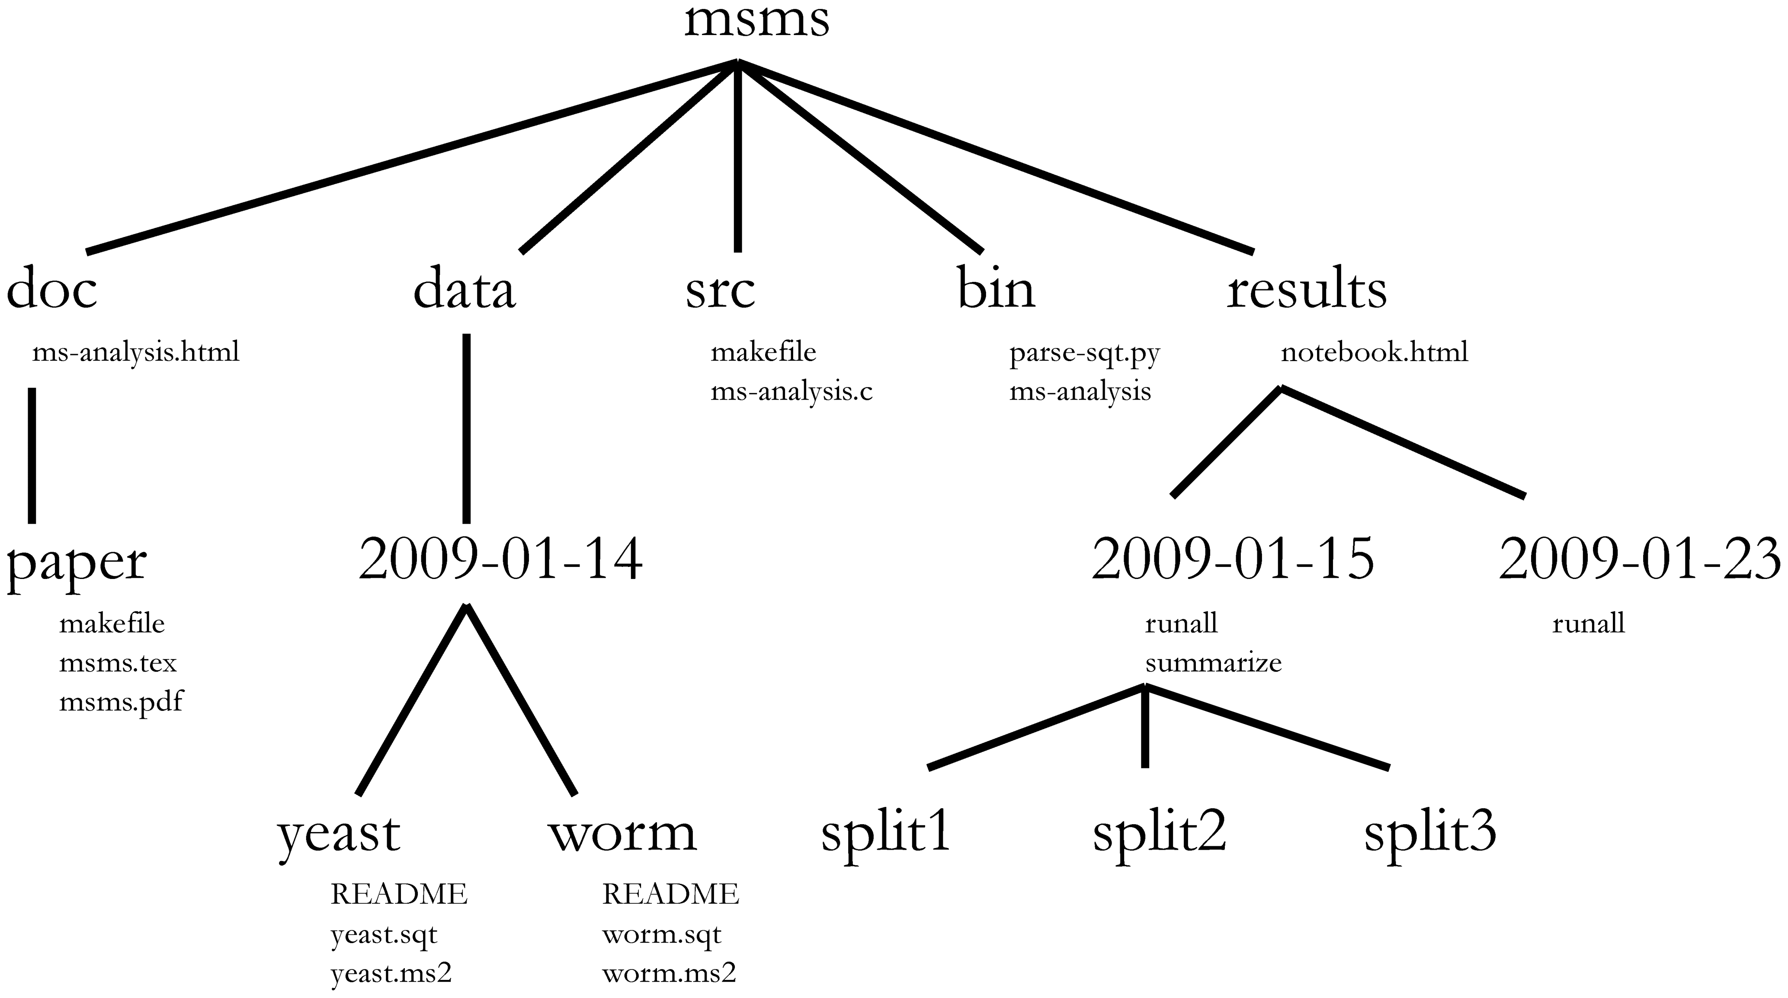
Directory structure
Choosing a consistent directory structure will help you (and your collaborators) find things later on.

Slide 7
Exercise: download and unzip git repo
Download and unzip the course repository at https://github.com/rvosa/ngs-workflows/zipball/master
Read the article http://dx.doi.org/10.1371/journal.pcbi.1000424

Slide 8
Capturing and versioning Data and Analysis Meta Data
Big push is to capture Research Data Provenance
Process of marshalling data from source (internal or external) through analysis pipeline should minimize human interaction/manipulation
Automated pipelines should maximize capture of information about data files, and analysis scripts/programs:
hashsums of data files before and after processing (md5, sha1)
paths (which), and versions* of scripts/programs before they are called
hashsums of scripts/programs before they are called (especially if script/program does not supply a version)
date/time, start time and end time, and possibly runtime, of each script/program run
Project should include all of this information, from beginning to end, in the RCS so that sharing a repository with the data and scripts ensures that this information is also included
* many scripts/programs do not print version information. You should get in the habit of making your own scripts/programs able to print a version to STDOUT and exit with a nonzero exit status upon request
Notes:
Fancy wine term. Hopefully, you will not ever find yourself in the unfortunate position of being accused of falsifying/doctoring your data. Using this strategy can make it easier for auditors to clear your name. Although a committed charlatan can still abuse this system, it is much more difficult.

Slide 9
Modification to Project Structure
add ‘log’ directory to top level directory (docs, data, src, bin, results, and now log)
Modify analysis pipeline scripts
redirect STDOUT and STDERR to files in log directory named for the script, and the run date-time (or in a date-time subdirectory)
print date, start time, end time, and even total run time to STDOUT log
capture hashsum and version of themselves in STDOUT log
capture hashsum of data file before* and after* any analysis is run on that data file in STDOUT log
capture hashsums of intermediate data files*, even if the files are to be deleted, in STDOUT log
log deletions *of any data files in STDOUT log
capture hashsums and versions of any other script/program executed by the script before executing the script in STDOUT log
capture hashsums of all result files immediately after they are produced in STDOUT log
close and git add/commit all new files, all deleted files, and the STDOUT log file immediately before exiting
alternatively, or in addition, use the STDOUT log file as the git commit message for all new and deleted files (git commit –f log/090212/foo.log path/to/files)
* these activities make up the data footprint of an analysis

Slide 10
Exercise
modify src/Plasmodium.sh to capture as much meta data as is available in your local repository, and add/commit its data footprint
write a wrapper script for src/Plasmodium.sh that captures its STDOUT and STDERR to a log file, and automatically add/commit the STDOUT log

