Slide 1
Running NGS analyses on the CLI
11 September 2012, 16.30-18.00
Notes:
Introducing command line tools for dealing with NGS data: SAM/BAM tools, sequence conversion using BioPerl, BioPython, reading with R BioConductor. How to run scripts on the command line. Exercise: http://bioinf.comav.upv.es/courses/sequence_analysis/sequence_file_formats.html http://samtools.sourceforge.net/

Slide 2
NGS analyses
Data pre-processing:
Characterize / trim low base scores
Clip adapters
Collapse duplicates
File conversion
Assembly:
de Novo
To reference sequence(s)
…more bioinformatics…

Slide 3
Data pre-processing
Many data cleaning steps can be programmed with common open source bioinformatics toolkits
Some off-the-shelf tools exist
FASTX-toolkit (also in galaxy)
FASTQC
PRINSEQ

Slide 4
Assembly
De-novo assembly tools:
SOAP de-novo
Velvet
Reference mapping:
BWA
MAQ
Bowtie
BFAST
MIRA

Slide 5
Data conversion
Command line programs
samtools
picard

Slide 6
Integrated suites
CLC
Geneious
Qiime
GATK

Slide 7
Open source and commercial

Slide 8
Graphical and command-line

Slide 9
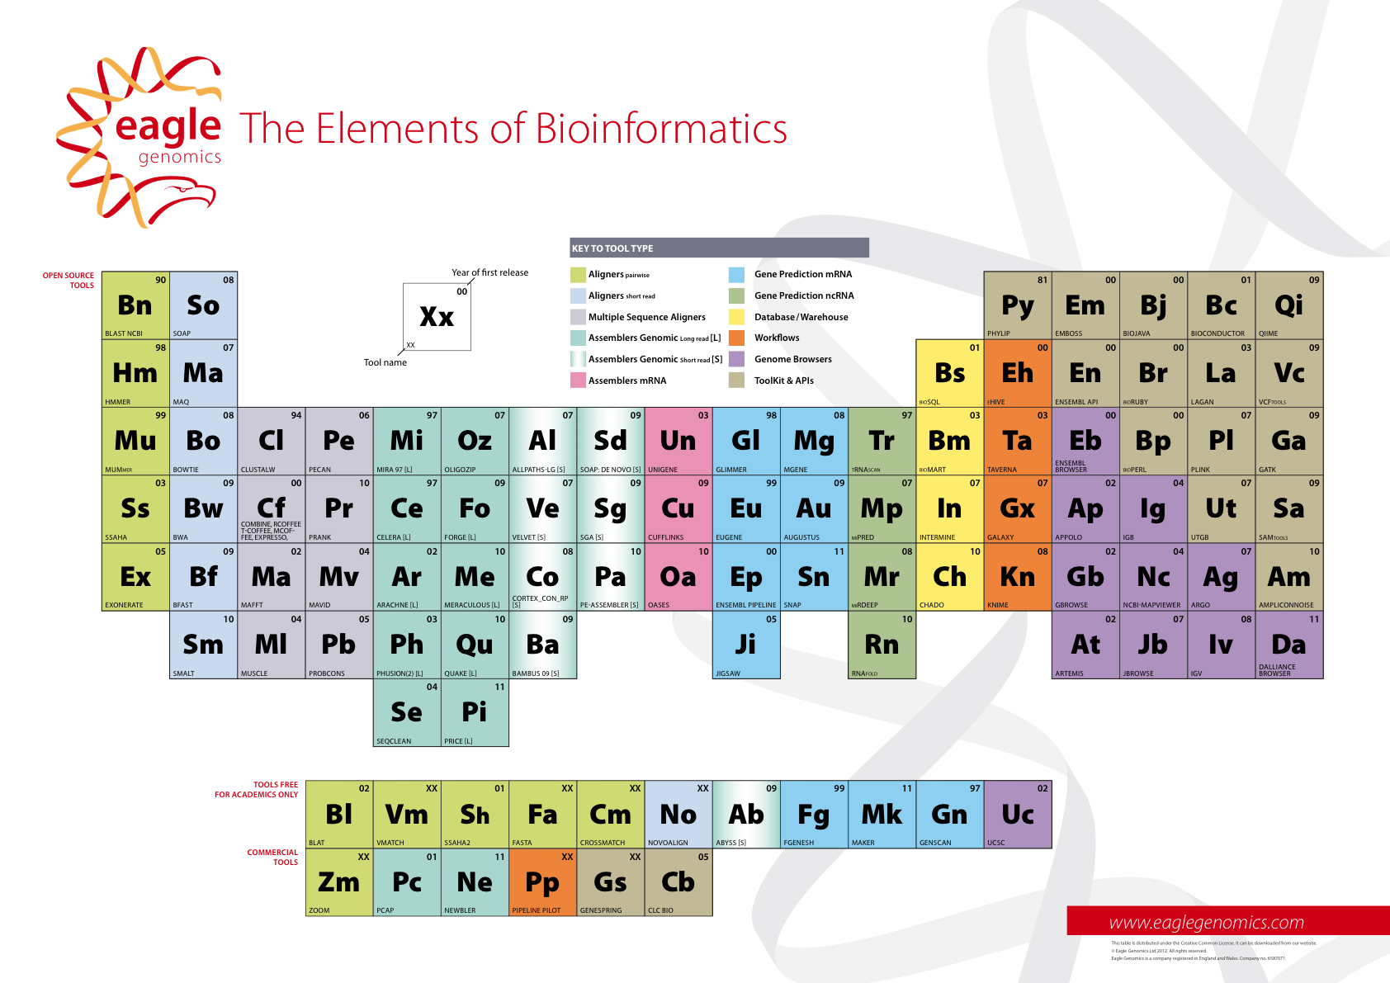
Periodic table of bioinformatics
Notes:
Introduces the

Slide 10
Exercise: compilation
Compile BWA
Compile Samtools
(Compile NCBI standalone BLAST)
Notes:
For this exercise, we compile samtools (?) and do some basic conversion on the command line.

