Slide 1
Project organization
12 September 2012, 14.30-18.00
Notes:
Explore layout of projects. This is a very short presentation, but that will allow for spill-over from the installation session before lunch.

Slide 2
How research actually works
Research is iterative: we make mistakes, acquire more data, learn new techniques
Different studies are done in parallel
Many months later (e.g. after reviews) you will have to re-visit old work
Research is done collaboratively, sometimes with people you don't know

Slide 3
A project-oriented view
Every study should be organized as a self-contained project
You should be able to share everything that relates to the project easily
You should be able to archive and retrieve the project easily

Slide 4
Project management

Slide 5
Project organization
store all of the files relevant to one project under a common root directory
logical top-level organization
doc
data
src
bin
results
chronological Secondary organization
logical tertiary organization

Slide 6
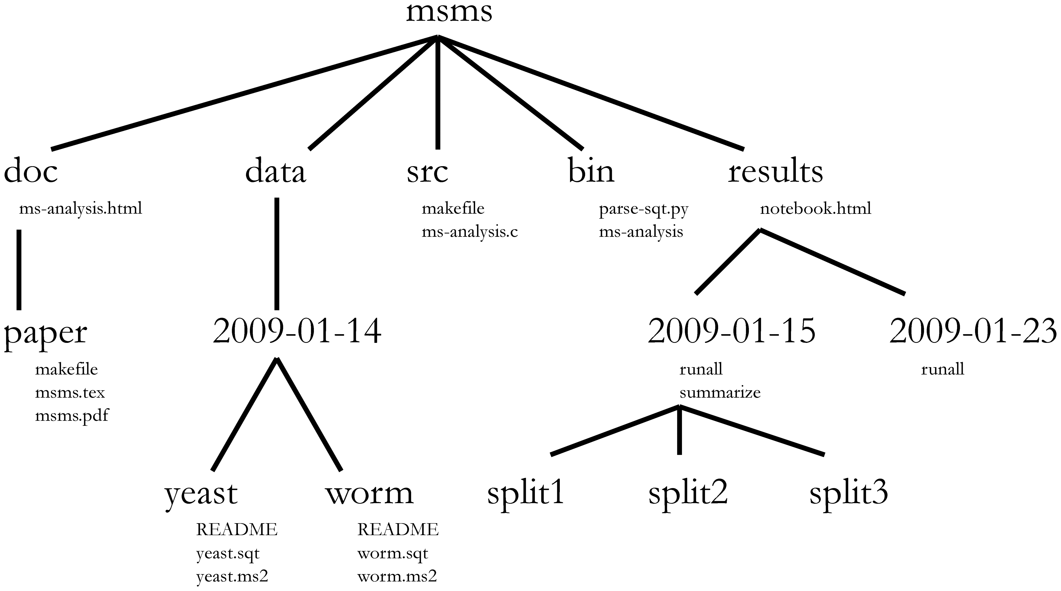
Directory structure
Choosing a consistent directory structure will help you (and your collaborators) find things later on.

Slide 7
Exercise: download and unzip git repo
Download and unzip the course repository at https://github.com/rvosa/ngs-workflows/zipball/master
Read the article http://dx.doi.org/10.1371/journal.pcbi.1000424

