Slide 1
Visual workflows
14 September 2012, 9.30-10.30
Notes:
Introduce concept of visual workflows. Yahoo pipes, PISE, Keppler, Galaxy, Taverna, Genome browsers.

Slide 2
Visualization

Slide 3
Visual pipeline metaphor

Slide 4
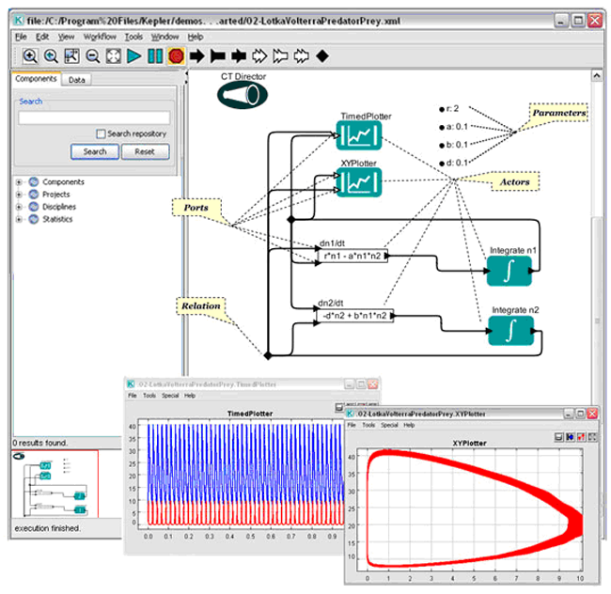
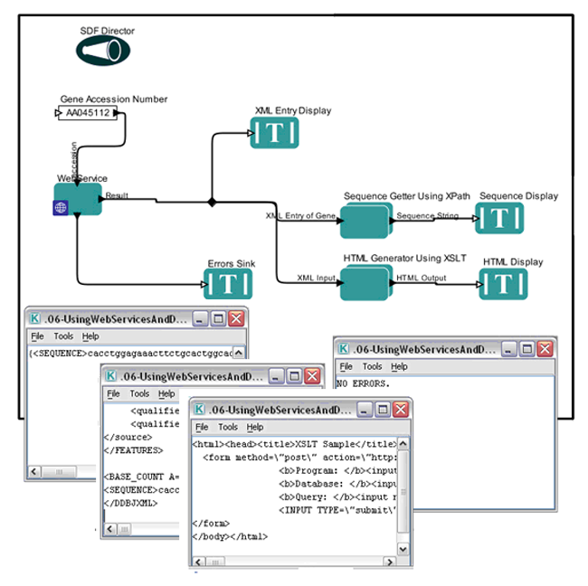
Kepler

Slide 5
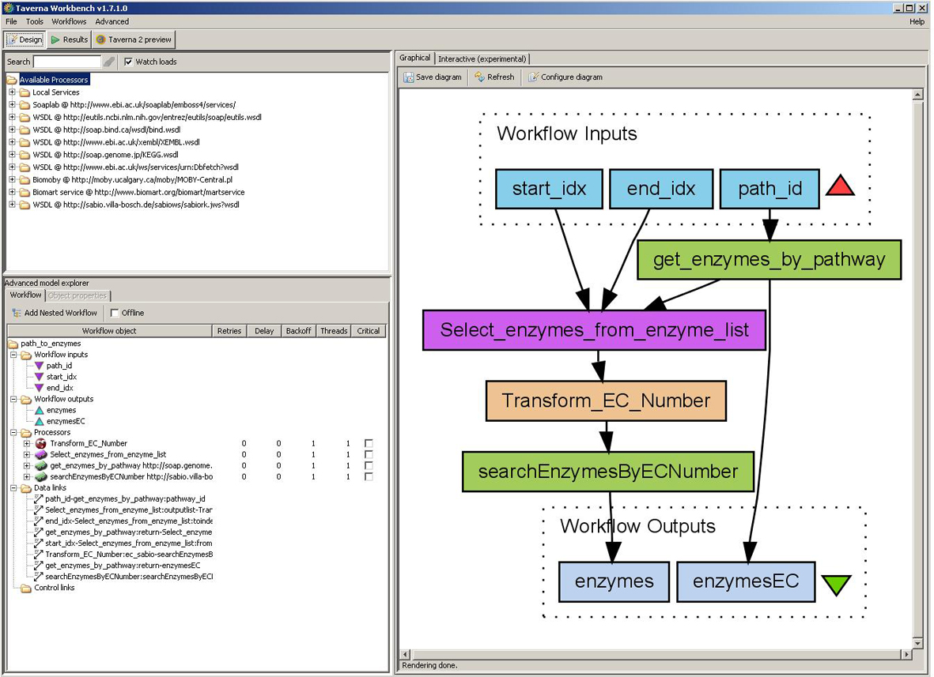
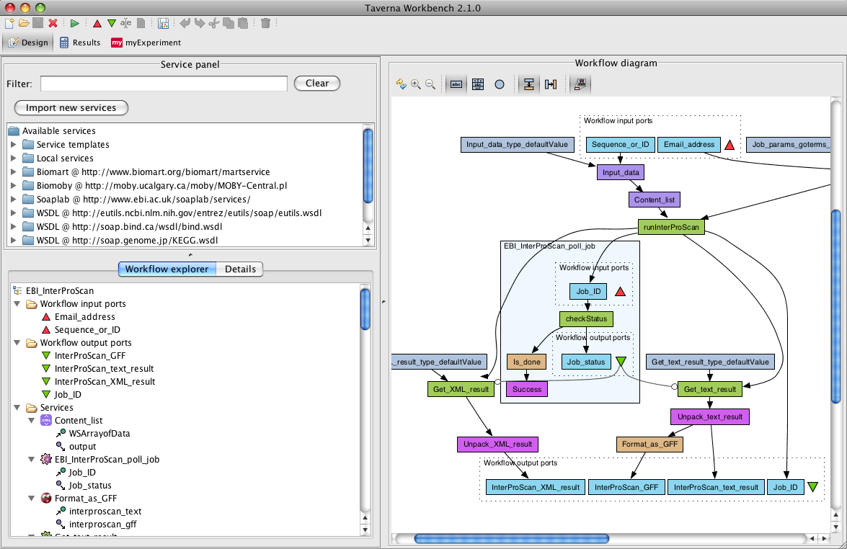
Taverna

Slide 6
Web-based

Slide 7
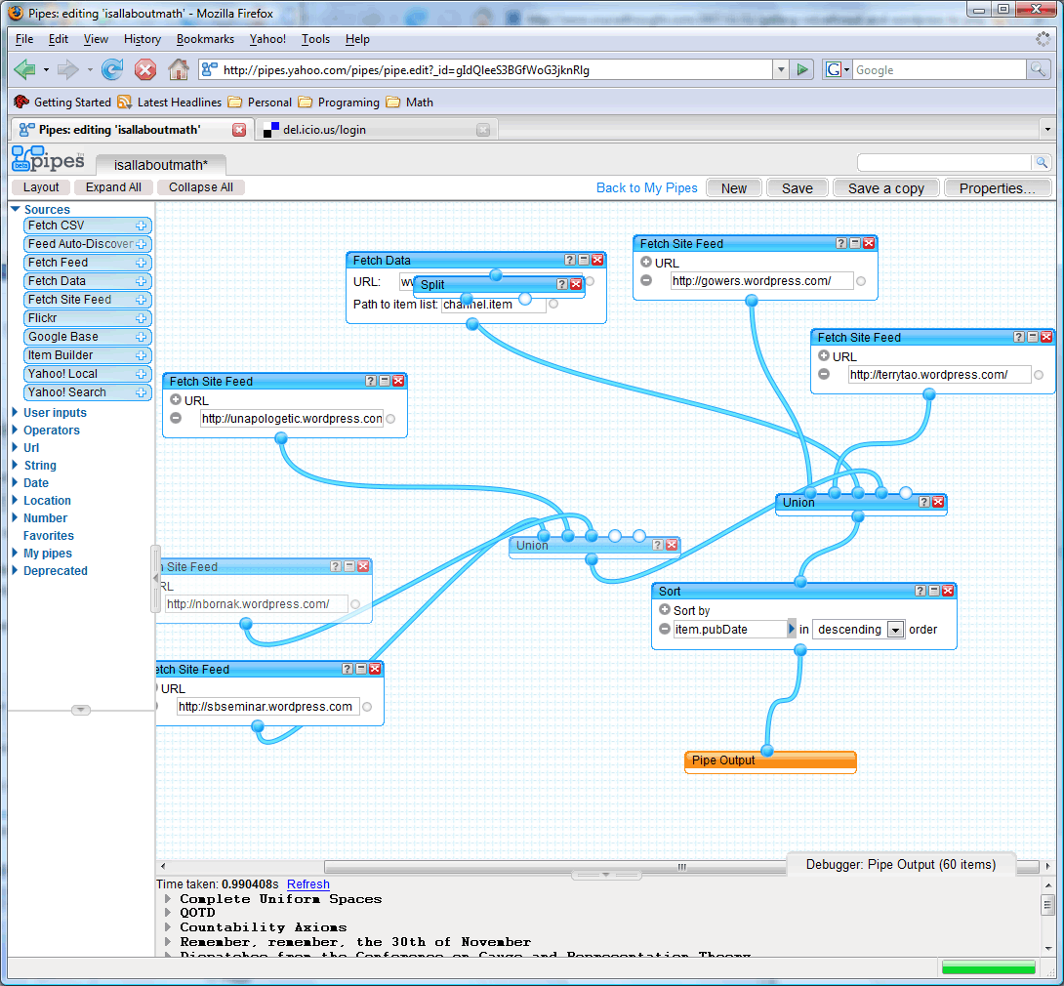
Yahoo! pipes

Slide 8
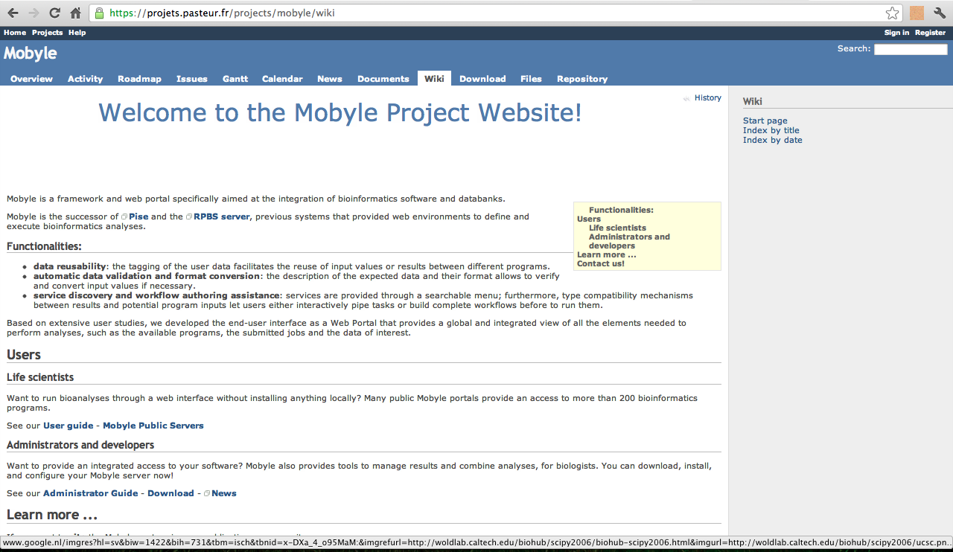
Mobyle

Slide 9
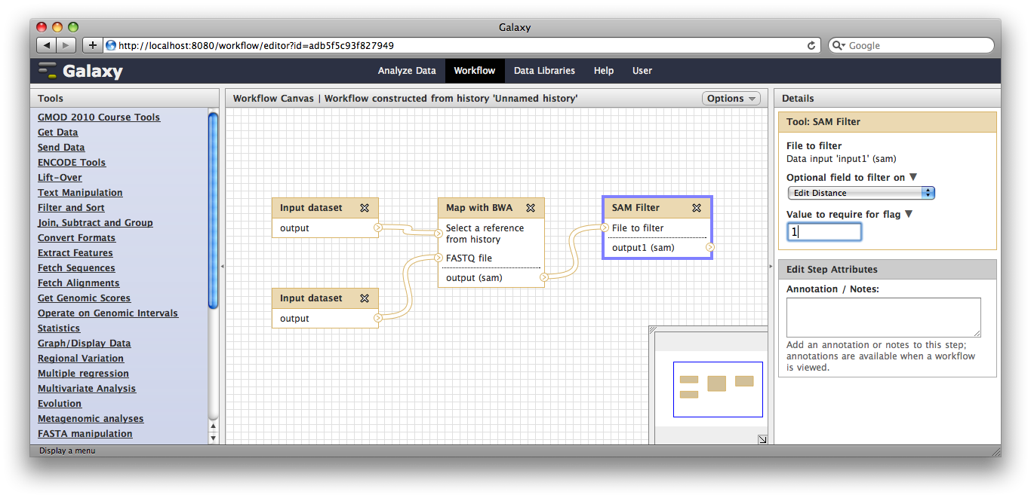
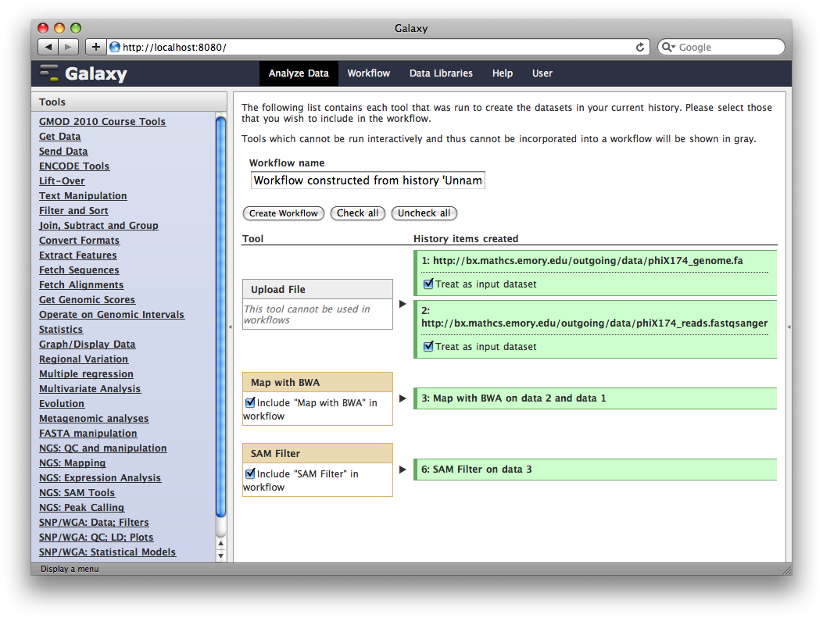
Galaxy

Slide 10
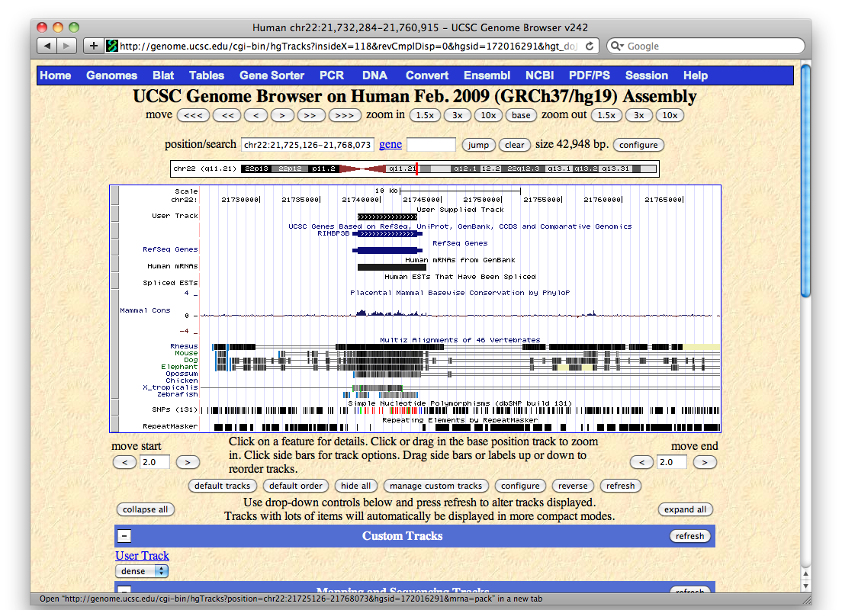
Genome browsers
UCSC genome browser

Slide 11
Exercise: galaxy
Notes:
Make an account

