Slide 1
Data sharing
14 September 2012, 11.00-12.30
Notes:
Introduce data sharing platforms. Short read archives. Sneaker net. Open data movement. Databases, FTP, rsync, WeShare, DropBox, Google Drive, github, galaxy data sets, biotorrents. Exercise FTP?

Slide 2
SRA’s and data volume

Slide 3
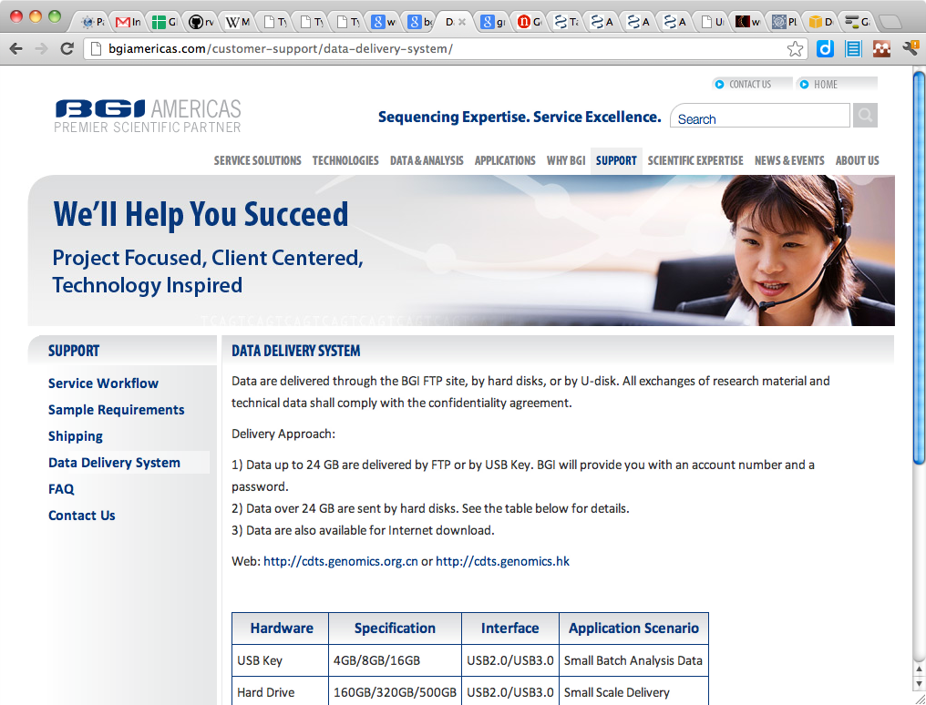
SneakerNet

Slide 4
Databases

Slide 5
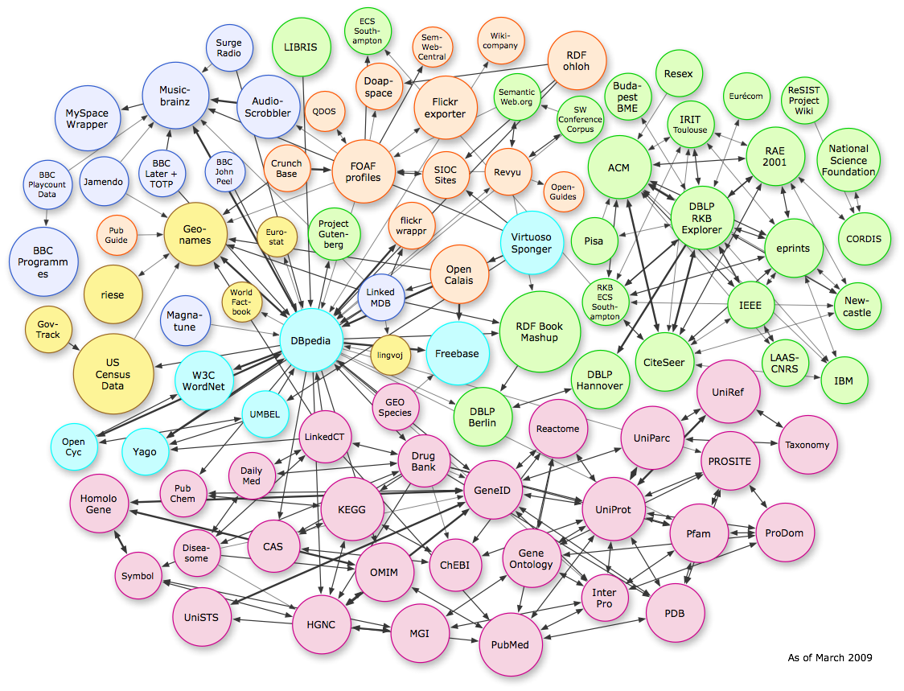
Semantic web

Slide 6
Open data

Slide 7
FTP

Slide 8
Rsync

Slide 9
WebDAV

Slide 10
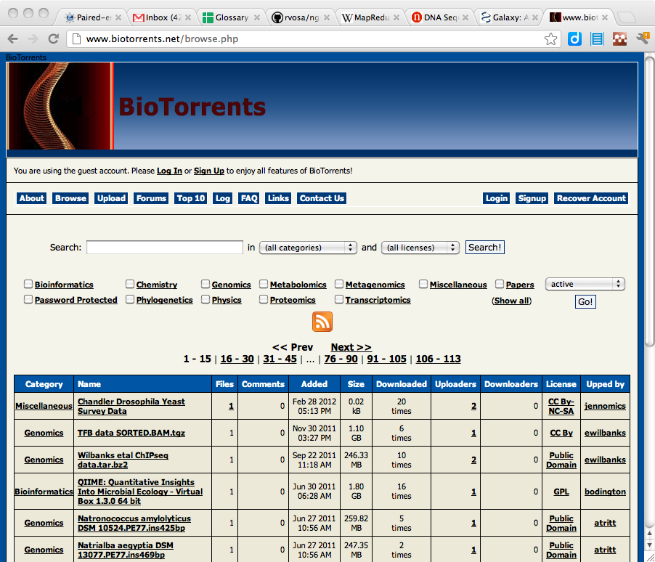
Torrents

Slide 11
Version control

Slide 12
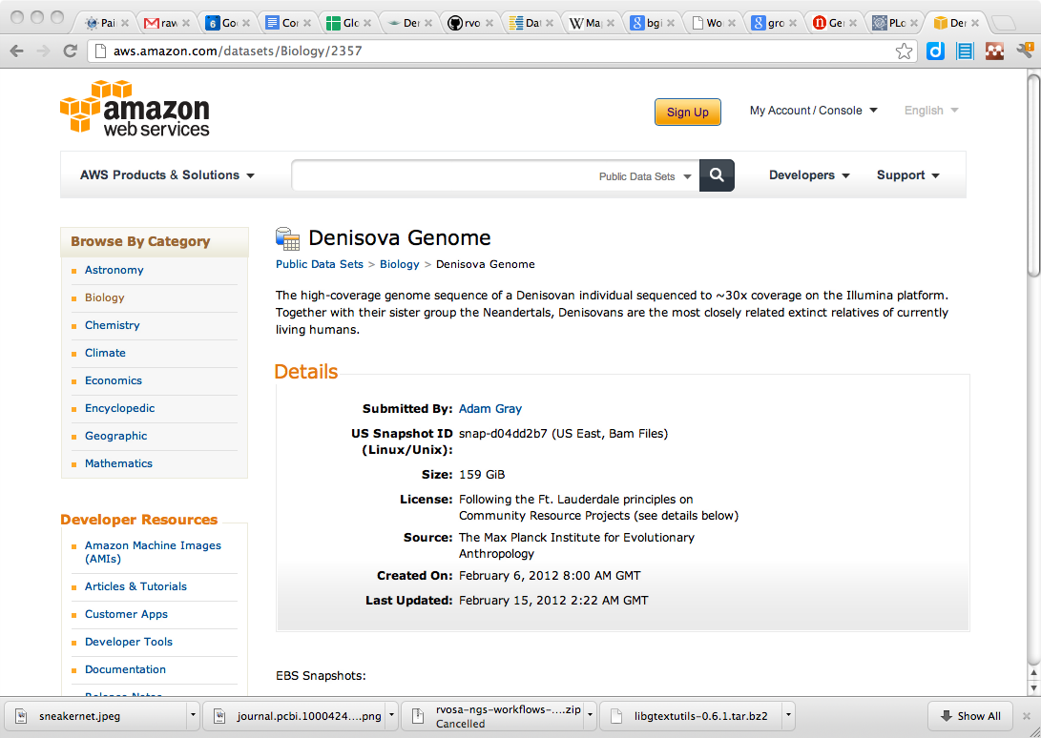
Proprietary systems
WeShare
Google Drive
DropBox
Amazon S3

Slide 13
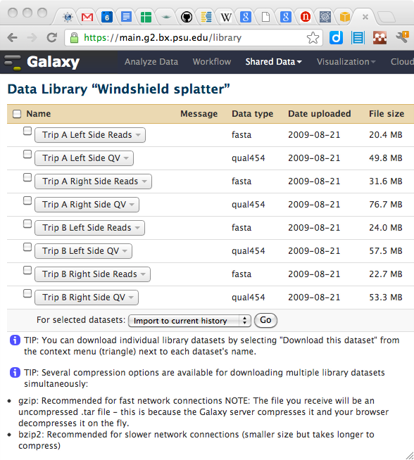
Galaxy data

Slide 14
Exercise: upload to galaxy

