Slide 1






HR Analytics: Using ML To Predict Employee Turnover
Earl Boston, 2017
Matt Dancho Founder Business Science mdancho@business-science.io | Business Science 570.419.4337 @bizScienc www.business-science.io

Slide 2
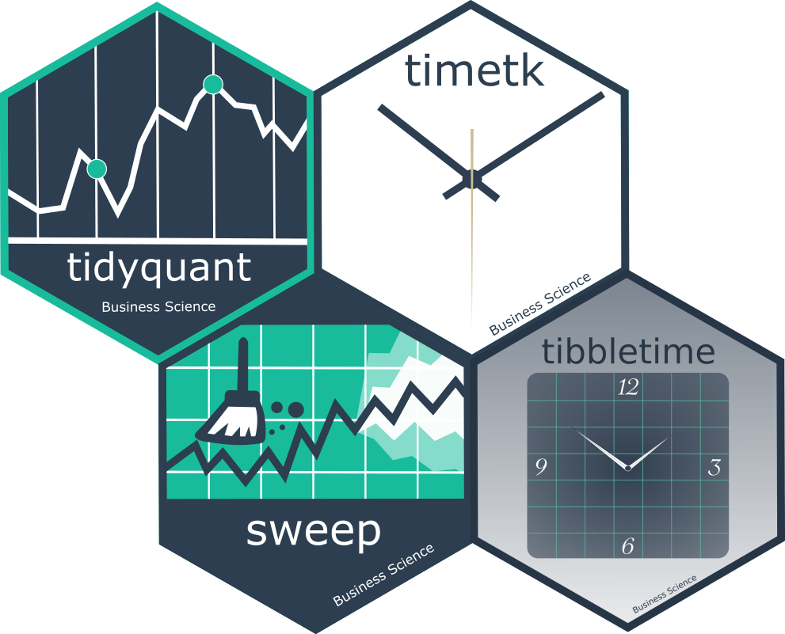
What We Do
Consulting
Executive Leadership
Bolt-on data science team
ML + Leadership = Good Decision Making
Community-driven
Educate data scientists
Open Source Software
Courses coming in 2018!

Slide 3
How We Help The Business
Executive Leadership
Education
Focus on significant problems
Data Management
Collecting data that yields results
Building a data management process
Data Science
Benefit from machine learning
How data fits into the picture
Distributing analytics
Risk mitigation
Making decisions with ML insights
How ML can help

Slide 4
Business Science Approach
Systematic Process, Adaptive Approach
Learn System
Model System
Build ML into Decision Making

Slide 5
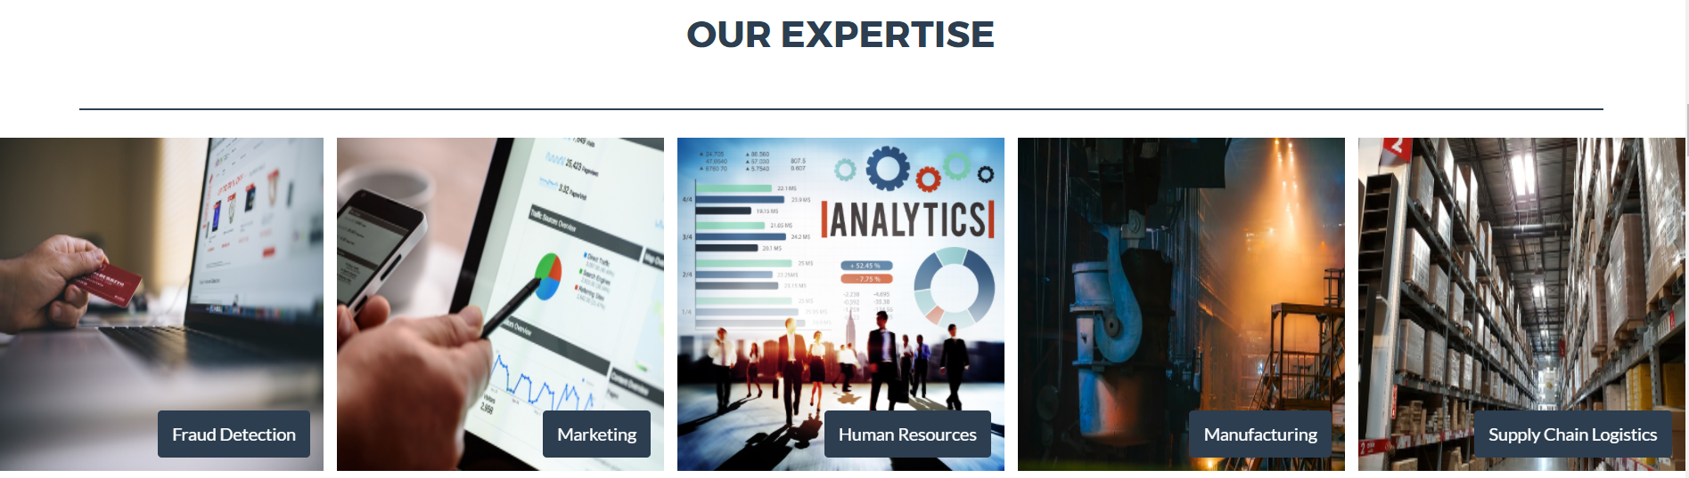
Business Science Expertise
Apply Systematic Approach To Any Problem

Slide 6
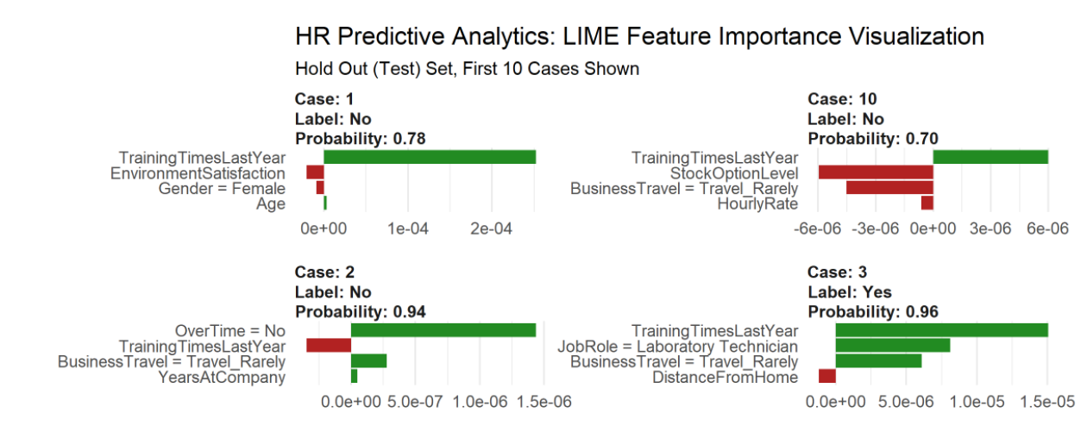
Case Study: HR Analytics
Using machine learning to predict & explain
employee turnover

Slide 7
3 Reasons You Should Listen
Employee attrition: A HUGE PROBLEM
New techniques to predict & explain turnover
Framework for ML in business applications

Slide 8
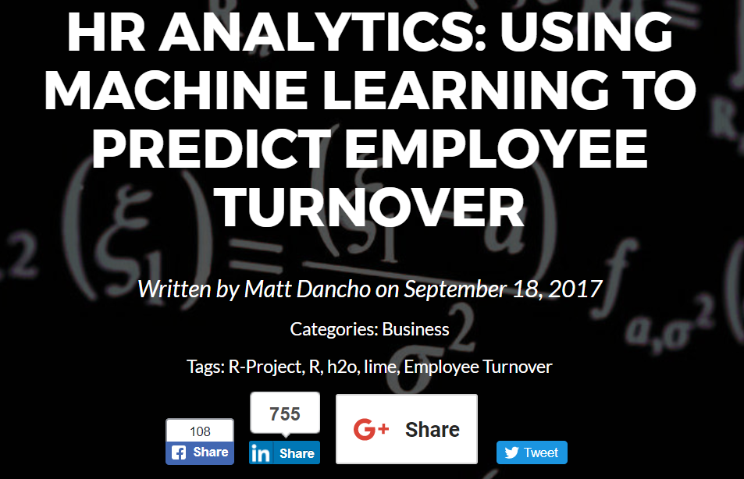
A 4th Reason: It’s Popular
Also featured on:
R-Bloggers ● KDNuggets ● LinkedIn
Code available in article:
http://www.business-science.io/business/2017/09/18/hr_employee_attrition.html
Just google:
“Predict Employee Turnover”

Slide 9
Employee Turnover
“You take away our top 20 employees and
overnight we [Microsoft] become
a mediocre company.”
-Bill Gates

Slide 10
Cost Of Turnover
Organizations face huge costs resulting from employee turnover
Most important costs are intangible:
When productive employee quits
Lost: New product ideas, great project management, or customer relationships

Slide 11
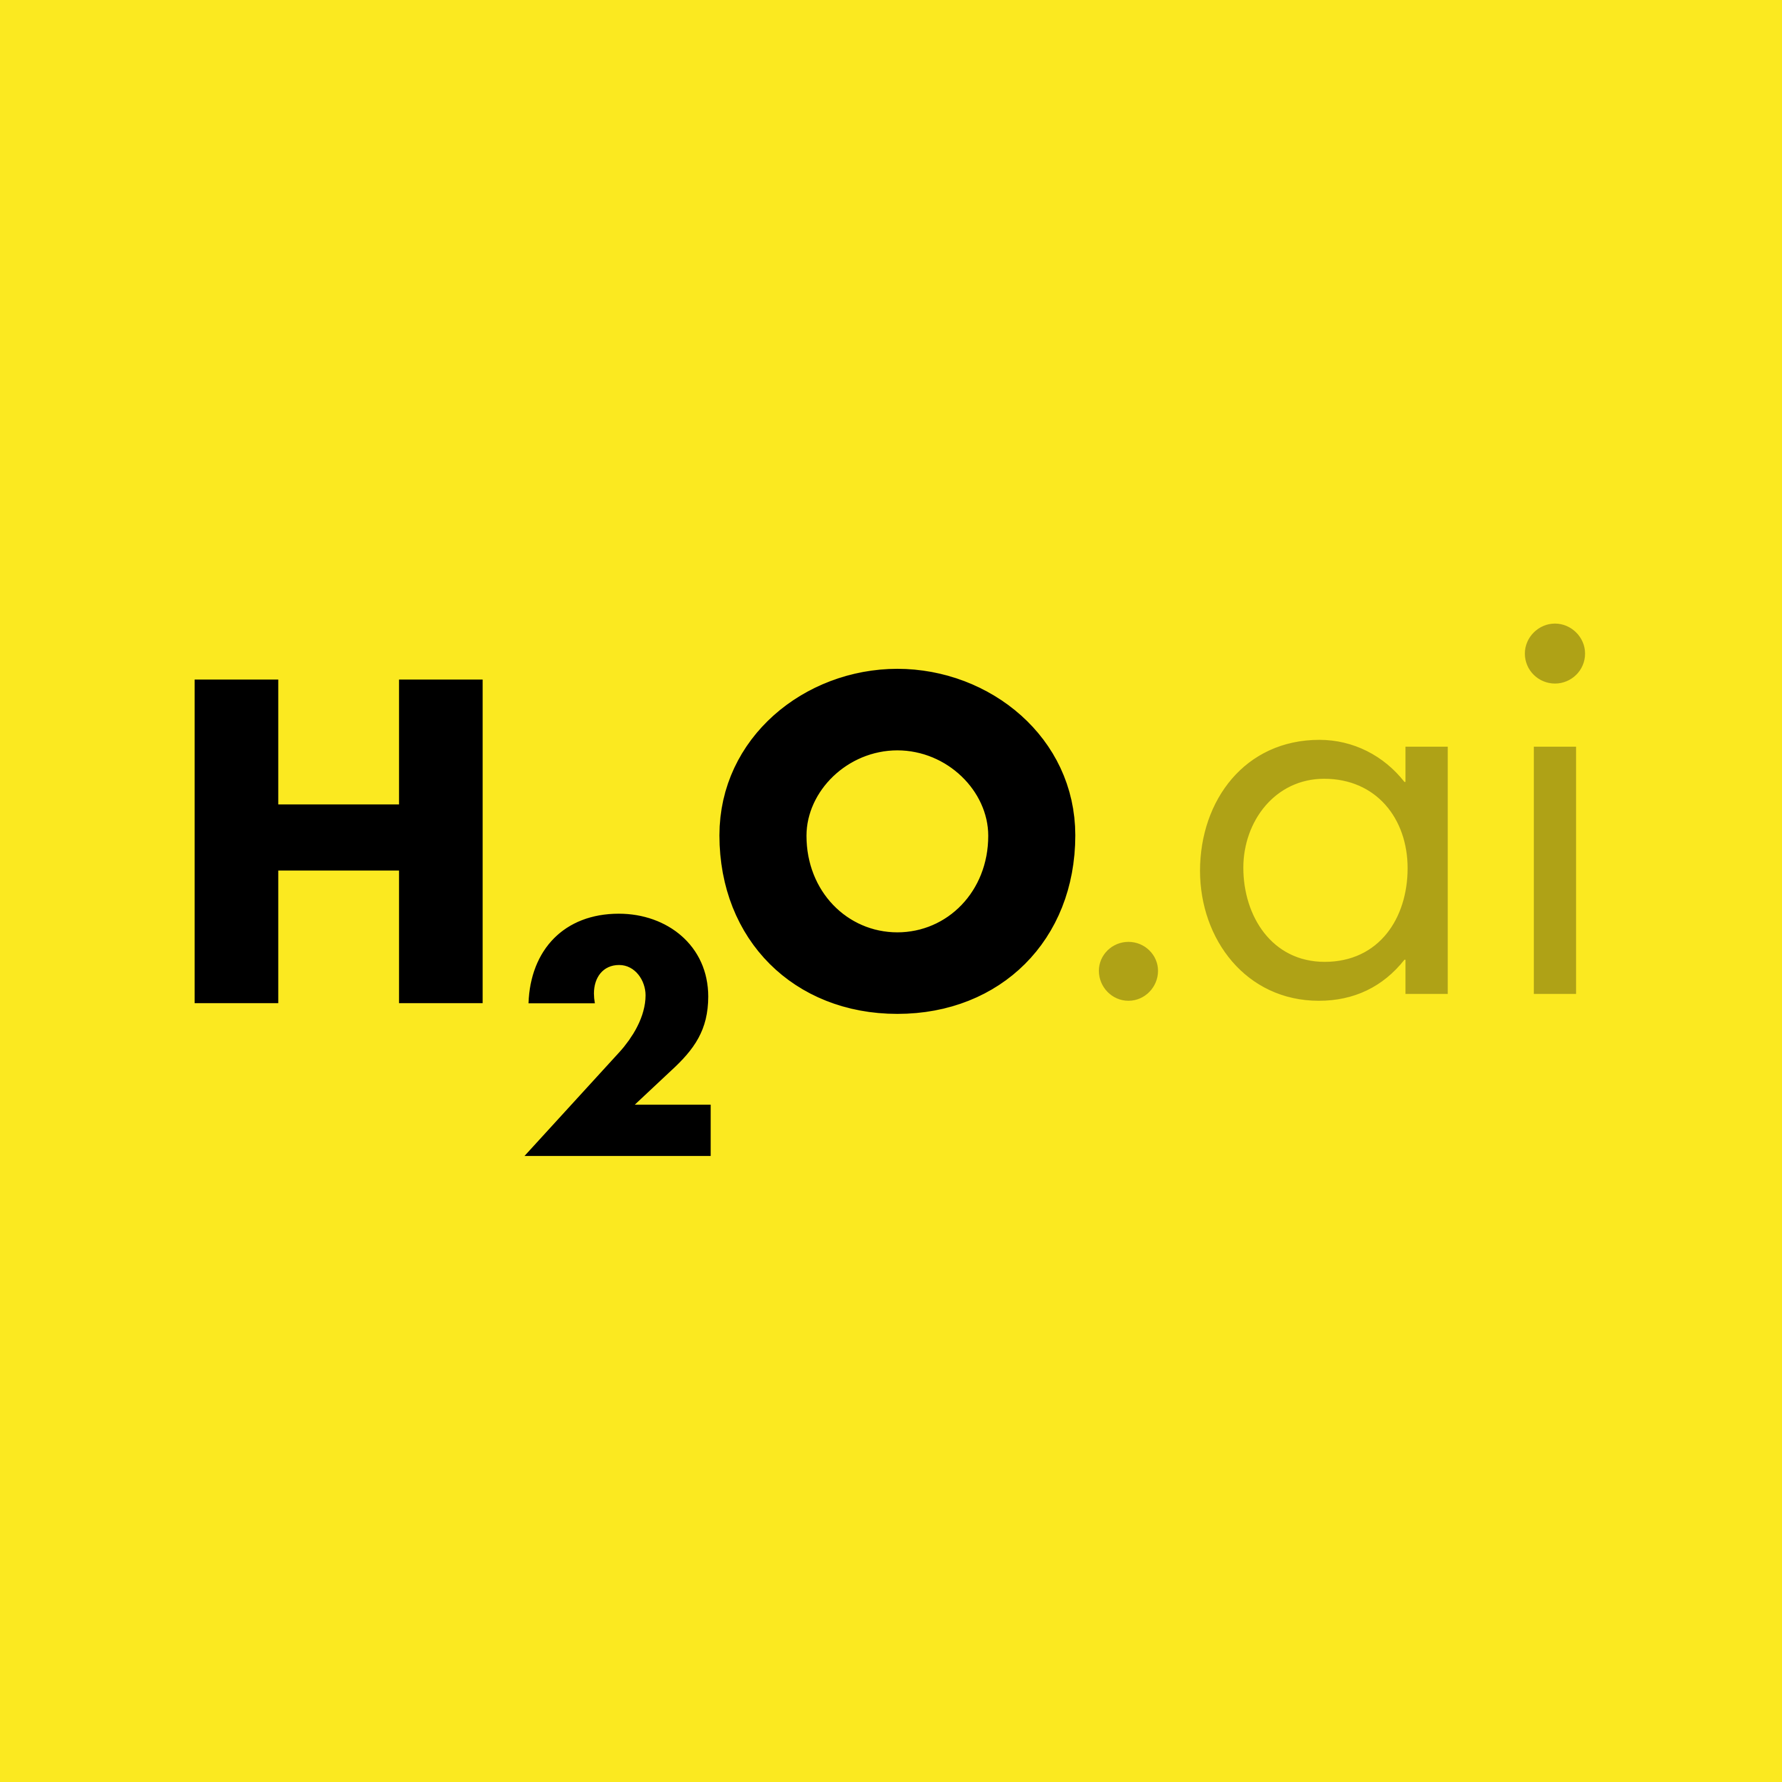

ML Tools Are Evolving
H2O
Automated Machine Learning
Predict at very high accuracy
Complex models can’t be explained
LIME
Used to explain ML classifiers
Deep learning, stacked ensembles now explainable

Slide 12
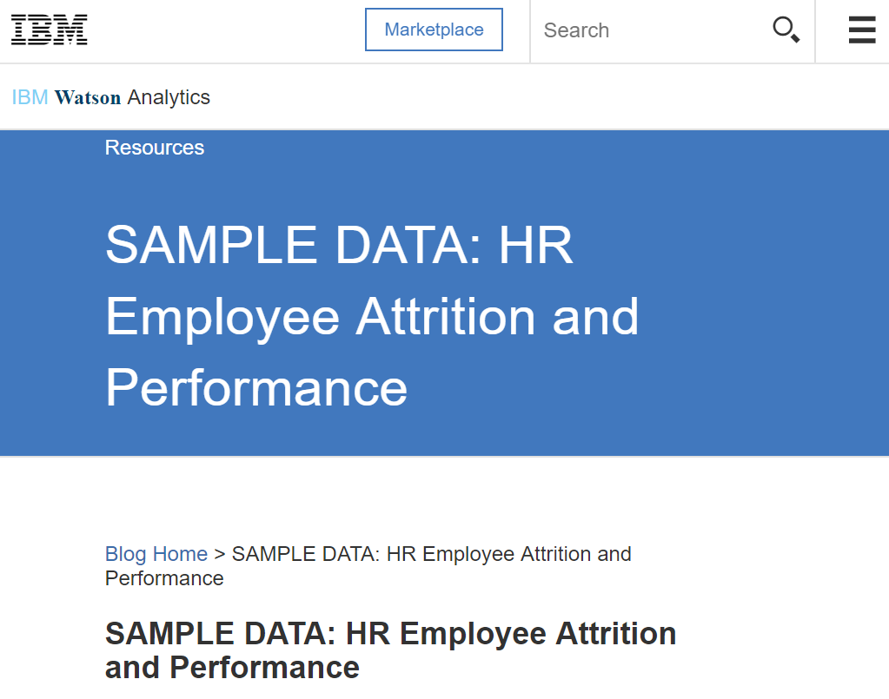
IBM Watson Data
Simulated HR Database
Representative of real-world data
Used for IBM Watson Case Study
Source: https://www.ibm.com/communities/analytics/watson-analytics-blog/hr-employee-attrition/

Slide 13
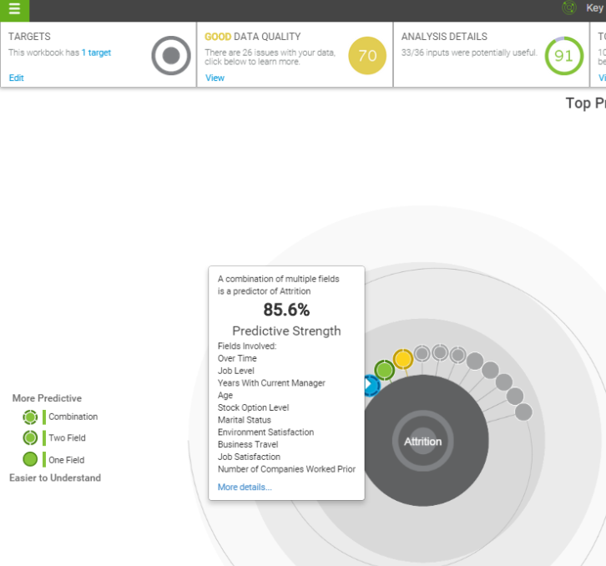
Goals
Improve predictive accuracy
Explain features that drive model
Beat & explain this
Source: https://www.ibm.com/communities/analytics/watson-analytics-blog/watson-analytics-use-case-for-hr-retaining-valuable-employees/

Slide 14
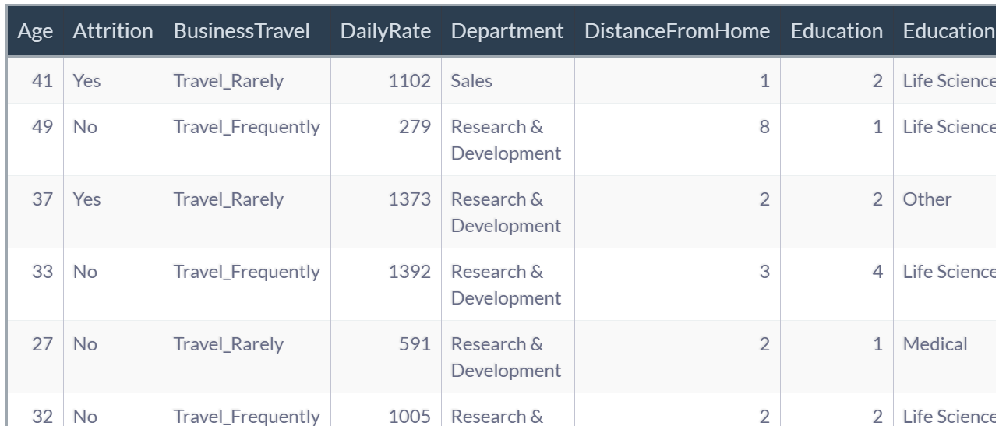
Feature Set
HR Dataset
35 Features
1,470 Observations

Slide 15
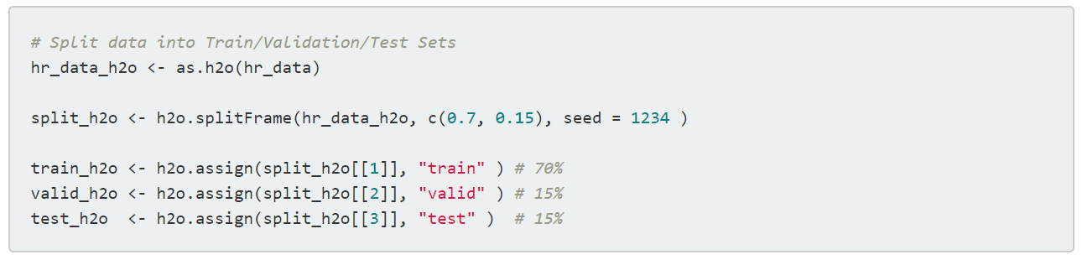
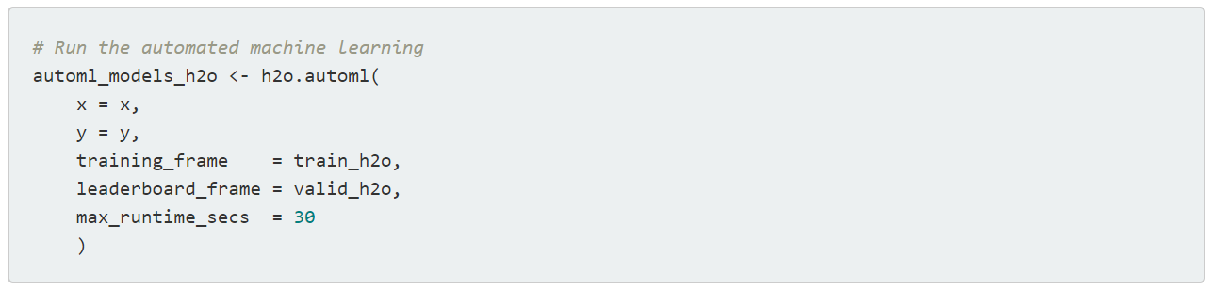
Modeling With H2O
Training the model
Automated ML:
-Deep Learning
-Ensembles
-GBM

Slide 16
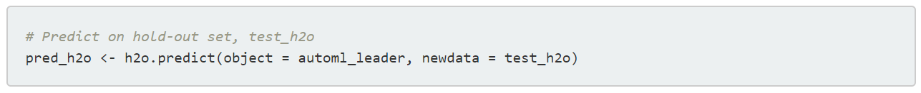
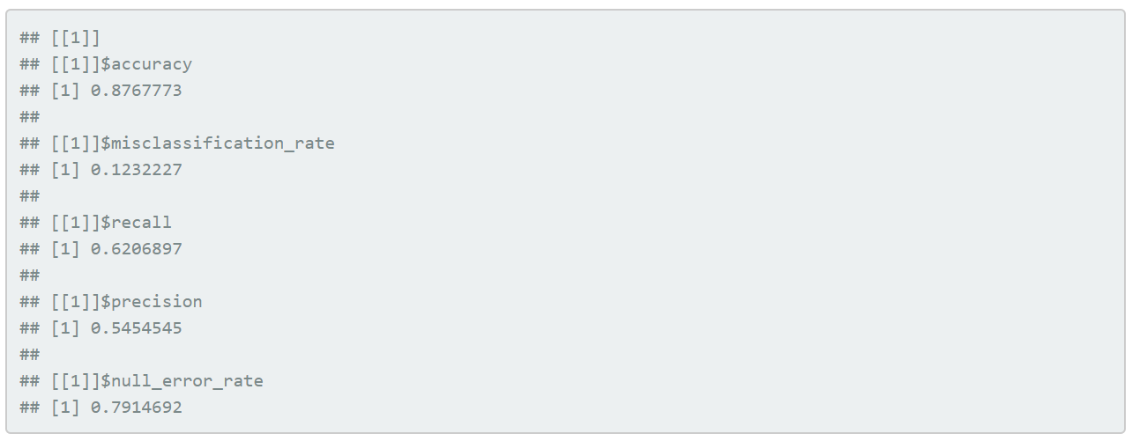
Modeling With H2O
Prediction: Test Data (Unseen)
Performance: 88% Accuracy
Important for Goal
Important for Business Case
Puts Accuracy Into Perspective

Slide 17
HR Implications
Recall = 62%
Will correctly classify those at risk of turnover 62 of 100 times
Critical to the business
62% of at risk employees that can be targeted preemptively
Precision = 54%
Will avoid incorrectly assigning “Yes” 54 of 100 times
Better to target incorrectly than miss
Should not sacrifice Recall

Slide 18
Have a great model, but…
how do we prevent turnover?

Slide 19
LIME
Local Interpretable Model-Agnostic Explanation
Theory
LIME approximates model locally as logistic or linear model
Repeats process 5000X
Outputs features that are important to local models
Result: Data Scientists Understand Why Model Predicts What it Predicts

Slide 20
LIME
Complex classification models can now be interpreted
Black Box Models
Neural Networks, Ensembles, Random Forests
H2O and LIME now integrated!
https://github.com/thomasp85/lime

Slide 21
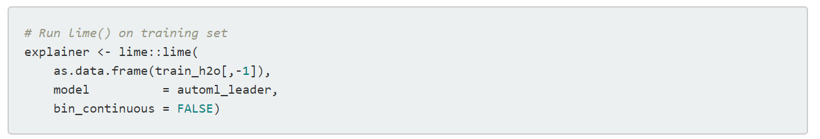
LIME
Step 1: Create explainer using lime()
Create explainer object

Slide 22
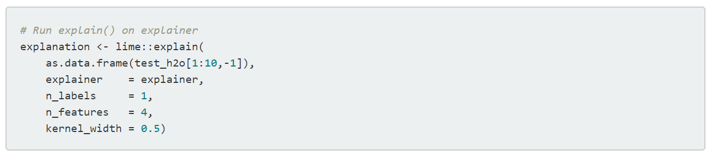
LIME
Step 2: Create explanation using explain()
Explain new observations

Slide 23
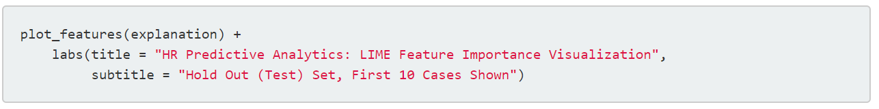
LIME
Step 3: Plot Feature Importance

Slide 24
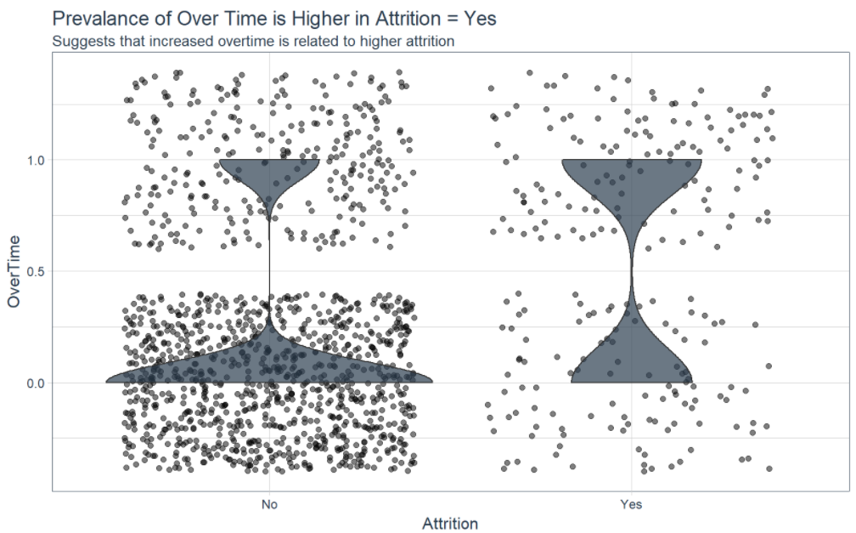
LIME
Step 4: Investigate Important Features
Overtime

Slide 25
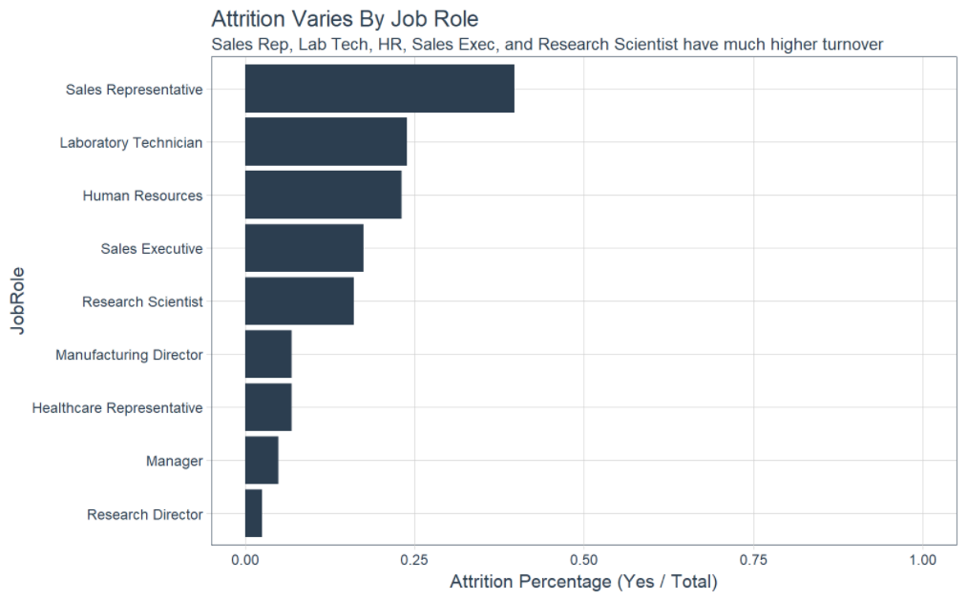
LIME
Step 4: Investigate Important Features
Job Role

Slide 26
What About Real World Applications?
Client Case Study
Fortune 500 firm
Modeled executive potential using more sophisticated process
Our algorithm identified 16 employees that predicted as executive potential but were not targeted by client

Slide 27
Conclusions
Can use predictive analytics & ML for HR
Predicted turnover
88% Accuracy
62% Recall ← Important!
Can explain black-box model
Turnover greater based on Job Role & Overtime
Framework for high accuracy & explainability

Slide 28
We’re done right? No!
Risks
How do we know model is right? Model not back-tested
Time: Cross-sectional analysis, model not adaptive
What do we do when model breaks down?
Model: Your model will change, can’t trust blindly
Only certainty: CHANGE

Slide 29
Business Science Approach
Systematic Process, Adaptive Approach
Learn System
Model System
Build ML into Decision Making

Slide 30
Client Archetype
Seeking predictive analytics to:
Understand business problem as a system
Increase profitability
Make better decisions
Mitigate data science risks
Convey insights to stakeholders
No data science team
“Business Science is your
Bolt-On Data Science Team”

Slide 31
Need Data Science for Business?
Contact Business Science!
Business Science www.business-science.io/contact 570.419.4337
Matt Dancho Founder mdancho@business-science.io
Try our software!

