Slide 1
A Time Series Platform For The Tidyverse
Matt Dancho
Founder & CEO, Business Science
business-science.io
June 1, 2018

Slide 2
About Business Science
We are applications people that build tools to solve tough problems
We serve the data science community
We empower data scientists via education

Slide 3
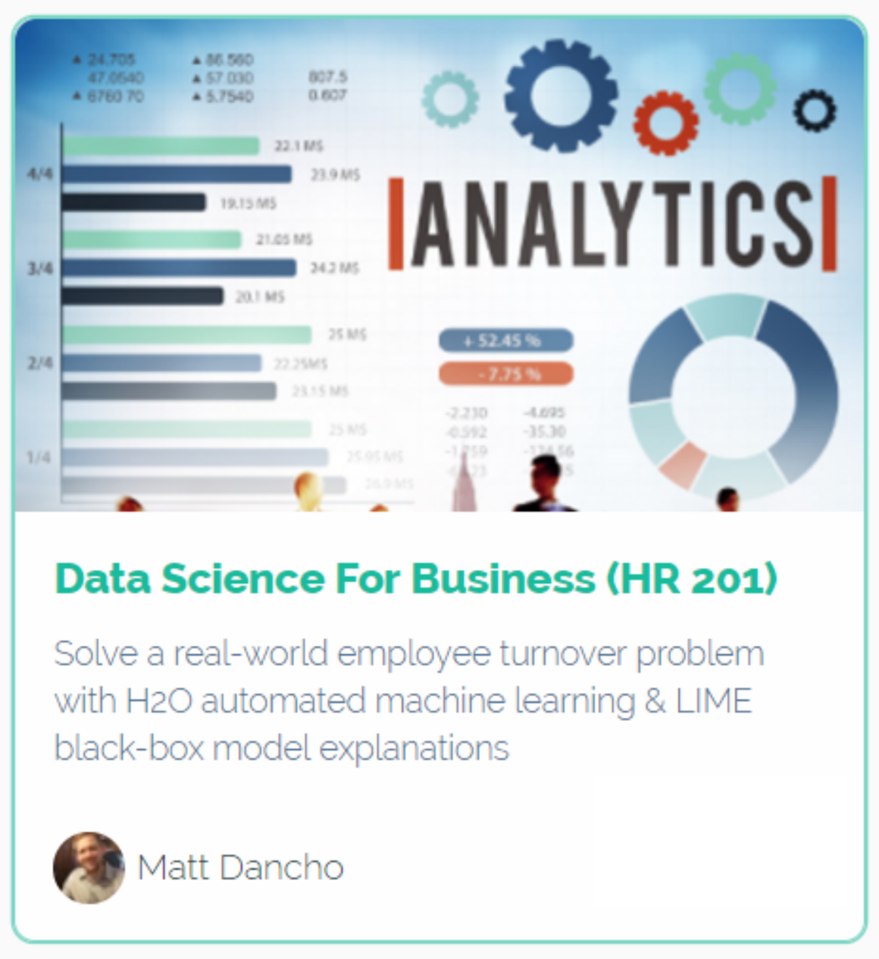
Business Science University
Data Science For Business
BSPF
Tidy Eval
H2O
LIME
Enrollment
Student Satisfaction Rating: 9.1 / 10
DS4B_15 (15% OFF in June)
university.business-science.io
Real World
CHURN Problem!

Slide 4
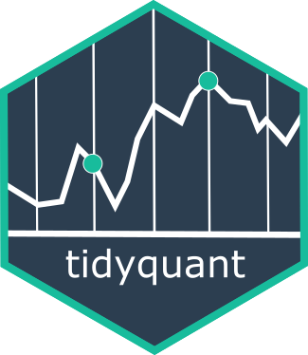

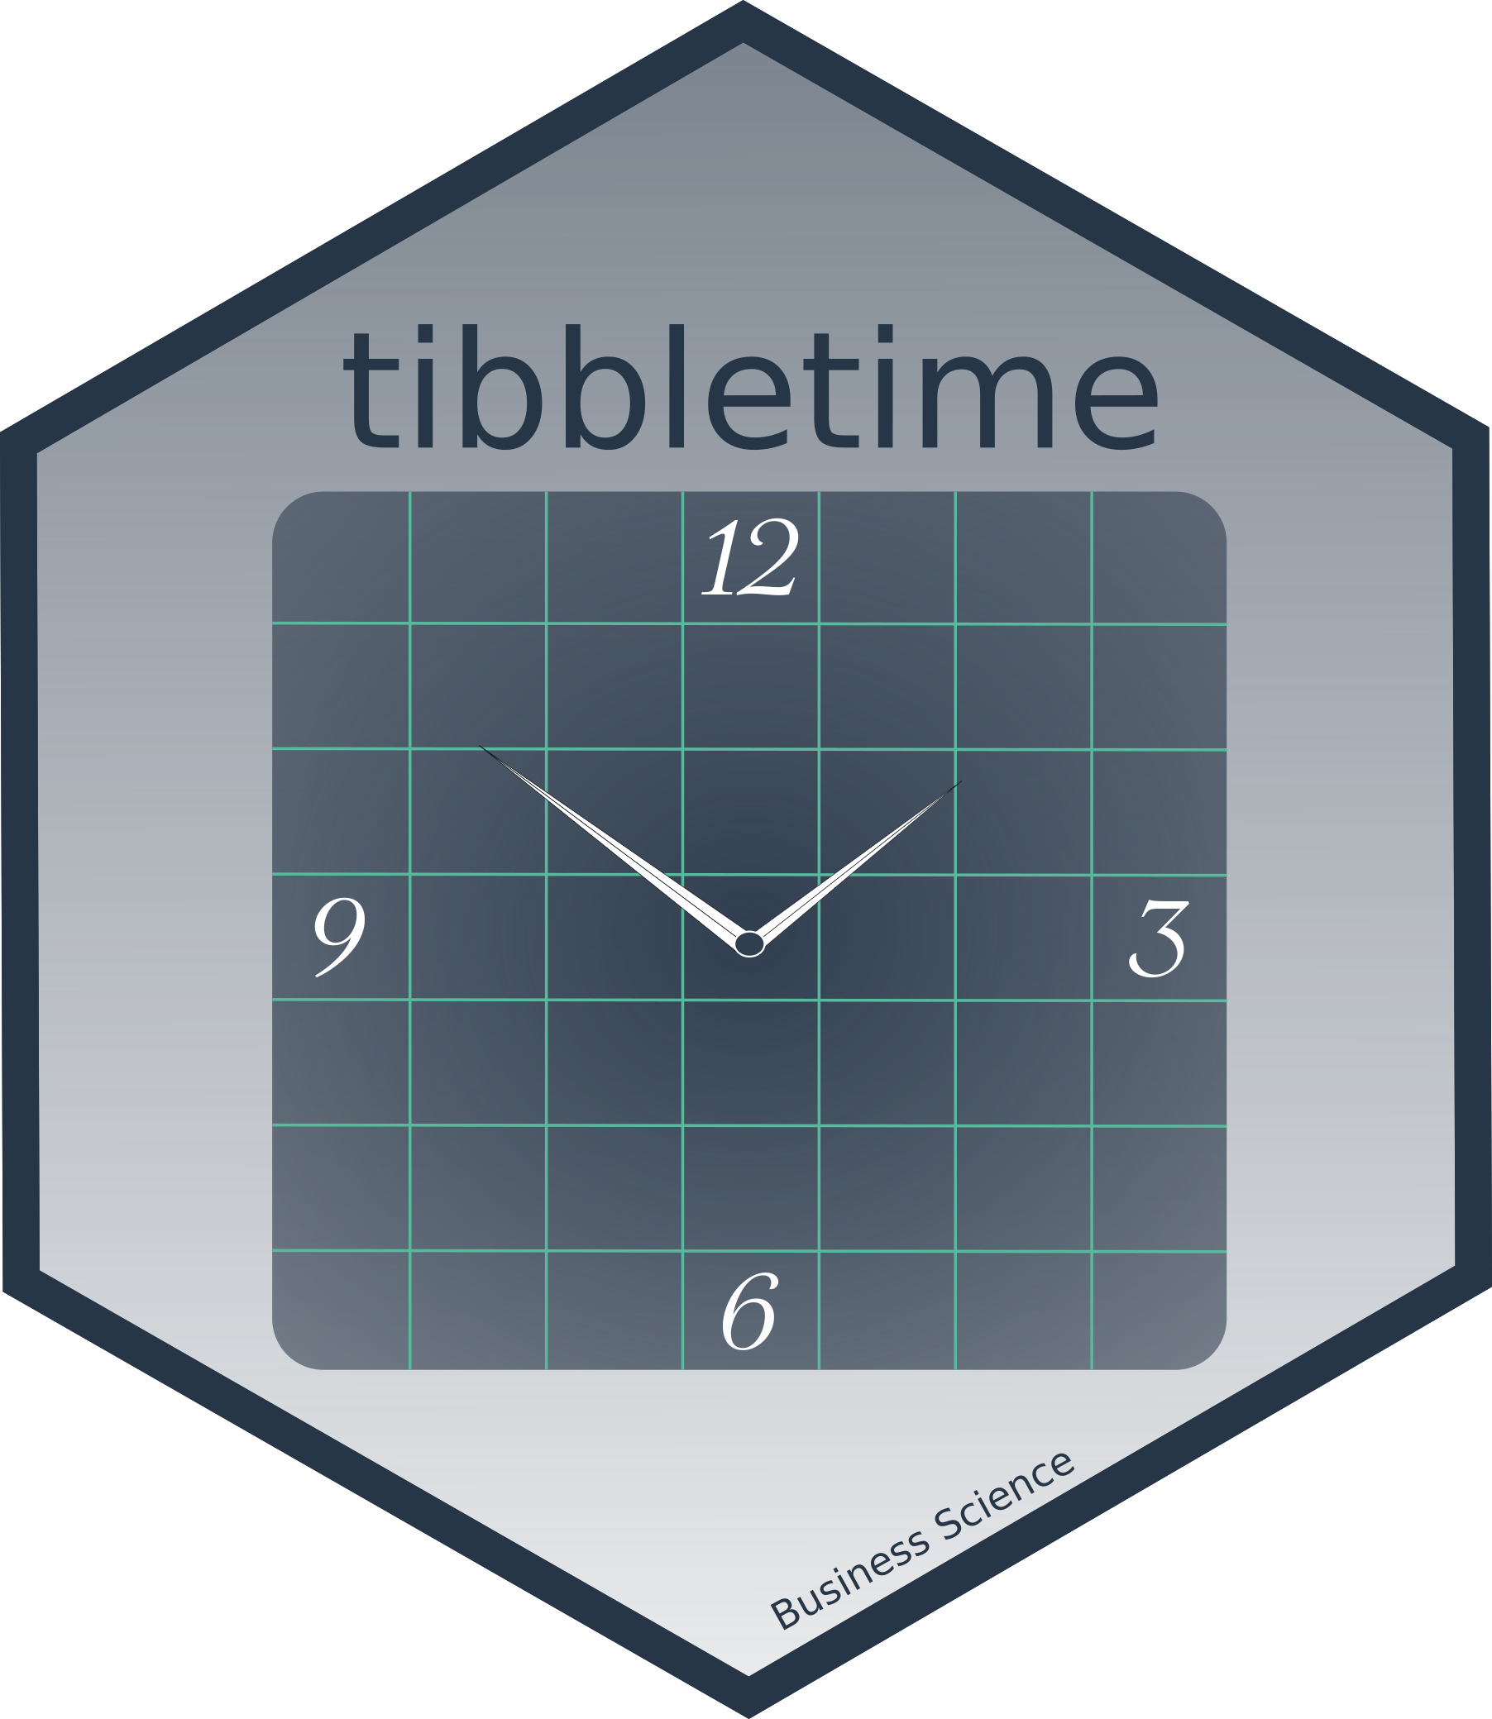


Open Source Packages
NEW!!
Anomaly Detection
Most Popular
Financial Data
Stock/Portfolio
Analysis
Time-Aware
tibbles
Helps Do Time-Based
Forecasting
w/ forecast
Time Series ML

Slide 5
Open Source Packages
NEW!!
Anomaly Detection
Time Series Platform
tidyverse
Most Popular
Financial Data
Stock/Portfolio
Analysis
Time-Aware
tibbles
(dplyr)
Helps Do Time-Based
Forecasting
w/ forecast
Time Series ML

Slide 6
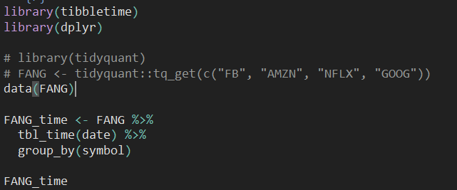
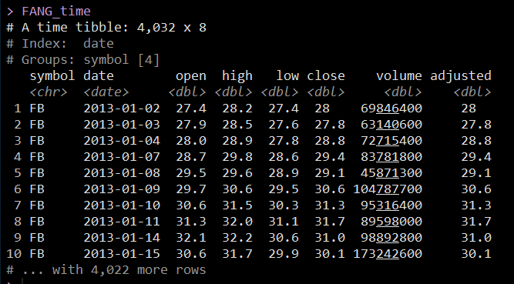
What Is tibbletime?
Set up a time-aware tibbletime object

Slide 7
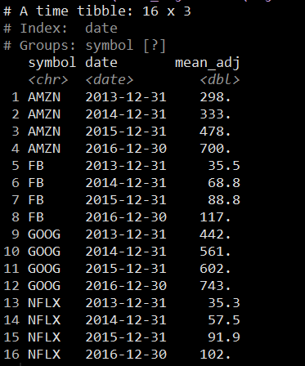
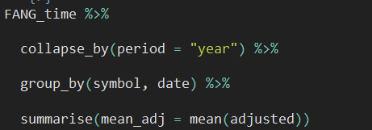
What Is tibbletime?
Work with time index using tidyverse infrastructure

Slide 8
What Is tibbletime?
Scalable grouped analysis
at your fingertips
Popular functions:
collapse_by()
rollify()
filter_time()
as_period()
Documentation:
https://business-science.github.io/tibbletime/

Slide 9
Open Source Packages
NEW!!
Anomaly Detection
NEW: Business Science Labs
PROJECT 001:
Algorithmic Trading
Backtest Optimization
with
Quantopian’s Zipline
in R
tibbletime
+
furrr
+
flyingfox
Most Popular
Financial Data
Stock/Portfolio
Analysis
Time-Aware
tibbles
(dplyr)
Helps Do Time-Based
Forecasting
w/ forecast
Time Series ML

Slide 10

Companion Blog Article
http://www.business-science.io/business-science-labs/2018/05/31/backtesting-quantopian-zipline-tibbletime-furrr-flyingfox.html

Slide 11
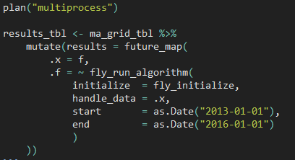
What Is furrr?
furrr = future + purrr
future
Parallel Processing
purrr
Iteration
furrr
Parallel Iteration
New
Replaces
map()

Slide 12


What Is flyingfox?
Quantopian’s Zipline
Backtesting Library for Algorithmic Trading Strategies
Python Only
reticulate
Connects to Python
flyingfox
Connects to Zipline using reticulate
Can Backtest ANY R Trading Strategy

Slide 13
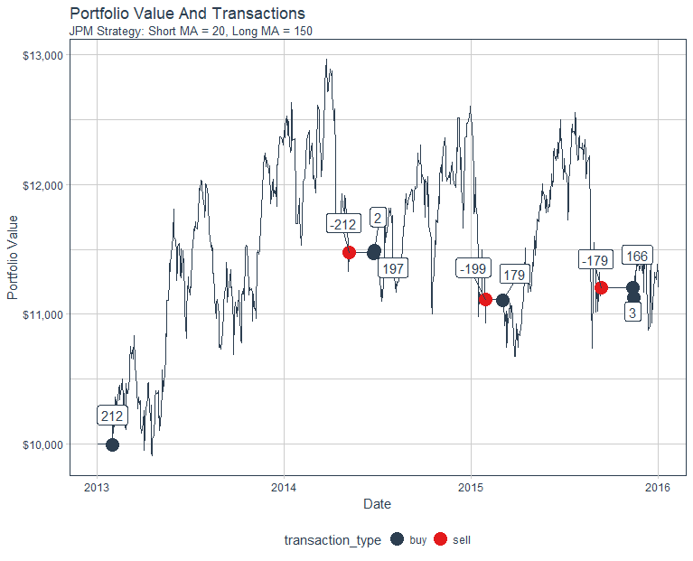
Usage Case: Backtested Order Optimizations
Zipline in R
JPM
Simple Moving Average Strategy
Short MA = 20 Days
Long MA = 150 Days

Slide 14
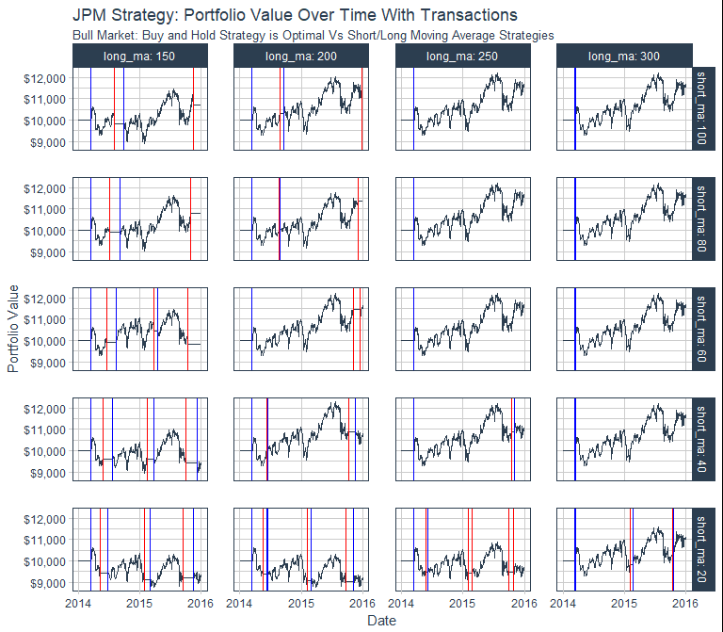
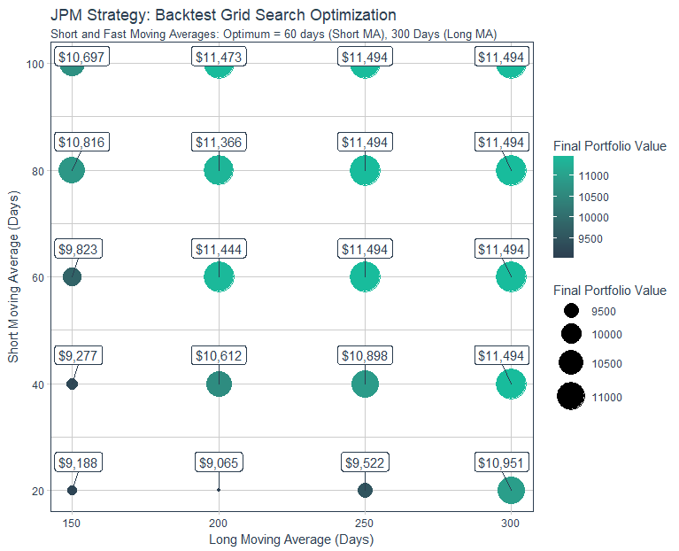
Usage Case: Backtested Order Optimizations
Optimized Backtests Using Grid Search – Parallelized With furrr

Slide 15
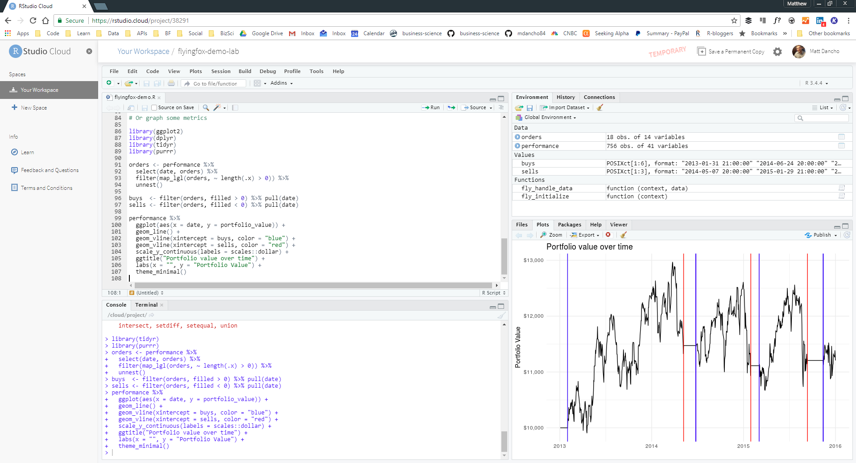
Try Backtesting With flyingfox
Experiment with flyingfox on RStudio Cloud
https://rstudio.cloud/project/38291

Slide 16

Business
+
Data
Science
business-science.io
university.business-science.io
DS4B_15 for 15%-OFF through June

