Slide 1
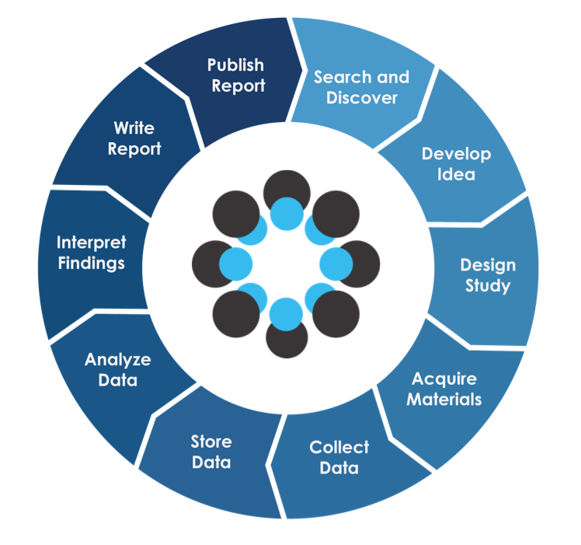
Session 6
Code
Repositories and Version Control
Nosek, B. A., Alter, G., Banks, G. C., Borsboom, D., Bowman, S. D., Breckler, S. J., … Yarkoni, T. (2015). Promoting an open research culture. Science, 348

Slide 2
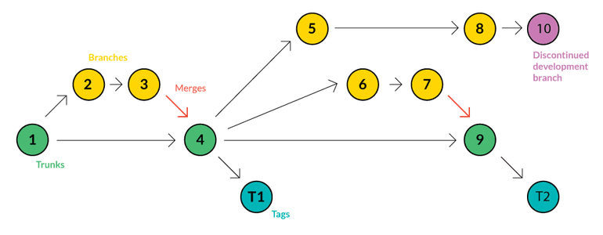
What is version control?
https://webinerds.com/version-control-systems-keep-your-code-in-order/

Slide 3
Configure Git
$ git config --global user.name „YOUR NAME“
$ git config --global user.email „YOUR EMAIL “
$ git config --global color.ui true
$ git config --list
Install Git on your computer (if not done)
Configure git and use same email as for github!
Time: 10 min

Slide 4
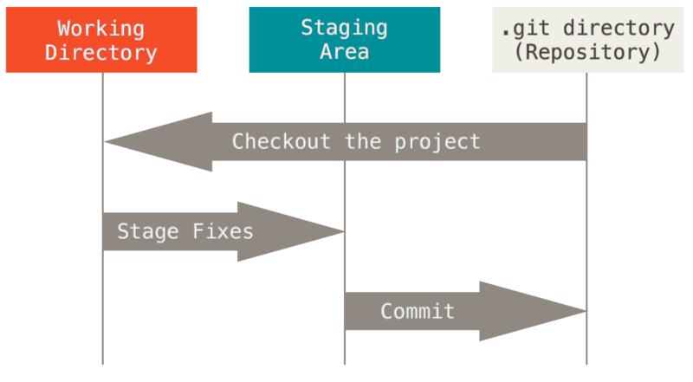
Git basics
ADD
COMMIT

Slide 5
Set up a local repository
Bash: go to the directory containing your code file
$ git init
$ git status
We are going to do this with Rstudio…
Time: 5 min

Slide 6
Stage files
$ git add my_new_file.txt
$ git status
$ git add . (--all --A)
$ git rm --cached my-file.ts
$ git status
Add all your code files to the staging area
Time: ~10 min

Slide 7
Commit files
$ git commit -m "Add three files"
$ git commit -a -m "Do something once more“
$ git reset --soft HEAD^
$ git add file-i-forgot-to-add.html
$ git commit --amend -m "Add the remaining file"
$ git status
Commit your files
Time: ~10 min

Slide 8
Remote repositories
create a repository on Github
DO NOT CREATE README, etc…
Make your neighbour a collaborator
$ git remote add origin <LINK>
$ git push -u origin master
$ git clone <LINK> folder-name
$ git pull
Push your code to a repository
Clone, pull, modify, and push to your neighbours repository
Time: ~25 min

Slide 9

Branches

Slide 10
Branches
$ git branch
$ git branch NAME
$ git branch
$ git checkout NAME
Make some changes
$ git branch
$ git checkout master
$ git merge NAME
$ git branch -d NAME

Slide 11
How often
commit
push
pull
merge
Project structure
Writing code

Slide 12
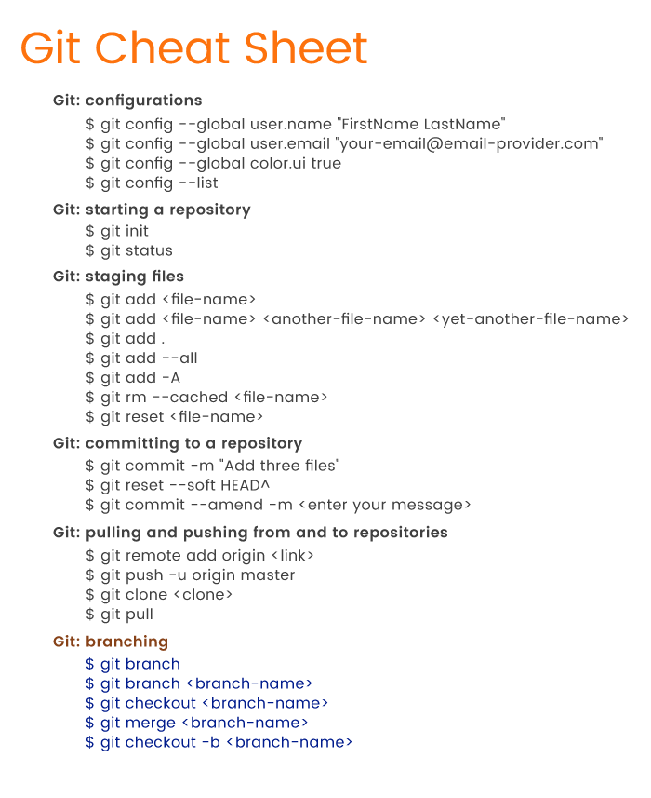
Rubygarage.org

Slide 13
Homework
Finish the tasks
Try to branch, modify, merge
Read markdown cheatsheet
https://github.com/adam-p/markdown-here/wiki/Markdown-Cheatsheet
String Manipulation in R with stringr

