Slide 1
ML Project
Loan Application Prediction Analysis
MSIS2508
Group Members:
Carina Meng
Irfan Basheer
John Sormark
Yuqing Cui
Notes:
Carina: 13-16
John: 1-4 17-18
Yuqing: 5-8
Irfan: 9-12

Slide 2
AGENDA
Project Overview – Project Definition
Strategy Overview
Loan Data Set
Data Preparation
Model Evaluation
Model Performance and Metrics
Results and Recommendations
Specific Business Cases
Conclusions
Notes:
Will complete once all slides/headings completed - John S.

Slide 3
Project Overview
ML-Analytics has been tasked to provide ABC Loans with machine learning (ML) modeling recommendations to predict the probability a loan defaults for future clientele. The goal is to deliver to the client the best prediction model/s for identifying loan defaults utilizing data analysis and machine learning techniques. The client has provided its existing loan application data set for the task and provided objectives to be solved for.
Project Deliverables:
Identify the best classifier to utilize for predicting defaulting on a loan.
Recommend best modeling classifiers based on client presented business cases.
Provide recommendations for risk assessment and gender business use cases.
GOAL: Provide the best predictive model for identifying loan defaults for ABC Loans.
Notes:
COMPLETE _ John S.

Slide 4
Strategy Overview - Objectives and Key Results (OKRs)
Objectives | Key Results
Improve the loan default prediction model/engine. | Provide the recommendation for the best modeling classifier.
Provide scenario insights for loan default predictions. | Identify the best modeling classifier for the business case scenarios.
Provide a classifier for predicting loan risk. | Provide the recommended classifier for predicting loan risk.
Validate gender based modeling performances. | Present modeling data by gender and recommendations.
Key benefits:
Reduction in total man hours to process defaulted loans.
Improves core competency, loan approval, provides value-add for clients and partners.
Lead to other product initiatives, e.g. client risk calculator.
Provides better visibility of future projections and company roadmap.
Notes:
100% COMPLETE - John S.
Update with default loan approach

Slide 5
Loan Data Set
Raw Data Set
Source
Kaggle - 'application_data.csv'
Original Shape: (307511, 122)
Primary key: “SK_ID_CURR” column
Target: Target variable (1 - default payments, 0 - on-time payments)
Clean/Pre-Processed Data Set Steps
Remove columns with more than 30% null values
(307511, 58)
Drop all rows with null value
(307496, 58)
Remove unwanted rows
Ex: 'FLAG_DOCUMENT_2', 'FLAG_EMAIL'
(307496, 28)
Convert all variables to metric
Get Dummies
Update/Delete ‘XNA’ values
'CODE_GENDER'
'ORGANIZATION_TYPE'
(252122, 28)
Notes:
Add test balancing

Slide 6
Loan Data Set
Raw Data Set
Source
Kaggle - ‘previous_application.csv’
Original Shape: (1670214, 37)
Primary key: “SK_ID_PREV” column
Clean/Pre-Processed Data Set Steps
Remove columns with more than 50% missing values
(1670214, 33)
Remove unwanted rows
Ex: "WEEKDAY_APPR_PROCESS_START"
(1670214, 29)
Replacing null values with median
AMT_ANNUITY
AMT_GOODS_PRICE

Slide 7
Data Preparation
Data Splitting
90% for Training & Validation and 10% for Testing.
Out of the 90%, 80% for Training & 20% for Validation.
Reasoning: algorithms need a large amount of data to train effectively without underfitting
Undersampling
To address class imbalance & prevent model bias.
 | Original Dataset | After Undersampling
% of Default Payments | 8.66% | 50%
% of On-time Payments | 91.34% | 50%

Slide 8
Model Evaluation
The following metrics are used to evaluate the model performance
Accuracy: Measures overall correctness of loan default predictions.
Precision: Indicates how accurately the model predicts actual loan defaults.
Recall: Shows the model’s ability to identify all actual loan defaults.
F1-Score: Balances precision and recall, useful when loan default classes are imbalanced.
ROC AUC: Assesses the model’s ability to distinguish between default and non-default loans.
Notes:
Accuracy: This is the proportion of correct predictions (both true positives and true negatives) among the total number of cases examined. It’s a good measure when the target variable classes in the data are nearly balanced. It can be used to get a general idea of how well the model is predicting both classes.
Precision: This is the proportion of true positive predictions (i.e., the model correctly predicted a default) among all positive predictions. It’s a good measure when the cost of a false positive is high. It can be used to understand how well the model is predicting defaults.
Recall: This is the proportion of true positive predictions among all actual positives. It’s a good measure when the cost of a false negative is high. It can be used to understand how well the model is identifying actual defaults.
F1-Score: This is the harmonic mean of precision and recall, and it tries to balance these two metrics. It’s a good measure when there’s an uneven class distribution. It can be used to get a balance between precision and recall.
ROC AUC: The ROC AUC (Area Under the Receiver Operating Characteristic Curve) measures the ability of the model to distinguish between the classes. An ROC AUC of 0.5 suggests no discrimination (i.e., the model is no better than random guessing), and an ROC AUC of 1.0 suggests perfect discrimination. It can be used to understand the overall performance of the model across all classification thresholds.

Slide 9
Model Optimization
Decision Tree: Optimized max_depth with values [2, 6, 10]
k-Nearest Neighbors: Optimized n_neighbors with values [3, 4, 5, 6, 7, 8]
Logistic Regression: Default parameters with max_iter set to 1000.
Random Forest Classifier: GridSearchCV with cv=5. Parameters max_features values [2, 4, 6, 8, 10] and max_depth [6, 8, 10, 12, 14]
Support Vector Machine: GridSearchCV with cv=5. Parameters C and gamma with values np.logspace(-2, 2, 3)
Gradient Booster Classifier: GridSearchCV with cv=5. learning_rate with values from np.logspace(-2, 0, 3) and n_estimators with values [50, 100, 200] and max_depth of 6
XG Booster Classifier: Default parameters
Light GBM Classifier: Default parameters
CatBoost Classifier: Default parameters
Notes:
Decision Tree: The max_depth parameter was optimized with values [2, 6, 10]. The model was trained with different tree depths to control over-fitting. The optimal depth was chosen based on model performance.
k-Nearest Neighbors: The n_neighbors parameter was optimized with values [3, 4, 5, 6, 7, 8].
Logistic Regression: The model was used with default parameters, and with a max_iter set to 1000, to allow for the solver to converge on the optimal solution.
Random Forest Classifier: Used GridSearchCV with 5-fold cross validation to optimize max_features and max_depth parameters.
Support Vector Machine: Used GridSearchCV with 5-fold cross validation to optimize C and gamma parameters.
Gradient Booster Classifier: Used GridSearchCV with 5-fold cross validation to optimize learning_rate, n_estimators, and max_depth parameters.
XG Booster Classifier: The model was used with default parameters.
Light GBM Classifier: The model was used with default parameters.
CatBoost Classifier: The model was used with default parameters.

Slide 10
Model Performance Metrics
 | Decision Tree | kNN | Logistic Regression | Random Forest | SVM | Gradient Booster | XG Booster | LightGBM | CatBoost
Accuracy | 0.5857 | 0.5281 | 0.5184 | 0.6160 | 0.6038 | 0.6240 | 0.6121 | 0.6279 | 0.6265
Precision | 0.5864 | 0.5424 | 0.5737 | 0.6161 | 0.6221 | 0.6258 | 0.6134 | 0.6309 | 0.6279
Recall | 0.6274 | 0.4066 | 0.6065 | 0.6315 | 0.5531 | 0.6315 | 0.6228 | 0.6306 | 0.6356
F1-Score | 0.6062 | 0.4648 | 0.5896 | 0.6237 | 0.5909 | 0.6286 | 0.6181 | 0.6307 | 0.6317
ROC AUC | 0.5888 | 0.5290 | 0.5742 | 0.6158 | 0.6072 | 0.6239 | 0.6120 | 0.6278 | 0.6264
Accuracy: LightGBM has the highest accuracy (0.6279), correctly predicting loan status 62.79% of the time.
Precision: LightGBM is the most precise (0.6309), correctly predicting a default payments 63.09% of the time.
Recall: CatBoost has the highest recall (0.6356), correctly identifying 63.56% of all default payments.
F1-Score: CatBoost and LightGBM have the highest F1-Scores (0.6317 and 0.6307), indicating a balance between precision and recall.
ROC AUC: LightGBM has the highest ROC AUC (0.6278), indicating the best overall performance across all classification thresholds.
Overall, LightGBM and CatBoost are the most effective models for predicting default payments
Notes:
Accuracy: This is the ratio of correct predictions to total predictions. The LightGBM model has the highest accuracy of 0.6279, meaning it correctly predicted the loan status about 62.79% of the time.
Precision: This is the ratio of true positives to the sum of true positives and false positives. It shows how precise the model is in predicting positive instances. The LightGBM model has the highest precision of 0.6309, meaning when it predicts a loan will default, it is correct about 63.09% of the time.
Recall (Sensitivity): This is the ratio of true positives to the sum of true positives and false negatives. It shows the ability of the model to find all the positive instances. The CatBoost model has the highest recall of 0.6356, meaning it correctly identifies 63.56% of all defaulted loans.
F1-Score: This is the harmonic mean of Precision and Recall and gives a better measure of the incorrectly classified cases than the Accuracy Metric. The CatBoost and LightGBM models both have the highest F1-Score of 0.6317 and 0.6307 respectively, indicating a balance between precision and recall.
ROC AUC: This is the area under the receiver operating characteristic curve. The LightGBM model has the highest ROC AUC of 0.6278, indicating that this model has the best overall performance across all possible classification thresholds.
Overall, LightGBM and CatBoost are the most effective models for predicting default payments

Slide 11
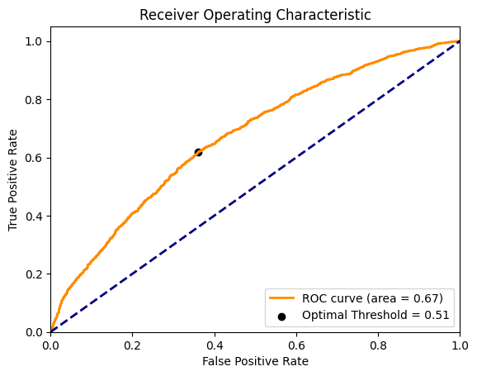
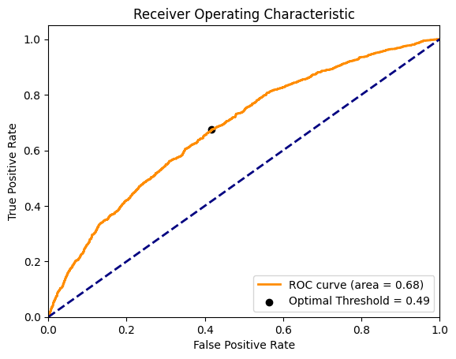
Top Models - ROC AUC Curves
Light GBM
CatBoost
Optimal Threshold = 0.51
Beneficial if false positives (i.e., identifying an on-time applicant as default) are costly
Optimal Threshold = 0.49
Beneficial if false negatives (i.e., identifying a default applicant as on-time applicant) are costly
Notes:
An optimal threshold of 0.51 is very close to 0.5, which is the default threshold. This means that if the predicted probability is greater than 0.51, the model will predict the positive class; otherwise, it will predict the negative class. In this case it suggests that slightly more certainty in predicting the positive class is required compared to the default threshold of 0.5. This might be beneficial if false positives (i.e., identifying an on-time applicant as default) are particularly costly for the loan company.
An optimal threshold of 0.49 is slightly less than the default threshold of 0.5. This means that if the predicted probability is greater than 0.49, the model will predict the positive class; otherwise, it will predict the negative class. In this case it suggests that the model requires a bit less certainty to predict the positive class compared to the default threshold of 0.5. This might be beneficial if false negatives (i.e., identifying a default applicant as on-time applicant) are particularly costly.
Also, both models have similar AUC values

Slide 12
Results & Recommendation
Risk Assessment: LightGBM - high accuracy and precision for correct loan status prediction.
Loan Approval: LightGBM - high precision for correct missed payment predictions.
Personalized Offers: LightGBM/CatBoost - high accuracy and precision for risk prediction, enabling personalized offers.
Early Intervention: CatBoost - high recall for identifying most actual missed payments, enabling proactive measures.
Automated Decision-Making: LightGBM/CatBoost - high accuracy and precision for speeding up the loan approval process.
Policy Development: LightGBM/CatBoost - high accuracy and precision for adjusting policies to reduce the risk of missed payments.
Notes:
We could make recommendations based on different applications.
Risk Assessment: Using the LightGBM model for risk assessment. It has the highest accuracy (0.6279) and precision (0.6309), making it ideal for correctly predicting loan status and missed payments, which is crucial for assessing risk.
Loan Approval Process: Incorporating the LightGBM model into the loan approval process. Its high precision (0.6309) makes it effective at correctly predicting missed payments, helping to inform decisions about who to lend to.
Personalized Loan Offers: Using the LightGBM or CatBoost models with high accuracy and precision can help predict the risk of missed payments, allowing the company to offer more favorable terms to lower-risk applicants.
Early Intervention Strategies: Implement early intervention strategies using the CatBoost model. It has the highest recall (0.6356), making it effective at correctly identifying most of the actual missed payments. This allows the company to implement strategies like financial counseling or flexible repayment plans for high-risk applicants.
Automated Decision-Making: Automate part of the decision-making process using the LightGBM or CatBoost models. These models’ high performance can speed up the loan approval process and reduce the workload of loan officers.
Policy Development: Use the LightGBM or CatBoost models to inform company policies. The insights gained from these models can help the company adjust its policies to reduce the risk of missed payments. For example, if the models find that applicants with higher credit scores are less likely to miss a payment, the company could decide to increase the minimum credit score required for a loan.

Slide 13
Specific Business Cases
Risk Assessment and Gender Dataset Comparisons
Notes:
Carina: 13-16
John: 1-4 17-18
Yuqing: 5-8
Irfan: 9-12

Slide 14
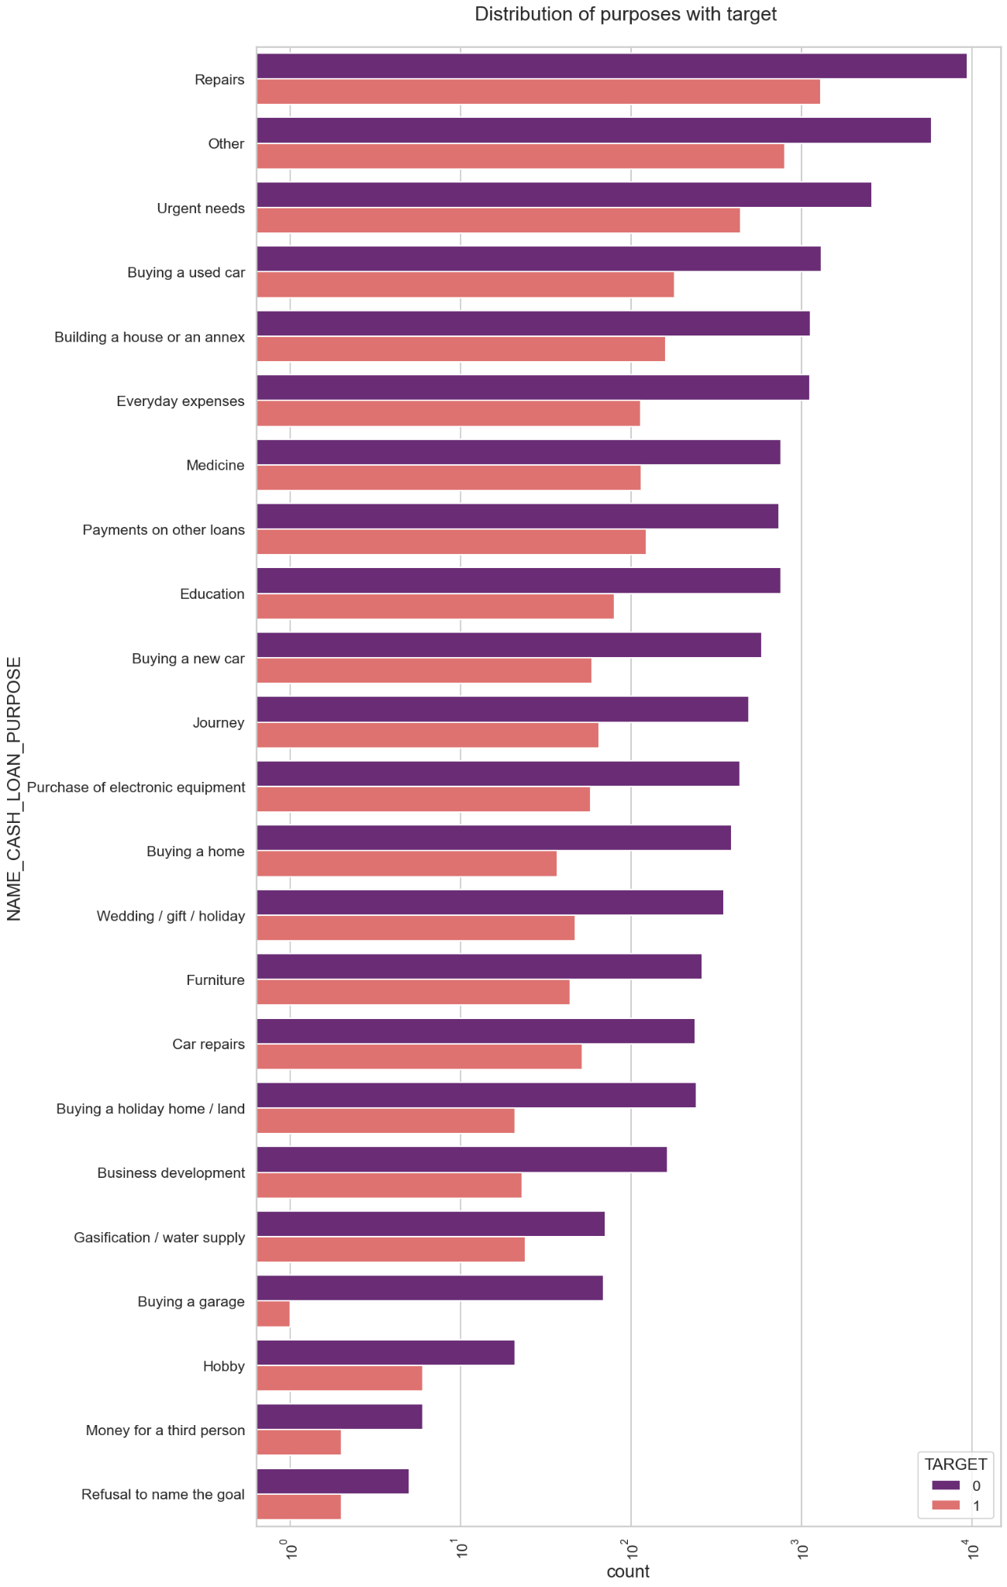
Loan Purpose Specific Use Case
Loan purposes with 'Repairs' are facing more difficulties in payment on time.
Find the best model to avoid risky applicants for ‘Repair’ loan type applicants.

Slide 15
Model Performance Metrics (Repair)
 | Decision Tree | Random Forest | SVM | Gradient Booster | XG Booster | LightGBM | CatBoost
Accuracy | 0.5705 | 0.6885 | 0.6115 | 0.6654 | 0.6654 | 0.7000 | 0.6731
Precision | 0.6380 | 0.7153 | 0.6512 | 0.6963 | 0.6992 | 0.7279 | 0.7037
Recall | 0.7429 | 0.7000 | 0.6000 | 0.6714 | 0.6643 | 0.7071 | 0.6786
F1-Score | 0.6865 | 0.7076 | 0.6245 | 0.6836 | 0.6813 | 0.7174 | 0.6909
ROC AUC | 0.6256 | 0.6875 | 0.6125 | 0.6649 | 0.6655 | 0.6994 | 0.6726
Accuracy: LightGBM has the highest accuracy (0.7), correctly predicting loan status 70% of the time.
Precision: LightGBM is the most precise (0.7279), correctly predicting default payments 72.79% of the time.
Recall: Decision Tree has the highest recall (0.7429), correctly identifying 74.29% of default payments.
F1-Score: LightGBM has the highest F1-Scores (0.7174), indicating a balance between precision and recall.
ROC AUC: LightGBM has the highest ROC AUC (0.6994), indicating the best overall performance across all classification thresholds.

Slide 16
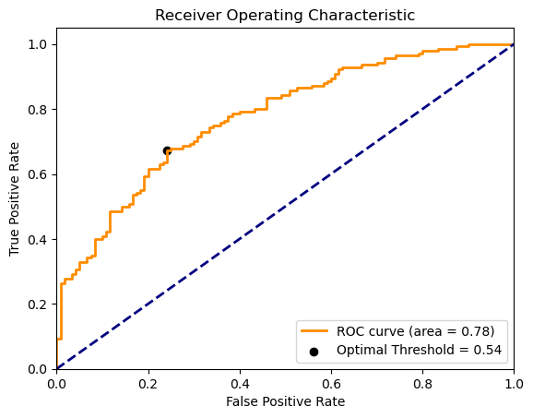
Top Model - ROC AUC Curve
Light GBM
ROC AUC = 0.78
Optimal Threshold = 0.54
Beneficial if false positives (i.e., identifying an on-time applicant as default) are costly

Slide 17
Results & Recommendation (Repair)
Recommendation Analysis
Risk Assessment: Use LightGBM (highest ROC AUC) for assessing loan risk as it considers both false positives, false negatives and the most effective models for predicting default payments.
Notes:
Irfan / John - Connect to deliverables
Risk Assessment: For risk assessment, you would want a model that has a high ROC AUC score as it considers both false positives and false negatives. In this case, the LightGBM model with the highest ROC AUC score would be a good choice.
Targeted Marketing: For targeted marketing, a model with high recall would be useful as it would minimize the chance of overlooking potential customers (false negatives). The CatBoost model, which has the highest recall, would be a good choice.
Improving Customer Experience: For improving customer experience, a model with high accuracy would be beneficial as it would correctly classify the most instances. The LightGBM model, which has the highest accuracy, would be suitable here.
Automating Loan Approval Process: For automating the loan approval process, a model with a high F1-Score would be useful as it balances both precision and recall. Both the LightGBM and CatBoost models, which have the highest F1-Scores, would be good choices.
Fraud Detection: For fraud detection, a model with high precision would be beneficial as it would minimize the chance of falsely flagging a loan as fraudulent (false positives). The LightGBM model, which has the highest precision, would be suitable here.
Policy Adjustment: For policy adjustment, a model with high precision would be beneficial as it would minimize the chance of approving risky loans (false positives). The LightGBM model, which has the highest precision, would be suitable here.

Slide 18
Gender Specific Use Case
Would it benefit to have a gender specific loan default model?
→ NO
Performance Metrics
Dataset | Accuracy | Precision | Recall | F1 Score | ROC AUC
Combined | 0.6279 | 0.6309 | 0.6306 | 0.6307 | 0.6278
Male | 0.6212 | 0.6306 | 0.7401 | 0.6810 | 0.6090
Female | 0.6158 | 0.6153 | 0.4925 | 0.5471 | 0.6091
The combined dataset is more likely to correctly predict a loan default.
Are there any scenarios for which a gender specific model is best?
Model trained on male data performs better, has the ability to identifying the male defaults, meaning it is less likely to miss a predicted defaulting client.
Recommend to review/audit the loan approval process to confirm no biases in data collection between M/F applicants. Additionally, confirm feature representation.
Notes:
Update with default loan approach
- John S.
Verbal input
Accuracy: the model trained on the combined dataset is slightly more likely to correctly predict whether any given loan (regardless of the applicant’s gender) will be approved.
Precision: the precision is similar for all three datasets, indicating that the models are similarly reliable at predicting loan approvals.
Recall: the recall is highest for the male dataset, indicating that the model trained on the male dataset is better at identifying loans that will be approved.
F1 Score: F1 score is highest for the male dataset, indicating that the model trained on the male dataset has the best balance between precision and recall.
ROC AUC: the ROC AUC is similar for all three datasets, indicating that all models have similar abilities to distinguish between loan approvals and denials.
Lower metrics can be attributed to reduced data quantity and diversity.
The difficulty in predicting positive instances of loan approval for females could be due to several factors:
Data Imbalance: If the dataset contains significantly more data about male applicants than female applicants, the model may be biased towards predicting outcomes for males.
Feature Representation: If certain features that are particularly important for predicting loan approval for females are not well represented or are missing in the dataset, this could affect the model’s performance.
Bias in Data: If there is any bias in the data collection process, such as certain types of applicants being more likely to be approved for a loan, this could be reflected in the model’s predictions.
Complex Interactions: There may be complex interactions between gender and other features that the model is not capturing.
Overfitting or Underfitting: If the model is too complex, it may overfit to the male data and perform poorly on the female data. Conversely, if the model is too simple, it may underfit the female data.
It’s important to investigate these potential issues to understand why the model is having difficulty predicting loan approval for females. This could involve exploring the data more thoroughly, trying different model architectures, or using techniques to handle imbalanced data.

Slide 19
Thank you!
MSIS2508
Group Member:
Carina Meng
Irfan Baheer
John Sormark
Yuqing Cui

