Slide 1

Summary
Understanding how a book recommendation works
First idea
Data for the project
Data handling
Recommendation algorithms
Project structure

Slide 2


First idea Lots of books recommendations applications, but…
If we want :
French site,
Lots of international referenced books (paper and electronic)
To give our opinion
To export our personal created library
To have personal recommendations…
…there only one site left…

Slide 3

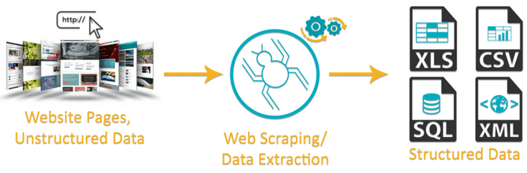
First idea Is there some database ???
There are some :
Of course… not free !
Amazon, Good Reads…do not share anymore their API !
Partial on some data science web site
…it remains only one solution…

Slide 4
Start with data
Context

Slide 5
300 000 books on Book Crossing ⇒ 1/3 completed
10 000 books on Good Books ⇒ completed
Raw data
isbn_13 / OtherID
Category
book_description
book_language
number_of_pages
author_genres
books_in_series
average_rating
awards
Additional fields

Slide 6
Start with data
Scrapping
Notes:
BooksSearch_BothWebSites.py is the main script
Calls :
- BooksSearch_GoodReads.py
- BooksSearch_Google.py
- Parser_csv_BooksList.py

Slide 7
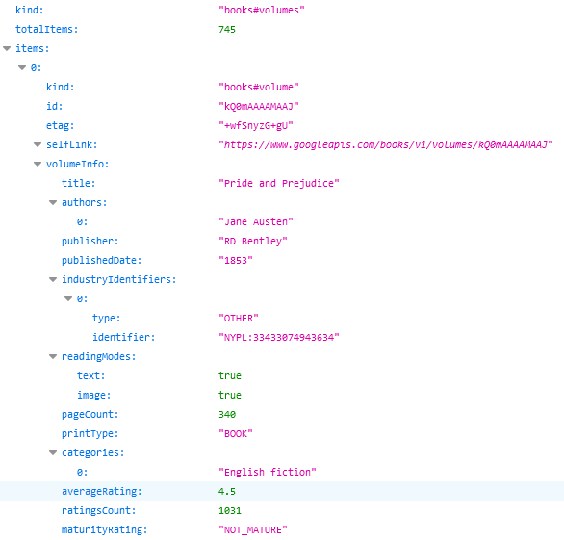
Easy way to access to book's information thanks to public API
Google books
But…
Not always reliable
Some information are not available
Search results with the title are always prolific

Slide 8
Information directly parsed from multiple web pages
Good Reads
2 Python libraries used :
urlopen from urllib.request
BeautifulSoup from bs4
Example :
book's gender
⇔
key words "actionLinkLite bookPageGenreLink“
But…
No available API
Regular jumps on web pages
Links for series were specific
if (soup.find("a", class_="actionLinkLite bookPageGenreLink")):
catSearched = soup.find_all("a", class_="actionLinkLite bookPageGenreLink")[0].text

Slide 9
Final solution
Both web sites used :
1st search with ISBN on Google Books
=> ISBN found : complementary search on Good Reads
=> Else : search with ISBN on Good Reads
=> ISBN found : finished
=> Else : search with title and author on Good Reads
AWS :
The scraping was very long => Ubuntu EC2 instance opened
Anaconda installed (use of jupyter notebooks)
GitHub services (use of scripts and files from our project GitHub)
Byobu (continuous scraping)
sftp connection (scraped information from remote computer to our PC)

Slide 10
Start with data
First Statistics
Notes:
First analysis performed : Books_csv_analysis.ipynb
Then a specific one to replace some books categories : Cat_AutGenr_Selection.ipynb
Finally the automatic cleaning has been performed with : Automatic_cleaning_colab_csv.ipynb

Slide 11

Mainly…
Publication between 1983 and 2006
English books
Max number of awards for a same book : 27 !!!
2 033 kind’s of awards
5 010 book's categories (lots of fiction…)

Slide 12
Data handling
Cleaning

Slide 13
ISBN
Language
Removing of "\n"
Coding ISO 639
Unexpected words
(ex. "Catalan; Valencian“ => ca)
Awards
Split according to "," (list of awards)
Split according to "(“ (keep only name)
Keep only 1 award name per book (most famous awards)
Duplicates
On ISBN
Then title + author.

Slide 14
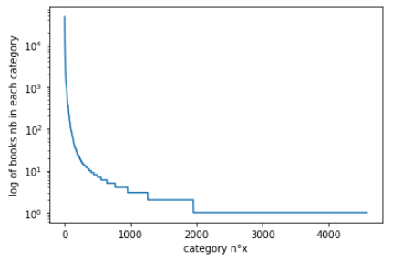
Category / Author gender (1/2)
First cleaning :
Several words, separated by "&", "(…)" or ",". (2nd column created)
Stemming operation (PorterStemmer)
Number of categories reduction :
Keep only the first 1 953 categories (steeper decline)… but only two books inside !
The first 403 categories have at least 10 books inside

Slide 15
Category / Author gender (2/2)
CAT_SEL CAT_OTHER
- cat_1 - oth_1
- cat_2 - oth_2
- … - …
- cat 403 - …
Word Embedding
neighbour
Word2Vec trained with :
- "book_description"
- "Category"
- "Category_other"
- "author_genres"
- "author_genres_other"

Slide 16
Data handling
Embedding

Slide 17
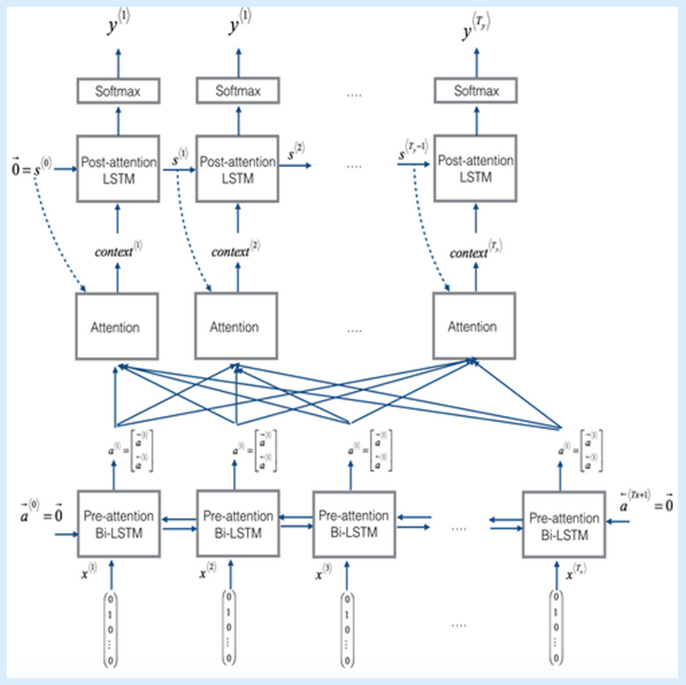
sentenceBERT embedding
- book's description -
Transform in tokens
Pretrained BertModel
Outputs are of 4 dimensions :
- 13 layers
- batch number (for us: nb of sentences per description)
- 64 (size of sentence)
- 768
Final dimension is of 768
(averaging and reduction)

Slide 18
Fast Text embedding
- book's description -
Book’s description cleaning + tokenization
Training of FastText
All tokens embedding of dimension 60
Final dimension is of 60
(Tokens of same book's description averaged)
Fast Text embedding
- categories context -
Sentence created with :
"book_title"
"book_author"
"Category"
"Category_other"
"author_genres"
"author_genres_other"

Slide 19

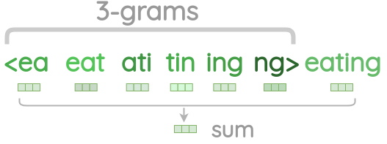
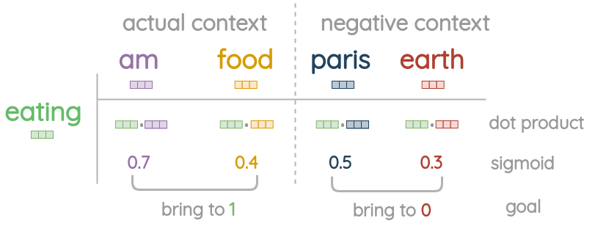
Fast Text embedding
Like Skip Gram : word => context
Center word treatment
Prediction

Slide 20
Recommendation algorithms
Classifiers
Notes:
Find ratings of the book, when book’s features inputs are given

Slide 21
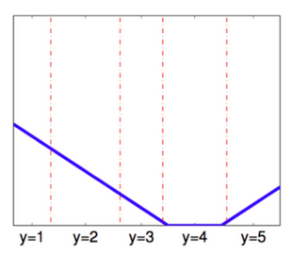
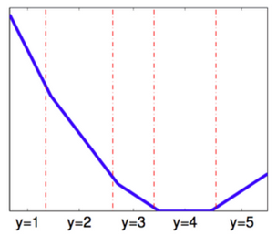
Ordinal regression
Extension of simple logistic regression model
2 losses used :
Immediate-threshold
All-threshold

Slide 22
Recommendation algorithms
Results

Slide 23
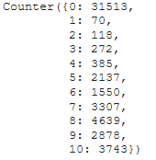
One embedding only
Each algorithms executed 3 times (3 embeddings)
10 unbalanced classes
5 unbalanced classes
Balanced binary classes
Balanced 10 classes (over / under sampling)
Balanced 5 classes (over / under sampling)
PCA
Book's description embedded with Bert Model
Balanced 10 classes (over / under sampling)
With 100 components : 82% of variance explained
With 150 components : 87% of variance explained

Slide 24
Several embeddings
Concatenation of 2 embeddings :
Unbalanced classes and Balanced binary classes
book's description with Bert || Categories context with fastText
book's description with fastText || Categories context with fastText
Addition of 2 embeddings :
Unbalanced classes and Balanced binary classes
book's description with fastText + Categories context with fastText
Incremental embeddings :
Balanced classes (over / under sampling) and fastText
Concatenation and addition
Embed features one by one

Slide 25
Conclusion
Results :
LogisticAT in unbalanced case predicts the mostly represented class
Random Forest slightly better
(begins to predict the 2 other classes the mostly represented)
OrdinalRidge and LinearReg better predict the least represented classes
(poorly)
Improvements :
Number of classes reduced to 5
Balanced classes with over / under sampling
(more classes are predicts, even if very poorly)
PCA in for Random Forest

Slide 26


