Slide 1
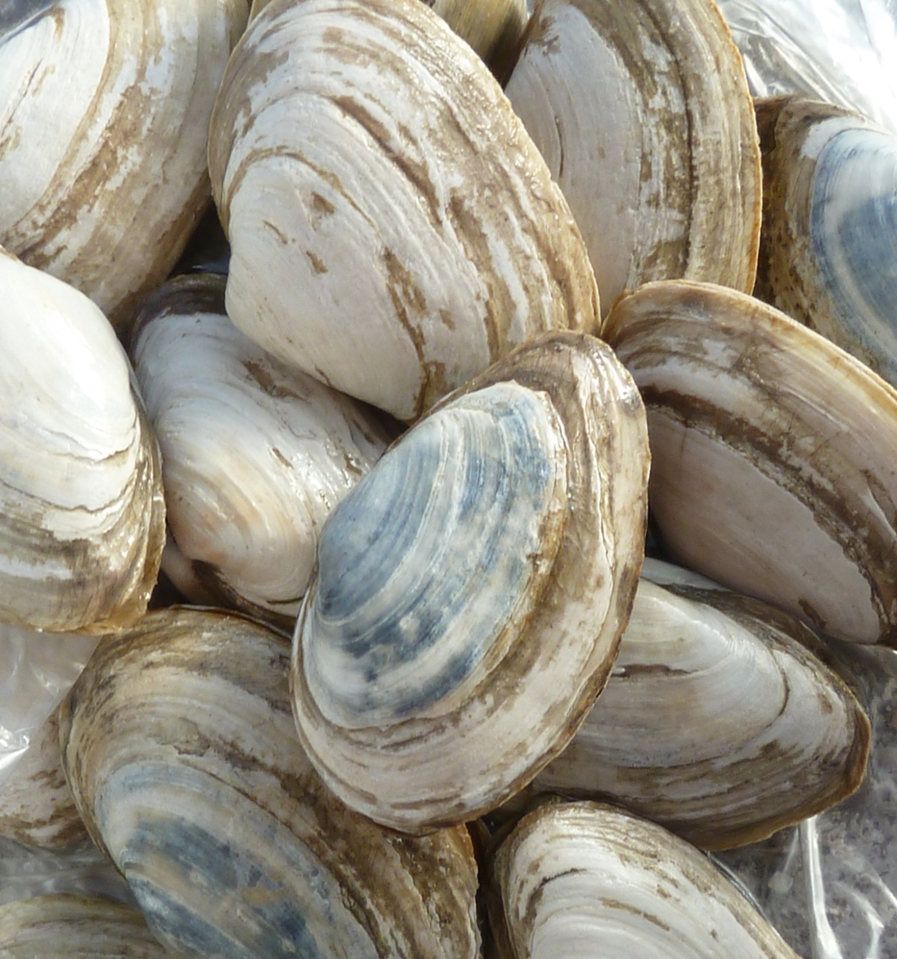


A Bayesian framework to model temperature-dependent transmissible cancer dynamics within soft-shell clam (Mya arenaria) populations
Carissa Mayo
University of Washington
Quantitative Ecology and Resource Management
Dr. Michael Metzger
M.S. Thesis Defense
March 03, 2026

Slide 2
Agenda
M.S. Defense
Introduction
Research Goals
Methods
Results
Conclusions

Slide 3
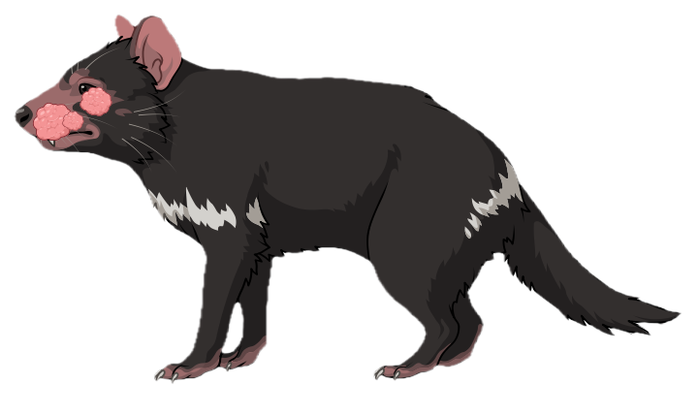


Natural Transmissible Cancers
Introduction
M.S. Defense
Tasmanian Devil Facial Tumor Disease (DFTD)
Canine Transmissible Venereal Tumor (CTVT)
Bivalve Transmissible Neoplasia (BTN)
Transmitted through biting
~ 40 years old
Two lineages
Almost always lethal
Transmitted sexually
4000 - 6000 years old
Mostly harmless
Not transmitted through contact
~ 400 years old
Many lineages
Reported to be lethal

Slide 4
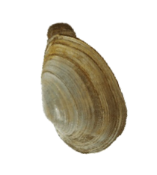
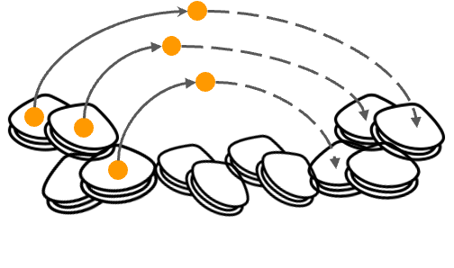
BTN
Introduction
M.S. Defense
Spreads through waterborne cancer cells
Leukemia-like cancer classified as transmissible in 2015
Found most notably in the hemolymph (invertebrate blood-like fluid)
Neoplastic cells infiltrate into tissues in later stages of disease
Cockles, Oysters, Clams
Soft-shell clam (Mya arenaria)
(Metzger et al. 2015)

Slide 5
Knowledge Gaps
Introduction
M.S. Defense
Due to its recent classification, much remains unknown about BTN
No existing epidemiological models
Lack quantitative estimates of the fundamental processes governing transmission, progression, and particle persistence
Data-driven modeling and seasonal forecasts are essential components of disease response strategies
Notes:
BTN is unusual because transmission occurs through waterborne cancer cells, which immediately raises questions about persistence, seasonality, and exposure pathways. These are things we can’t get from prevalence data alone and they require a mechanistic framework.

Slide 6
Agenda
M.S. Defense
Introduction
Research Goals
Methods
Results
Conclusions

Slide 7
Research Goals
M.S. Defense
1) Core Disease Model
Estimate key transmission and progression rates using a Bayesian epidemiological framework.
2) Particle Component
Integrate particle dynamics into a mechanistic disease model.
3) Seasonality
Test the hypothesis that incorporating seasonal temperature effects allows the model to reproduce observed trends in disease dynamics.
Notes:
We observe seasonality in the data and have alb evidence for temperature dependent mechanisms of the disease. With the lab data, we see two opposing seasonal mechanisms so identifying how the seasonality of the disease is shaped is a main focus

Slide 8
Agenda
M.S. Defense
Introduction
Research Goals
Methods
Results
Conclusions

Slide 9
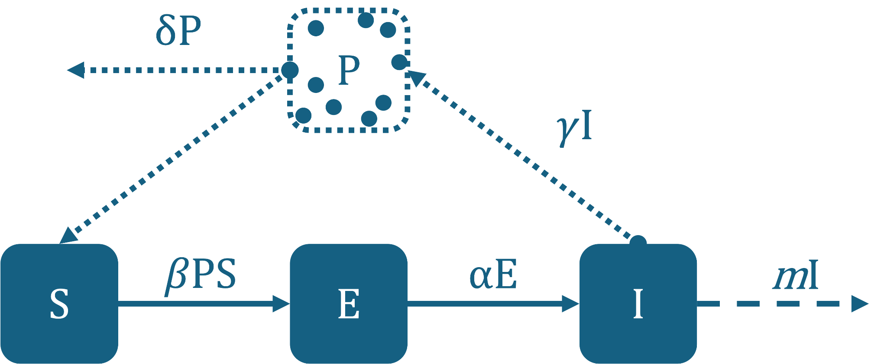
SEIP Model
Methods
M.S. Defense
β : Rate at which susceptibles get infected from particles in the water
α : Progression rate from exposed to infectious
m : Mortality rate of infectious individuals
γ : Particle shedding rate
δ : Particle decay rate
Notes:
We looked at temperature effects in two key areas: cell survival and disease progression

Slide 10
Four Model Variants
Methods
M.S. Defense
No temperature dependence
dS/dt = -β*P*S + m*I
dE/dt = β*P*S - α*Ε
dI/dt = α*E - m*I
dP/dt = γ*I - δ*P
1.
Temperature dependence in particle decay (δ)
2.
Temperature dependence in disease progression (β)
3.
Both temperature dependent parameters (δ, β)
4.

Slide 11
Model Assumptions
Methods
M.S. Defense
No natural births/deaths unrelated to disease
Constant population size
  Total population is conserved over time
⇒ S + E + I = 1
  Individuals return to the system into S at rate mI to maintain population balance
  Modeling at an endemic state of the disease

Slide 12
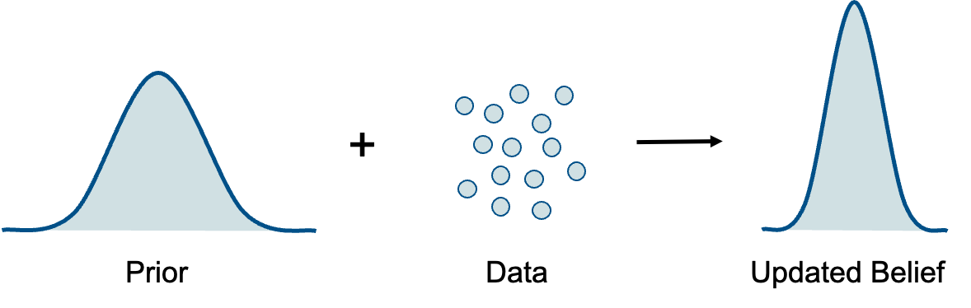
Bayesian Modeling
Methods
M.S. Defense
Combine prior knowledge (lab data) with new observations (survey data)
Quantify uncertainty in parameters and predictions
  Gives a range of likely values, not just one number
Works well with limited or noisy data
p(θ) *p(y|θ)∝ p(θ|y)
Bayes Formula

Slide 13

STAN
Methods
M.S. Defense
A programming tool for running Bayesian models that has an R interface (rstan, cmdstanr)
Process:
Define the system (ODEs) and what ranges are reasonable for each parameter (priors)
Stan explores parameter space
  Hamiltonian Monte Carlo to efficiently test many combinations of parameter values
  Prefers values that make the simulated data look like the observed data
Sampling setup
  4 HMC chains, each run for 2000 iterations
    First 1000 iterations are a warm-up to adjust and tune the sampler
    Remaining iterations are used for the posterior
The output is thousands of possible parameter combinations (posterior)
  Report medians and uncertainty ranges
(Gelman et al. 2020)

Slide 14
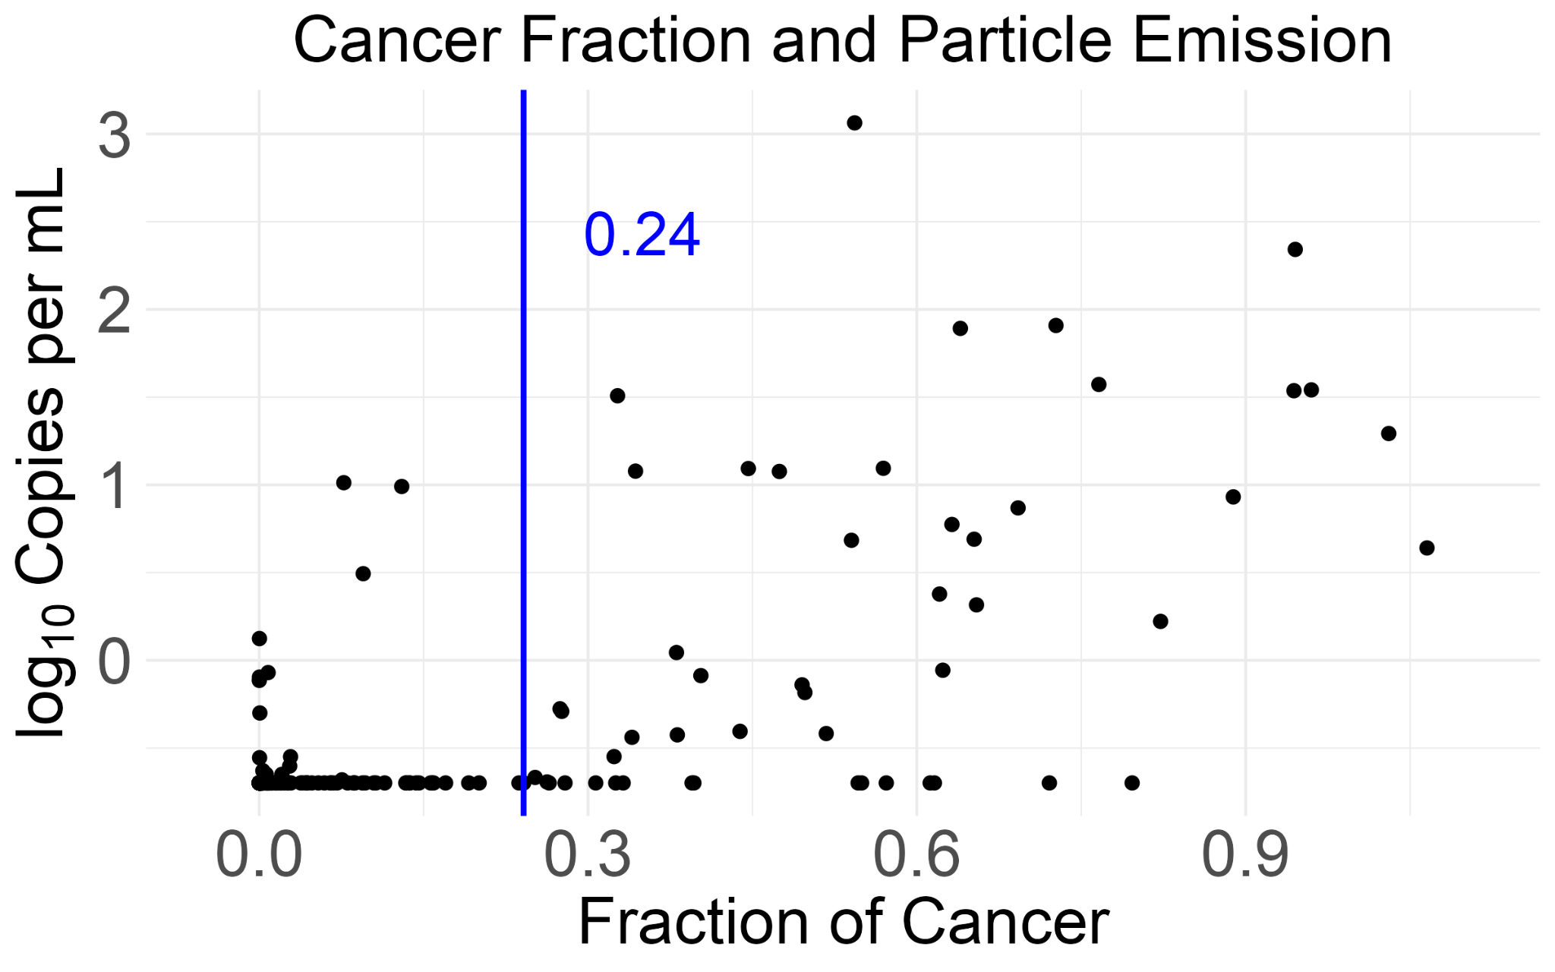
Lab Data - Cancer Cell Emission
Methods
M.S. Defense
Purpose: When and how much cancer is released into the water by infectious clams
Informs: Infectious cutoff, γ
Infectious starting at 0.24 cancer fraction
Average particle emission ≈ 10.11 copies per mL
Method: Change point analysis on emission

Slide 15
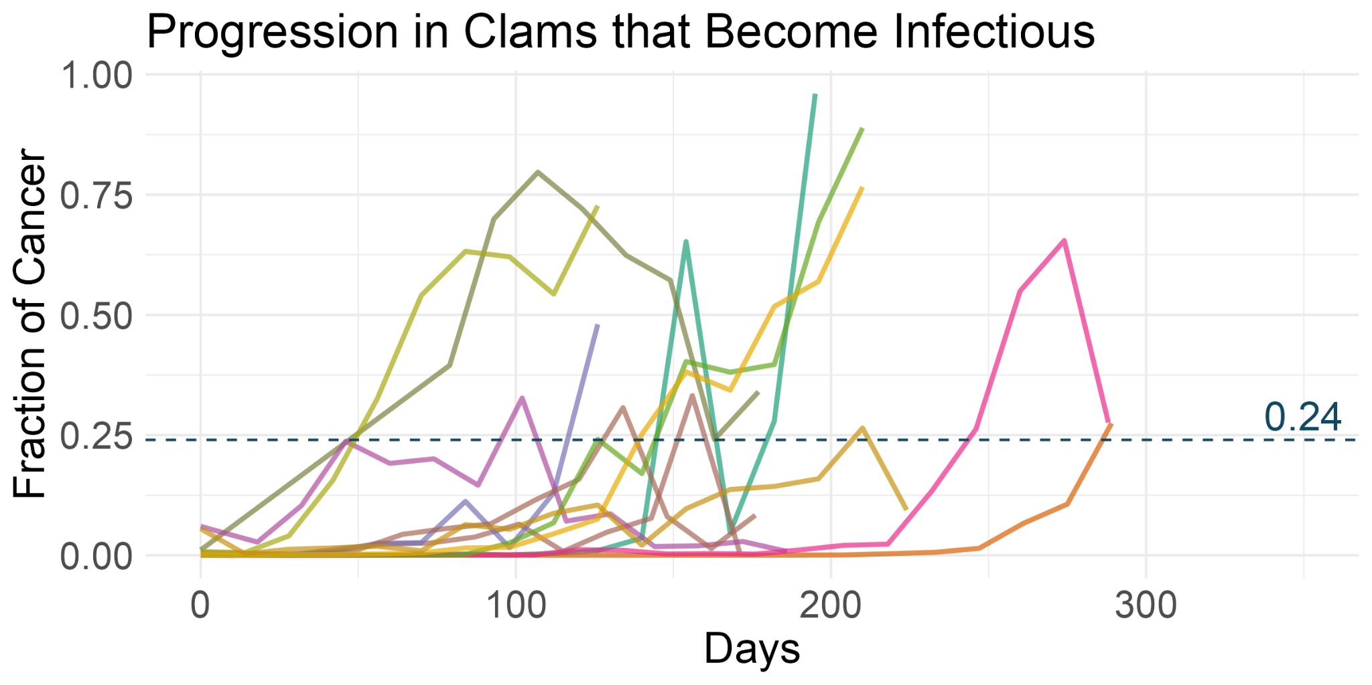
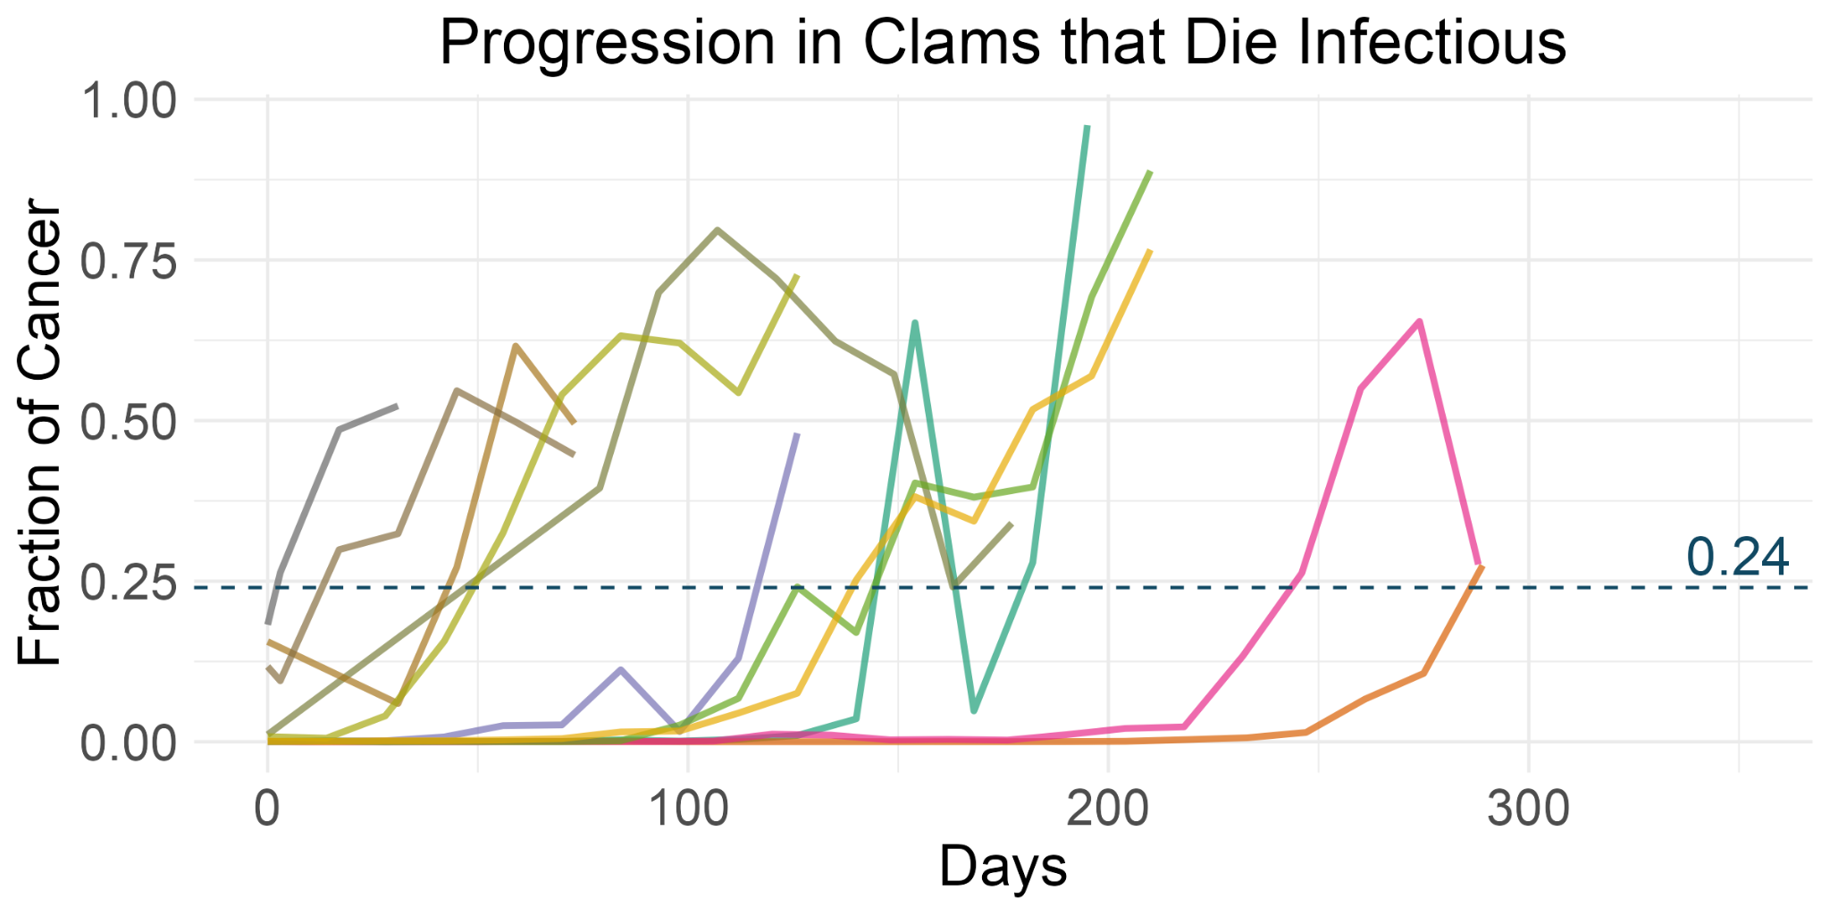
Lab Data - Cancer Progression
Methods
M.S. Defense
Purpose: Timing of cancer progression
Informs: α, m
Average minimum time from exposed to infectious ≈ 80 days
Average time from infectious to death ≈ 59 days
Method: Fit growth curves and derived times to infectious and death

Slide 16
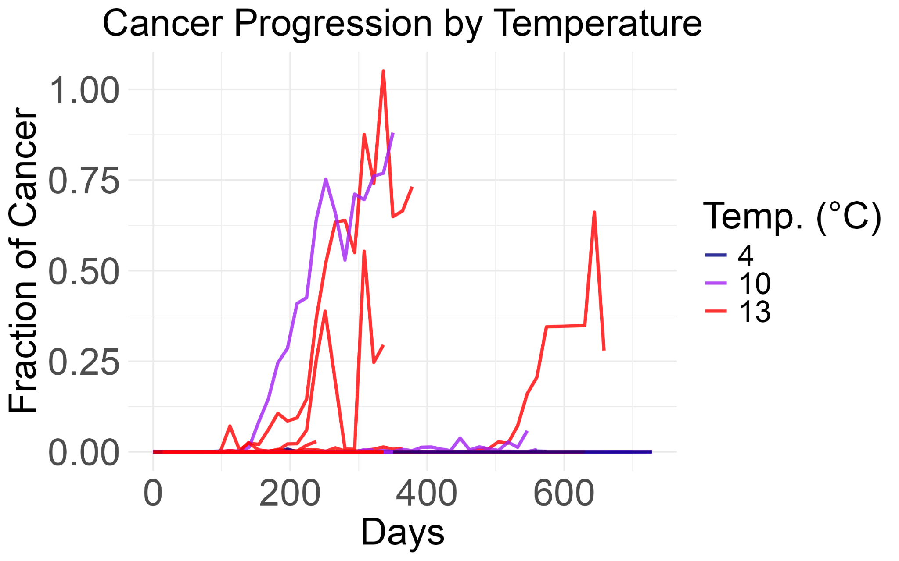
Lab Data - Temp. Effect on Progression
Methods
M.S. Defense
Purpose: How temperature affects progression
Informs: Temperature effect on β
Higher temperature seems to increase the likelihood of cancer progression
Method: Logistic regression on binary progression

Slide 17
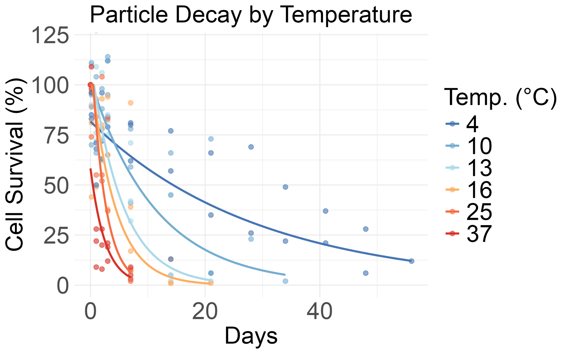
Lab Data - Cell Decay
Methods
M.S. Defense
Purpose: How temperature affects particle decay
Informs: δ, temperature effect on δ
Higher temperature increases cell decay rate
Method: Fit exponential decay curves and performed regression on rates across temperatures
Notes:
These are the opposing seasonal mechanisms I mentioned earlier where temperature increases cell decay, but also increases disease progression likelihood.

Slide 18
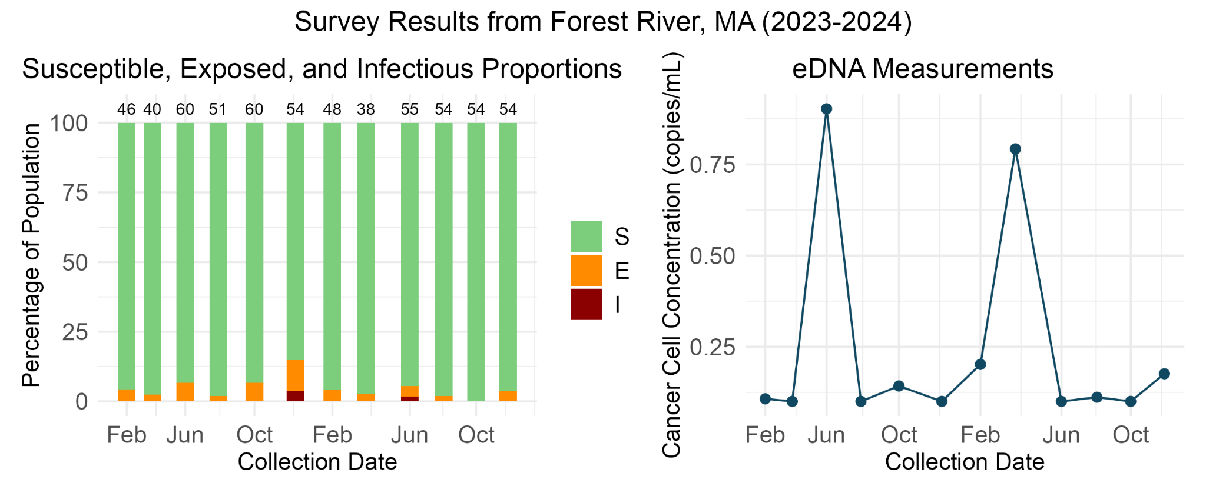
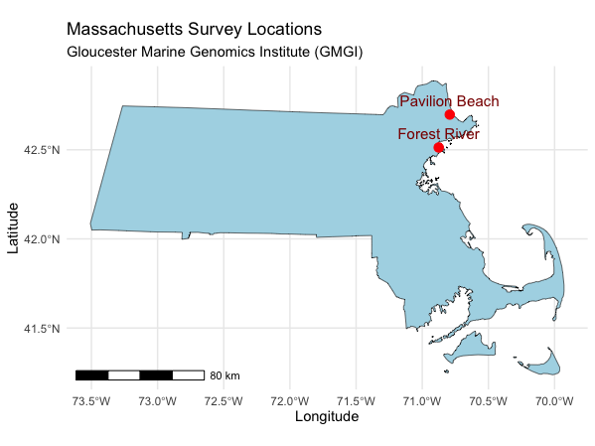
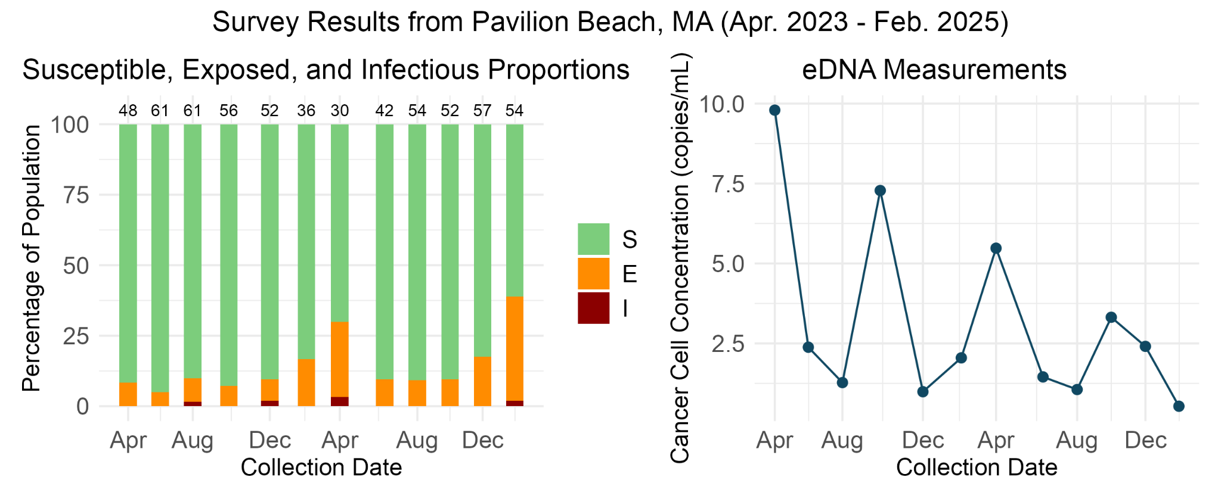
Study Sites
Methods
M.S. Defense
Notes:
There are differences in these sites and we are not sure why there are differences.

Slide 19
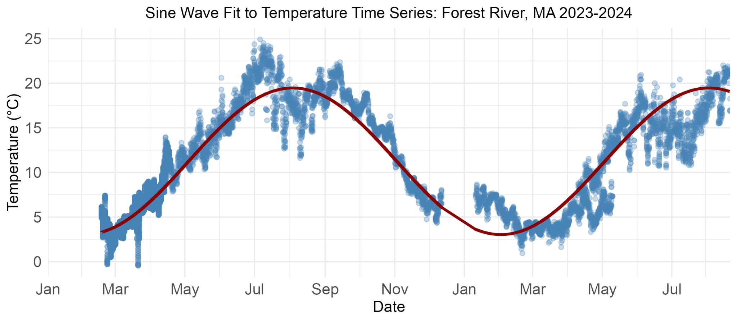
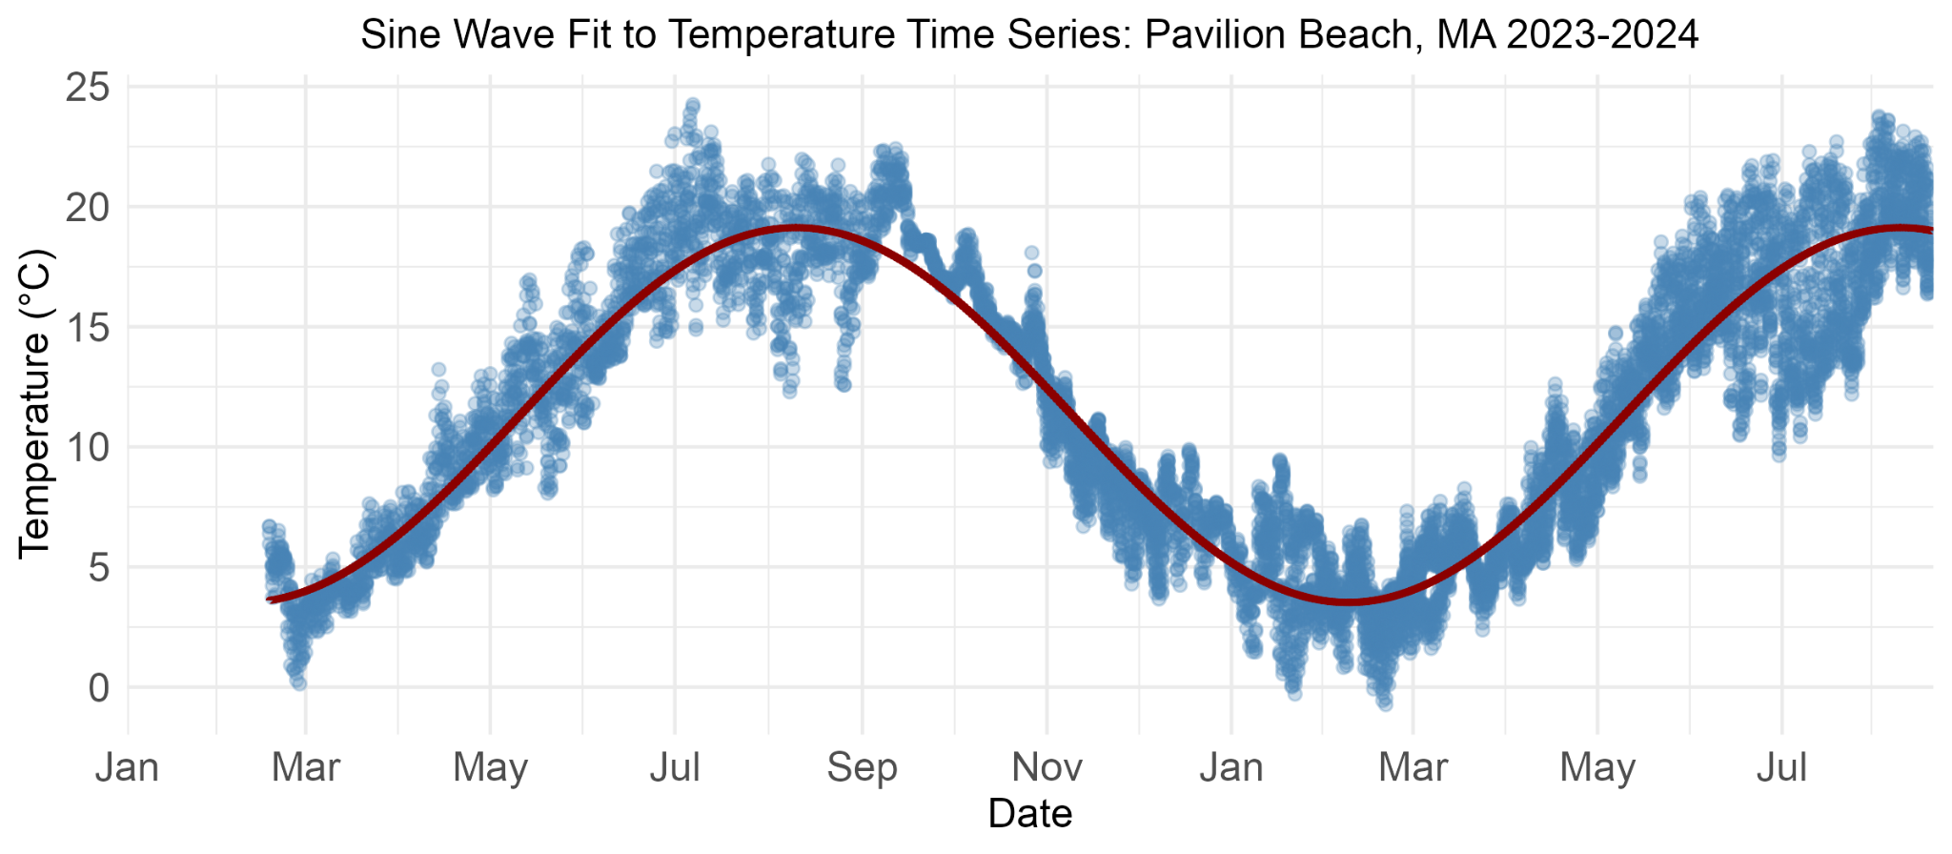
T(t) temp function
Methods
M.S. Defense

Slide 20
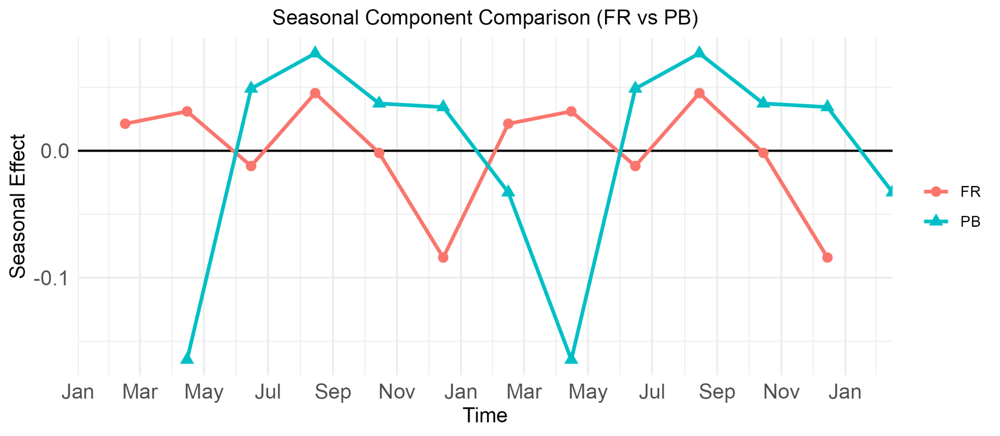
Observed Seasonality
Methods
M.S. Defense
Decomposition separates observed S into the repeating seasonal component
Seasonal effect = how the data consistently rises or falls at certain times of year
Notes:
The two sites show differently phased seasonal patterns, suggesting that a single shared seasonal mechanism may not describe both. Also, comparing the timing of the main seasonal effects to the model results can help us interpret how the model is picking up the seasonality in the data. So for Forest River we see the main seasonal point is in December with a smaller one in June.

Slide 21
Methods
M.S. Defense

Slide 22
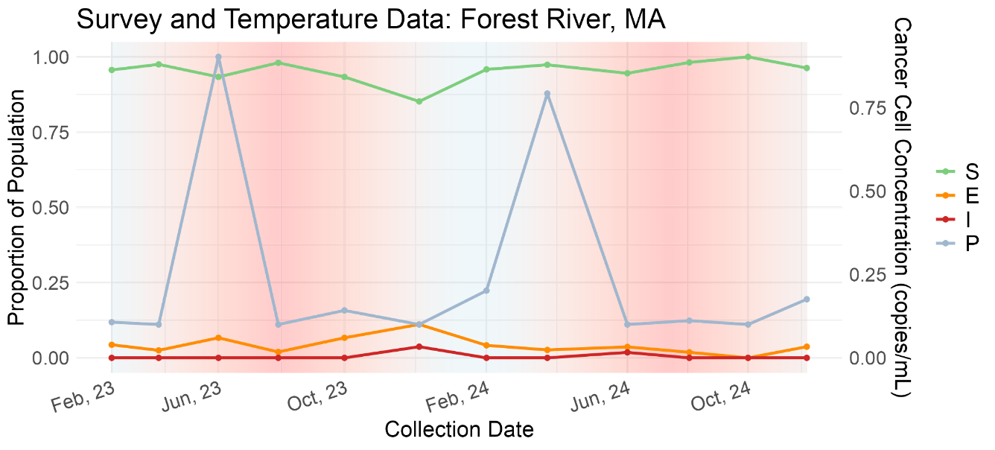
Methods
M.S. Defense

Slide 23
Model Set-up
Methods
M.S. Defense
p(θ) - Priors
Prior distributions for each parameter is defined based on laboratory data
p(y|θ) - Likelihood
How likely the data is given the chosen parameter values
SEI counts are a noisy sample of the underlying fractions S, E, I
  y(t) ∼ Multinomial(n(t), (S(t), E(t), I(t)))
P is noisy eDNA sample of the underlying P fraction
  log(y(t)) ~ N(log(P(t), σ)
p(θ) * p(y|θ) ∝ p(θ|y)
Bayes Formula
Notes:
The model setup has two parts. First, I define prior distributions for each parameter based on laboratory data, which ensures that the rates remain biologically realistic. Second, I specify how the observed data relate to the underlying model. The SEI proportions predicted by the ODE model represent the true population-level state, but our field surveys are samples from that state, so I model SEI counts using a multinomial distribution. Similarly, the particle concentration predicted by the model is not observed directly; instead, we measure eDNA with error, so I model log eDNA as a noisy observation around the predicted value. Together, this framework connects biological mechanism to observed data while explicitly accounting for sampling and measurement noise.

Slide 24
Structural Identifiability
Methods
M.S. Defense
To distinguish data limitations from model misspecification
Identifies which parameters and combinations can be uniquely recovered from ideal, noise-free observations
Ran with Julia package
Results:
  Initial conditions of SEI proportions and P concentrations
  Individual terms of temp dependent parameters (a_{δ}, b_{δ}, a_{β}, b_{β})
  Everything else is identifiable
Notes:
Structural identifiability asks whether, in theory, the model parameters can be uniquely recovered from ideal, noise-free data. This allows us to distinguish between two possibilities: a structural flaw in the model versus limited information in the data.
The individual temperature coefficients are not uniquely identifiable on their own. However, the effective temperature-dependent rates β(T) and δ(T) are identifiable as functions. Since inference focuses on these functions, this does not limit interpretation.

Slide 25
Agenda
M.S. Defense
Introduction
Research Goals
Methods
Results
Conclusions

Slide 26
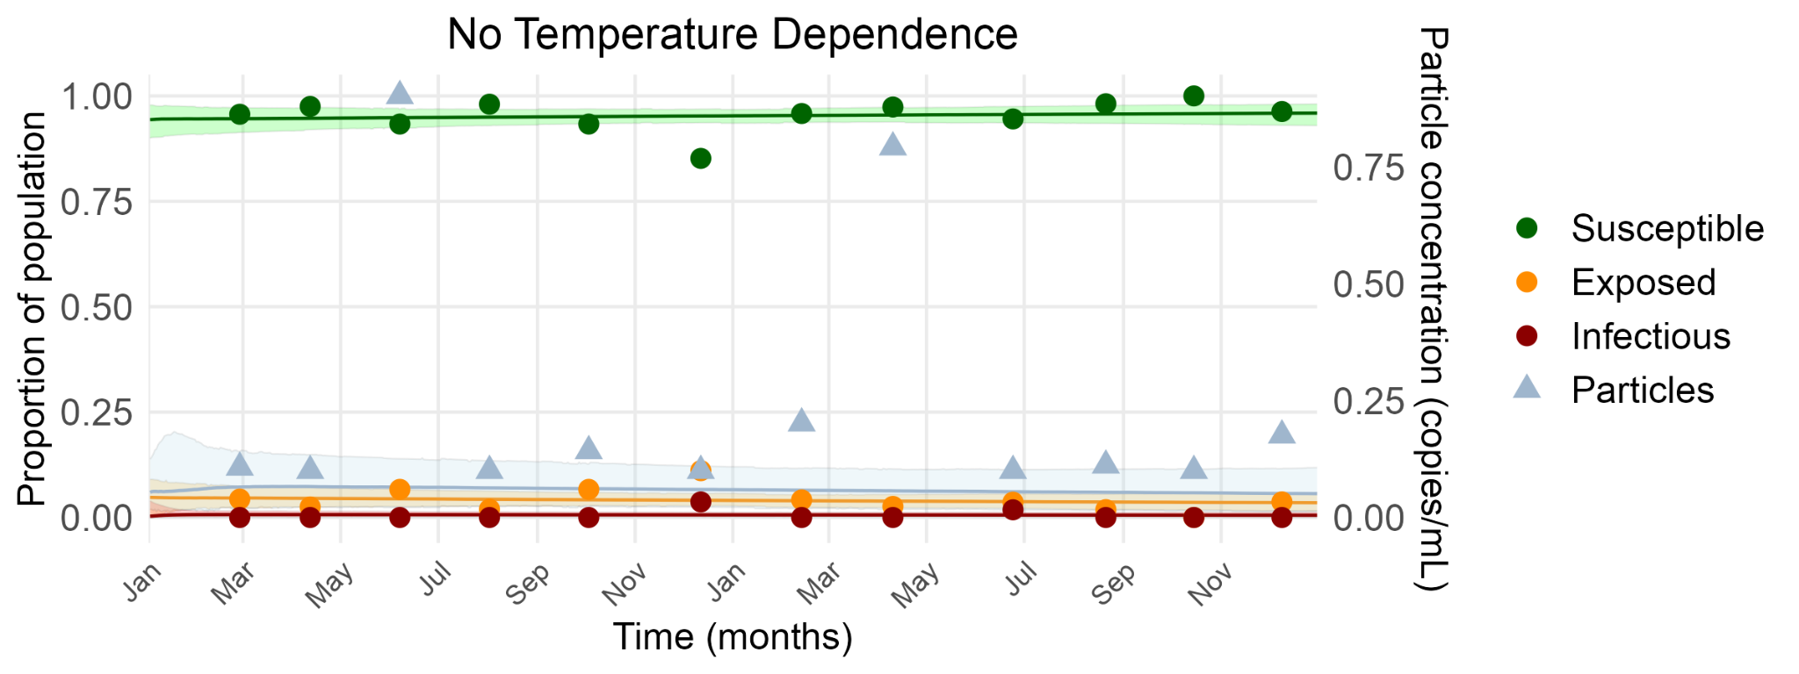
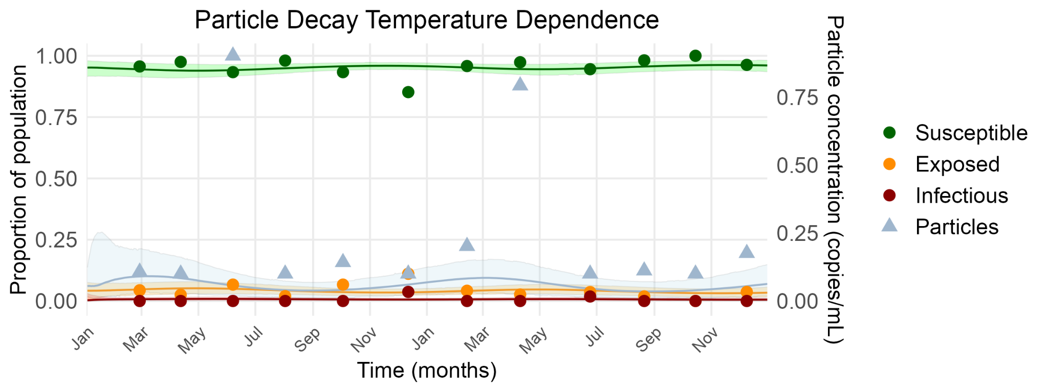
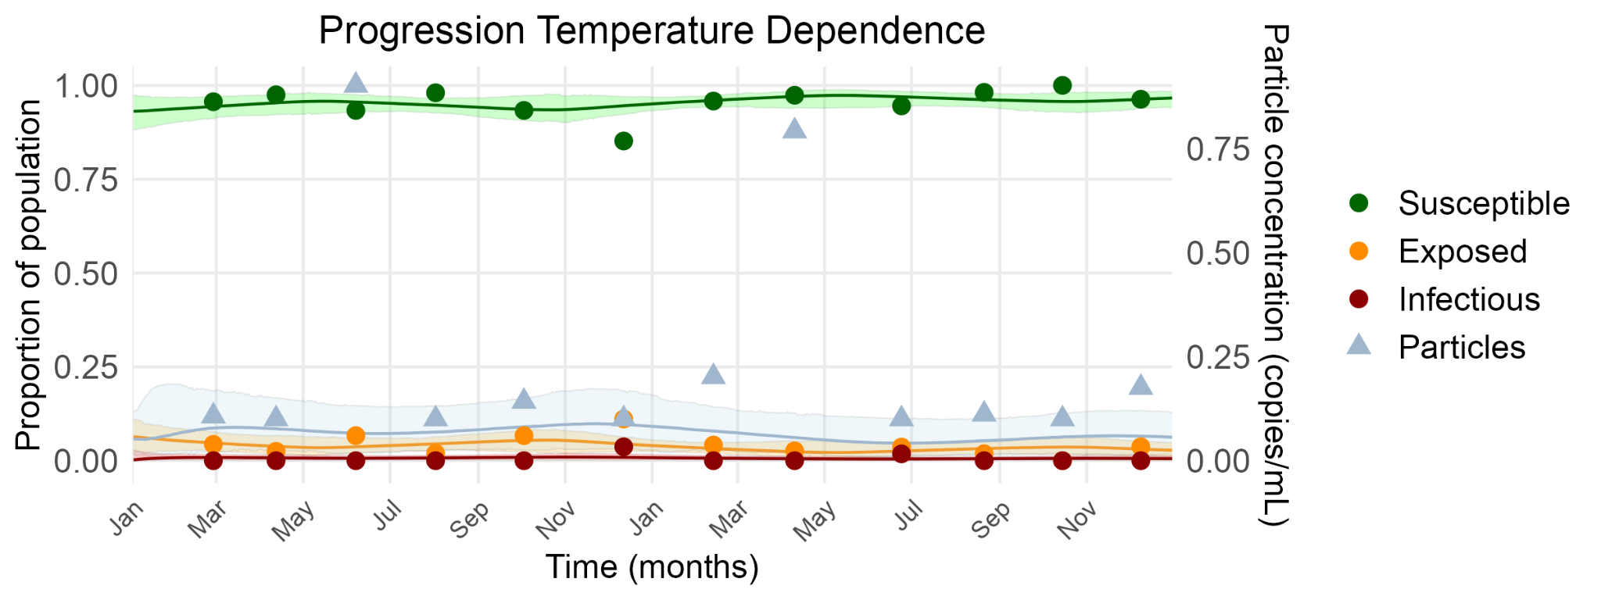
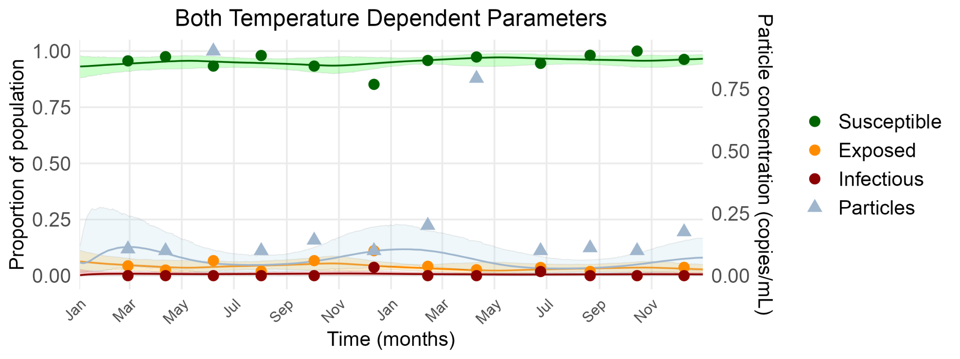
Model Results
Results
M.S. Defense

Slide 27
Model Comparisons
Results
M.S. Defense
Quantitatively: Pareto smoothed importance sampling with leave-one-out cross validation (PSIS-LOO) (Vehtari et al. 2017)
  Rates model on how it predicts unseen data
  Differences in comparisons were less than their standard errors
  Models cannot be reliably compared by predictive accuracy
Quantitatively: Posterior Predictive Checks (PPC)
  Compute the 95% posterior predictive interval for SEIP using the observation models
  Each model showed the same number of observations included in this interval
  Models cannot be compared by posterior predictive accuracy
Qualitatively:
  Compare based on biological interpretation and visual seasonal pattern alignment
Notes:
PPC - If the model were true, would it generate data that look like what we observed?

Slide 28
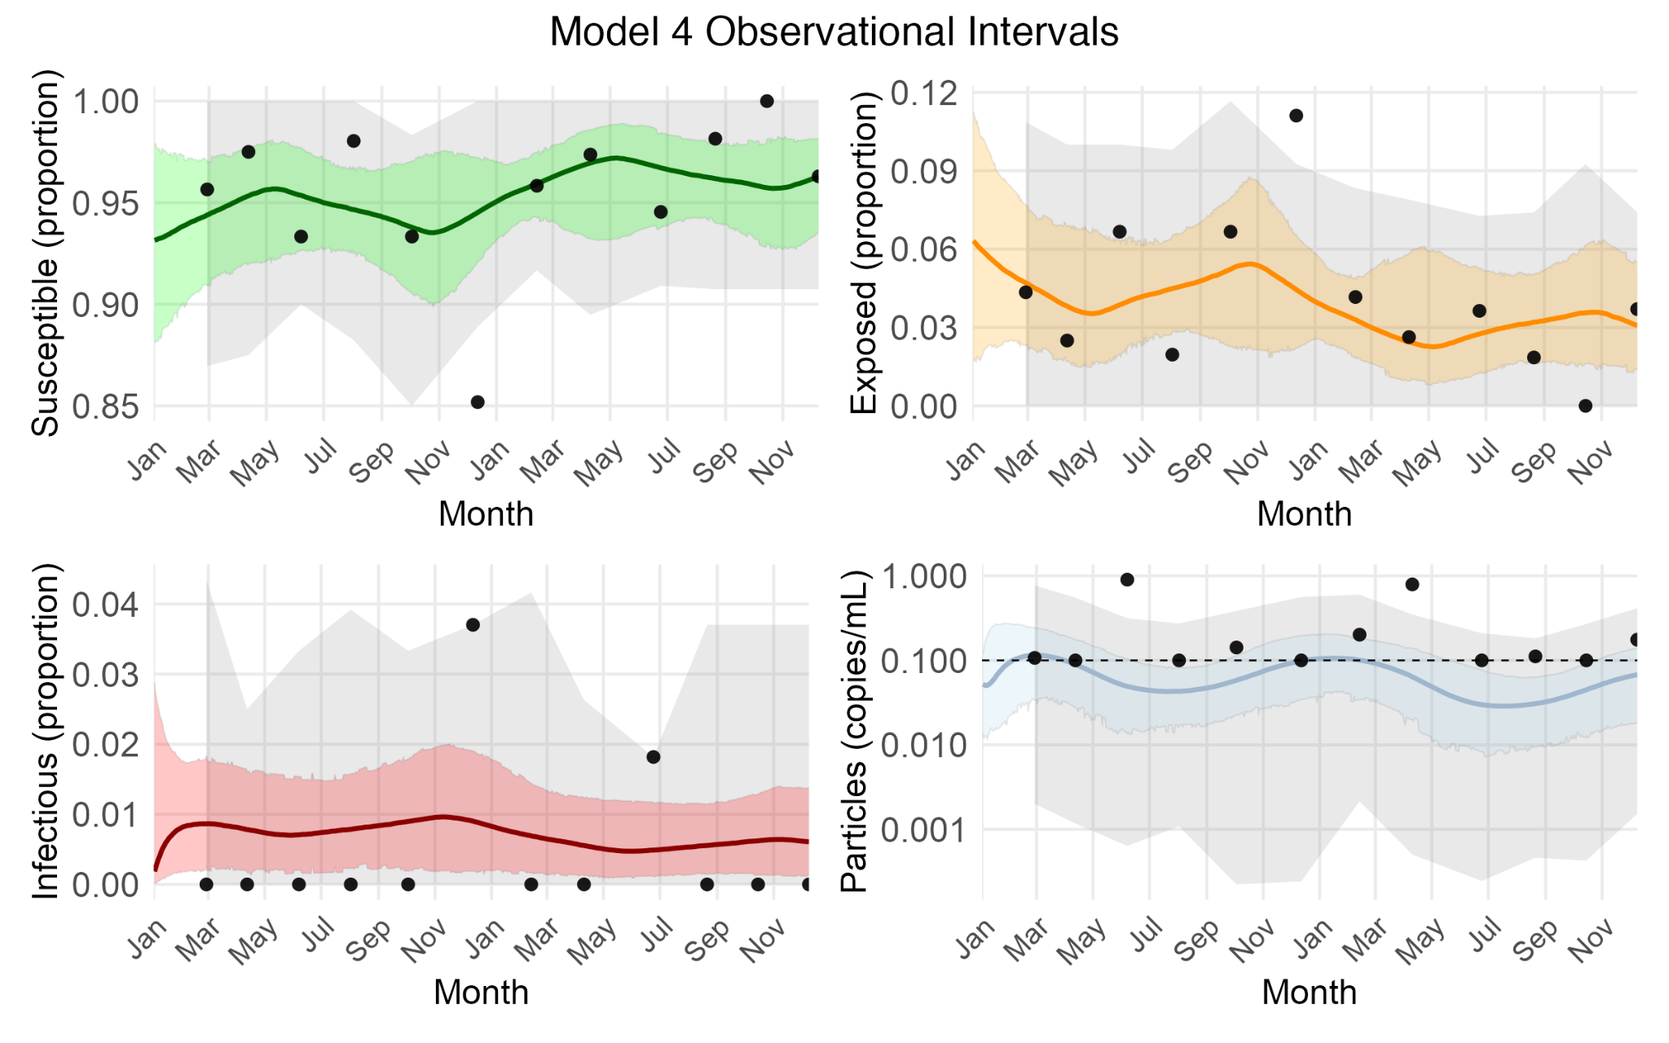
PPCs
Methods
M.S. Defense
All models show the same result: One or two observations outside of the interval for each trajectory.
Notes:
A posterior predictive check evaluates whether the model can generate data that resemble what we observed. The shaded region shows the range of values the model expects, accounting for both parameter uncertainty and sampling noise and the black points are the observed data. Most observed points fall within this range for all model variants, indicating that each model can reproduce the overall magnitude and variability of the data, which is a good diagnostic of the models. However, because all models perform similarly, PPC alone cannot distinguish the best fit model.

Slide 29
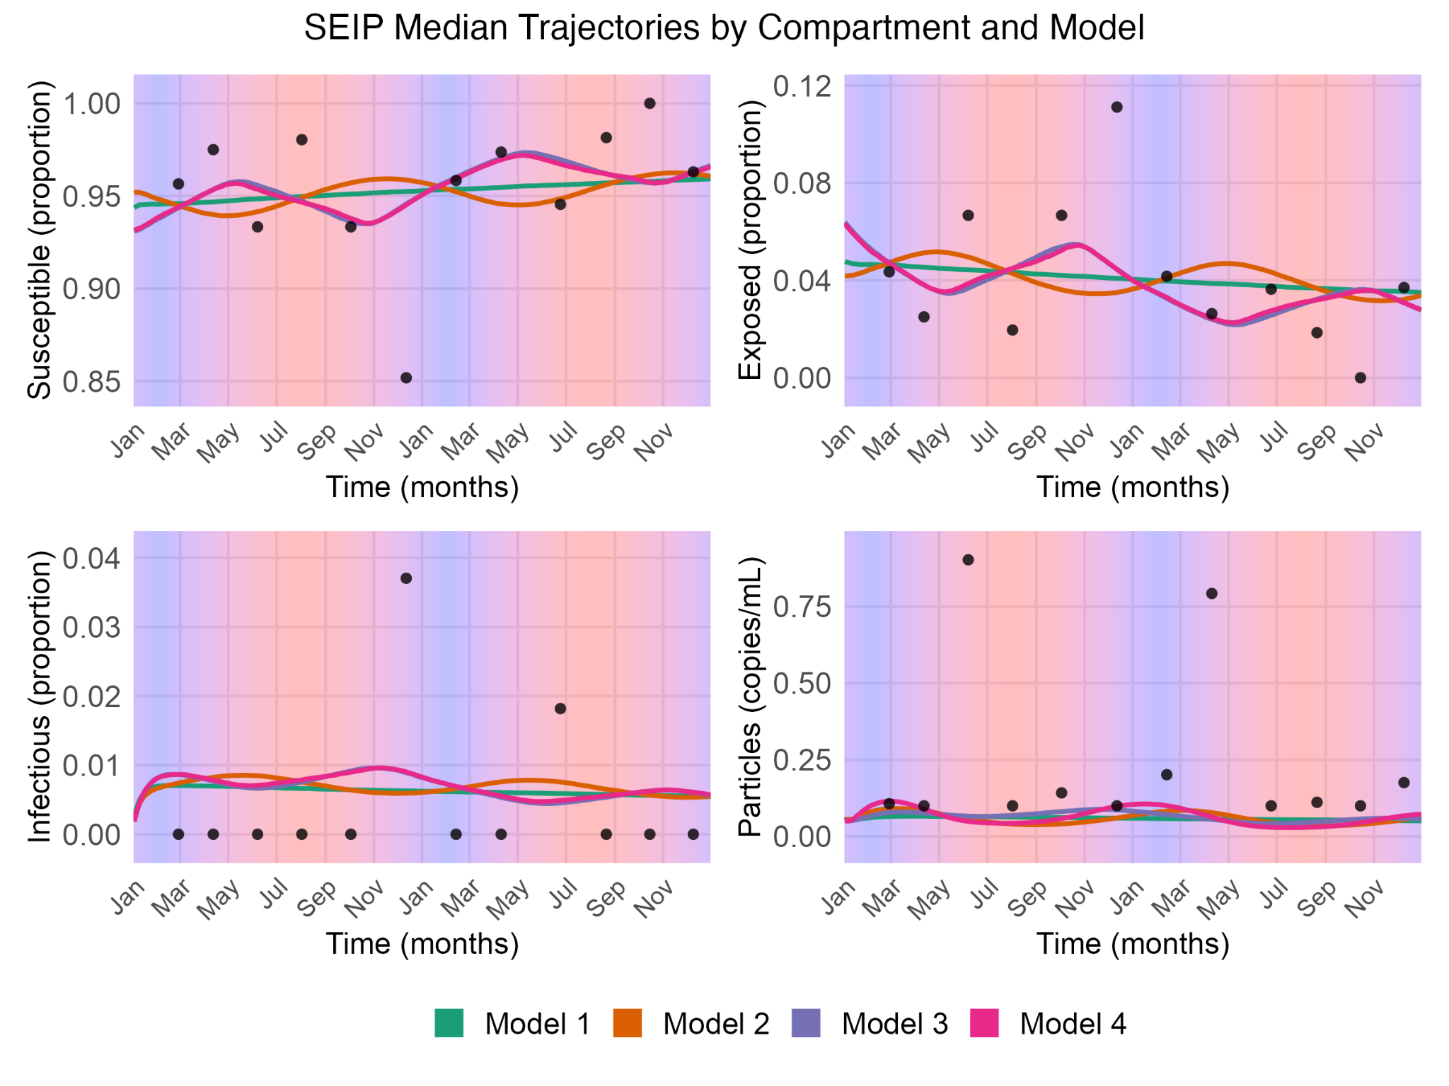
Visual Model Comparisons
Methods
M.S. Defense
All models show a general decrease in disease prevalence over time
Two opposing seasonal patterns
  Model 2 - early summer peaks
  Model 3/4 - winter peaks
Model 4 is most similar to model 3
  ⇒ progression temperature dependence is a driving force of seasonality

Slide 30
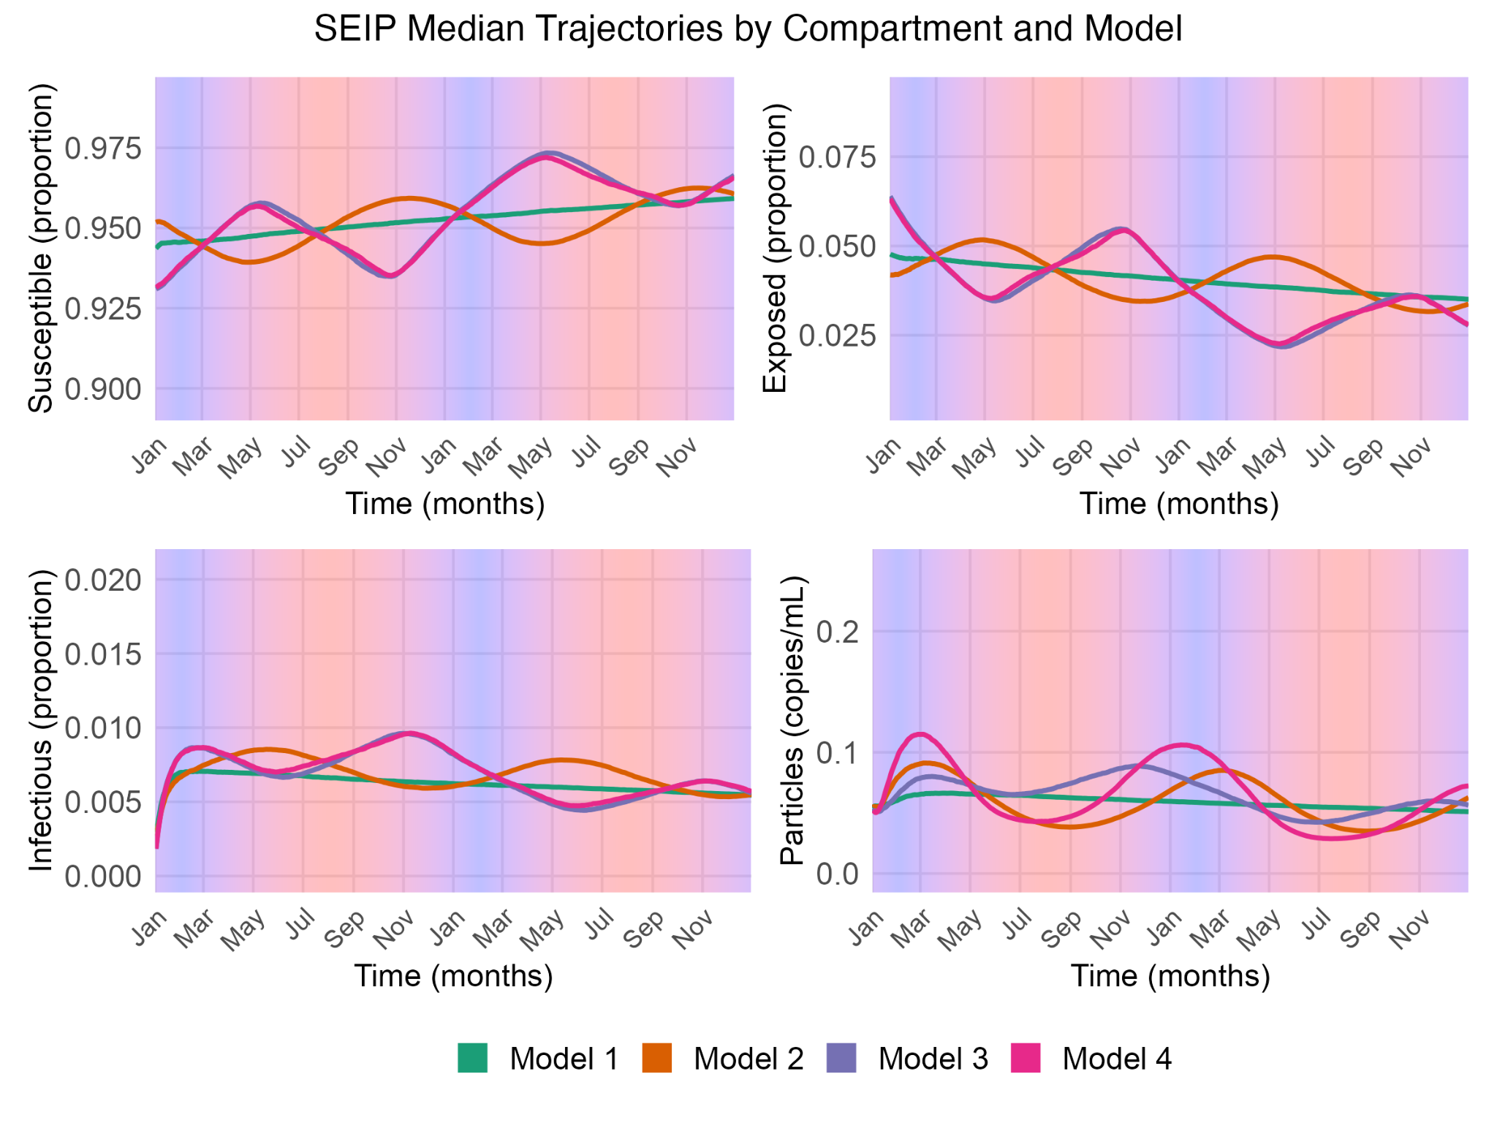
Visual Model Comparisons
Methods
M.S. Defense
Model 4 results in highest P trajectory peaks
Temperature-dependent decay primarily refines the particle dynamics
P is still not at the amplitude as seen in the data

Slide 31
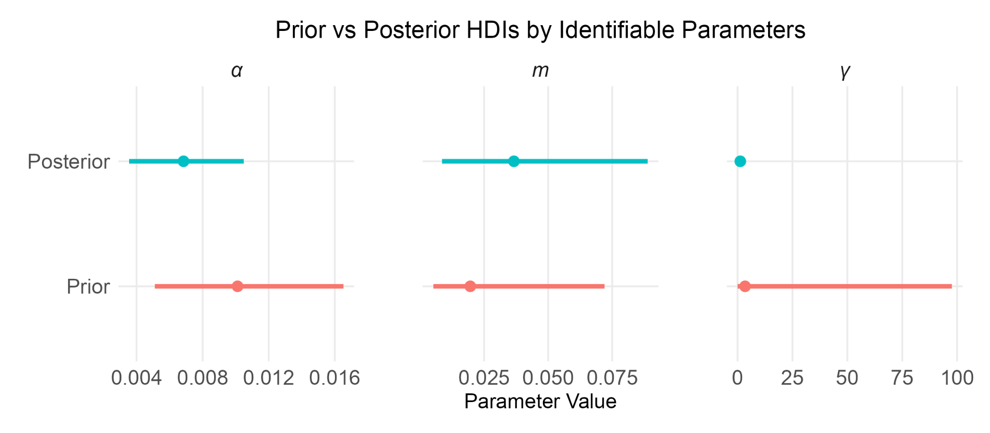
Model 4 Results
Methods
M.S. Defense
α posterior shifted and is narrower
  ⇒ longer latent periods than initially assumed
  ⇒ strong data-driven learning
γ posterior narrowed
  ⇒ data support for a lower emission rate
m posterior is similar to prior
  ⇒ weak data influence

Slide 32
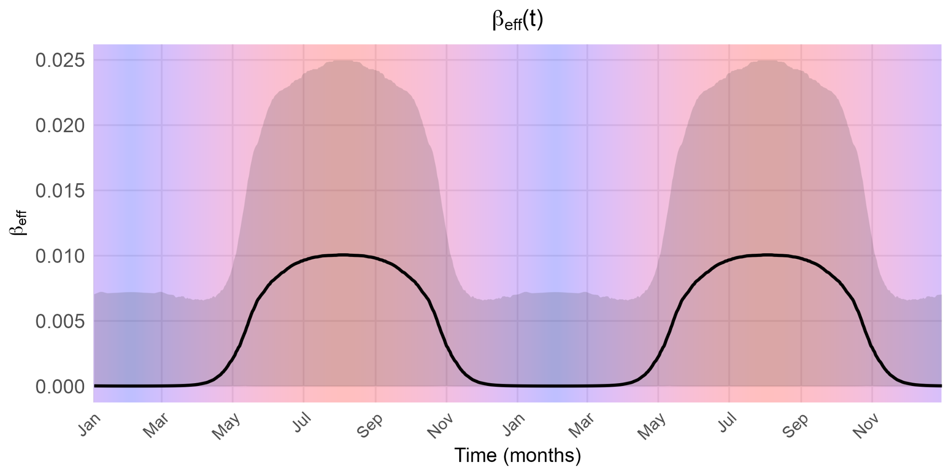
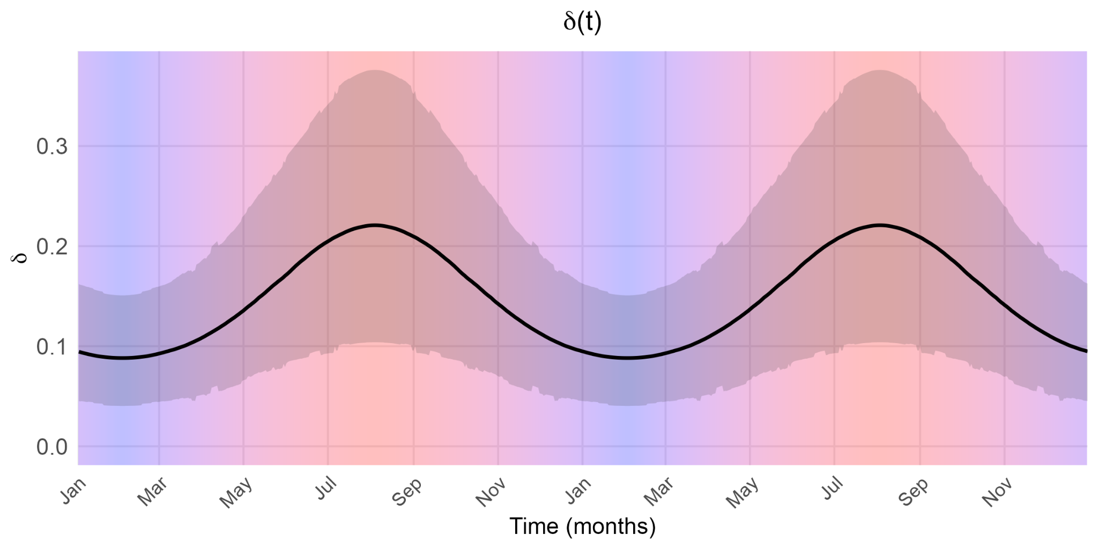
Model 4 Results
Methods
M.S. Defense
Beta temperature-dependence and delta rates increase with warmer temperatures, consistent with laboratory evidence.

Slide 33
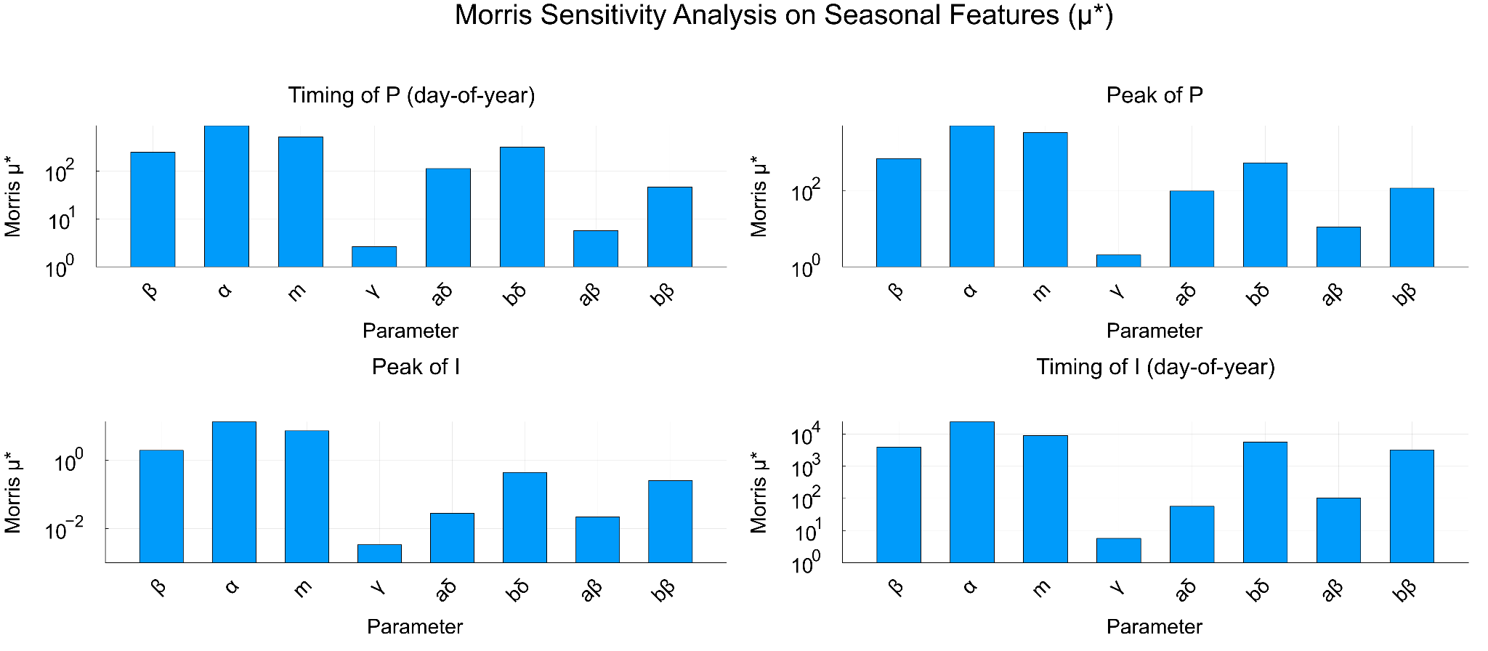
Model Sensitivity
Results
M.S. Defense
Overall importance of each parameter on a given seasonal feature evaluated over 5-95% prior intervals
α and m: Most influential parameters
γ: Least influential parameter

Slide 34
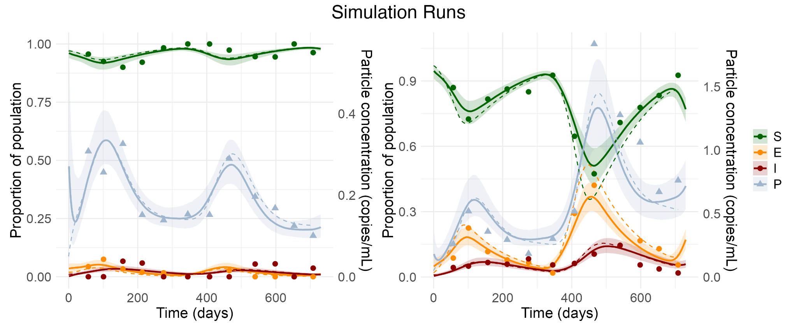
Model Validation
Results
M.S. Defense
Simulated trajectories from prior distributions 100 times (100 simulated datasets)
Calculated posterior estimate 95% interval coverage of simulated parameters
While overall calibration is good, α is weakly informed by data under the current prior
Results:
α: 80% coverage
m: 96% coverage
δ(T): 96% coverage
β(T): 93% coverage
γ: 95% coverage

Slide 35

Model Extension - “Model 5”
Results
M.S. Defense
Spawning could be a reason to why there are summer spikes that the model cannot capture mechanistically
Introducing a particle spike in summer spawning months is a possible model extension
Limited knowledge on spawning and cancer particle emission, and timing of spawning
But still a good theoretical experiment
Define a pulse equation to introduce an increase in P for a duration of 3-10 days and in the months of May/June (timing and duration inferred by model)
Notes:
The goal was not to estimate biological spawning magnitude, but to assess whether the inclusion of a temporally localized input improves structural fit. Estimating amplitude would require independent data on spawning intensity.

Slide 36
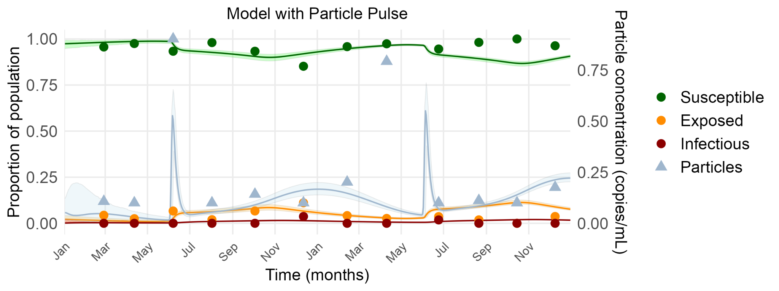
Model Extension - “Model 5”
Results
M.S. Defense
Ran with fixed parameters from Model 4 and inferring timing/duration of pulse

Slide 37
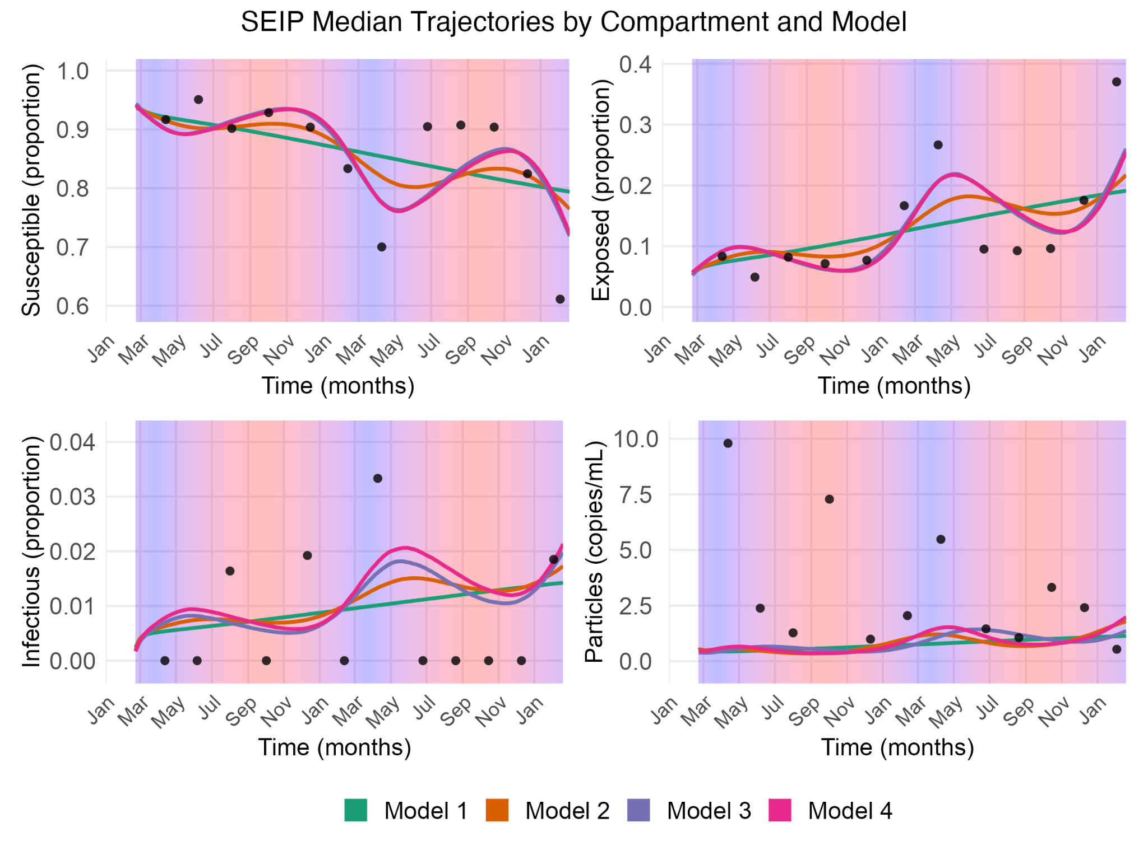
Second Site - Pavilion Beach
Methods
M.S. Defense
All model trajectories are showing similar patterns
Seasonal drivers cannot be distinguished
PB does not contain enough information to identify the seasonal mechanism
Tests generality of the Forest River results
It seems that the April prevalence point is highly influential in the model
Notes:
Across sites, we see clear differences in seasonal structure. In FR, models with different temperature dependencies produce distinct seasonal behavior, and the data are informative enough to identify temperature-dependent progression as the dominant driver. In contrast, in PB, models 1 through 4 produce nearly identical trajectories when temperature dependence is not enforced, indicating that the seasonal mechanism is not identifiable at that site. This suggests that PB is governed by additional or different processes not captured by the current model, and therefore functions as a diagnostic site rather than a source of independent parameter inference.

Slide 38
Data Limitations
Results
M.S. Defense
Available data (laboratory and field data) impose several limitations on model inference
  Progression parameters
  Limits of detection (S and P)
  Survey data resolution
  Low levels of Infectious clams
Mechanistic piece of the model is missing
  Spawning
  Tidal dynamics

Slide 39
Agenda
M.S. Defense
Introduction
Research Goals
Methods
Results
Conclusions

Slide 40
Conclusions
Conclusion
M.S. Defense
Epidemiological Model of BTN - Synthesized laboratory experiments and field surveys to quantify progression and transmission parameters.
Disease Seasonality and Driving Force in Forest River - Temperature-dependent progression is the driving force of BTN seasonality in Forest River. Under these model assumptions, increasing ocean temps will increase prevalence.
Model Generality - Seasonality is identifiable in Forest River, but not in Pavilion Beach under the same model, indicating differences in the site-specific processes governing BTN dynamics.
Foundational Model - Can be updated with new information of BTN dynamics.
Bayesian Disease Modeling - Demonstrated Bayesian modeling in an epidemiological system to uncover underlying processes even with sparse, noisy, and limited data.

Slide 41

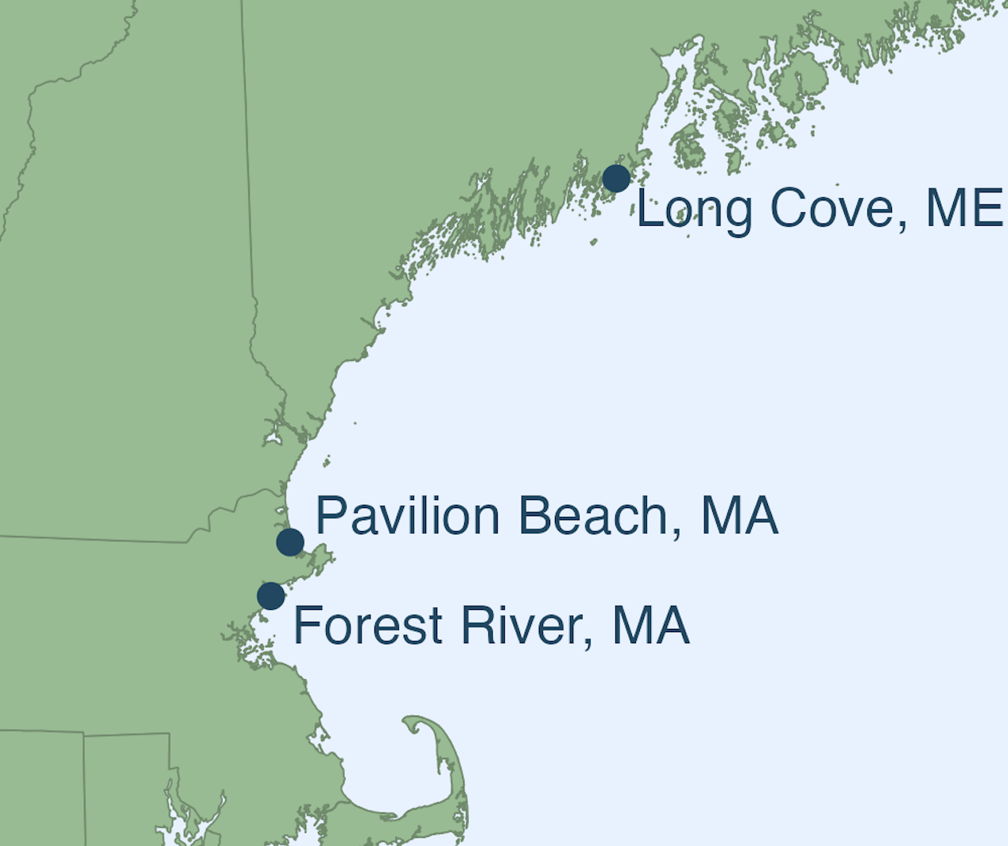
Future Directions
Conclusion
M.S. Defense
Puget Sound, WA
Compare model predictions to 2025 collection for validation
Apply to different sites to assess differences in transmission across populations and test with other temperature gradients
Apply to other species
  Cockles
Puget Sound, WA
East Coast, MA & ME

Slide 42
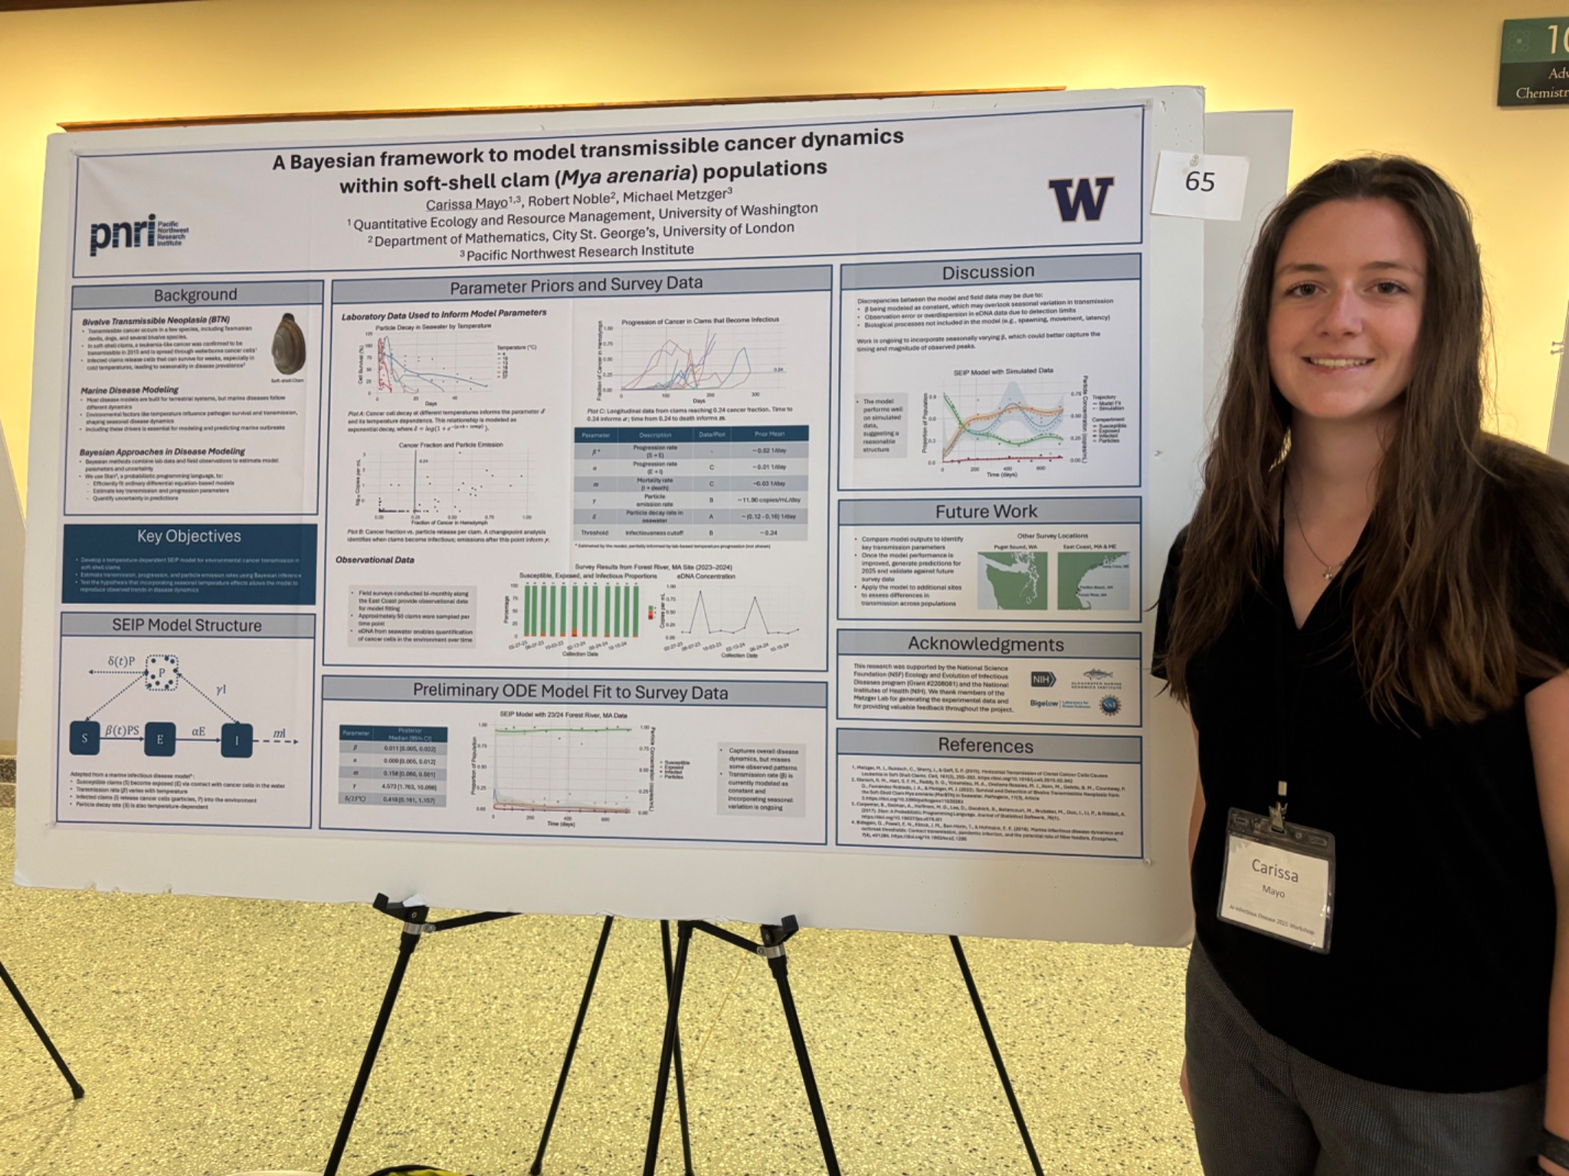
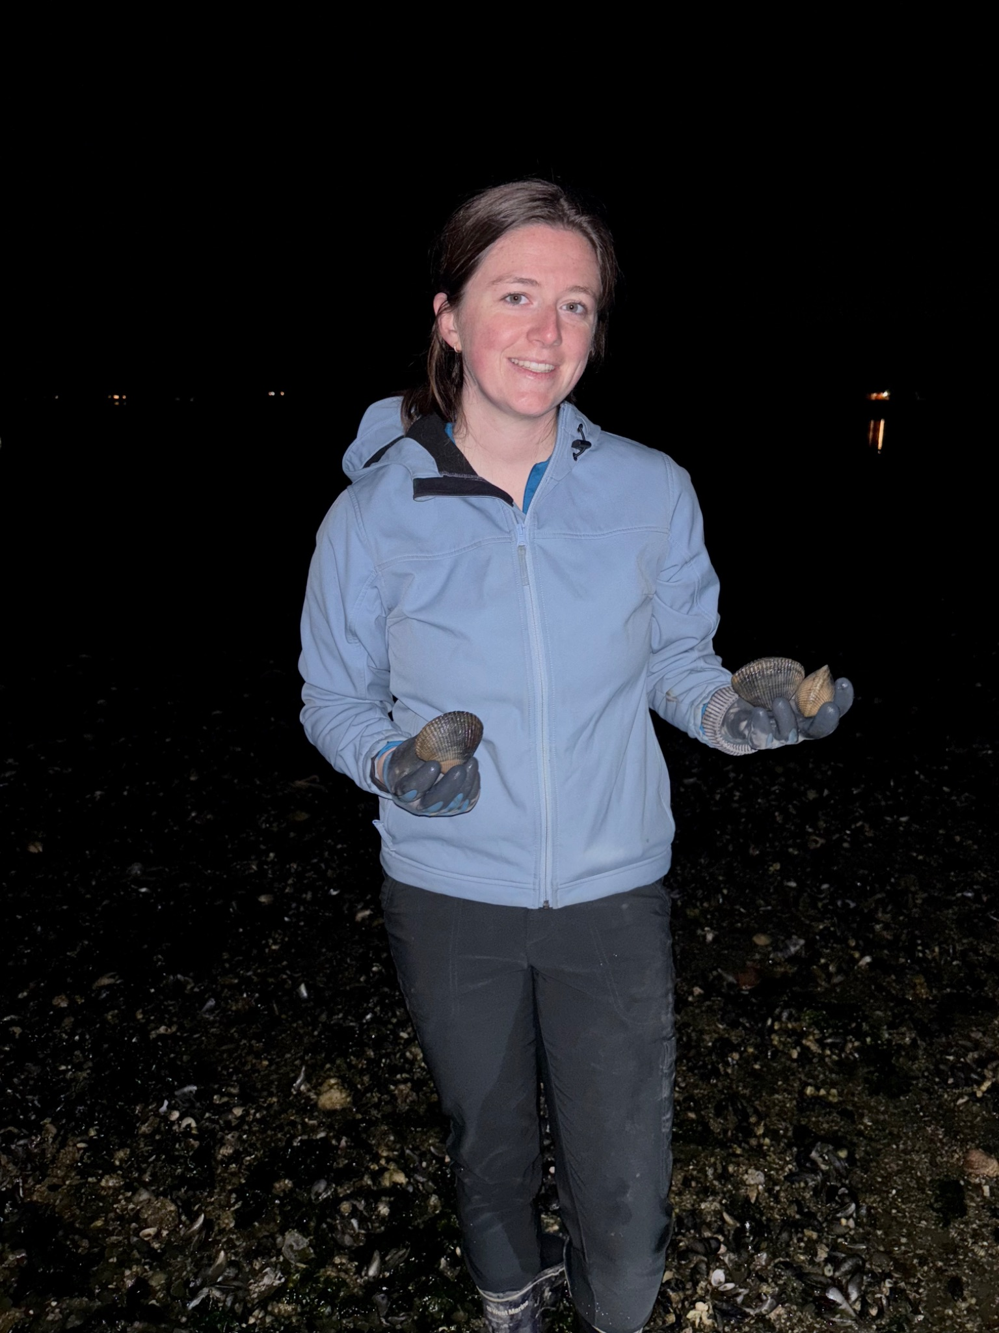



Thank You
M.S. Defense
Adviser: Dr. Michael Metzger, University of Washington
Committee
Dr. Rob Noble, City St. George’s, University of London
Dr. Chelsea Wood, University of Washington
Dr. Alison Feder, University of Washington
Metzger Lab
Fiona Garrett
Peter Smith
Zach Child
Past lab members
Sydney Weinandt
Marisa Yonemitsu
Rachael Giersch
Sam Hart
Jordana Sevigny

Slide 43
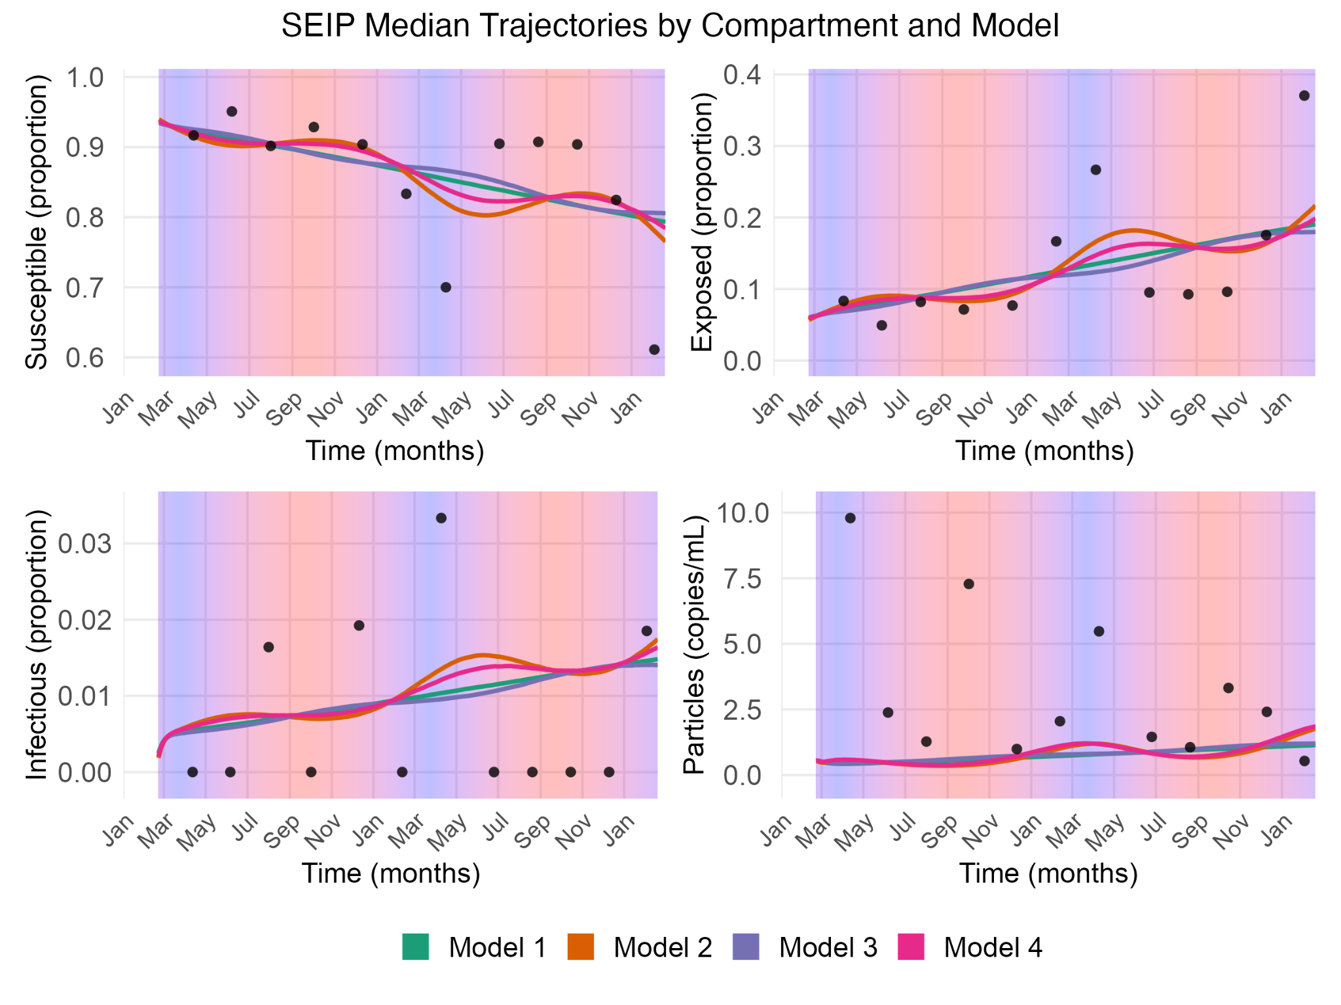
Second Site - Pavilion Beach
Results
M.S. Defense
Enforcing the beta_temp relationship flipped the model 3 trajectory

Slide 44
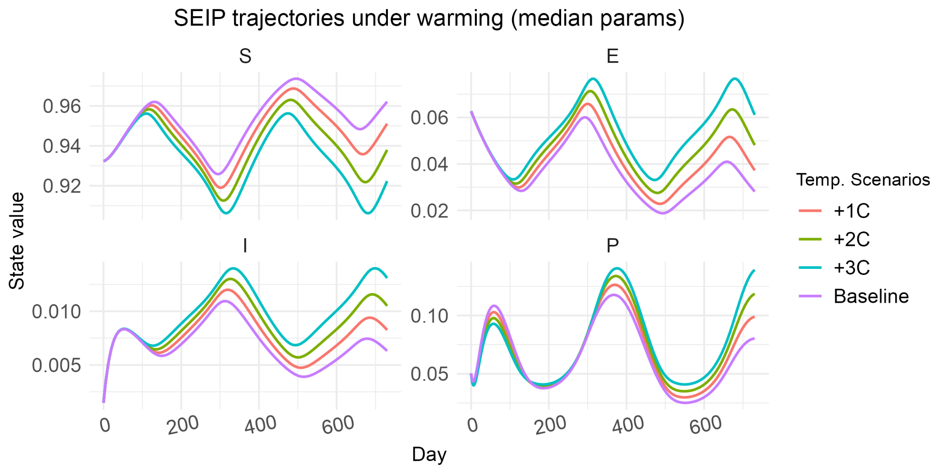
Temperature Scenarios
Results
M.S. Defense

Slide 45
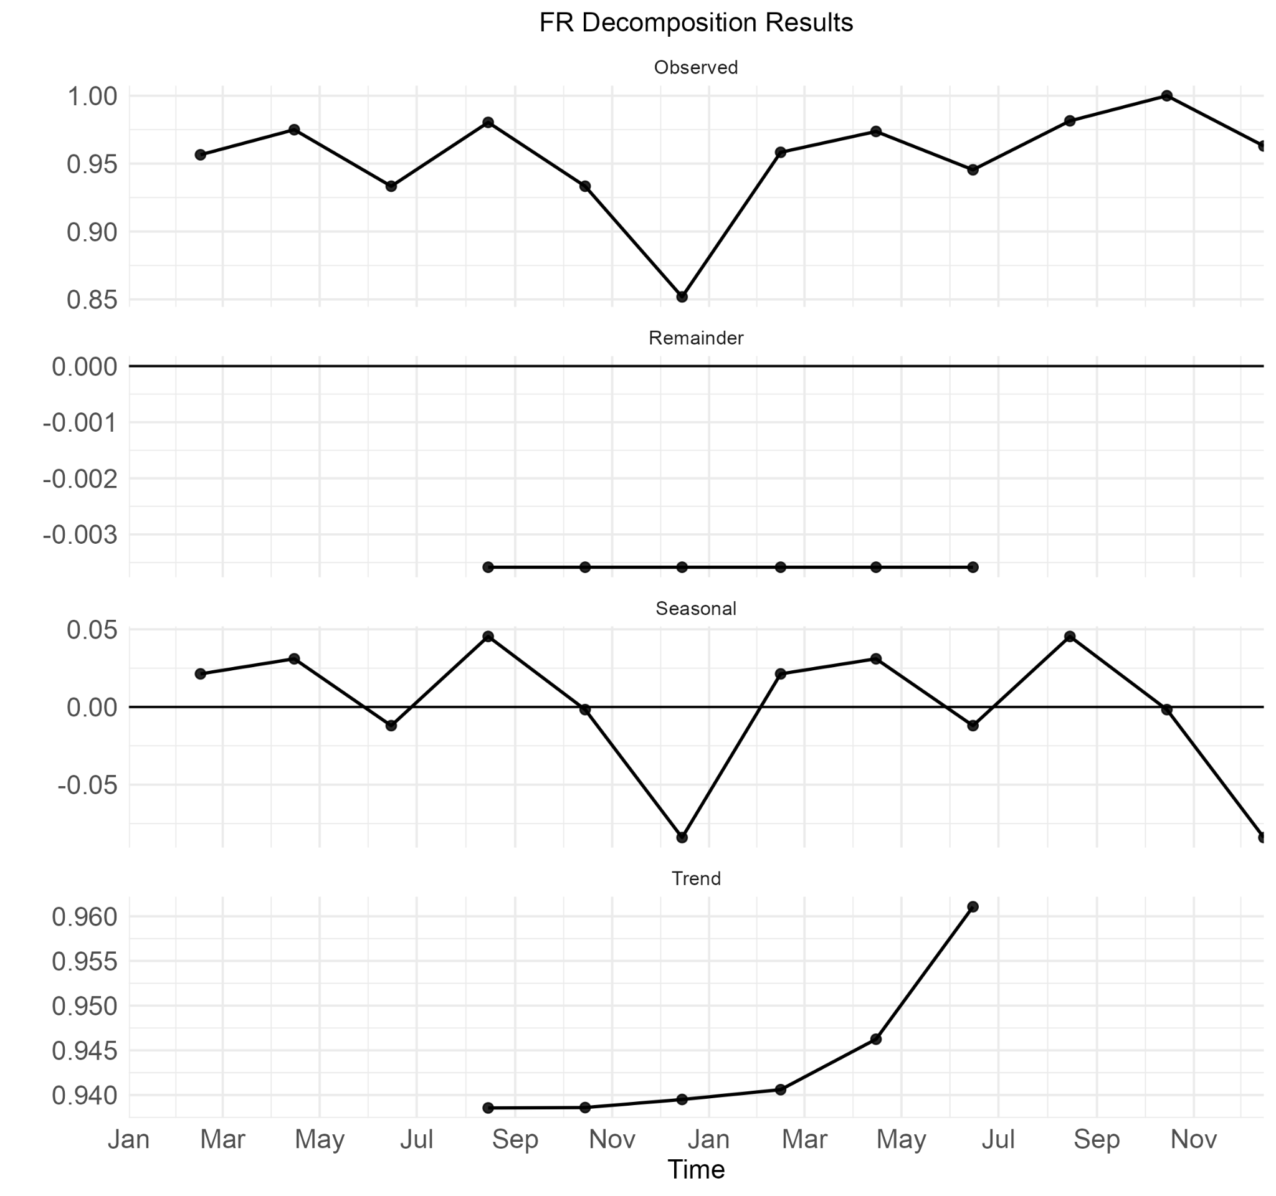
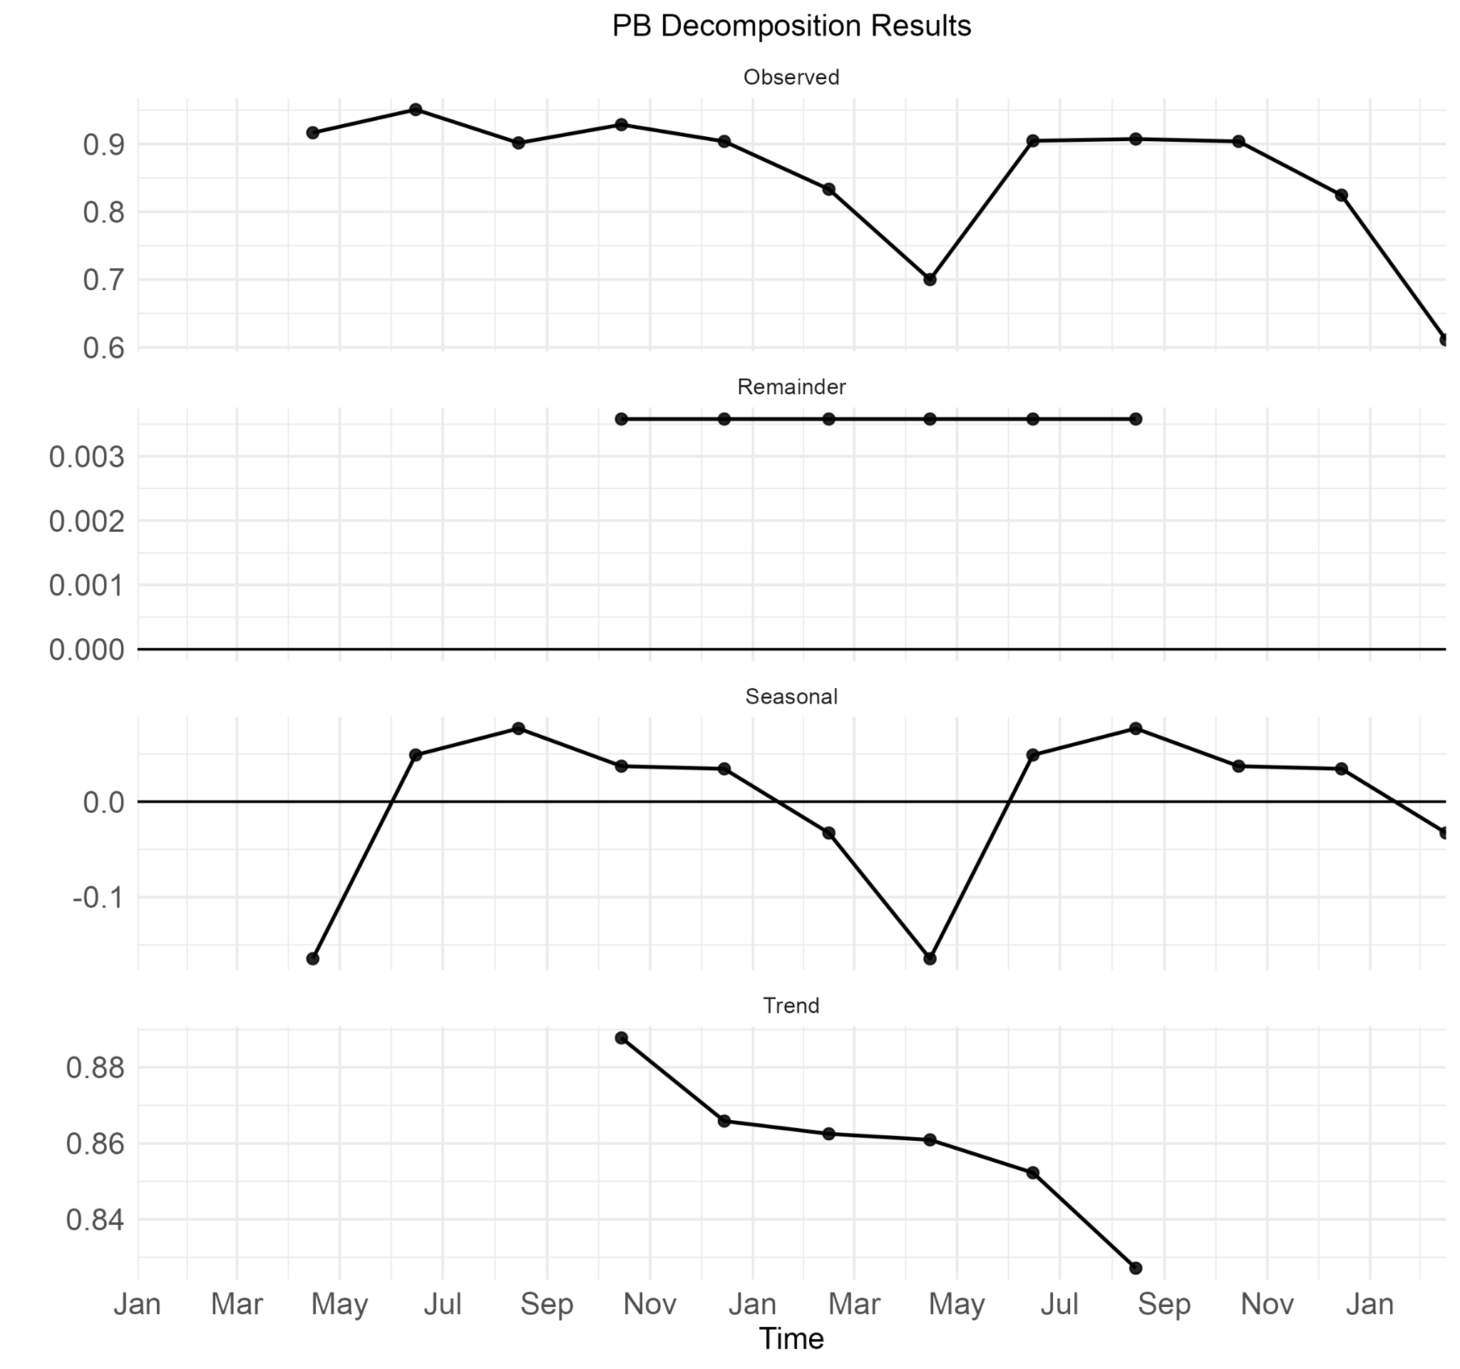
Decomposition
Conclusion
M.S. Defense
Puget Sound, WA
East Coast, MA & ME

Slide 46
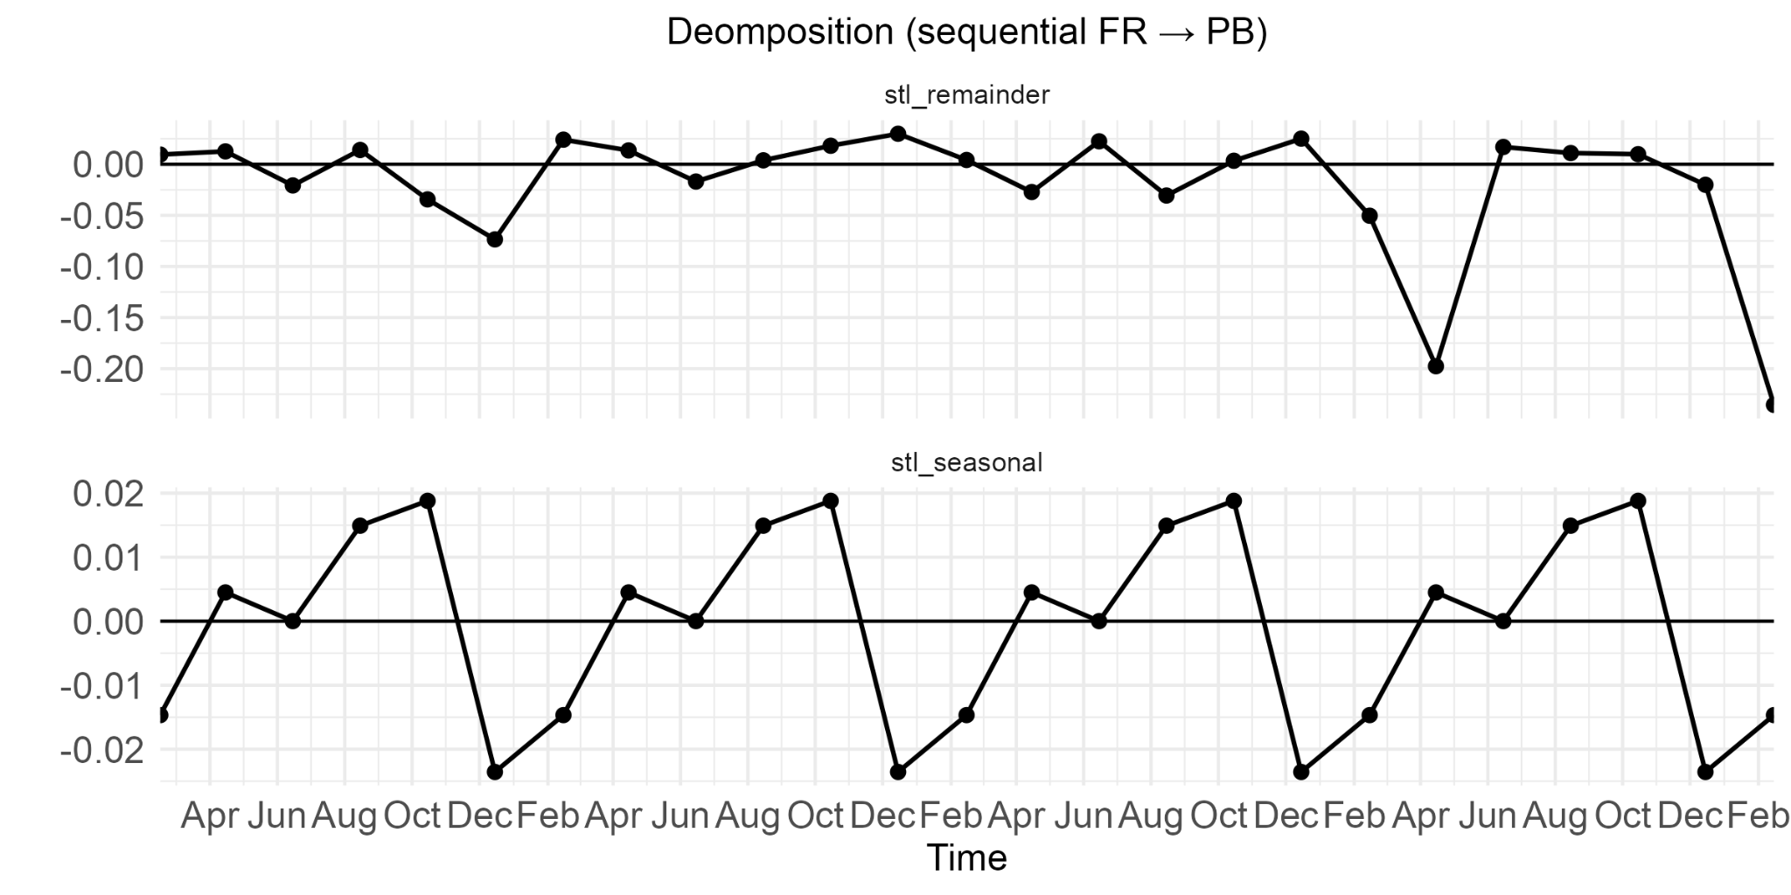
Decomposition
Conclusion
M.S. Defense
Puget Sound, WA
East Coast, MA & ME

