Slide 1


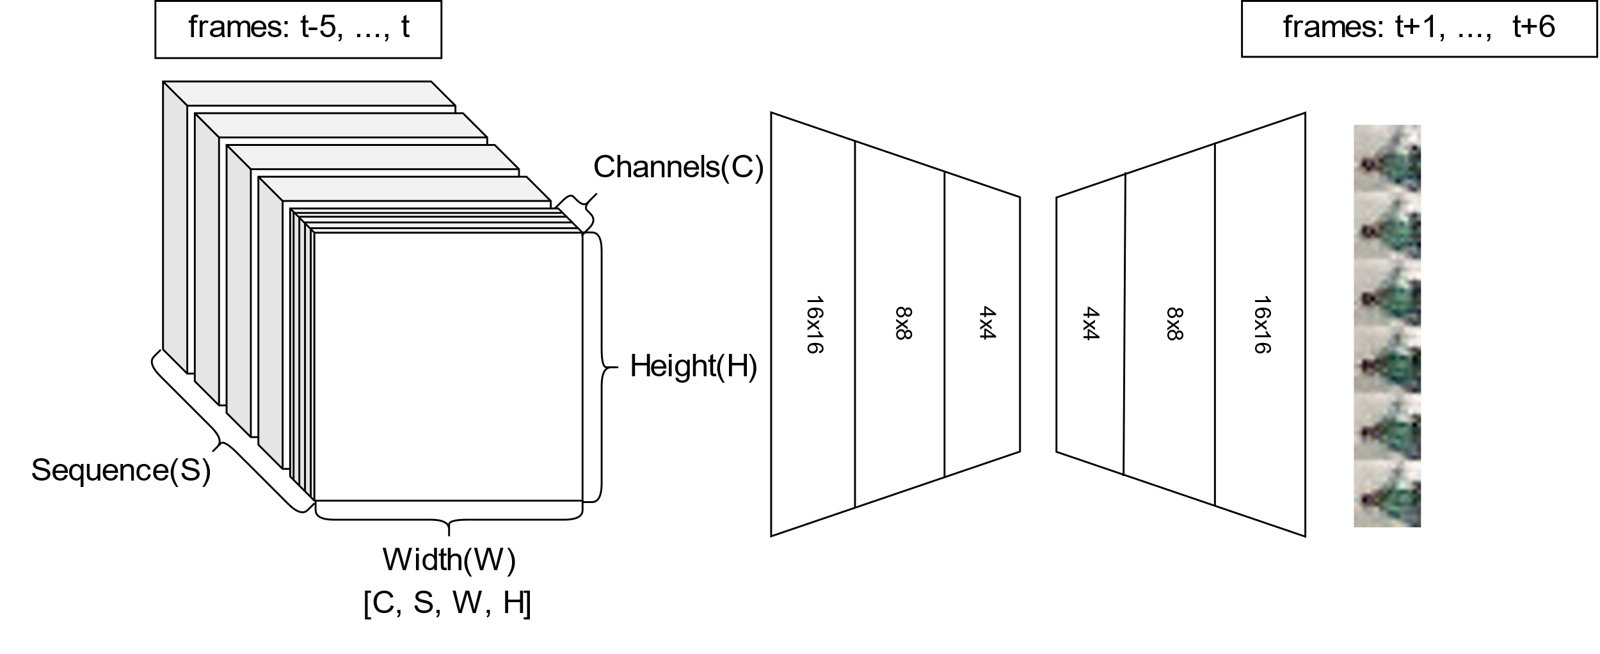
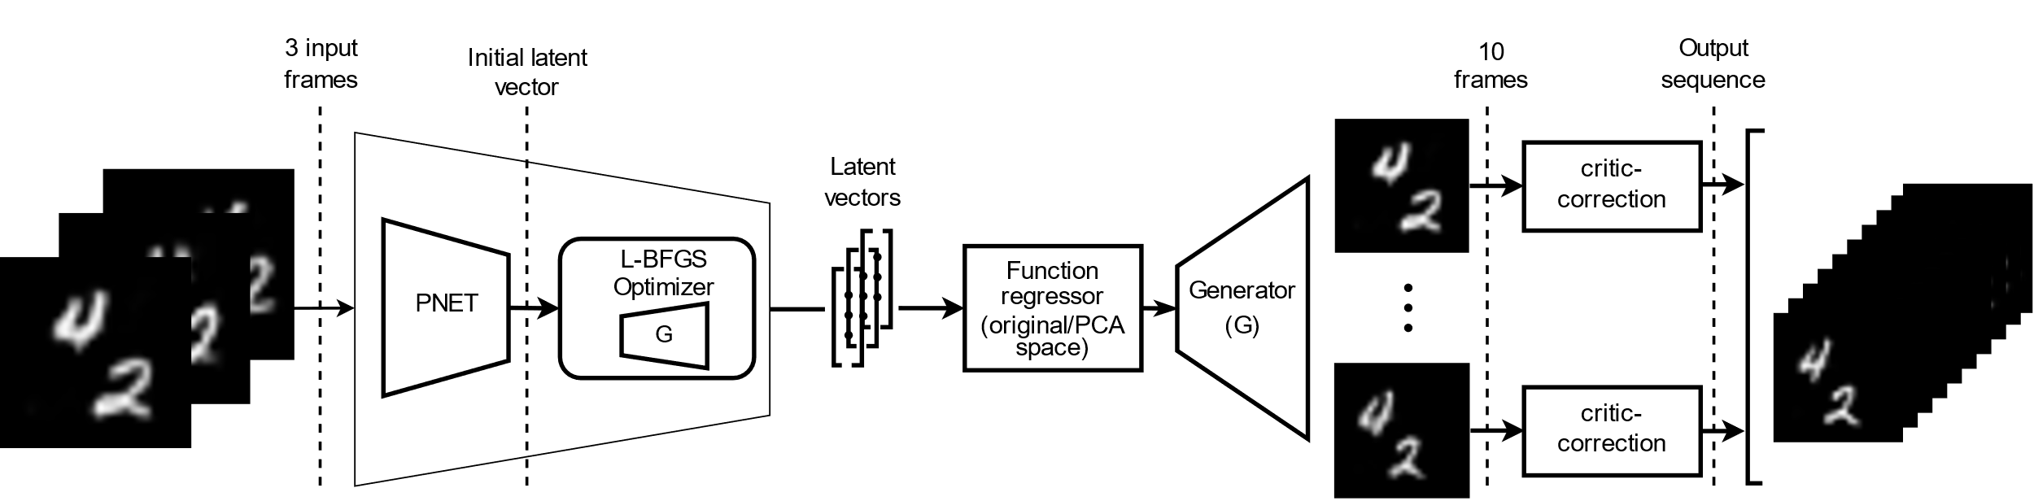
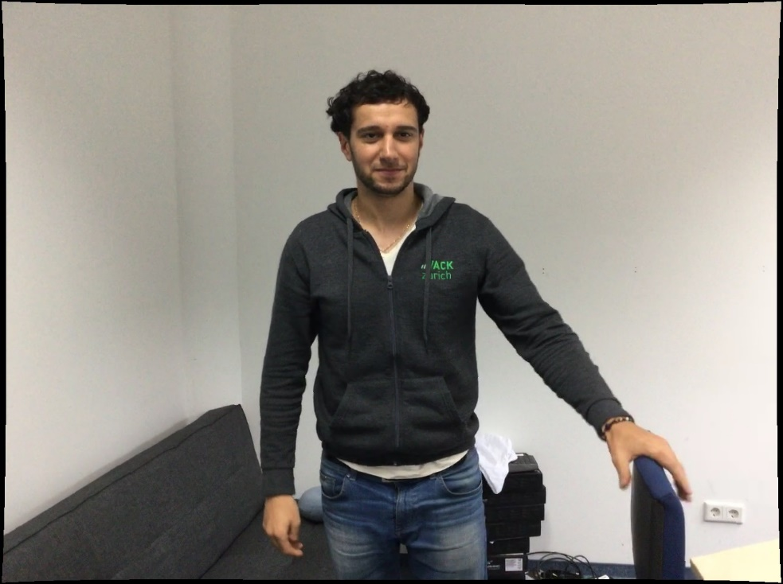
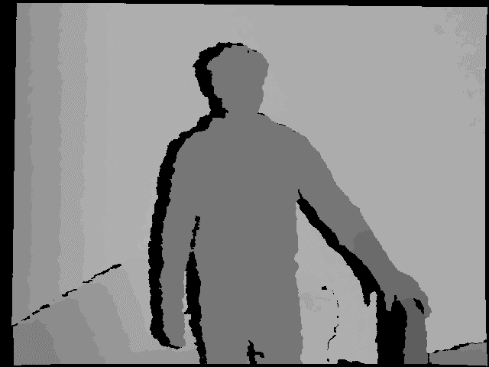
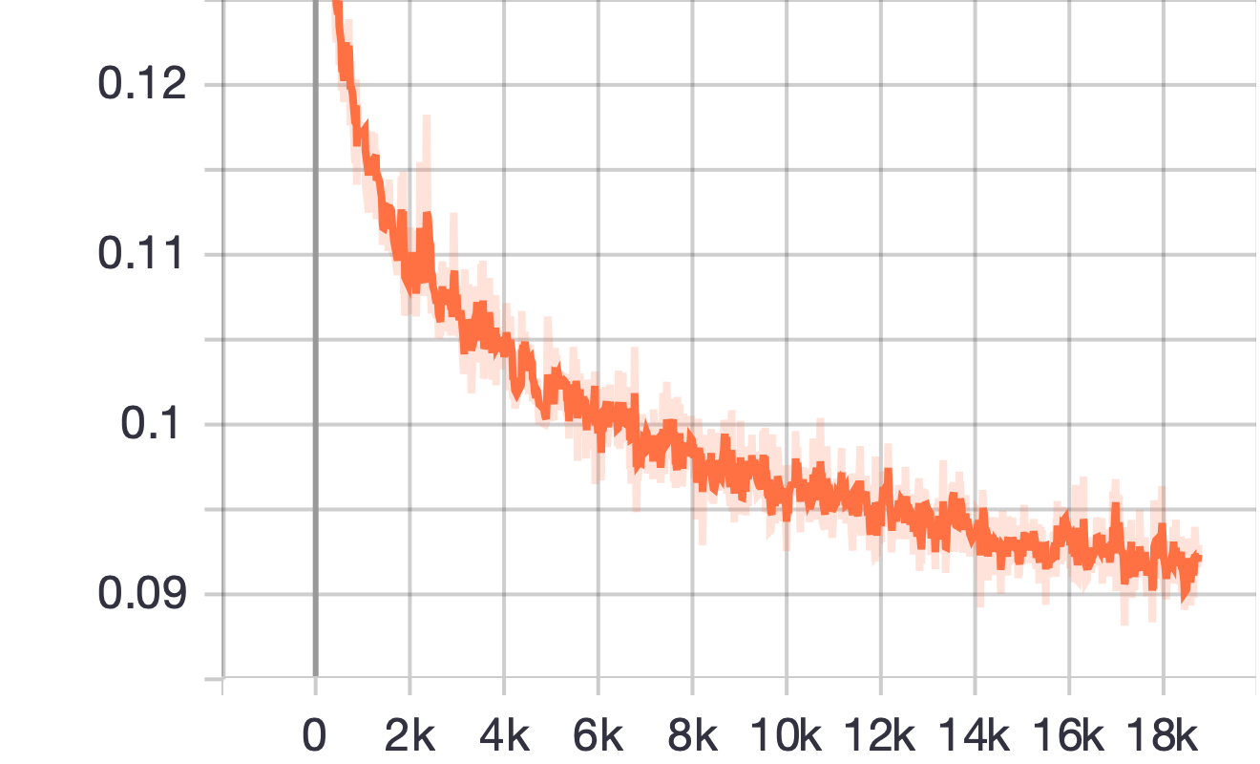
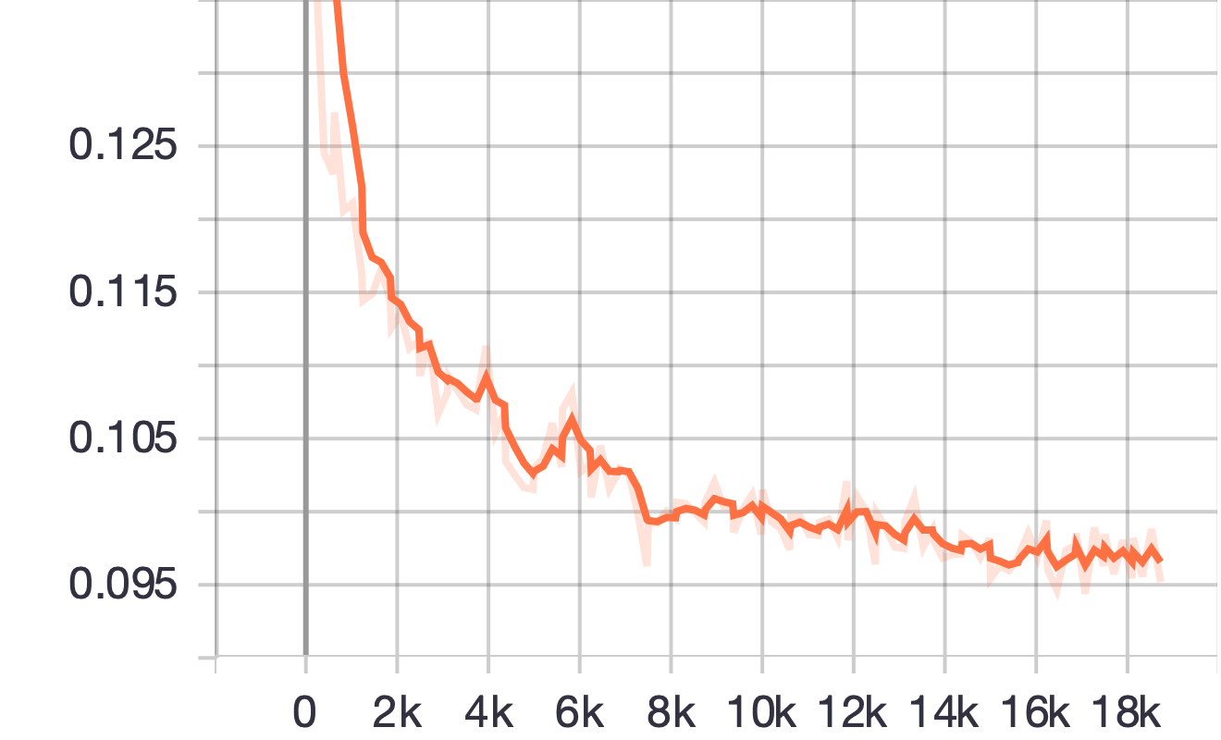
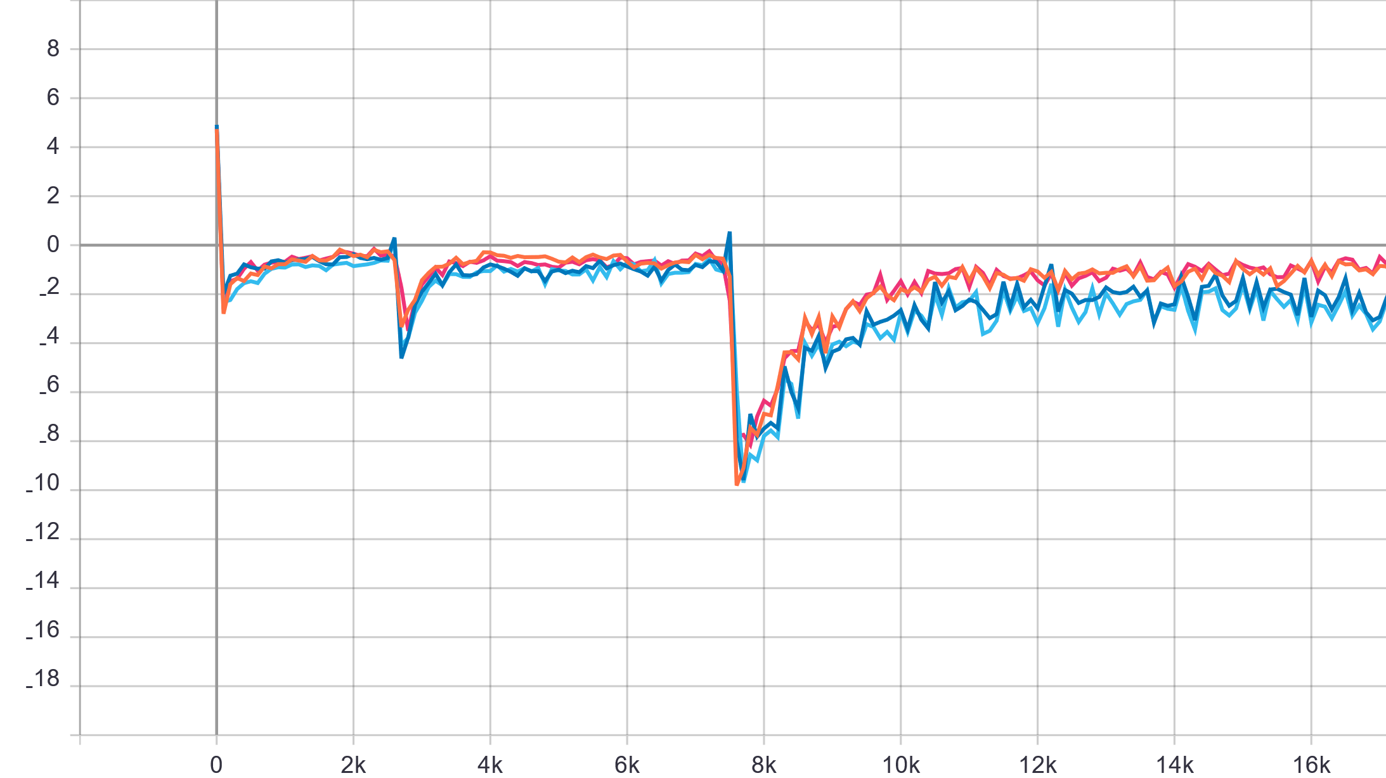
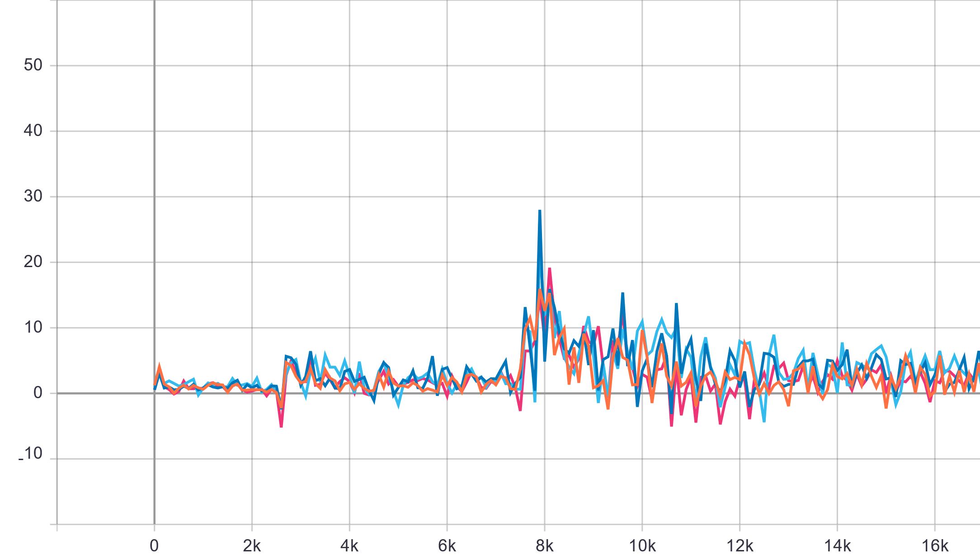
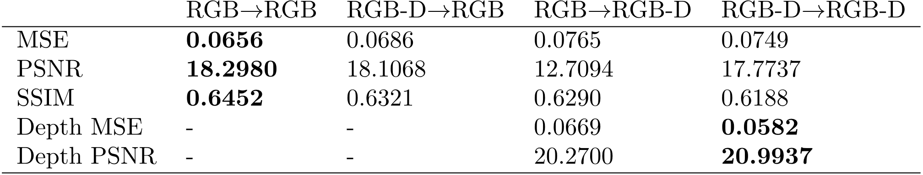
Improving State-of-the-Art GAN Video Synthesis
Michael Gentner Lars Carius
Advanced Deep Learning for Computer Vision (IN2364)
Abstract
Related Work
We propose multiple methods for improving state-of-the-art GAN-based video synthesis approaches. We show that GANs using 3D-convolutions for video generation can easily be extended to predicting coherent depth maps alongside RGB frames, but results indicate that this does not improve RGB accuracy if depth is available. We further propose critic-correction, a method for improving videos generated by latent space curve fitting. Additionally, we study the effect of Principal Component Analysis as well as different backprojection methods on the quality of generated videos.
BigGAN was extended to video generation by Clark et al. using Recurrent Neural Network (RNN) blocks and separate discriminators for spatial and temporal consistency [1]. Building on PGGAN [2], FutureGAN uses 3D-convolutions to synthesize video sequences conditioned on input frames [3].
The low-dimensional latent manifold of GANs was used to interpolate between generated images [4]. Zhu et al. use encoded spatial properties to morph images based on user suggestions [5], Chen et al. [6] propose additional methods to manipulate specific properties of generated faces.
GitHub Repo
Incorporating Depth
Latent Space Video Generation (LSVG)
Progressively Growing 3D-convolution architecture for video synthesis
Pipeline for generating videos via backprojection of conditioning frames, curve-fitting in latent space and generation of new samples including post-processing with critic-correction
Key Facts
6 input frames, 6 output frames
3D-convolutions, WGAN-GP loss
Progressive growing every 20 episodes (transition & stabilization phases)
Trained on DEFORM dataset
Ablation Study
Dense depth maps as an additional channel
All combinations of depth input & output
Key Facts
Arbitrary number of input frames (28x28 px)
Backprojection using a hybrid approach (Projection-net + L-BFGS optimization)
Polynomial fitting in latent space (16 dim.)
GAN generator to synthesize an arbitrary number of new frames
Critic-correction as a postprocessing step
Deform Dataset
Backprojection
Incorporating Depth - Results
Input
Prediction
L-BFGS
P-Net
L-BFGS+ P-Net
Ground truth
P-Net train loss
P-Net validation loss
Numerical Solver
L-BFGS worked best
Minimizes reconstruction error with fixed generator weights
Projection-Net
Similar structure as critic, BCE loss
Trained on MovingMNIST
Used to initialize numerical solver
Ground truth
RGB → RGB
RGB-D → RGB
Critic-Correction
RGB → RGB-D
RGB-D → RGB-D
RGB → RGB
Discriminator Loss
Update formula for critic-correction. The latent vector is optimized to achieve a high critic score and thus to produce a realistic image
RGB → RGB
RGB-D → RGB
RGB-D → RGB
RGB → RGB-D
Key Insights
Critic rates realism of frame
Method recovers blurry images
100 update steps worked best
RGB-D → RGB-D
Backprojected video frames before and after critic correction. The frames become considerably sharper and more readable, but not all digits converge to the correct ground truth
RGB → RGB-D
Generator loss
LSVG – Results
RGB-D → RGB-D
Test set sequences generated in the ablation study
Scores from the ablation study
Video sequences generated by our pipeline. 3 frames are used as input, backprojected into latent space using P-net and L-BFGS. A linear curve is fit via regression, 10 points are sampled and fed into the generator network and critic-correction is applied as a postprocessing step
Key Insights
Depth information does not improve RGB prediction
Network does not draw a connection between RGB and D-channel
Learning depth works well with little extra cost
Predicting depth works well without depth availability at test time (in given constraints)
Key Insights
Video generation by latent space curve-fitting is possible but requires very good latent space
Hybrid backprojection performs best
Low-rank polynomials perform better for curve-fitting
PCA can help overcome ill-conditioned latent spaces
Critic-correction can improve image quality, but might need additional information
References
[1] Adversarial Video Generation on Complex Datasets. Clark et al., 2019.
[2] Progressive growing of GANs for improved quality, stability, and variation. Karras et al., ICLR 2018.
[3] Futuregan: Anticipating the Future Frames of Video Sequences Using Spatio-Temporal 3D Convolutions in Progressively Growing Gans. Aigner et al., ISPRS 2019.
[4] Progressive growing of GANs for improved quality, stability, and variation. Karras et al., ICLR 2018.
[5] Generative visual manipulation on the natural image manifold. Zhu et al., Lecture Notes in Computer Science 2016.
[6] Homomorphic Latent Space Interpolation for Unpaired Image-to-image Translation. Chen et al., CVPR 2019.

