Slide 1
Project Scope
Objectives
An opportunity to upskill various technologies in modern information systems and experience the work as a full-stack developer plus putting AI/ML in practical use.
Technology Stacks
Business Problem
  To provide a front-end dashboard to visualise trends of selective business data plus future values prediction utilizing machine learning
Architecture
  Java SpringBoot as a data provider through Restful API, with the underlying source data stored in either CSV files or tables in MySQL
  Python components read data from the API and extract the data as JSON format, then load into the PostgreSQL database as a master data, as well as using sklearn modules to generate predictions with machine learning models (Linear Regression).
  Node.js client side serves dashboard with data, reading from the server side via page routers. Using various database views on top of the material data
Domain | Technologies
Operating Systems | Windows, Linux
Databases | PostgreSQL, MySQL as data storage, CSV as source data storage
Backends | Java SpringBoot, server side Next JS on Node.js, Python as a data processing method, Machine Learning for future values prediction
Inter-system communication | Restful API
Front-ends | Client side Next JS on Node.js
Technologies and Tools | Language: SQL/Stored Procedure for PostgreSQL, Python (Pandas/sklearn for machine learning), Java with SpringBoot, Next JS with Typescript and Javascript IDE: VS Code with Github Copilot, Eclipse Database: PostgreSQL, MySQL

Slide 2
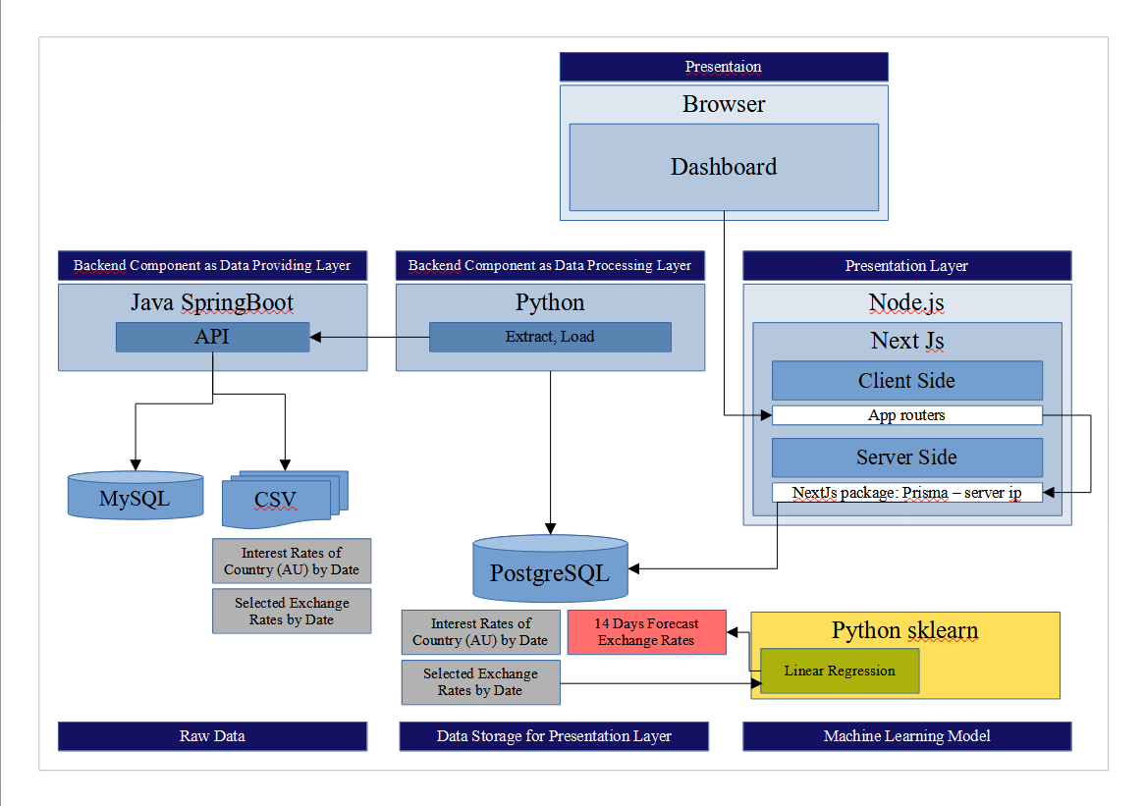
Architecture Overview

Slide 3
Architecture Breakdown
Dashboard displayed in any Browser with graphs visualise from the data in the database
Java SpringBoot connect to the source via database connection and host machine file path
Python extract data with the latest file date and load data for a period of duration
App routers serve as a middle point for each user to request for database’s response
Database IP details provided to the Next JS package Prisma as a database communication
Database views sourced from the master tables stored metrics for the visuals on the dashboard
Python sklearn module creates machine learning models and predicts the values by using the existing data source

Slide 4
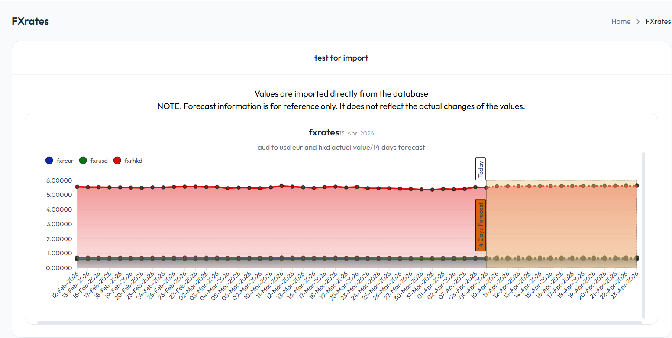
Screenshots
Machine Learning Future Values Prediction

Slide 5
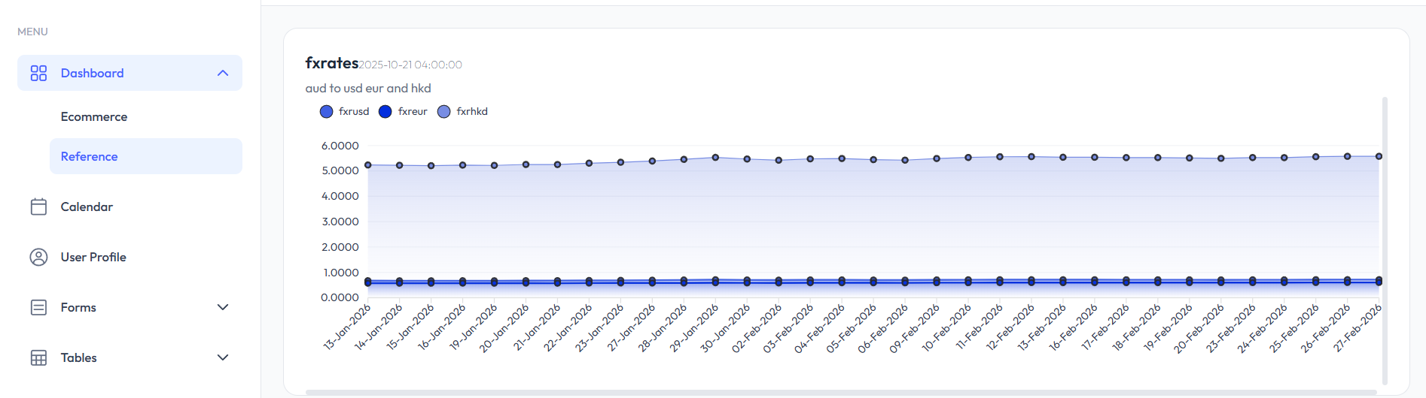
Screenshots

Slide 6
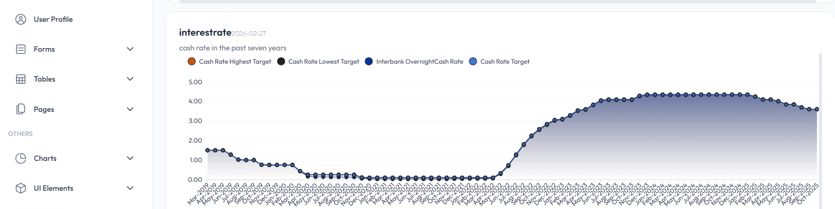
Screenshots

