Slide 1

Time to React
Waiter, there is HTML in my JavaScript!

Slide 2
Date | Topic
September 13 | React
September 20 | React Native
September 27 | Redux

Slide 3
What’s up?
First a theoretical introduction (max 1h)
Then a hands-on tutorial (~2-3h)

Slide 4
Feel free to ask questions!
There are no stupid questions.
Only stupid people.

Slide 5
The web platform
The Web platform
HTML
CSS
Javascript
Content
Style & Layout
Behaviour

Slide 6
Old school web
Web today
frontend
generates
backend
frontend
queries
backend
UI
Business logic, database
UI, view logic
Business logic, database
Notes:
Old way: Serverside creation and rendering of UI. Pushed to client. Struts, JSF etc.
Today: View logic executed in browser. Queries backend for needed data. Backend generally unaware of what type of client accessing the API (if it is web or mobile)

Slide 7
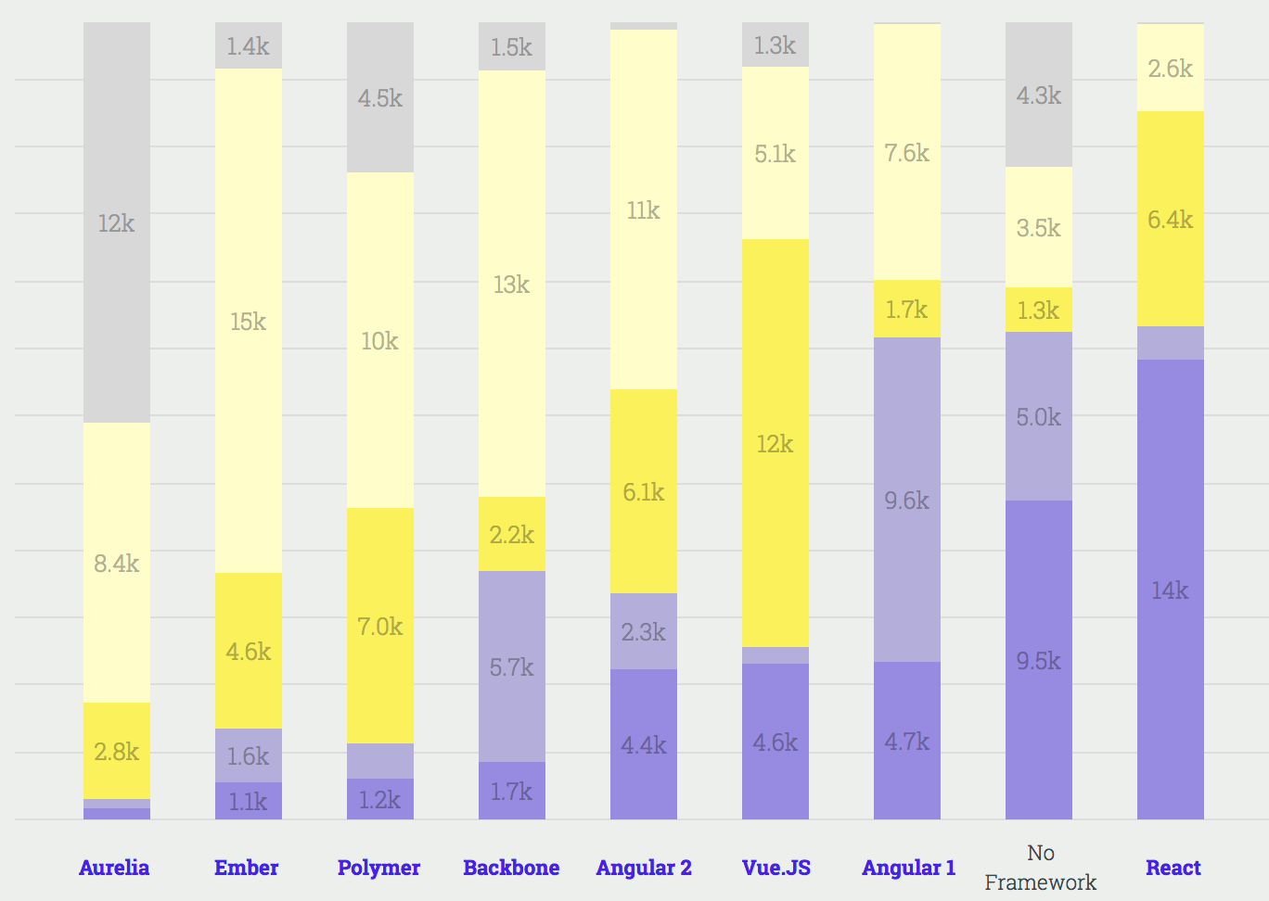
JavaScript frameworks & libraries
State of Javascript 2017:
I’ve never heard of it
Heard of it, but not interested
Heard of it, would like to learn it
Used it before, will not use it again
Used it before, would use it again
Notes:
React is still the dominant player here, but Vue is making big gains on the back of Angular's diminishing popularity. By 2018, this chart might end up looking very different!

Slide 8
React and complexity comparison
Library
Vue
React
Angular
Ember
Framework
"Observe that there is no right or wrong in the complexity choice. The important thing is to be aware of where on the scale you are, and understand the consequences of that."

Slide 9
React
2014 - The year of Expansion
2016 - React gets mainstream
2013 - The year of the Big Launch
2015 - React is Stable
React Native + Redux
2017 - The year of further improvements
Notes:
React introducerades på JS ConfUS i maj 2013, till en hyfsat klentrogen publik.
2014: Anseendet för React växte, fokus på att bli sedd som en stabil platform, för att attrahera stora spelare som Netflix.
2015: React blir stabilt, Netflix och Airbnb använder React. React Native samt Redux lanseras.
2016: Goes mainstream
2017: En hel del utökningar av React sker, t ex error boundaries, portals, fragments and the Fiber architecture
2018: React 16.3.0 släppt i mars.

Slide 10
React
React is a JavaScript library for building user interfaces. It is the view layer for web applications.
At the heart of all React applications are components.
A component is a self-contained module that renders some output.
It is all about converting data to UI

Slide 11
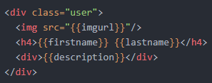
Converting data to UI
The templating problem
Given a handlebars template looking like this:
If we send the content of such a file into Handlebars.compile()...
...then we get back a template function that, when called with some data, will return the corresponding DOM structure.
let usertemplate = Handlebars.compile(definition);

Slide 12
Converting data to UI
So if we have this object:
and feed it to the browser
...then DOM will be:
let data = { firstname: 'John', lastname: 'Doe', imgurl: 'http://some.url', description: 'Best dude EVER.' };
let DOM = usertemplate(data);
(the template definition again, for comparison)
<div class="user"> <img src="http://some.url"/> <h4>John Doe</h4> <div>Best dude EVER.</div> </div>

Slide 13
Reacts way of handling templating
What we just saw was an example of this:
Data
template function
DOM
How React deals with templating:
Props
component
DOM
But what is the difference then?

Slide 14
In React
We express the UI in Javascript instead of HTML
We rerender the whole UI on every update (what‽)
We create components that are inherently composable

Slide 15
Here's the mandatory HelloWorld demo
let HelloWorld = function(props) { return <div>Hello world!</div>; };
let HelloWorld = (props) => { return <div>Hello world!</div>; };
or
As you can see the HelloWorld component is a plain JavaScript function, although with some weird xml syntax mixed in! That's called JSX, short for JavaScript eXtension.
The previous example was a bit boring as it was completely static. Here instead is a HelloWorld component which greets whoever you tell it to:
let HelloWorld = (props) => { return <div>Hello {props.who}!</div>; };

Slide 16
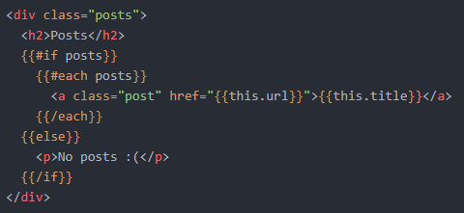
What does React trying to solve with JSX?
Let’s look at a more complex example:
Note the usage of augmented html for handling view logic (like iterating over posts).
This means that you have to learn this augmentations, which are solution specific. Your knowledge is useless outside the context of the solution.

Slide 17
What does React trying to solve with JSX?
The same in React:
let ListOfPosts = (props) => { let posts = (props.posts || []).map(p => { return <a className="post" href={p.url}>{p.title}</a> }); return ( <div className="posts"> <h2>Posts</h2> { props.posts.length > 0 ? posts : <p>No posts ☹</p> } </div> ); };
Apart from the JSX syntax, everything else in the code is just pure JavaScript. Being an actual programming language, it has no problem with expressing logic.
HTML is of course better at expressing markup, since it is a markup language. This is why Facebook added the JSX syntax to JavaScript.

Slide 18
What is JSX?
Consider this line of JSX code:
<div className="bar">Hello <strong>WORLD</strong>!</div>
If we indent it to show off the structure, then it would look like this:
The JSX is simply transformed into matching nested React.createElement calls:
<div className="bar"> Hello <strong> WORLD </strong> ! </div>
React.createElement( "div", // tagname {className:"bar"}, // properties "Hello ", // child 1 React.createElement( // child 2 "strong", // tagname null, // properties "WORLD" // child 1 ), "!" // child 3 )

Slide 19
We enter JSX mode simply by opening a tag. If you close the (last) tag then you are back in JS mode again.
let HelloWorld = () => ( <div className="bar">Hello <strong>WORLD</strong>!</div> );
If you want to go into JS mode inside JSX, use curly braces {}:
let HelloWorld = (props) => ( <div className="bar">Hello <strong>{props.name || 'mate'}</strong>!</div> );
<tag>
{
JS
JSX
JS
</tag>
}

Slide 20
Components are composable
const myPosts = [{url: "http://mymail.se#xyz", title: "You got mail!"}]; return ( <div className="post-main"> <img src="images/my-pic.png"/> <ListOfPosts posts={myPosts}/> </div> );
When an element type starts with a lowercase letter, it refers to a built-in component like <div> or <img> and results in a string 'div' or img' passed to React.createElement.
Types that start with a capital letter like <ListOfPosts /> compile to React.createElement(ListOfPosts) and correspond to a component defined or imported in your JavaScript file.

Slide 21
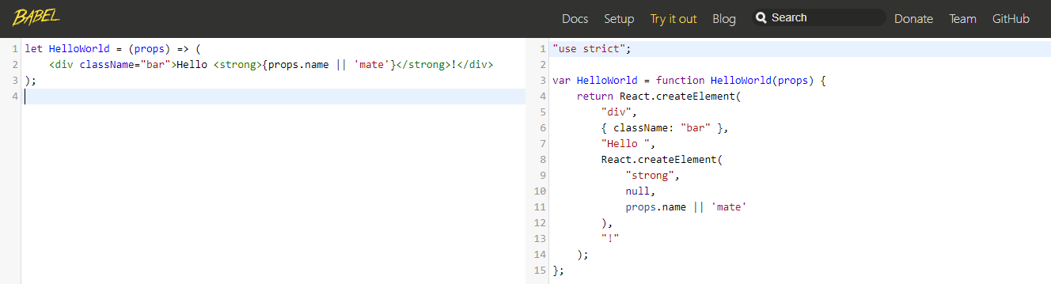

Since JSX isn't (yet) a part of the language, some kind of transpilation must occur.
Old Browsers has not full support for JSX or ES6 (JavaScript 2016), so we are using Babel for transpiling to JavaScript that old browsers understand.
Babel was setup in the project you created in the prerequisites, it will transpile your code automatically for you.

Slide 22

Updating the UI
Let's return back to the problem of updating our UI whenever data changes.
Handlebars doesn't solve this problem at all, it just provides the initial DOM. In a dynamic app we need additional functionality to update the UI when something happens.
React instead takes a super-simple, brute force approach; it rerenders everything on every data update, using the same function for the initial render and every subsequent update.

Slide 23
Updating the UI
But doesn't this give us headaches like performance issues and loss off scroll positions, and other things?
The answer is: No, because we lied before, a React component doesn't output DOM, but a virtual DOM.
Props
component
Virtual DOM
The virtual DOM is simply a JavaScript representation of a DOM structure.

Slide 24
Updating the UI
The point of the virtual DOM is that it allows React to compare new output with the previous output, and figure out what changes needs to be made to the actual DOM.
Only those changes are actually made, so the complete rerender is just conceptual.
prev virtual DOM
Set of DOM update instructions
React diffing engine
Props
component
virtual DOM
Notes:
This seemingly simple idea is one of the biggest advantages of React, as it removes lots of complexity and makes components easy to reason about.

Slide 25
Getting in the mood for tutorial
The tutorial will gradually introduce React concepts and discuss them.
Including the ones touched upon here
And also new ones
But before that, here are some things to be aware of…

Slide 26
Class based vs functional components
Class based:
Functional:
import React from 'react';
class SearchBar extends React.Component {
constructor(props) { super(props); this.state = { ... };
}
render() { return <input />; } }
export default SearchBar;
import React from 'react';
const SearchBar = () => { return <input />; };
export default SearchBar;
A functional component is a plain, "dumb", JavaScript function.
A class based component can hold state in the state object initialized in constructor. The tutorial will show you more about state and what it is.

Slide 27
Just one thing
A React component can only return one thing, either an array, a string, or an element. The most common you will see returned is an element.
A basic mistake that will trip most people up regarding render output, involves doing something like this:
return ( <h4>Sidebar!</h4> <MyComp somedata={data}/> <footer>Copyright</footer> );
This will not work, you'll need to wrap it in an enclosing element and return that instead:
return ( <div> <h4>Sidebar!</h4> <MyComp somedata={data}/> <footer>Copyright</footer> </div> );

Slide 28
Close your JSX properly
In JSX all elements must be closed.
An HTML image tag that can be written like this:
must in JSX be closed
or
<img src="../imgs/logo.png" alt="Logo">
<img src="../imgs/logo.png" alt="Logo"/>
<img src="../imgs/logo.png" alt="Logo"></img>

Slide 29
Destructuring assignment - a JavaScript expression that makes it possible to unpack values from arrays, or properties from objects, into distinct variables.
var data = { field1: "one", field2: "two" }; const {field1, field2} = data;
var data = { field1: "one", field2: "two" }; const field1 = data.field1; const field2 = data.field2;
is equivalent to

Slide 30
Summary
You write React applications using JavaScript
Components are the building blocks in a React application
A component (and all it’s children) are rerendered when data change
The virtual DOM helps in updating just the parts of a page that has changed
You express the UI in JavaScript and JSX instead of HTML
Babel is used for transpiling new fancy JavaScript and JSX to a JavaScript version old browser out there understands

Slide 31
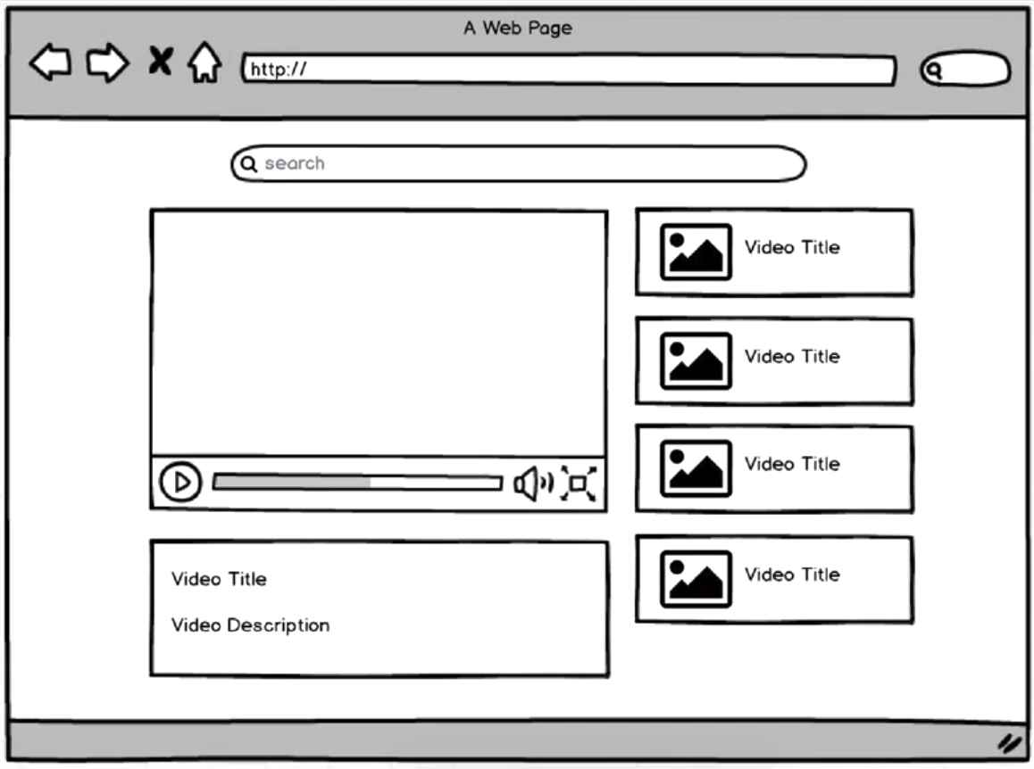
Tutorial: Build a video browser
The tutorial is written to hold your hand from start to finish
Don’t just copy and paste, make sure to read and reflect upon what you are doing
Recommendation: Team up in pairs and do it together!

Slide 32
