Slide 1

Cross DFU Project
Introduction and demo-show
Youqun Sun
H2 2020

Slide 2
Agenda
Project Brief
Introduction
Architecture
Demo Show
DFU from 91 to 52
DFU from 52 to 91
Tech Details
HTTP Download
DFU bin file format
app_cmd library
…

Slide 3
Project Brief

Slide 4


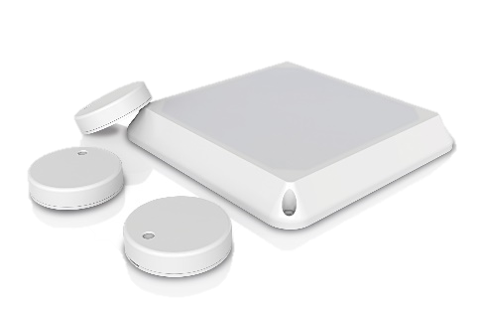
Tracker
HTTP
BLE
Web Server
Tracker
App
Notes:
Product of picture is from Ruuvi Innovations, Nordic nRF9160 inside.
https://www.nordicsemi.com/News/2019/04/Ruuvi-Node-open-source-node-solution-combines-nRF9160-SiP-and-nRF52840-SoC
Picture is from: https://www.cnx-software.com/2019/04/23/ruuvi-node-open-source-node-solution-nordic-semi-nrf9160-cellular-sip-nrf52840-bluetooth-soc/

Slide 5
Nordic Inside
HTTP
BLE
UART
nRF91
nRF52
Web Server
Tracker
App
Notes:
Product of picture is from Ruuvi Innovations, Nordic nRF9160 inside.
https://www.nordicsemi.com/News/2019/04/Ruuvi-Node-open-source-node-solution-combines-nRF9160-SiP-and-nRF52840-SoC
Picture is from: https://www.cnx-software.com/2019/04/23/ruuvi-node-open-source-node-solution-nordic-semi-nrf9160-cellular-sip-nrf52840-bluetooth-soc/

Slide 6
Cross DFU
Get DFU file from different way:
From HTTP (nRF91)
From BLE (nRF52)
Use case list:
91 -> 52
91 -> 91 application
91 -> 91 modem
52 -> 52
52 -> 91 application
52 -> 91 modem

Slide 7
Design Architecture
Always store new image in bank 1 of nRF91
Then do:
DFU to nRF91 by mcuboot
DFU to nRF52 by secure serial DFU
DFU to modem by socket

Slide 8
DFU Procedure: 91 -> 52

Slide 9
DFU Procedure: 91 -> 52
1. Download DFU file from web server…
HTTP
Bank 1
UART
Bank 1
Bank 0
Bank 0
Web Server
nRF91
nRF52
active application
new image

Slide 10
DFU Procedure: 91 -> 52
2. Do serial DFU to nRF52…
HTTP
Bank 1
UART
Bank 1
Bank 0
Bank 0
Web Server
nRF91
nRF52
active application
new image

Slide 11
DFU Procedure: 91 -> 52
3. Copy image in bootloader and set active…
HTTP
Bank 1
UART
Bank 1
Bank 0
Bank 0
Web Server
nRF91
nRF52
active application
new image

Slide 12
DFU Procedure: 52 -> 91

Slide 13
DFU Procedure: 52 -> 91
1. Get DFU file from App and send to 91…
Bank 1
UART
Bank 1
BLE
Bank 0
Bank 0
nRF91
nRF52
App
active application
new image

Slide 14
DFU Procedure: 52 -> 91
2. Swap active application and new image…
Bank 1
UART
Bank 1
BLE
Bank 0
Bank 0
nRF91
nRF52
App
active application
new image

Slide 15
DFU Procedure: 52 -> 91
3. Set active for new image…
Bank 1
UART
Bank 1
BLE
Bank 0
Bank 0
nRF91
nRF52
App
active application
new image

Slide 16
DFU Procedure: 52 -> Modem

Slide 17
DFU Procedure: 52 -> Modem
1. Get DFU file from App and send to 91…
Bank 1
UART
Bank 1
BLE
Bank 0
Bank 0
nRF91
nRF52
App
active application
new image

Slide 18
DFU Procedure: 52 -> Modem
2. Copy image to modem core…
Bank 1
UART
Bank 1
BLE
Bank 0
Bank 0
nRF91
nRF52
App
active application
new image

Slide 19
DFU Procedure: 52 -> Modem
2. Copy image to modem core…
Bank 1
UART
Bank 1
BLE
Bank 0
Bank 0
nRF91
nRF52
App
active application
new image

Slide 20
DFU Procedure: 52 -> Modem
2. Copy image to modem core…
Bank 1
Socket
Bank 1
UART
Bank 1
BLE
Bank 0
Bank 0
Bank 0
nRF91
nRF91
nRF52
App
(modem core)
(app core)
active application
new image

Slide 21
DFU Procedure: 52 -> Modem
2. Copy image to modem core…
Bank 1
Socket
Bank 1
UART
Bank 1
BLE
Bank 0
Bank 0
Bank 0
nRF91
nRF91
nRF52
App
(modem core)
(app core)
active application
new image

Slide 22
DFU Procedure: 52 -> Modem
3. Active new modem image…
Bank 1
Socket
Bank 1
UART
Bank 1
BLE
Bank 0
Bank 0
Bank 0
nRF91
nRF91
nRF52
App
(modem core)
(app core)
active application
new image

Slide 23
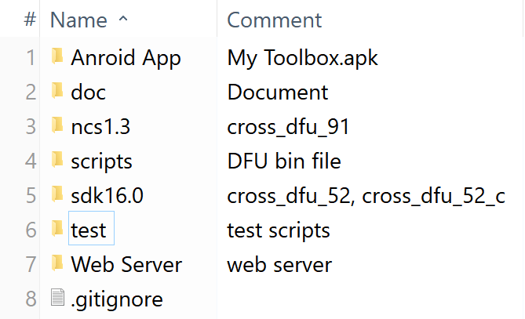
Cross DFU Project
It’s a complete system:
Web server
nRF91 firmware
nRF52 firmware
App
Script
How do they work?

Slide 24
Web Server
Upload DFU bin file(*.bin)
Generate a public URL for each uploaded file
http://106.13.189.165/
Based on Flask(Python) web framework
Deployed at Baidu Cloud

Slide 25
nRF91 Firmware
Use NB-IoT network
Download DFU file from server, HTTP
Do DFU to 52, 91 or modem
Receive file data from nRF52, UART
Based on NCS v1.3.0, http_application_update project
DFU host is ported from Bernard’s project (UartSecureDFU)

Slide 26
nRF52 Firmware
BLE NUS peripheral
Get DFU file from Mobile App, BLE
Transfer file data to nRF91, UART
Based on SDK v16.0, ble_app_uart project
It requires a serial bootloader

Slide 27
App
Name: My Toolbox
BLE NUS central
Store DFU file
Transfer DFU file to nRF52, BLE
Based on nRF Toolbox(Android)
A nRF52840 firmware with the same function is implemented as well

Slide 28
Script
Name: dfu_zip_to_bin.py
Convert a DFU package file(*.zip) to a bin format
Based on Python 3
Usage: $ python dfu_zip_to_bin.py dfu-pkg.zip dfu-bin.bin
Q: Why convert it to bin format?
A: (1) hard to read zip format in MCU (2) 91 and modem DFU files are bin format, unify them

Slide 29
Demo Show

Slide 30
Prerequisite
nRF9160 DK
nRF52832 DK
My Toolbox.apk
ncs v1.3.0
sdk v16.0
Python 3

Slide 31
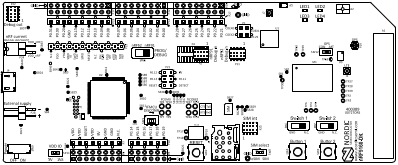
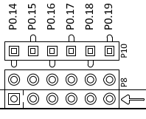
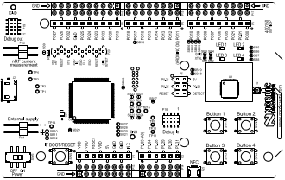
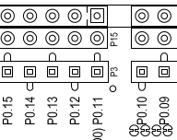
UART Wire Connection
91 DK
TX: P0.18 RX: P0.17
52 DK
TX: P0.12 RX: P0.11

Slide 32
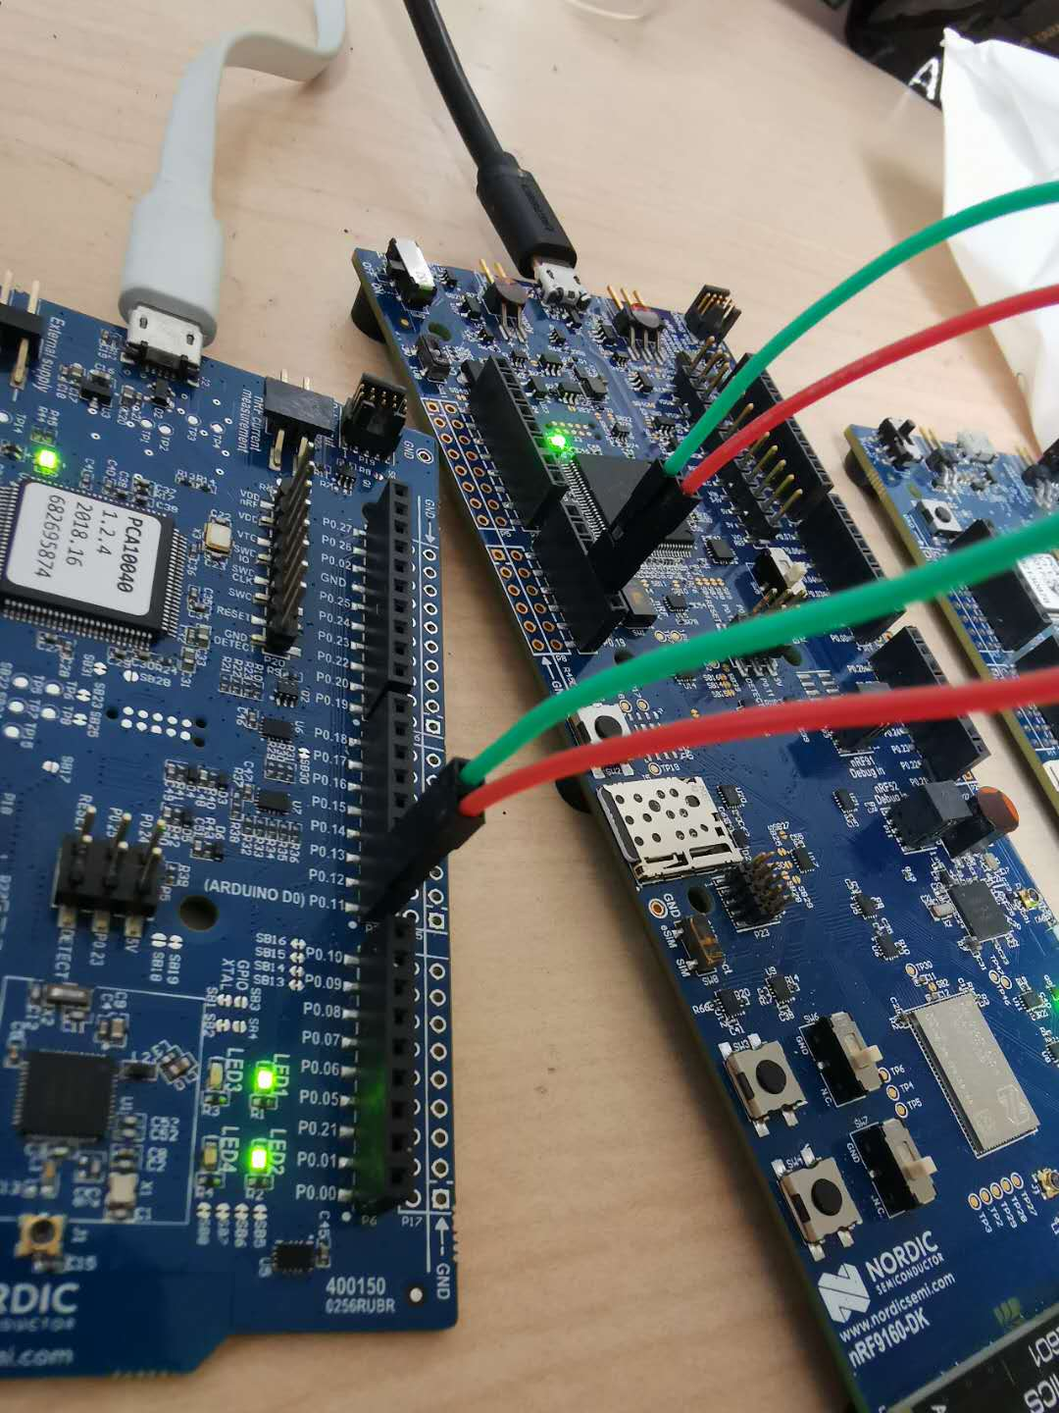
UART Wire Connection
91 DK
TX: P0.18 RX: P0.17
52 DK
TX: P0.12 RX: P0.11

Slide 33
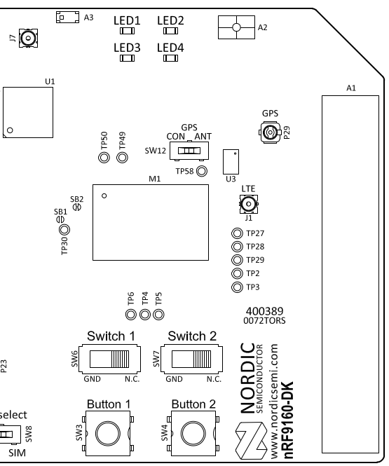
LED and Button of 91 DK
LED 1: NB-IoT network is connected
LED 2: File is downloaded or received
Switch 1 + Switch 2 to left: set URL to 52 DFU file
Switch 1 + Switch 2 to right: set URL to 91 DFU file
Button 1: start to download
Button 2: start to do DFU

Slide 34
DFU Operation: 91 -> 52
Make 52 DFU bin file
Upload to web site
Program 91 and 52 DK
Download DFU file
Do DFU
Prepare a new application hex
Generate a DFU package $ python make_dfu_zip.py
Convert to DFU bin file $ python make_dfu_bin.py
Test file
<cross_dfu>\test\in_files\dfu_bin_52.bin
Advertising name is Nordic_HRM

Slide 35
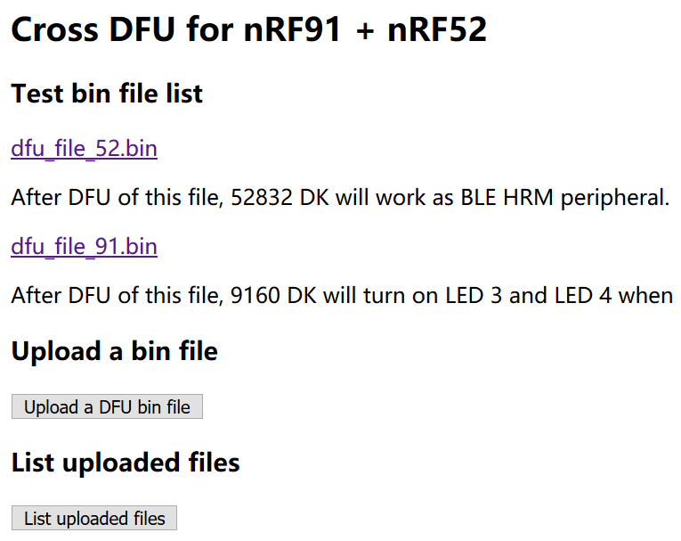
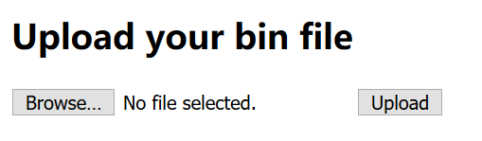
DFU Operation: 91 -> 52
Make 52 DFU bin file
Upload to web site
Program 91 and 52 DK
Download DFU file
Do DFU
2
3
Access URL of uploaded file: http://106.13.189.165/upload/<uploaded-file-name>
1

Slide 36
DFU Operation: 91 -> 52
Make 52 DFU bin file
Upload to web site
Program 91 and 52 DK
Download DFU file
Do DFU
Update m_http_file_52 variable in main.c
typically: m_http_file_52 = “upload/<dfu-bin-file>.bin“
Build and program 91 DK
$ west flash --snr xxxx
Program 52 DK
Program sd + app + bl + bl_settings
$ python prog_sd_app_bl.py

Slide 37
DFU Operation: 91 -> 52
Make 52 DFU bin file
Upload to web site
Program 91 and 52 DK
Download DFU file
Do DFU
Wait NB-IoT connected (LED 1 on)
Put switch 1 and switch 2 to left
Press button 1 to start downloading
When file is downloaded, LED 2 is set on

Slide 38
DFU Operation: 91 -> 52
Make 52 DFU bin file
Upload to web site
Program 91 and 52 DK
Download DFU file
Do DFU
Press button 2 to start DFU
Check advertising name of 52 DK is changed:
Cross_DFU_52 -> Nordic_HRM

Slide 39
Demo show: DFU 91 -> 52

Slide 40
DFU Operation: 52 -> 91
Make 91 DFU bin file
Upload to phone
Program 91 and 52 DK
Transfer DFU file
Do DFU
Get firmware bin from project build directory
.\build\zephyr\app_update.bin
Get modem bin by unzipping modem zip file
mfw_nrf9160_update_from_1.2.0_to_1.2.0-FOTA-TEST.bin
Test file
<cross_dfu>\test\in_files\dfu_bin_91.bin
LED 3 and LED 4 will turn on after booting up
Welcome message log is Cross DFU Demo(new)

Slide 41
DFU Operation: 52 -> 91
Make 91 DFU bin file
Upload to phone
Program 91 and 52 DK
Transfer DFU file
Do DFU
Common method
Copy file to SD card of your phone
Engineer method (Android only)
$ adb push <file-name> storage/sdcard0/<dir>

Slide 42
DFU Operation: 52 -> 91
Make 91 DFU bin file
Upload to phone
Program 91 and 52 DK
Transfer DFU file
Do DFU
Build and program 91 DK
$ west flash --snr xxxx
Program 52 DK
Program sd + app + bl + bl_settings
$ python prog_sd_app_bl.py

Slide 43
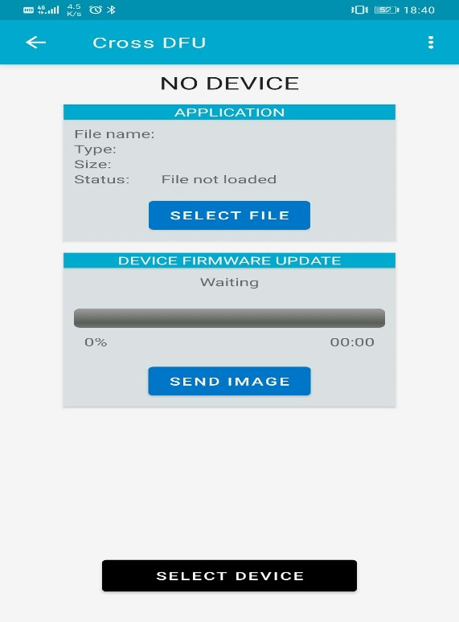
DFU Operation: 52 -> 91
Make 91 DFU bin file
Upload to phone
Program 91 and 52 DK
Transfer DFU file
Do DFU
Wait NB-IoT connected (LED 1 on)
My Toolbox
connect to CROSS_DFU_52
select DFU bin file
send image
When file is sent, LED 2 is set on
2
3
1

Slide 44
DFU Operation: 52 -> 91
Make 91 DFU bin file
Upload to phone
Program 91 and 52 DK
Transfer DFU file
Do DFU
Press button 2 to start DFU
Check changes of 91 DK:
LED 3 and LED 4 are on
Welcome message log is updated

Slide 45
Demo show: DFU 52 -> 91

Slide 46
Other Use Cases
91 -> 91, 91 -> modem
Similar to 91 -> 52
put switch 1 and switch 2 to right
52 -> 52, 52 -> modem
Same as 52 -> 91
Skip them to save time

Slide 47
Tech Details

Slide 48
Notice
Only useful when you need to use it,
so I will introduce them quickly

Slide 49
1. HTTP download

Slide 50
HTTP Download
NCS prepares all things about HTTP download
HTTP download library
exchange data with Amazon file storage service
Why not to use a cloud service(dropbox etc.) to store file and download from it?

Slide 51
GET Request
Generally, use GET request to download file from HTTP server
Suppose a file URL: http://106.13.189.165/dfu_file_91
Get the whole file:
$ pip install httpie
$ http GET http://106.13.189.165/dfu_file_91 > dfu_file.bin
How to get the partial content of the file?

Slide 52
Range Parameter
Use Range parameter in HTTP header to get partial content
For example, get 0 – 10 bytes of the file:
$ http GET http://106.13.189.165/dfu_file_91 Range:bytes=0-10 > 10_bytes.bin
This feature requires server support
download_client.c library of NCS uses Range parameter
I don’t know who supports it, the direct way is making one

Slide 53
2. DFU bin file format

Slide 54
DFU File Types
NCS DFU file
91 application: xxx.bin
91 modem: xxx.bin
SDK DFU file
xxx.zip
It’s better unifying all types of DFU file format

Slide 55
SDK Zip File Format
DFU package file is made up of:
manifest.xml
init packet.dat
firmware.bin
manifest contains: image name, type and size
We can put init packet and firmware bin together as a bin file and add a header to it

Slide 56
DFU Bin File Format
Magic Number 1
Magic Number 2
File Size
Image Count
Image Type
Init Packet Addr Offset
Init Packet Size
Firmware Addr Offset
Firmware Size
Padding to 128 bytes
Init Packet content
Init Packet content
Padding to 512 bytes
Firmware
Firmware
Firmware
Padding to word aligned
CRC32
file header
firmware
init packet
crc32

Slide 57
DFU Bin File Format
Magic Number 1: mcuboot magic number
Magic Number 2: my magic number
File size: binary file size
Image count: always be 1 for this version
Image Type: application or softdevice or bootloader or sd_bl
CRC32: crc 32 for the file, excluding crc field
Use little endian
Padding byte is 0xFF

Slide 58
File Header of DFU Bin
91 application:
91 modem:
52 DFU:
magic number |  |  |  | padding
3D | B8 | F3 | 96 | xx | xx | xx | xx
padding |  |  |  | magic number
xx | xx | xx | xx | 6D | 65 | 44 | 75
magic number |  |  |  | magic number 2
3D | B8 | F3 | 96 | 51 | 59 | 53 | 49

Slide 59
3. app_cmd library

Slide 60
Introduction
What A library to handle data exchange between two MCUs through UART
Why
Standardize the process, use request & response to exchange data
Control the process, handle correct and error operations
Easy to extend, easy to add customized commands
Cross the platform, 91 and 52 available
How
Based on Simple Packet Protocol

Slide 61
Example
52 asks 91 to erase one flash page
52:
Define a cmd for this operation
send cmd to 91
wait for response
91:
Define a cmd for this operation
receive cmd
process cmd(do erasing)
respond cmd(send result to 52)

Slide 62
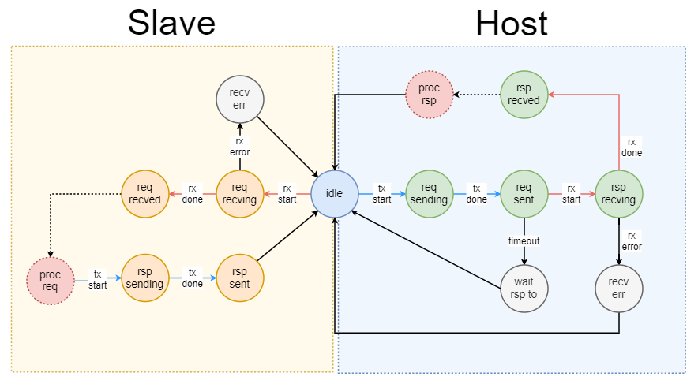
State Machine

Slide 63
4. My Toolbox App

Slide 64
Communication Protocol
Start DFU
App → 52: write 0x00
Get image size
52 → App: notify 0x01
App → 52: write [0x01, 0xFF, 0xFF, 0xFF, 0xFF] (file size in little endian)
Get image data
52 → App: notify 0x02
App → 52: write [0x02, 0xFF, 0xFF, … 0xFF] (129 bytes each packet)
App → 52: write [0x02, 0xFF, 0xFF, … 0xFF] (129 bytes each packet)
… (repeat 8 times)
Get image data again, until finish

Slide 65
5. Modem version

Slide 66
Version Match
Unzip a modem file(*.zip), you can get:
mfw_nrf9160_update_from_1.2.0_to_1.2.0-FOTA-TEST.bin
mfw_nrf9160_update_from_1.2.0-FOTA-TEST_to_1.2.0.bin
“mfw_nrf9160_update_from_1.2.0_to_1.2.0-FOTA-TEST.bin”
Update modem from 1.2.0 to 1.2.0-FOTA-TEST
If current version is not 1.2.0, updating will be failed
After updating, new version is 1.2.0-FOTA-TEST

Slide 67
Get Version
Get version string: mfw_nrf9160_1.2.0
modem_info_params_get(&modem_info)
modem_info.device.modem_fw.value_string
Get UUID: 22bd7d7e-368b-4513-aac0-31aa78cafa98
getsockopt(fd, SOL_DFU, SO_DFU_FW_VERSION, &version, &len);
snprintf(version_string, sizeof(version_string), "%.*s", sizeof(version), version);

Slide 68
Thank you

