Slide 1
NASA IV&V – FSU
Monte Carlo Simulation Project
Max Spolaor, Ph.D.
Sr. Systems Engineer
NASA IV&V - ITC - JSTAR Team
TMC Technologies

Slide 2
Welcome to Phase II
Congratulations on successfully finishing your class and for reaching this point.
Next step: let’s get our hands dirty coding!
The Plan:
2 software projects and 2 groups.
Work at least 4 hours per week.
Meet at NASA IV&V every other Thursday from 9am to 10am – starting from January 25th.
Meet/ work with your professors.
Upload your projects to git accounts. Inclusive of comments, readme files, etc.
Final project presentations at FSU and NASA in May 2018. We will set specific dates today.

Slide 3
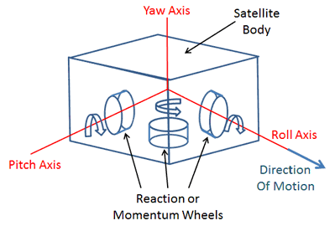
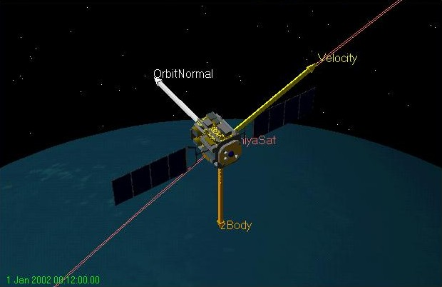
Project #1: Satellite Directional Stability (Introduction to the problem)
Satellite, once placed in its orbit, experiences various perturbing torques (e.g. push and pull): gravitational forces from sun, moon, magnetic field interaction, solar radiation pressure, etc.
Thus satellite orbit tends to drift and its orientation also changes.
The attitude and orbit control system maintains the satellite position and its orientation and keeps the antenna correctly pointed in the desired direction. Orbit control is performed by firing thrusters. Commonly employed techniques for satellite attitude control include:
Spin stabilization
Three-axis or body stabilization

Slide 4
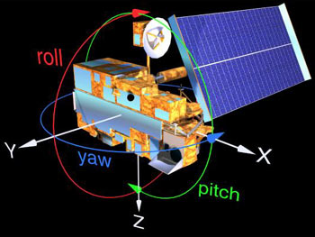
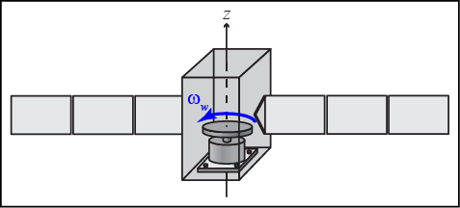
Project #1: Satellite Directional Stability (Introduction to the problem)
Stabilization is achieved by controlling the movement of the satellite along the three axes, i.e. yaw, pitch, and roll (x,y,z), with respect to a reference. Stability of the three-axis system is provided by the active control system, which applies small corrective forces on the wheels to correct the undesirable changes in the satellite orbit. Basically, speeding up or slowing down the reaction wheel depending upon the direction in which the satellite is perturbed. For example, an increase in speed of the wheel in the clockwise direction will make the satellite rotate in a counterclockwise direction. To maintain stability, the moment of inertia about the desired spin axis should at least be 10% greater than the moment of inertia about the traverse axis.
In summary: A reaction wheel is spun up or down to create a torque thus changing its momentum thus forcing the vehicle to rotate.

Slide 5
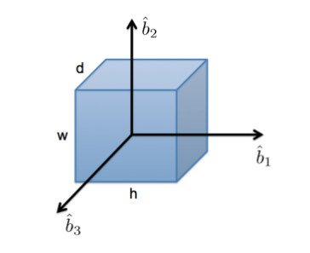
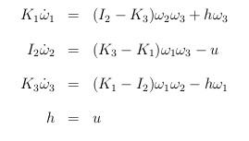
Project #1: Satellite Directional Stability (The problem)
We will re-create the results for the directional stability analysis of a satellite in reference. The satellite is modeled as a cube with a reaction wheel that spins about one of its axis. We assume b₂ to be the axis of pure-spin. We perform the analysis with a set of linearized equations:
where:
ω_{i} = angular velocities u = wheel torque
I_{i} = inertias of the satellite K₁ = I₁ + J_{t}
J_{t} = tangential inertia of the wheel torque K₃ = I₃ + J_{t}
h = constant angular momentum of the wheel
Angular velocity: amount of rotation that a spinning object undergoes in a unit of time. It measures how fast the object rotates.
Inertia: it is the resistance of any physical object to any change in its state of motion. This includes changes to the object’s speed, direction, or state of rest.
Angular momentum: the product of the moment of inertia of a body about an axis and its angular velocity with respect to the same axis.
Moment of inertia: a measure of the resistance of a body to angular acceleration about a given axis.
Torque: In rotational motion, torque is required to produce an angular acceleration of an object. The amount of torque required to produce an angular acceleration depends on the distribution of the mass of the object.

Slide 6
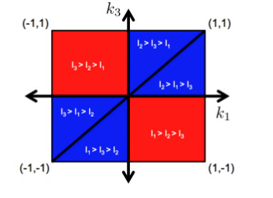
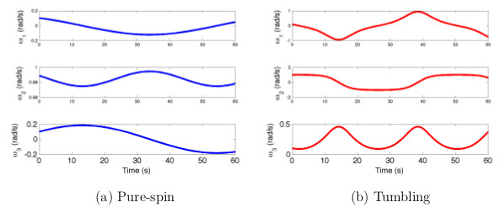
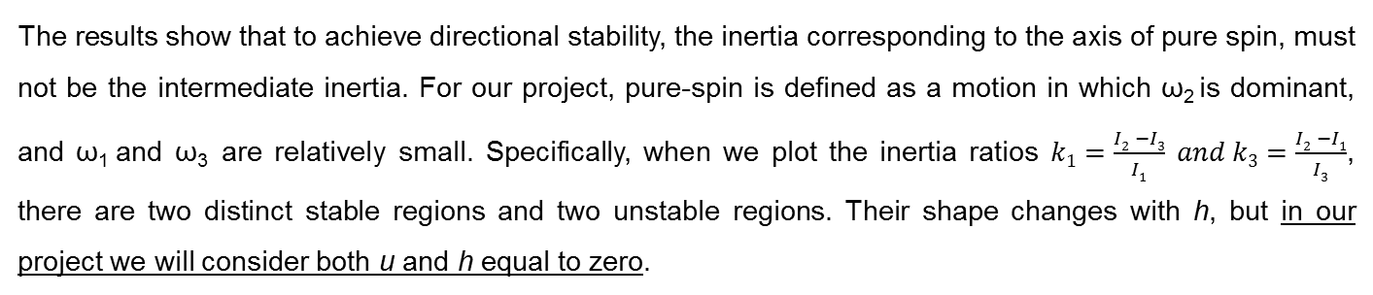
Project #1: Satellite Directional Stability (The problem)
The results show that to achieve directional stability, the inertia corresponding to the axis of pure spin, must not be the intermediate inertia. For our project, pure-spin is defined as a motion in which ω₂ is dominant, and ω₁ and ω₃ are relatively small. Specifically, when we plot the inertia ratios $k1=\frac{I2 −I3}{I1} and k3=\frac{I2 −I1}{I3}$, there are two distinct stable regions and two unstable regions. Their shape changes with h, but in our project we will consider both u and h equal to zero.
(Performance metric)

Slide 7
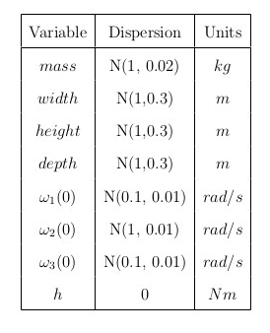
Project #1: Satellite Directional Stability (Don’t Panic Guide to the Project)
Solve (numerically!) the set of linearized equations.
Disperse parameters using normal distributions (to start with).
Run Monte Carlo simulations.
Define performance metric.
Analyze influential variables (hint: KDE algorithm) and influential variable combinations (hint: k-NN algorithm), to determine how the mass properties and initial conditions influence the solution on individual basis and in the higher-dimensional regions.
Visualize results/rankings and write-up results.
Try alone and then ask for help!
If enough time try to solve with h = -0.01.
Tools:
Python + Numpy, Pandas, and Matplotlib libraries.
SciPy and Scikit-learn: for solving equations and algorithms.
Jupyter notebook.
Git.

Slide 8
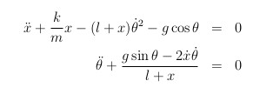
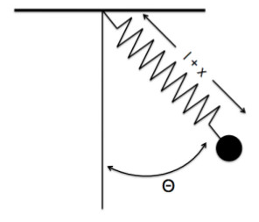
Project #2: Spring Pendulum (The problem)
Characterize the motion of a spring pendulum. Resulting motion is combination of a simple pendulum and a spring. While in a simple pendulum, the length of the string is constant and so is the period, for a spring pendulum, the length of a spring can also change. This additional degree of freedom gives rise to chaotic behavior. This problem is a great example of how the behavior of a dynamical system can depend on nonlinear variable interactions but is not directly dependent on any one variable alone. Equations of motion of the system are:
where:
m = mass of the pendulum
k = spring constant
l = un-stretched length of the pendulum
x = stretch
g = acceleration due to gravity
θ = swing degrees-of-freedom

Slide 9
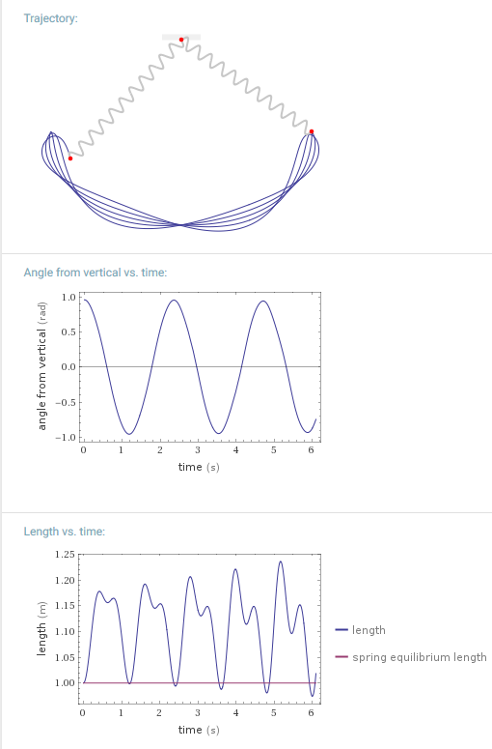
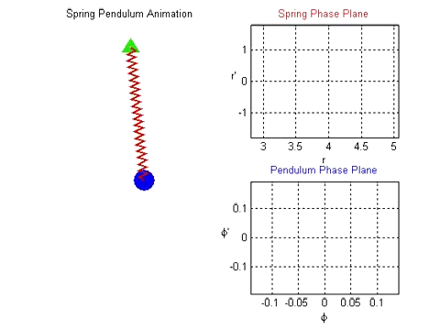
Project #2: Spring Pendulum (The problem)

Slide 10
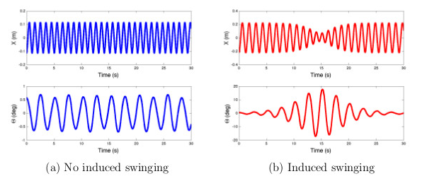
Project #2: Spring Pendulum
Let’s analyze the state trajectories of the spring pendulum with two different sets of parameter values. The motion is initiated by pulling down on the pendulum 10cm. However, the motions are very different. In Figure a, the pendulum moves up and down but it does not swing much. In Figure b, we note how the shorter length causes the spring to move faster due to the conservation of angular momentum.
Regular motion
Chaotic motion
(performance metric: case b = pendulum is out of control)
Physically, this is due to the fact that the pendulum’s kinetic energy oscillates between up and down motion and the swing motion. Also, the spring has a range that is overtaken by the motion of the pendulum, making its contribution practically neutral to the motion of the overall system.

Slide 11
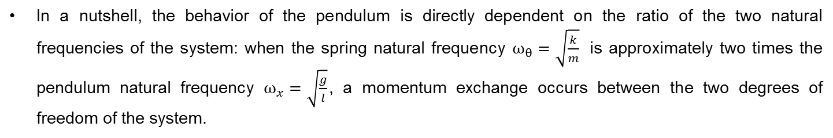
Project #2: Spring Pendulum
In a nutshell, the behavior of the pendulum is directly dependent on the ratio of the two natural frequencies of the system: when the spring natural frequency $ω_{θ}=\sqrt{\frac{k}{m}}$ is approximately two times the pendulum natural frequency $ω_{x}=\sqrt{\frac{g}{l}}$, a momentum exchange occurs between the two degrees of freedom of the system.
Specifically, if the mass properties of the system are interacting in this particular manner, the spring pendulum behaves in a unique way (a.k.a. out of control) that cannot be predicted by analyzing any single variable individually. This suggests that KDE and k-NN analyses performed on a Monte Carlo simulation data set will be capable of finding this solution.

Slide 12
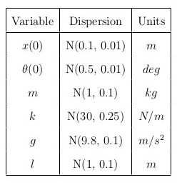
Project #2: Spring pendulum (Don’t Panic Guide to the Project)
Solve (numerically!) the set of linearized equations.
Disperse parameters using normal distributions (to start with).
Run Monte Carlo simulations.
Define performance metrics.
Analyze influential variables (hint: KDE algorithm) and influential variable combinations (hint: k-NN algorithm), to determine how the mass and spring properties and initial conditions influence the solution on individual basis and in the higher-dimensional regions.
Visualize results and write-up results.
Try alone and then ask for help!
Tools:
Python + Numpy, Pandas, and Matplotlib libraries
SciPy and Scikit-learn: for solving equations and algorithms
Jupyter notebook
Git

Slide 13
Let’s get to work! Questions?

