Slide 1
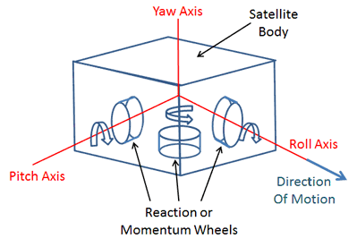
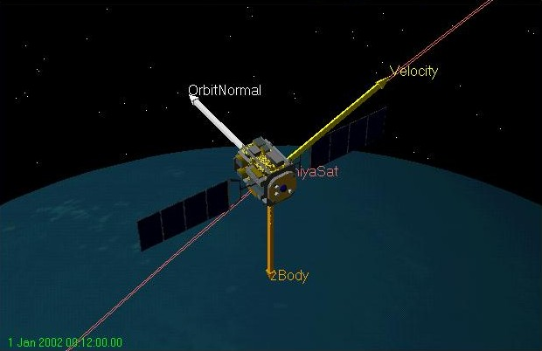
Project #1: Satellite Directional Stability (Introduction to the problem)
Satellite, once placed in its orbit, experiences various perturbing torques (e.g. push and pull): gravitational forces from sun, moon, magnetic field interaction, solar radiation pressure, etc.
Thus satellite orbit tends to drift and its orientation also changes.
The attitude and orbit control system maintains the satellite position and its orientation and keeps the antenna correctly pointed in the desired direction. Orbit control is performed by firing thrusters. Commonly employed techniques for satellite attitude control include:
Spin stabilization
Three-axis or body stabilization

Slide 2
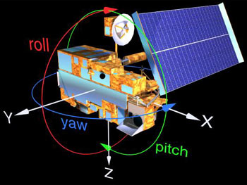
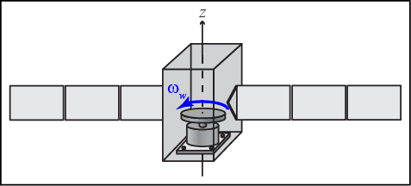
Project #1: Satellite Directional Stability (Introduction to the problem)
Stabilization is achieved by controlling the movement of the satellite along the three axes, i.e. yaw, pitch, and roll (x,y,z), with respect to a reference. Stability of the three-axis system is provided by the active control system, which applies small corrective forces on the wheels to correct the undesirable changes in the satellite orbit. Basically, speeding up or slowing down the reaction wheel depending upon the direction in which the satellite is perturbed. For example, an increase in speed of the wheel in the clockwise direction will make the satellite rotate in a counterclockwise direction. To maintain stability, the moment of inertia about the desired spin axis should at least be 10% greater than the moment of inertia about the traverse axis.
In summary: A reaction wheel is spun up or down to create a torque thus changing its momentum thus forcing the vehicle to rotate.

Slide 3
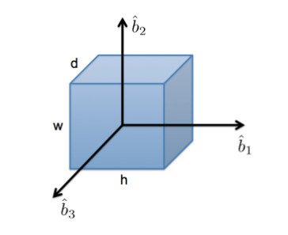
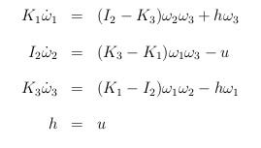
Project #1: Satellite Directional Stability (The problem)
We will re-create the results for the directional stability analysis of a satellite in reference. The satellite is modeled as a cube with a reaction wheel that spins about one of its axis. We assume b₂ to be the axis of pure-spin. We perform the analysis with a set of linearized equations:
where:
ω_{i} = angular velocities u = wheel torque
I_{i} = inertias of the satellite K₁ = I₁ + J_{t}
J_{t} = tangential inertia of the wheel torque K₃ = I₃ + J_{t}
h = constant angular momentum of the wheel
Angular velocity: amount of rotation that a spinning object undergoes in a unit of time. It measures how fast the object rotates.
Inertia: it is the resistance of any physical object to any change in its state of motion. This includes changes to the object’s speed, direction, or state of rest.
Angular momentum: the product of the moment of inertia of a body about an axis and its angular velocity with respect to the same axis.
Moment of inertia: a measure of the resistance of a body to angular acceleration about a given axis.
Torque: In rotational motion, torque is required to produce an angular acceleration of an object. The amount of torque required to produce an angular acceleration depends on the distribution of the mass of the object.

Slide 4
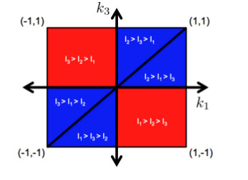
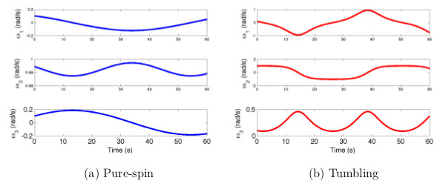
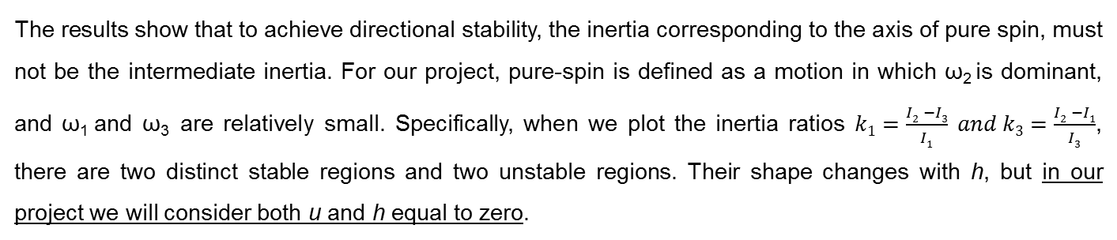
Project #1: Satellite Directional Stability (The problem)
The results show that to achieve directional stability, the inertia corresponding to the axis of pure spin, must not be the intermediate inertia. For our project, pure-spin is defined as a motion in which ω₂ is dominant, and ω₁ and ω₃ are relatively small. Specifically, when we plot the inertia ratios $k1=\frac{I2 −I3}{I1} and k3=\frac{I2 −I1}{I3}$, there are two distinct stable regions and two unstable regions. Their shape changes with h, but in our project we will consider both u and h equal to zero.
(Performance metric)

Slide 5
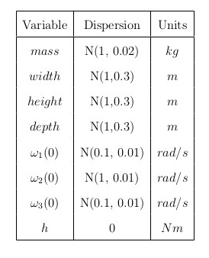
Project #1: Satellite Directional Stability (Don’t Panic Guide to the Project)
Solve (numerically!) the set of linearized equations.
Disperse parameters using normal distributions (to start with).
Run Monte Carlo simulations.
Define performance metric.
Analyze influential variables (hint: KDE algorithm) and influential variable combinations (hint: k-NN algorithm), to determine how the mass properties and initial conditions influence the solution on individual basis and in the higher-dimensional regions.
Visualize results/rankings and write-up results.
Try alone and then ask for help!
If enough time try to solve with h = -0.01.
Tools:
Python + Numpy, Pandas, and Matplotlib libraries.
SciPy and Scikit-learn: for solving equations and algorithms.
Jupyter notebook.
Git.

