Slide 1

NourishAI: Smart Recipe Prediction and Identification
Presented by:
Alaaedine Soboh
Carl Amine

Slide 2
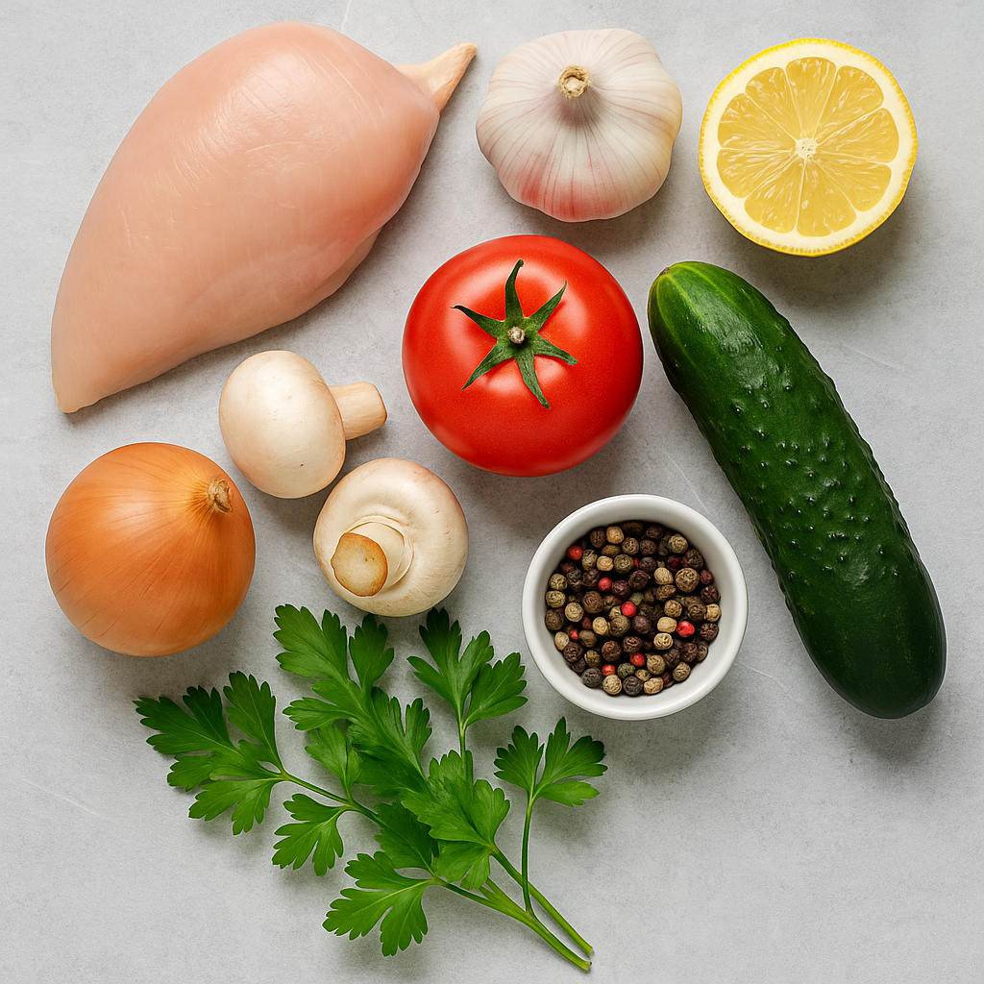
Problem Statement
• Traditional recipe search is slow and keyword-based.
• Exact matches fail when ingredient lists vary.
• Users want suggestions based on what they have, not what they can guess.

Slide 3
Why Not ANN?
• ANN struggles with 230K+ sparse ingredient combinations.
• No spatial structure in inputs.
• High risk of overfitting + poor generalization.
• Switched to RAG for semantic flexibility.

Slide 4
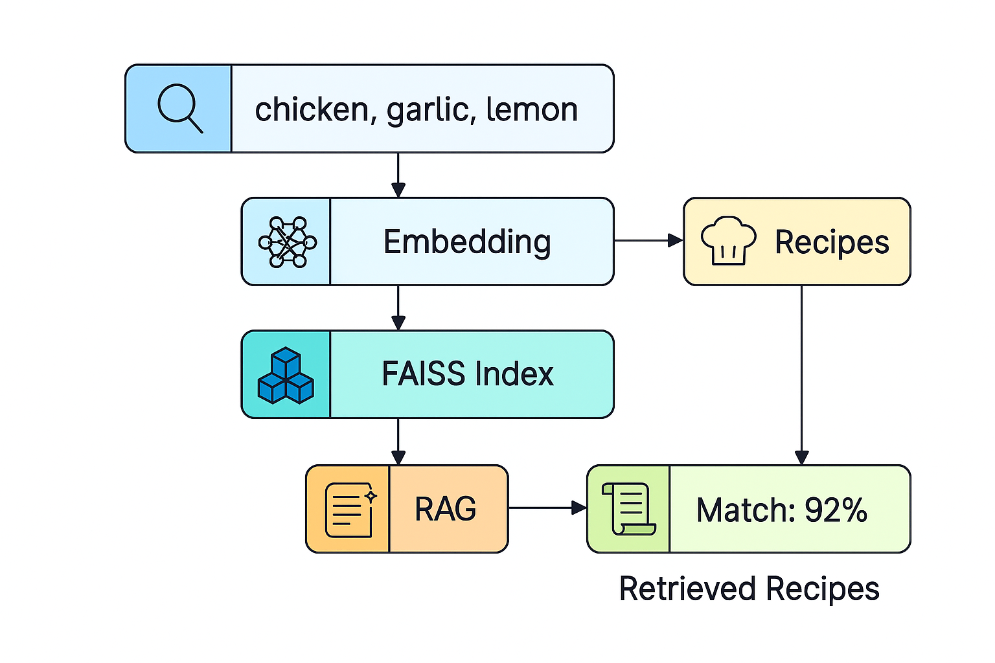
System Flow

Slide 5
Why RAG Works
• Understands natural language input (not keyword-dependent)
• Adapts to unseen ingredient combinations
• Leverages pretrained transformer knowledge
• Returns clear, readable outputs ranked by relevance

Slide 6
Image Classification
• Importance of identifying recipes from a simple snapshot
• Opens the door to identify calories intake, ingredients and steps required
• Makes recipe searching faster
• Usage of SVM classifier (SVC)

Slide 7
Why SVC?
• CNN presented a lower accuracy
• Models like EfficientNet and VGG 16 did not perform well on smaller samples
• SVC performed better on smaller samples with very high accuracy (99%)
• Training SVCs is more resource-efficient

Slide 8
THANK YOU

