Slide 1

Workshop (London)
Fonts and Models
Thursday, September 25th 6:30 PM
SkillsMatter, 116-120 Goswell Road, London
Next: TBA
Models (formats, creation and loading)

Slide 2
Workshop (London)
Also today
Online Model Viewer (Autodesk)
Isaac Cohen (Caribo)

Slide 3
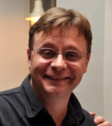
Carl Bateman
By day --
Software Engineer (desktop)
C#, C++, VB, MySQL, .NET, Linq, blah, blah, blah
By night --
Software Engineer (desktop)
OpenGL, Unity, JavaScript, PHP, CSS, HTML and, of course, WebGL
Love 3d and game jams

Slide 4
Thanks to…
SkillsMatter (venue)
With whom I am in no way affiliated
Pearson
eBook 45% discount

Slide 5
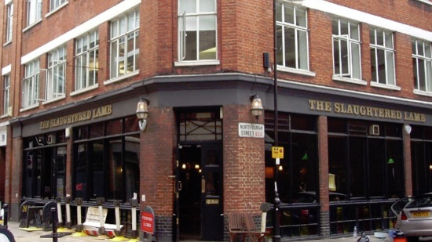
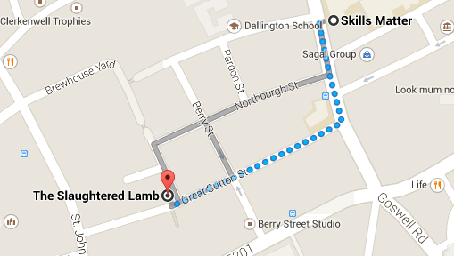
WebGL Workshop
After Workshop Drinkies @ The Slaughtered Lamb

Slide 6
WebGL Workshop
Not a lecture
A resumé of my WebGL experience
Question? Ask!
A few books – many, many, many web pages
Frankencode
A lot to cover

Slide 7
Back to Basics
Slides and stuff at
webglworkshop.com/10

Slide 8
WebGL Workshop
Help!
Volunteers
Web site
Material
Presentations
Sponsors
Venue
Door prize
Speakers
Catering

Slide 9
WebGL Workshop
Great News, Chums
We’re now the official Khronos London Chapter
No major changes
But should be able to get food for future workshops

Slide 10
WebGL Workshop
News (shamelessly ripped off from the interwebbings)

