Slide 1
WebGL Workshop
Carl Bateman
Software Engineer
C#, C++, VB, MySQL, .NET, Linq, blah, blah, blah, blah
Desktop developer – no web
OpenGL
not shaders
JavaScript, PHP, CSS, HTML
Next workshop: Textures and models (probably)
Thursday, February 20th 2014

Slide 2


WebGL Workshop
Files and slides at
http://webglworkshop.com/workshops/03/

Slide 3
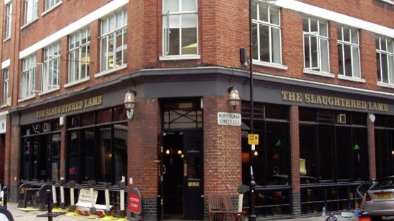
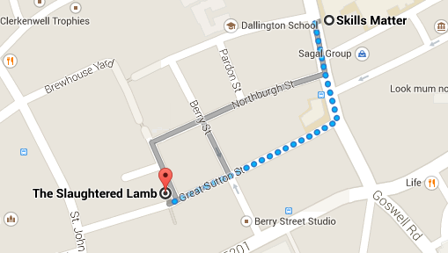
WebGL Workshop
After Workshop Drinkies @ The Slaughtered Lamb

Slide 4
Light and Shadows
Light Types
None
Ambient
Directional
Point
Spot
Area
Volumetric

Slide 5

Light and Shadows
Ambient
Scattered
Environmental
Lights all parts of all objects equally / evenly

Slide 6

Light and Shadows
Directional
Single direction
No position
e.g. the Sun
Brightness depends on angle

Slide 7

Light and Shadows
Point
Multi-directional
Position
e.g. bulb (not really)
Brightness depends on angle
Brightness depends on distance
Brightest here
Brightest here

Slide 8


Light and Shadows
Spotlight
Like a point light BUT
Restricted
Fall off
Not lit

Slide 9
Light and Shadows
Area
Like many point lights
e.g. panel lighting
Hidden from
part of light

Slide 10
Light and Shadows
Volumetric

Slide 11
Light and Shadows
Materials
Determine how light reflects
Diffuse
Specular
Emissive

Slide 12

Light and Shadows
Materials
Determine how light reflects
Diffuse
Specular
Emissive

Slide 13
WebGL Workshop
References:
WebGL Programming Guide
Mozilla Developer Centre
https://developer.mozilla.org/en-US/docs/Web/WebGL
Learning WebGL blog
http://learningwebgl.com/blog/

