Slide 1
All Things Data

Slide 2
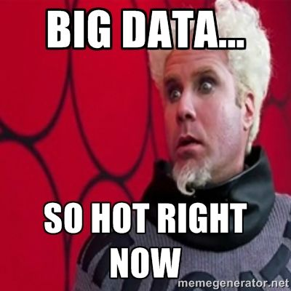
Data Setup
Today’s goal is to level set specifically for data used in the course.
R Data Types
R Data Structures
How does data manipulation fit in a business context?
Exploratory Data Analysis
Preprocessing for Modeling
Data Engineering
Data Enrichment
Data Source Examples

Slide 3
Agenda
Start | End | Item
6:30 | 6:40 | R Object Types
6:40 | 6:50 | Data Structure for analysis
6:50 | 7:00 | Break
7:00 | 7:20 | Process of Data Mining in a Business Context
7:20 | 7:35 | EDA
7:35 | 7:45 | Pre-Processing for Modeling
7:45 | 8:00 | Break
8:00 | 8:45 | Feature Engineering & Enrichment
8:45 | 9:30 | Break as needed & Data-Driven Case

Slide 4



Common R Object Types - Vectors
Objects in R can be various forms and even made to be “custom” types.
Numeric/Integer
Factors (Distinct Classes)
as.factor(c('MALE','FEMALE','FEMALE'))
Cardinality
2
1
10
12
3.47
82
MALE
FEMALE
FEMALE
Unordered
c(1,10,12,3.47)
[1] MALE FEMALE FEMALE
Levels: FEMALE MALE
High
Med
Low
as.factor(c(‘High',‘Med',‘Low'))
Cardinality
3
Ordinal
Boolean
STRING (just text)
TRUE
TRUE
FALSE
TRUE
FALSE
c('MALE','FEMALE','FEMALE')
c(T, T, F, T, F)
c(TRUE,TRUE, FALSE, TRUE,FALSE)
c(T,TRUE, F, TRUE,FALSE)
[1] "MALE" "FEMALE" "FEMALE"
In R, a vector can be numeric, Boolean (T/F), factors, or contain strings.
Notes:
Ordinal – is there an order to the factor, how does that factor level relate to other levels
Cardinality – number of distinct factor levels, the number of elements in a set

Slide 5
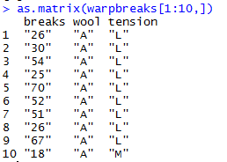
More Complex Common R Object Types - Matrix
Matrices are 2 dimensional data (rows/columns). Each column must be the same type.
RowID | breaks | wool | tension
1 | 26 | A | L
2 | 30 | A | L
3 | 54 | A | L
4 | 25 | A | L
5 | 70 | A | L
6 | 52 | A | L
7 | 51 | A | L
8 | 26 | A | L
9 | 67 | A | L
10 | 18 | A | M
All strings
Matrices are organized into rows and columns. In R, the row names are not actually a vector of the matrix but are an attribute of the matrix. In excel you would need a standalone vector to capture that information.

Slide 6
More Complex Common R Object Types – Array
Arrays aren’t widely used, except in image analysis (R,G,B matrices)
RowID | breaks | wool | tension
1 | 26 | A | L
2 | 30 | A | L
3 | 54 | A | L
4 | 25 | A | L
5 | 70 | A | L
6 | 52 | A | L
7 | 51 | A | L
8 | 26 | A | L
9 | 67 | A | L
10 | 18 | A | M
library(EBImage)
a <- imageData(x)
r <- a[,,1]
g <- a[,,2]
b <- a[,,3]
RowID | breaks | wool | tension
1 | 26 | A | L
2 | 30 | A | L
3 | 54 | A | L
4 | 25 | A | L
5 | 70 | A | L
6 | 52 | A | L
7 | 51 | A | L
8 | 26 | A | L
9 | 67 | A | L
10 | 18 | A | M
RowID | breaks | wool | tension
1 | 26 | A | L
2 | 30 | A | L
3 | 54 | A | L
4 | 25 | A | L
5 | 70 | A | L
6 | 52 | A | L
7 | 51 | A | L
8 | 26 | A | L
9 | 67 | A | L
10 | 18 | A | M
This is an example of extracting RGB data from an image but is not covered in this course since arrays are seldom used.
Arrays can be thought of similar to Excel’s workbook which can contain multiple single sheet work books.

Slide 7
More Complex Common R Object Types – List
Lists are multi-dimensional objects that can contain different data types of different lengths.
ListA
single value
Single data frame
single vector
Nested list
Nested data frame
Nested matrix
Lists are useful for data organization but can be complex and difficult to navigate to get specific information.

Slide 8
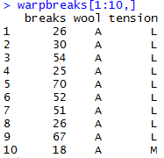
More Complex Common R Object Types – Data Frame
Data Frames are like 2 dimensional data objects but can have mixed data types.
A data frame is actually a named list but with equal length elements. Being a list lets it contain mixed data types.
RowID | breaks | wool | tension
1 | 26 | A | L
2 | 30 | A | L
3 | 54 | A | L
4 | 25 | A | L
5 | 70 | A | L
6 | 52 | A | L
7 | 51 | A | L
8 | 26 | A | L
9 | 67 | A | L
10 | 18 | A | M
Integers
Factor
Factor
Data frames are used often because they can hold different types of vectors, but can be switched back and forth with as.matrix() and as.data.frame(). Remember that the vector classes could change!!

Slide 9
Data Structure for Analysis & Modeling
Often the 1st Column is a unique identifier but the identifier could also be a row attribute (not actually a vector)
name | mfr | type | calories | protein | fat | sodium | fiber | carbo | sugars | potass | vitamins | shelf | weight | cups | rating
100%_Bran | N | C | 70 | 4 | 1 | 130 | 10 | 5 | 6 | 280 | 25 | 3 | 1 | 0.33 | 68.40297
100%_Natural_Bran | Q | C | 120 | 3 | 5 | 15 | 2 | 8 | 8 | 135 | 0 | 3 | 1 | 1 | 33.98368
All-Bran | K | C | 70 | 4 | 1 | 260 | 9 | 7 | 5 | 320 | 25 | 3 | 1 | 0.33 | 59.42551
All-Bran_with_Extra_Fiber | K | C | 50 | 4 | 0 | 140 | 14 | 8 | 0 | 330 | 25 | 3 | 1 | 0.5 | 93.70491
Almond_Delight | R | C | 110 | 2 | 2 | 200 | 1 | 14 | 8 |  | 25 | 3 | 1 | 0.75 | 34.38484
Apple_Cinnamon_Cheerios | G | C | 110 | 2 | 2 | 180 | 1.5 | 10.5 | 10 | 70 | 25 | 1 | 1 | 0.75 | 29.50954
Apple_Jacks | K | C | 110 | 2 | 0 | 125 | 1 | 11 | 14 | 30 | 25 | 2 | 1 | 1 | 33.17409
Basic_4 | G | C | 130 | 3 | 2 | 210 | 2 | 18 | 8 | 100 | 25 | 3 | 1.33 | 0.75 | 37.03856
Bran_Chex | R | C | 90 | 2 | 1 | 200 | 4 | 15 | 6 | 125 | 25 | 1 | 1 | 0.67 | 49.12025
Bran_Flakes | P | C | 90 | 3 | 0 | 210 | 5 | 13 | 5 | 190 | 25 | 3 | 1 | 0.67 | 53.31381
Cap'n'Crunch | Q | C | 120 | 1 | 2 | 220 | 0 | 12 | 12 | 35 | 25 | 2 | 1 | 0.75 | 18.04285
Generally we will use data frames to avoid complexity but you will be exposed to other data types.

Slide 10
Data Structure for Analysis & Modeling
Informative features are usually independent & do not lend information to other rows (auto-correlation). Can be called informative columns, independent variables, or features.
Remember in a DF, these can be mixed with decimals, integers, factors, strings, T/F.
name | mfr | type | calories | protein | fat | sodium | fiber | carbo | sugars | potass | vitamins | shelf | weight | cups | rating
100%_Bran | N | C | 70 | 4 | 1 | 130 | 10 | 5 | 6 | 280 | 25 | 3 | 1 | 0.33 | 68.40297
100%_Natural_Bran | Q | C | 120 | 3 | 5 | 15 | 2 | 8 | 8 | 135 | 0 | 3 | 1 | 1 | 33.98368
All-Bran | K | C | 70 | 4 | 1 | 260 | 9 | 7 | 5 | 320 | 25 | 3 | 1 | 0.33 | 59.42551
All-Bran_with_Extra_Fiber | K | C | 50 | 4 | 0 | 140 | 14 | 8 | 0 | 330 | 25 | 3 | 1 | 0.5 | 93.70491
Almond_Delight | R | C | 110 | 2 | 2 | 200 | 1 | 14 | 8 |  | 25 | 3 | 1 | 0.75 | 34.38484
Apple_Cinnamon_Cheerios | G | C | 110 | 2 | 2 | 180 | 1.5 | 10.5 | 10 | 70 | 25 | 1 | 1 | 0.75 | 29.50954
Apple_Jacks | K | C | 110 | 2 | 0 | 125 | 1 | 11 | 14 | 30 | 25 | 2 | 1 | 1 | 33.17409
Basic_4 | G | C | 130 | 3 | 2 | 210 | 2 | 18 | 8 | 100 | 25 | 3 | 1.33 | 0.75 | 37.03856
Bran_Chex | R | C | 90 | 2 | 1 | 200 | 4 | 15 | 6 | 125 | 25 | 1 | 1 | 0.67 | 49.12025
Bran_Flakes | P | C | 90 | 3 | 0 | 210 | 5 | 13 | 5 | 190 | 25 | 3 | 1 | 0.67 | 53.31381
Cap'n'Crunch | Q | C | 120 | 1 | 2 | 220 | 0 | 12 | 12 | 35 | 25 | 2 | 1 | 0.75 | 18.04285
Generally we will use data frames to avoid complexity but you will be exposed to other data types.

Slide 11
Data Structure for Analysis & Modeling
If we are doing supervised learning, there is a dependent variable.
This is the outcome and is “dependent” on the informative columns. An analysis with this vector can be binary, classification, or predictive.
name | mfr | type | calories | protein | fat | sodium | fiber | carbo | sugars | potass | vitamins | shelf | weight | cups | rating
100%_Bran | N | C | 70 | 4 | 1 | 130 | 10 | 5 | 6 | 280 | 25 | 3 | 1 | 0.33 | 68.40297
100%_Natural_Bran | Q | C | 120 | 3 | 5 | 15 | 2 | 8 | 8 | 135 | 0 | 3 | 1 | 1 | 33.98368
All-Bran | K | C | 70 | 4 | 1 | 260 | 9 | 7 | 5 | 320 | 25 | 3 | 1 | 0.33 | 59.42551
All-Bran_with_Extra_Fiber | K | C | 50 | 4 | 0 | 140 | 14 | 8 | 0 | 330 | 25 | 3 | 1 | 0.5 | 93.70491
Almond_Delight | R | C | 110 | 2 | 2 | 200 | 1 | 14 | 8 |  | 25 | 3 | 1 | 0.75 | 34.38484
Apple_Cinnamon_Cheerios | G | C | 110 | 2 | 2 | 180 | 1.5 | 10.5 | 10 | 70 | 25 | 1 | 1 | 0.75 | 29.50954
Apple_Jacks | K | C | 110 | 2 | 0 | 125 | 1 | 11 | 14 | 30 | 25 | 2 | 1 | 1 | 33.17409
Basic_4 | G | C | 130 | 3 | 2 | 210 | 2 | 18 | 8 | 100 | 25 | 3 | 1.33 | 0.75 | 37.03856
Bran_Chex | R | C | 90 | 2 | 1 | 200 | 4 | 15 | 6 | 125 | 25 | 1 | 1 | 0.67 | 49.12025
Bran_Flakes | P | C | 90 | 3 | 0 | 210 | 5 | 13 | 5 | 190 | 25 | 3 | 1 | 0.67 | 53.31381
Cap'n'Crunch | Q | C | 120 | 1 | 2 | 220 | 0 | 12 | 12 | 35 | 25 | 2 | 1 | 0.75 | 18.04285
Generally we will use data frames to avoid complexity but you will be exposed to other data types.

Slide 12
Let’s Practice!
Open A_R objects.R:
c() to combine values into a vector
as.matrix() to create a matrix object
data.fraome()
as.list()
List elements by index
List elements by name

Slide 13
When should you use a specific data type?
Number of Dimensions >1
No
Yes
Use a Vector
Data Types >1
No
Yes
Matrix or Array
Data Frame or List
Most analyses start with a data frame, and change classes as needed.

Slide 14
Agenda
Start | End | Item
6:30 | 6:40 | R Object Types
6:40 | 6:50 | Data Structure for analysis
6:50 | 7:00 | Break
7:00 | 7:20 | Process of Data Mining in a Business Context
7:20 | 7:35 | EDA
7:35 | 7:45 | Pre-Processing for Modeling
7:45 | 8:00 | Break
8:00 | 8:45 | Feature Engineering & Enrichment
8:45 | 9:30 | Break as needed & Data-Driven Case

Slide 15
The Process of Data Mining

Slide 16
Modeling Process
SEMMA (from SAS)
In this course…
1. Sample
In this course, most data sets are curated for you.
2. Explore
As part of your course analysis you perform basic exploratory data analysis (EDA)
3. Modify
Data cleanup, Dimension Reduction, Feature Engineering & Feature Enrichment
4. Model
Regression, Logistic Regression, KNN, Decision Trees, Random Forest etc.
5. Assess
There are many ways to evaluate a model. We will cover specific KPI and business implications.
Often data is sampled from a large database so you can more quickly explore, apply methods and prototype before reassessing on full data.

Slide 17
Steps in Data Mining (from the book)
Define/understand purpose
Obtain data (may involve random sampling)
Explore, clean, pre-process data
Reduce the data; if supervised DM, partition it
Specify task (classification, clustering, etc.)
Choose the techniques (regression, CART, neural networks, etc.)
Iterative implementation and “tuning”
Assess results – compare models
Deploy best model
The book’s process is excellent but is focused largely on the modeling process not how the process is part of a business context or if the effort doesn’t require a model.

Slide 18
Data Mining in a Complete Business Workflow
Iterative Business Data Mining Project Life Cycle
Problem Definition
Identify Available Data Sources
EDA
Perform Analyssis
Assessment
Communicate Results
Document
Problem Formulation.
Define data requirements
Explore the data
Perform Analysis & Create Project Artifacts
Asses/Adjust the Project Artifacts
Communicate Results
Document to make it repeatable
In this view the steps of a project are not solely for modeling, more iterative and not in isolation because the results are communicated to stakeholders.

Slide 19
Data Mining in a Complete Business Workflow
Iterative Business Data Mining Project Life Cycle
Problem Definition
Identify Available Data Sources
EDA
Perform Analyssis
Assessment
Communicate Results
Document
Problem Formulation
Spend time acquiring subject matter expertise
Frame problem correctly: retrospective, descriptive, supervised, forecasting etc.

Slide 20
Data Mining in a Complete Business Workflow
Iterative Business Data Mining Project Life Cycle
Problem Definition
Identify Available Data Sources
EDA
Perform Analyssis
Assessment
Communicate Results
Document
2. Define data requirements
Find appropriate data, including engineered and enriched data sources
Ensure integrity of data
Organize data into a flat file (in most cases)

Slide 21
Data Mining in a Complete Business Workflow
Iterative Business Data Mining Project Life Cycle
Problem Definition
Identify Available Data Sources
EDA
Perform Analyssis
Assessment
Communicate Results
Document
3. Explore the data
Distributions, summary info (avg, medians, number of missing etc)

Slide 22
Data Mining in a Complete Business Workflow
Iterative Business Data Mining Project Life Cycle
Problem Definition
Identify Available Data Sources
EDA
Perform Analyssis
Assessment
Communicate Results
Document
4. Perform Analysis & Create Project Artifacts
Fit Models (if applicable to Problem Definition)
Visuals, Dashboards, summary Tables (if applicable to Problem Definition).

Slide 23
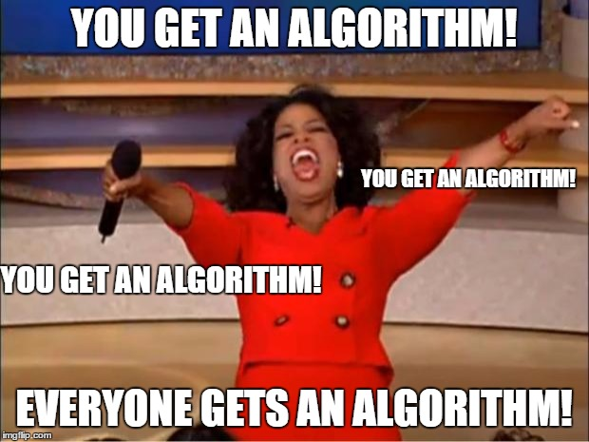
What is a model?
An model is a set of rules governing actions or phenomena.
Empirical Support without math
Your brain:
Algo#1: “fur” =Y, “tail”=Y, “claws”=Y, “meow”=Y therefore high probability that’s a cat
Algo#2: “another meme”=Y, “short & bald professor”=Y therefore “professor trying to hard to be cool”
Algorithms or mental models of reality can be correct or lead you to incorrect assumptions.

Slide 24
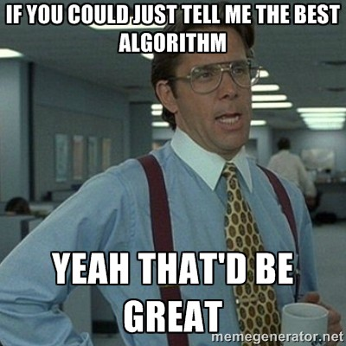
What is a model?
An model is a set of rules governing actions or phenomena.
Empirical Support w/math
The way you instruct the rules to be constructed is the algorithm (KNN, RF, LogReg etc)
Due to limitations of our brain computers can learn complex representations of phenomena
Just like mental algorithms, the observations we give a mathematical algorithm which result in a final model (set of rules) can lead to correct or incorrect assumptions. “Garbage in…Garbage out.”

Slide 25
Vocabulary
What is a model?
What is an algorithm?
A set of rules governing actions, or describing phenomena.
Some representation of reality.
The method you choose to construct the model rules.
The way you expect to learn about reality.
The algorithm produces the model.

Slide 26
Data Mining in a Complete Business Workflow
Iterative Business Data Mining Project Life Cycle
Problem Definition
Identify Available Data Sources
EDA
Perform Analyssis
Assessment
Communicate Results
Document
5. Asses Project Artifacts to Fit Audience
Support or disprove SME beliefs; tie back to problem statement, business impact (ie customer experience or saved $$ etc.)
For Models
Performance of inputs
Model accuracy acceptable?
Speed vs. Accuracy tradeoff

Slide 27
Data Mining in a Complete Business Workflow
Iterative Business Data Mining Project Life Cycle
Problem Definition
Identify Available Data Sources
EDA
Perform Analyssis
Assessment
Communicate Results
Document
6. Communicate Results
Presentation to business stakeholders
For Models
Implement Model
Batch predict
Build an application, requires collaboration with IT

Slide 28
Data Mining in a Complete Business Workflow
Iterative Business Data Mining Project Life Cycle
Problem Definition
Identify Available Data Sources
EDA
Perform Analyssis
Assessment
Communicate Results
Document
7. Document to make it repeatable
Eventually you will leave your role, stakeholders will want to revisit the analysis or you will need to perform a refresh of the model (if applicable) so clear documentation of the steps, assumptions and data will aid you.
Remember your work will never occur in a vacuum and is always iterative.

Slide 29

Don’t be Dale!
Force stakeholders to agree on a problem, plan and output.
Put together a plan, adjust the plan as needed…but have a plan!!

Slide 30

Common Pitfalls
State the problem in business terms. Avoid open ended questions or just curiosity analysis.
When modeling avoid multi-collinearity (more on that later)
Don’t measure things twice, like Fahrenheit and Celsius in the same data set
Understand data integrity & human behavior
Customers filling out surveys are already self selecting & therefore biased compared to all customers
Employees that are on an improvement plan may leave voluntarily rather than get fired. Data may record them as voluntarily leaving but that may mask the real issue
Beware of perfection
Perfectly aligned analyses and SME expectations seldom occur
Model perfection likely means you have an error (data integrity)
Beware of data leak!
Predict flight cancellations using minutes a flight was delayed... you wouldn’t know it was late ahead of time as an input to your model. The data points are linked.

Slide 31
Agenda
Start | End | Item
6:30 | 6:40 | R Object Types
6:40 | 6:50 | Data Structure for analysis
6:50 | 7:00 | Break
7:00 | 7:20 | Process of Data Mining in a Business Context
7:20 | 7:35 | EDA
7:35 | 7:45 | Pre-Processing for Modeling
7:45 | 8:00 | Break
8:00 | 8:45 | Feature Engineering & Enrichment
8:45 | 9:30 | Break as needed & Data-Driven Case

Slide 32
Modeling Process
SEMMA (from SAS)
In this course…
1. Sample
In this course, most data sets are curated for you.
2. Explore
As part of your course analysis you perform basic exploratory data analysis (EDA)
3. Modify
Data cleanup, Dimension Reduction, Feature Engineering & Feature Enrichment
4. Model
Regression, Logistic Regression, KNN, Decision Trees, Random Forest etc.
5. Assess
There are many ways to evaluate a model. We will cover specific KPI and business implications.
Often data is sampled from a large database so you can more quickly explore, apply methods and prototype before reassessing on full data.

Slide 33
Data Exploration (EDA)
Data sets are typically large, complex & messy
Need to review the data to help refine the task
Use techniques of Reduction and Visualization

Slide 34
Exploring Data: Sampling
Data mining typically deals with huge databases
For piloting/prototyping, algorithms and models are typically applied to a sample from a database, to produce statistically-valid results
Once you develop and select a final model, you use it to “score” (predict values or classes for) the observations in the larger database

Slide 35
Rare Event Over-Sampling
Often the event of interest is rare
Examples: response to mailing, fraud in taxes, …
Sampling may yield too few “interesting” cases to effectively train a model
A popular solution: oversample the rare cases to obtain a more balanced training set
Later, need to adjust results for the oversampling
What are some cases where you think over sampling rare cases makes sense?

Slide 36
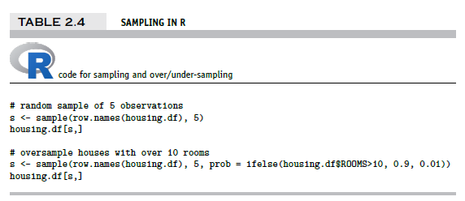
Sampling & Oversampling
Create an index of random numbers from 1 to the number of rows.
idx <- sample(a vector to choose from, the number to choose)
Use the index of randomly chosen numbers to select rows
dataFrame[ idx, ]

Slide 37
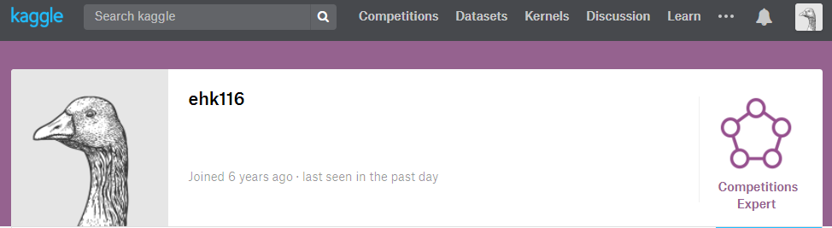
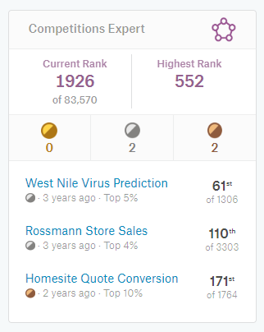
What’s the value of good EDA?
Asked to predict the presence of West Nile Virus in Chicago mosquitos traps.

Slide 38

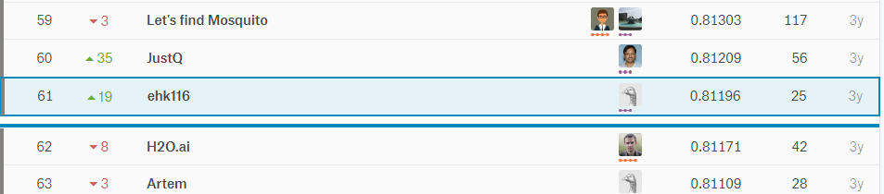
EDA let me realize a flaw!
Simple EDA by year would show that West Nile was 2x in 2012
After fitting an algorithm, I merely doubled predictions if they were within 2012 for the test set. Not great DS but an easy way to move up the leaderboard.

Slide 39
Let’s Practice
Open B_EDA work.R:
Lots of basic R options
str()
dim()
class()
head()
nlevels()
summary()
cor()
unique()
mean()
colSums()
is.na()
Specific packages make life easier
library(DataExplorer)
plot_str()
plot_missing()
plot_histogram()
plot_density()
plot_scatterplot()
library(radiant.data)
On this script you will fill in the object, vector and information into the code scaffold. Then spend 5-10min exploring the data with radiant.data

Slide 40
Agenda
Start | End | Item
6:30 | 6:40 | R Object Types
6:40 | 6:50 | Data Structure for analysis
6:50 | 7:00 | Break
7:00 | 7:20 | Process of Data Mining in a Business Context
7:20 | 7:35 | EDA
7:35 | 7:45 | Pre-Processing for Modeling
7:45 | 8:00 | Break
8:00 | 8:45 | Feature Engineering & Enrichment
8:45 | 9:30 | Break as needed & Data-Driven Case

Slide 41
Modeling Process
SEMMA (from SAS)
In this course…
1. Sample
In this course, most data sets are curated for you.
2. Explore
As part of your course analysis you perform basic exploratory data analysis (EDA)
3. Modify
Data cleanup, Dimension Reduction, Feature Engineering & Feature Enrichment
4. Model
Regression, Logistic Regression, KNN, Decision Trees, Random Forest etc.
5. Assess
There are many ways to evaluate a model. We will cover specific KPI and business implications.
Often data is sampled from a large database so you can more quickly explore, apply methods and prototype before reassessing on full data.

Slide 42
PreProcessing
Many algorithms cannot accept the data directly.
Thus you must preprocess your data before training.
Common Pre-Processing
Categorical Variables
Common Pre-Processing
Numeric Variables
Dummy Variables
Binning Low Frequency Levels
Changing to Numeric for Ordinal
Deal with Missing Levels
Deal with Missing
Outlier Detection
Binning
The book does these steps in a traditional manner but we will use an easier method called variable treatment (vtreat). Review the book if you want to see the manual methods.

Slide 43

Dummy Variables
Dummy Variables represent category levels as 1/0 within new vectors. For some approaches, this lets the algorithm understand the information.
Consider this data:
CuID | Gender | Profession | Affiliation
CU43E439 | Male | Nurse | Democrat
CU36E506 | Male | Teacher | Independent
CU91E65 | Female | Manager | Republican
CU17E255 | Male | Student | Democrat
CU27E792 | Female | Executive | Democrat
CU74E430 | Female | Manager | Republican
CU25E466 | Female | Teacher | Democrat

Slide 44
Dummy Variables
Dummy Variables represent category levels as 1/0 within new vectors. For some approaches, this lets the algorithm understand the information.
Consider this data:
Through EDA you realize:
CuID | Gender | Profession | Affiliation
CU43E439 | Male | Nurse | Democrat
CU36E506 | Male | Teacher | Independent
CU91E65 | Female | Manager | Republican
CU17E255 | Male | Student | Democrat
CU27E792 | Female | Executive
CU74E430 | Female | Manager | Republican
CU25E466 | Female | Teacher | Democrat
You wouldn’t use the ID var for training
Gender has 2 levels
Profession has 5 levels
Affiliation has 3 levels & missing

Slide 45
Dummy Variables
Always make dummy variables “1 less than the state of the data nature”
Consider this data:
CuID | Gender | Profession | Affiliation
CU43E439 | Male | Nurse | Democrat
CU36E506 | Male | Teacher | Independent
CU91E65 | Female | Manager | Republican
CU17E255 | Male | Student | Democrat
CU27E792 | Female | Executive
CU74E430 | Female | Manager | Republican
CU25E466 | Female | Teacher | Democrat
CuID | Gender__Male | Profession_Nurse | Profession_Teacher | Profession_Manager | Profession_Student | Affiliation_D | Affiliation_I | Affiliation_Missing
CU43E439 | 1 | 1 | 0 | 0 | 0 | 1 | 0 | 0
CU36E506 | 1 | 0 | 1 | 0 | 0 | 0 | 1 | 0
CU91E65 | 0 | 0 | 0 | 1 | 0 | 0 | 0 | 0
CU17E255 | 1 | 0 | 0 | 0 | 1 | 1 | 0 | 0
CU27E792 | 0 | 0 | 0 | 0 | 0 | 0 | 0 | 1
CU74E430 | 0 | 0 | 0 | 1 | 0 | 0 | 0 | 0
CU25E466 | 0 | 0 | 1 | 0 | 0 | 1 | 0 | 0
A light switch has 2 states, on/off. You only need 1 switch. The same is true as more levels are added, you don’t need one for each level.
Notes:
Multicolinearity – counting things twice, algo understands all 0’s represents a piece of information.
Missing “flag” - often has a hidden meaning such as data integrity or data collection. Sometimes these issues are systematic & informative

Slide 46
Dummy Variables
Always make dummy variables “1 less than the state of the data nature”
Dummy Data:
CuID | Gender__Male | Profession_Nurse | Profession_Teacher | Profession_Manager | Profession_Student | Affiliation_D | Affiliation_I | Affiliation_Missing
CU43E439 | 1 | 1 | 0 | 0 | 0 | 1 | 0 | 0
CU36E506 | 1 | 0 | 1 | 0 | 0 | 0 | 1 | 0
CU91E65 | 0 | 0 | 0 | 1 | 0 | 0 | 0 | 0
CU17E255 | 1 | 0 | 0 | 0 | 1 | 1 | 0 | 0
CU27E792 | 0 | 0 | 0 | 0 | 0 | 0 | 0 | 1
CU74E430 | 0 | 0 | 0 | 1 | 0 | 0 | 0 | 0
CU25E466 | 0 | 0 | 1 | 0 | 0 | 1 | 0 | 0
Applying Judgment:
CuID | Gender__Male | Profession_LowCount | Profession_Teacher | Profession_Manager | Affiliation_D | Affiliation_MissingOther
CU43E439 | 1 | 1 | 0 | 0 | 1 | 0
CU36E506 | 1 | 0 | 1 | 0 | 0 | 1
CU91E65 | 0 | 0 | 0 | 1 | 0 | 0
CU17E255 | 1 | 1 | 0 | 0 | 1 | 0
CU27E792 | 0 | 0 | 0 | 0 | 0 | 1
CU74E430 | 0 | 0 | 0 | 1 | 0 | 0
CU25E466 | 0 | 0 | 1 | 0 | 1 | 0
Never throw the “kitchen sink” at an algo, exercise your problem knowledge to reduce the number of vectors.

Slide 47
Numeric Variables
Numeric variables need to be examined, corrected and missing flags need to be created.
Consider this data:
With domain expertise you realize:
Model | mpg | cyl | disp | hp | drat | wt | qsec
Mazda RX4 | 21 | 6 | 160 | 110 | 3.9 | 2.62
Mazda RX4 Wag | 21 | 6 | 160 | -110 | 3.9 | 2.875 | 17.02
Datsun 710 | 122.8 | NA | 108 | 93 | 3.85 | 2.32 | 18.61
Hornet 4 Drive | 21.4 | 6 | 258 | 110 | 3.08 | 3.215 | 19.44
Hornet Sportabout | 18.7 | 8 | ? | 175 | 3.15 | 3.44 | 17.02
Valiant | 18.1 | 6 | 225 | 105 | 2.76 | NA | 20.22
Duster 360 | 14.3 | 8 | 360 | 245 | 3.21 | 3.57 | 15.84
Merc 240D | 24.4 | 4 | 146.7 | 62 | 3.69 | 3.19
Merc 230 | 22.8 | 4 | 140.8 | 95 | 3.92 | 3.15 | 22.9
Merc 280 | 19.2 | 6 | 167.6 | 123 | 3.92 | 3.44 | 18.3
Its unlikely a car has 122mpg
No way -122 horsepower!
Through EDA you realize:
Missing values are blank, NA, and “?”

Slide 48
Outlier Numeric Variables
Outliers can be removed or the values can be replaced with imputation.
Consider this data:
Drop a row if:
You have many other records for training
The record contains multiple integrity issues
Model | mpg | cyl | disp | hp | drat | wt | qsec
Mazda RX4 | 21 | 6 | 160 | 110 | 3.9 | 2.62
Mazda RX4 Wag | 21 | 6 | 160 | -110 | 3.9 | 2.875 | 17.02
Datsun 710 | 122.8 | NA | 108 | 93 | 3.85 | 2.32 | 18.61
Hornet 4 Drive | 21.4 | 6 | 258 | 110 | 3.08 | 3.215 | 19.44
Hornet Sportabout | 18.7 | 8 | ? | 175 | 3.15 | 3.44 | 17.02
Valiant | 18.1 | 6 | 225 | 105 | 2.76 | NA | 20.22
Duster 360 | 14.3 | 8 | 360 | 245 | 3.21 | 3.57 | 15.84
Merc 240D | 24.4 | 4 | 146.7 | 62 | 3.69 | 3.19
Merc 230 | 22.8 | 4 | 140.8 | 95 | 3.92 | 3.15 | 22.9
Merc 280 | 19.2 | 6 | 167.6 | 123 | 3.92 | 3.44 | 18.3
Impute (use a method to change the value):
Hotdeck – choose a random value in the vector say 19.2
Mean Imputation – mean avg of vector
Median Imputation – median avg
Train an algorithm to fill in the values (KNN)
Notes:
Document document document!!

Slide 49
Detecting Outliers
An outlier is an observation that is “extreme”, being distant from the rest of the data (definition of “distant” is deliberately vague)
Outliers can have disproportionate influence on models (a problem if it is spurious)
An important step in data pre-processing is detecting outliers
Once detected, domain knowledge is required to determine if it is an error, or truly extreme.
Correct them to a more normal (avg) value?
Remove the record altogether?

Slide 50
Detecting Outliers
In some contexts, finding outliers is the purpose of the DM exercise (airport security screening). This is called “anomaly detection”.

Slide 51
Missing Numeric Variables
Imputation is a best practice over Usually start with an easy method like median or hotdeck.
Consider this data:
Drop a row if:
You have many other records for training
The record contains multiple integrity issues
Model | mpg | cyl | disp | hp | drat | wt | qsec
Mazda RX4 | 21 | 6 | 160 | 110 | 3.9 | 2.62
Mazda RX4 Wag | 21 | 6 | 160 | -110 | 3.9 | 2.875 | 17.02
Datsun 710 | 20.1 | NA | 108 | 93 | 3.85 | 2.32 | 18.61
Hornet 4 Drive | 21.4 | 6 | 258 | 110 | 3.08 | 3.215 | 19.44
Hornet Sportabout | 18.7 | 8 | ? | 175 | 3.15 | 3.44 | 17.02
Valiant | 18.1 | 6 | 225 | 105 | 2.76 | NA | 20.22
Duster 360 | 14.3 | 8 | 360 | 245 | 3.21 | 3.57 | 15.84
Merc 240D | 24.4 | 4 | 146.7 | 62 | 3.69 | 3.19
Merc 230 | 22.8 | 4 | 140.8 | 95 | 3.92 | 3.15 | 22.9
Merc 280 | 19.2 | 6 | 167.6 | 123 | 3.92 | 3.44 | 18.3
Impute (use a method to change the value):
Hotdeck
Mean
Median
Algorithm (KNN)
Notes:
Changed mpg to mean avg
Document document document
add flag

Slide 52
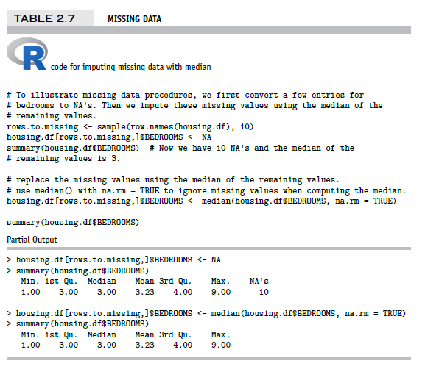
Replacing Missing Data with Median (Book)

Slide 53
Missing Numeric Variables
Imputation through domain expertise can be VERY time consuming but is sometimes worth it though not often.
Consider this data:
Drop a row if:
You have many other records for training
The record contains multiple integrity issues
Model | mpg | cyl | disp | hp | drat | wt | qsec
Mazda RX4 | 21 | 6 | 160 | 110 | 3.9 | 2.62
Mazda RX4 Wag | 21 | 6 | 160 | -110 | 3.9 | 2.875 | 17.02
Datsun 710 | 20.1 | 8 | 108 | 93 | 3.85 | 2.32 | 18.61
Hornet 4 Drive | 21.4 | 6 | 258 | 110 | 3.08 | 3.215 | 19.44
Hornet Sportabout | 18.7 | 8 | 146.7 | 175 | 3.15 | 3.44 | 17.02
Valiant | 18.1 | 6 | 225 | 105 | 2.76 | 3.15 | 20.22
Duster 360 | 14.3 | 8 | 360 | 245 | 3.21 | 3.57 | 15.84
Merc 240D | 24.4 | 4 | 146.7 | 62 | 3.69 | 3.19
Merc 230 | 22.8 | 4 | 140.8 | 95 | 3.92 | 3.15 | 22.9
Merc 280 | 19.2 | 6 | 167.6 | 123 | 3.92 | 3.44 | 18.3
Impute (use a method to change the value):
-110 looks like a data entry issue & other Mazda has 110.
Qsec can be imputed with the similar model values.
Notes:
Hotdeck for disp hp and wt
Document document document
add flag

Slide 54
Missing Numeric Variables
Imputation through domain expertise can be VERY time consuming but is sometimes worth it though not often.
Consider this data:
Drop a row if:
You have many other records for training
The record contains multiple integrity issues
Model | mpg | cyl | disp | hp | drat | wt | qsec
Mazda RX4 | 21 | 6 | 160 | 110 | 3.9 | 2.62 | 17.02
Mazda RX4 Wag | 21 | 6 | 160 | 110 | 3.9 | 2.875 | 17.02
Datsun 710 | 20.1 | 8 | 108 | 93 | 3.85 | 2.32 | 18.61
Hornet 4 Drive | 21.4 | 6 | 258 | 110 | 3.08 | 3.215 | 19.44
Hornet Sportabout | 18.7 | 8 | 146.7 | 175 | 3.15 | 3.44 | 17.02
Valiant | 18.1 | 6 | 225 | 105 | 2.76 | 3.15 | 20.22
Duster 360 | 14.3 | 8 | 360 | 245 | 3.21 | 3.57 | 15.84
Merc 240D | 24.4 | 4 | 146.7 | 62 | 3.69 | 3.19 | 22.9
Merc 230 | 22.8 | 4 | 140.8 | 95 | 3.92 | 3.15 | 22.9
Merc 280 | 19.2 | 6 | 167.6 | 123 | 3.92 | 3.44 | 18.3
Impute (use a method to change the value):
-110 looks like a data entry issue & other Mazda has 110.
Qsec can be imputed with the similar model values.
Notes:
Hotdeck for disp hp and wt
Document document document
add flag

Slide 55
Missing Flags
Add missing indicator dummy variables similar to the categorical exercise.
Consider this data:
Model | mpg | cyl | disp | hp | drat | wt | qsec | missingMPG | missingDisp | missingHP | missingWT | missingQSec
Mazda RX4 | 21 | 6 | 160 | 110 | 3.9 | 2.62 | 17.02 | 0 | 0 | 0 | 0 | 1
Mazda RX4 Wag | 21 | 6 | 160 | 110 | 3.9 | 2.875 | 17.02 | 0 | 0 | 1 | 0 | 0
Datsun 710 | 20.1 | 8 | 108 | 93 | 3.85 | 2.32 | 18.61 | 1 | 0 | 0 | 0 | 0
Hornet 4 Drive | 21.4 | 6 | 258 | 110 | 3.08 | 3.215 | 19.44 | 0 | 0 | 0 | 0 | 0
Hornet Sportabout | 18.7 | 8 | 146.7 | 175 | 3.15 | 3.44 | 17.02 | 0 | 1 | 0 | 0 | 0
Valiant | 18.1 | 6 | 225 | 105 | 2.76 | 3.15 | 20.22 | 0 | 0 | 0 | 1 | 0
Duster 360 | 14.3 | 8 | 360 | 245 | 3.21 | 3.57 | 15.84 | 0 | 0 | 0 | 0 | 0
Merc 240D | 24.4 | 4 | 146.7 | 62 | 3.69 | 3.19 | 22.9 | 0 | 0 | 0 | 0 | 1
Merc 230 | 22.8 | 4 | 140.8 | 95 | 3.92 | 3.15 | 22.9 | 0 | 0 | 0 | 0 | 0
Merc 280 | 19.2 | 6 | 167.6 | 123 | 3.92 | 3.44 | 18.3 | 0 | 0 | 0 | 0 | 0
Notes:
Hotdeck for disp hp and wt
Document document document
add flag

Slide 56
Agenda
Start | End | Item
6:30 | 6:40 | R Object Types
6:40 | 6:50 | Data Structure for analysis
6:50 | 7:00 | Break
7:00 | 7:20 | Process of Data Mining in a Business Context
7:20 | 7:35 | EDA
7:35 | 7:45 | Pre-Processing for Modeling
7:45 | 8:00 | Break
8:00 | 8:45 | Feature Engineering & Enrichment
8:45 | 9:30 | Break as needed & Data-Driven Case

Slide 57
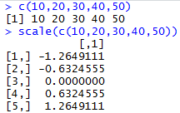
As an Aside, Data Normalization
Used in some techniques when variables with the largest scales would dominate and skew results
Puts all variables on same scale
Normalizing function: Subtract mean and divide by standard deviation
Alternative function: scale to 0-1 by subtracting minimum and dividing by the range
Useful when the data contain dummies and numeric
We will revisit normalization for KNN but this is a form of preprocessing.

Slide 58

Feature Engineering- Still Pre-Processing!!
Once you have your data identified, collected and organized, you may want to create new vectors using existing data to aid the analysis.
Feature engineering or “feature crossing” is the act of using existing data to form new data inputs for analysis. For example, dividing one data point by another to derive a new data point.

Slide 59

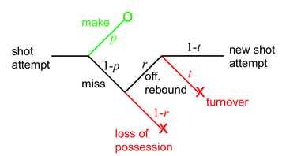
What is Feature Engineering?
Using qualitative or technical expertise to derive new features for machine learning.
Example
Suppose you want to predict the number of wins the Cavs will have this year:
Raw Data:
Total Rebounds (2017-18): 2749
Total Games: 56
LBJ triple doubles: 10
Engineered
Name | Value | Type | Reasoning
Rebounds per Game | 41 | Technical | Simple ratio of two team level stats
Percent of Games that Lebron James has a “triple double” | 10/56 = 17.8% | Qualitative | Capturing information about the best player’s performance e.g. getting double digit stats in 3 of assists, blocks, points, rebounds, or steals

Slide 60
Why is Feature Engineering Effective?
Using qualitative or technical expertise to derive new features for machine learning.
$$f\left(Modeling Results\right)=the Algo+Parameters+Data provided$$
Better features means flexibility.
less than optimal models can still yield good results
Betters features means simpler models.
less than optimal parameters can still yield good results
Better features means better results.
“The algorithms we used are very standard for Kagglers. We spent most of our efforts in feature engineering.” Xavier Conort describing his winning “Flight Quest” submission
Way to differentiate & squeeze out more accuracy

Slide 61
Example Feature Engineering Methods
library(vtreat)
Automatic variable treatment functions
library(acepack)
Alternating conditional expectations for feature importance
Hand-Coded Variables
Subject Matter Experts tell you which variables to interact
Dimension Reduction - PCA
Principle component analysis
Grey not covered
in summer but if interested can share code

Slide 62

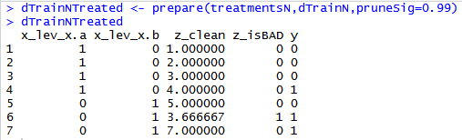
lib(vtreat) – automated variable treatment
Vtreat Actions | Common Name
NA, NAN, and Infinity replaced with mean | Mean imputation
Indicator | Missing indicator
Indicator variables | Dummy variable
Estimated single-variable model effect sizes and significances. | Mean response encoding or level difference from mean response based on univariate linear model for numeric & Bayes for classification
Level prevalence | Frequency encoding
Level deviation | Response deviation level encoding
Constant/Near Constant | Suppress uninformative variables
Raw Data
Design Treatment Plan
Prepare Data to get New Data Frame
treatmentsN <- designTreatmentsN(...)
Notes:
Automates a lot what we talked about, and some of the books code
easy, automated
Repeatable bc plan is saved
Dangerous bc automation can lead to probs (multi-colinarity) measuring things twice

Slide 63

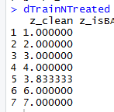
Mean Imputation - PreProcessing
Most of the time we will use vtreat to clean data…its faster and easier.
Vtreat Actions | Common Name
NA, NAN, and Infinity replaced with mean | Mean imputation
When a numeric value is missing
Replace that value with the mean average
Not applicable for categorical variables
Design a treatment plan and apply it.

Slide 64
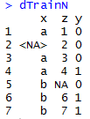
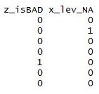
Missing Flags- PreProcessing
Vtreat Actions | Common Name
Indicator | Missing indicator
When a numeric value is missing
Add a missing flag variable
When a factor level is missing
Add a missing flag variable
Design a treatment plan and apply it.

Slide 65
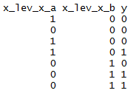
Dummy Variables - PreProcessing
Vtreat Actions | Common Name
Indicator variables | Dummy variable
Not applicable for numeric values
For each factor level, will create dummy variables.
Design a treatment plan and apply it.
Beware! Since some algorithms don’t care, vtreat will return ALL dummy variables and not drop one to represent all 0s.

Slide 66

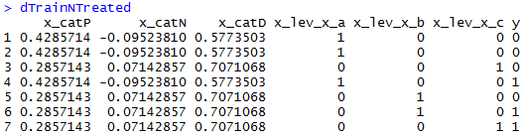
Response Encoding - Engineering
Vtreat Actions | Common Name
Estimated single-variable model effect sizes and significances. | Mean response encoding
Level prevalence | Frequency encoding
Deviation Fact | Level’s St Dev from mean response
For each factor level, the average Y is calculated. A new variable is appended with these corresponding values.
Raw Data
Design Treatment Plan
Prepare Data to get New Data Frame
treatmentsN <- designTreatmentsN(...)
Notes:
Mpg is the response or Y variable

Slide 67
Response Encoding - Engineering
Raw Data
Design Treatment Plan
Prepare Data to get New Data Frame
treatmentsN <- designTreatmentsN(...)
Technical Documentation
Explanation
cat_N : a single variable regression model of the difference in outcome expectation conditioned on the observed value of the original variable.
cat_P : a “prevalence fact” about a categorical level. Tells us if the original level was rare or common. Tells us if the original level was rare or common. Probably not good for direct use in a model, but possibly useful for metanalysis on the variable.
cat_D : a “deviation fact” about a categorical level tells us if ‘y’ is concentrated or diffuse when conditioned on the observed level of the original categorical variable. Probably not good for direct use in a model, but possibly useful for metanalysis on the variable.
cat_N : what’s the individual level relationship to the observed value of Y i.e. y occurs 42% of the time (3 out of 7) and level c has a 50% chance (1 of 2) so the relationship is +.07 better than the natural occurrence of Y. Level A has .33 chance so it is .09 less (.42-.33)
cat_P : How frequent is the specific level ie “level a was in 3 of 7 records so 42% of the time that level appeared. X_catP =.42 for all level A observations.
cat_D : how each level deviates from the average of the outcome variable – usually dropped. i.e. admittedly the calcs are a bit off
(sd(c(0,0,0,1,0,1,1))*.33) + (3/7) for level A
Notes:
Mpg is the response or Y variable

Slide 68

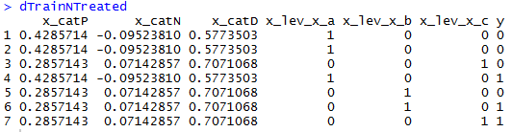
Non-Informative Check
Vtreat Actions | Common Name
Constant/Near Constant | Suppress uninformative variables
Z is automatically dropped.
In this fake example, since z contains a constant value an algorithm cant learn from it.

Slide 69
Vtreat summary
Original Data
Design a Treatment Plan
Apply the plan to the original and test sets
Get data ready for modeling
When specifying a plan you need to pass in :
The Data
The column names of informative variables.
The name of the Y or Response Variable.
Almost always drop cat_D variables
When possible design a treatment plan on separate data than the training & test sets
Always review the output to ensure coherence, its not a free automated lunch!

Slide 70
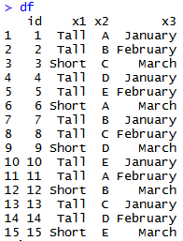
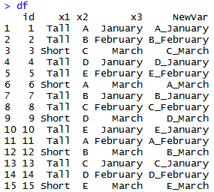
SME – Factor Level Interactions
Domain Specific Knowledge can be applied to factors to create new variables.
Example Data w/Factors
If we believe x2 & x3
have a qualitative interaction
Then concatenating the variables
could help the algo learn faster
With factors, you combine by concatenating the levels, capturing the information contained in both levels such as “bald” “male” to “bald_male”

Slide 71
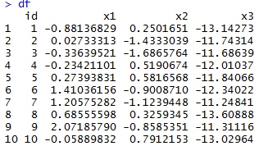
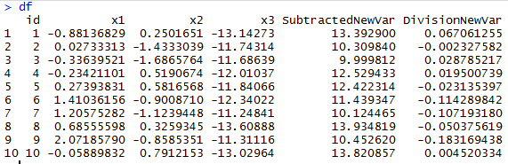
SME – Numeric Interactions
Domain Specific Knowledge can be applied to numeric variables to create new variables.
If we believe x2 & x3
have a qualitative interaction
Then interacting them with simple operators
Such as subtraction or division may help the
Algorithm learn faster
Example Data w/Numeric Vectors
X1
X3
Div. New Var
In sports, variables like “turnovers per game” are expert led engineered variables. “per” is interaction through division of two seasonal level statistics.

Slide 72
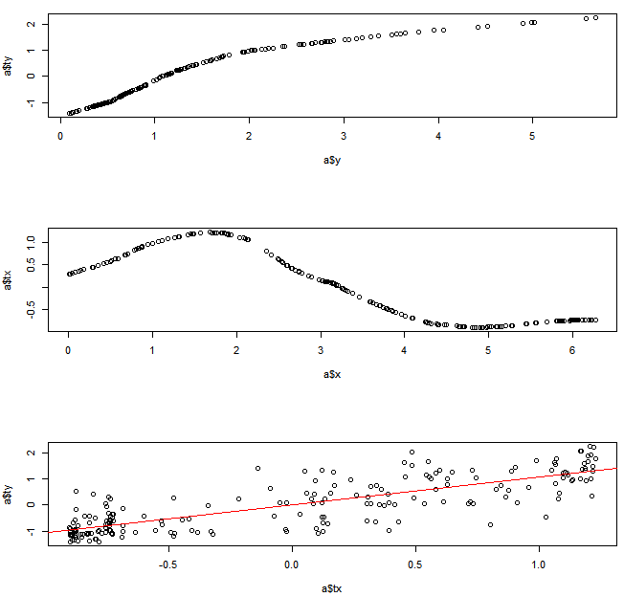
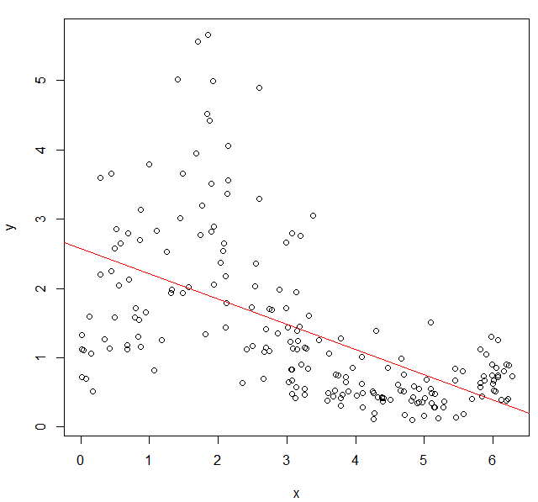
AcePack – Alternating Conditional Expectations
ACE was introduced by Breiman & Friedman for estimating transformations of a response & predictors in multiple regression to produce the maximum linear effect between the transformed predictors & the transformed response.
In short, non-linear relationships can be identified for numeric variables.
Example, weak linear relationship
correlation =-0.569
Transform x, y
correlation= 0.816
Variable Identification &
Construction
One method is to use top 10 ACE identified variables to derive 45 more.
NewX₁ = topVar1 – topVar2
NewX₂ = topVar1 / topVar2
NewX₃ = topVar1 – topVar3
…
newX₄₂ = topVar8 – topVar9
newX₄₃ = topVar8 / topVar9
NewX₄₄ = topVar9 - topVar10
NewX₄₅ = topVar9 / topVar10
Notes:
This and similar uses math to ID important variables and interact them automatically

Slide 73
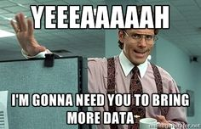
Feature Enrichment
When training a model you can
Add more training records
Find more row!
OR
Add more information
Find more columns!

Slide 74
Why is Feature Enrichment Effective?
Using qualitative or technical expertise to derive new features for machine learning.
$$f\left(Modeling Results\right)=the Algo+Parameters+Data provided$$
Better features means flexibility.
less than optimal models can still yield good results
Betters features means simpler models.
less than optimal parameters can still yield good results
Better features means better results.
“The algorithms we used are very standard for Kagglers. We spent most of our efforts in feature engineering.” Xavier Conort describing his winning “Flight Quest” submission
Way to differentiate & squeeze out more accuracy

Slide 75
Data Enrichment aids Model Performance
Feature Enrichment is the act of adding new information to your dataset. You are enriching your existing data, often with public or 3rd party data.
Existing Data
New Data
There are limits to what an organization has in house for data on customers, products and employees. Companies exist solely to enrich data sources.

Slide 76
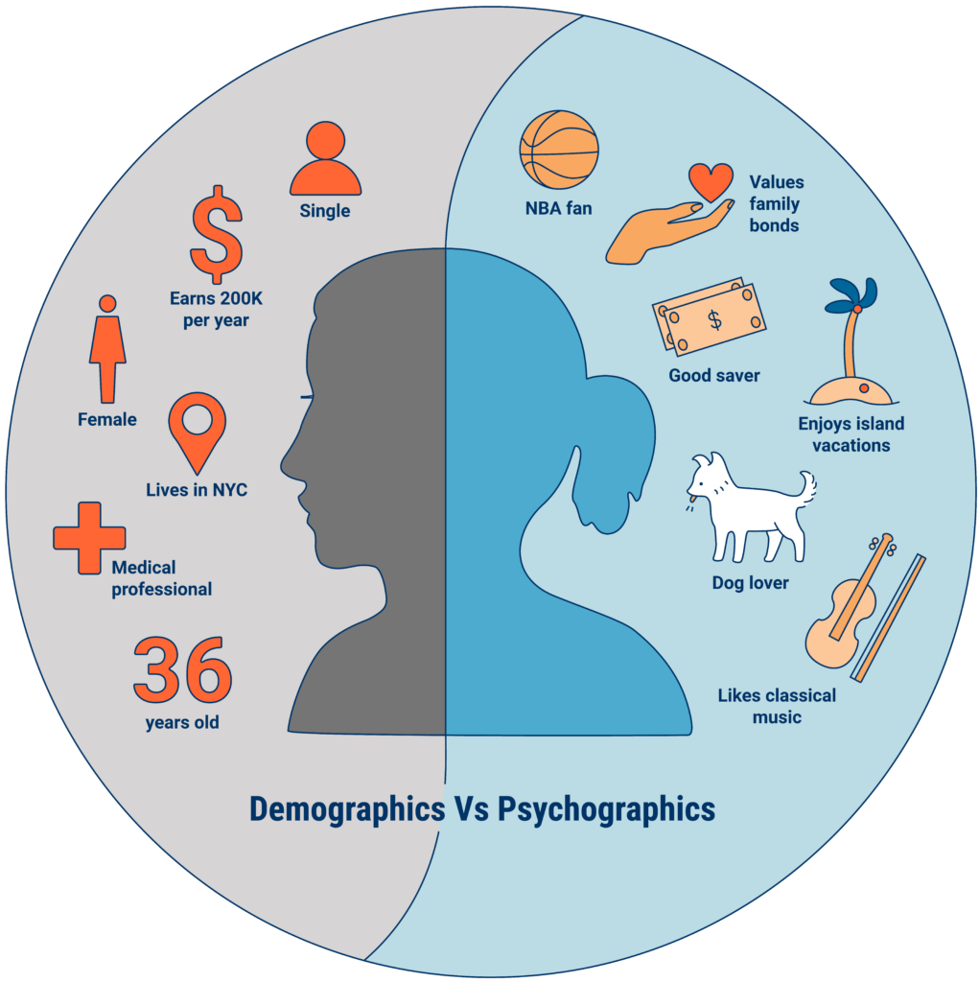
An example of Data Enrichment
To identify attrition risks (make them more happy) they could buy data about employees to have a more complete picture.
An organization may collect some information about employees during the application process.
https://www.cbinsights.com/research/what-is-psychographics/

Slide 77


Modeling with Feature Enrichment is Widespread
Used social media information of individual and friends to model voting tendencies
Uses 3rd party data to predict if a household member has diabetes for marketing.
Most consumers are not aware the type and amount of data that is available about them.

Slide 78
Feature Enrichment Requires a Join
library(dplyr)
instruments <- as.data.frame(band_instruments)
grades <- data.frame(name = instruments$name,
ptAvg = c(3.2,3.3,3.4))
left_join(instruments, grades, by=c('name'))
x
y
instruments
Grades
Return all rows from x where there are matching values in y, and all columns from x and y. If there are multiple matches between x and y, all combination of the matches are returned.
Notes:
Very common to append the existing data as the left side

Slide 79
Feature Enrichment Requires a Join
library(dplyr)
instruments <- as.data.frame(band_instruments)
grades <- data.frame(name = instruments$name,
ptAvg = c(3.2,3.3,3.4))
right_join(instruments, grades, by=c('name'))
x
y
instruments
Grades
Return all rows from y, and all columns from x and y. Rows in y with no match in x will have NA values in the new columns. If there are multiple matches between x and y, all combinations of the matches are returned.
Notes:
The reverse

Slide 80
Feature Enrichment Requires a Join
library(dplyr)
instruments <- as.data.frame(band_instruments)
grades <- data.frame(name = instruments$name,
ptAvg = c(3.2,3.3,3.4))
inner_join(instruments, grades, by=c('name'))
x
y
instruments
Grades
Return all rows from x where there are matching values in y, and all columns from x and y. If there are multiple matches between x and y, all combination of the matches are returned.
Notes:
What records are in common; say you have a potential mailing list and want to find your existing customers
Will do during text mining

Slide 81
Feature Enrichment Requires a Join
library(dplyr)
instruments <- as.data.frame(band_instruments)
grades <- data.frame(name = instruments$name,
ptAvg = c(3.2,3.3,3.4))
full_join(instruments, grades, by=c('name'))
x
y
instruments
Grades
Return all rows and all columns from both x and y. Where there are not matching values, returns NA for the one missing.
Notes:
What records are in common; say you have a potential mailing list and want to find your existing customers
Will do during text mining

Slide 82

Meet Donor Bureau

Slide 83
Company Overview
Founded in 2011
DonorBureau spun out of a direct mail agency
Works with non-profits to optimize their direct mail fundraising
Data Stats:
900M past mail transactions
140M past donations
40M individuals

Slide 84
Modeling Problem
Two modeling problems
What acquisition targets should NOT get mail?
What donor cultivation targets should get mail?
Acquisition modeling
Drop bottom 20% of list to be mailed
Goal is to have the top 80% gross twice as much as the bottom 20%
Cultivation modeling:
Add names to the monthly 10k piece cultivation mailings
Find 2k additional names per month to mail from a 40k donor file

Slide 85
Let’s Practice
Open C_DataPreProcessingEngineering:
Variable | Description
rowID | Appended Row ID - noninformative
uniqueID | Unique Identifier – noninformative
Zip | Zip code group to anonymize
Homeowner | Y/N if they own a hom
NUMCHLD | Number of children in house
Income | Household Income
Gender | M/F
Wealth | Wealth rating uses median family income and population statistics from each area to index relative wealth within each state. The segments are denoted 0-9, with 9 being the highest wealth group and zero being the lowest. Each rating has a different meaning within each state.
Variable | Description
HV | Avg Home Value in potential donor's neighborhood in hundreds of dollars.
Icmed | Median Income in potential donor's neighborhood in hundreds of dollars.
Icavg | Avg Family Income in potential donor's neighborhood in hundreds of dollars.
IC15 | % earning less than $15K in potential donor's neighborhood.
NUMPROM | Lifetime # of promotions received to date
RAMNTALL | Dollar amount of lifetime gifts to date.
MAXRAMNT | Dollar amount of largest gift to date.
LASTGIFT | Dollar amount of most recent gift.
TOTALMONTHS | Number of months from last donation
TIMELAG | Number of months between first and second gift.
AVGGIFT | Average dollar amount of gifts to date.
Y1_Donation | Y/N did they donate
Y2_DonatedAmt | Dollar Amt of donation
Notes:
2 identifier col
2 y binary and continuous

Slide 86
Agenda
Start | End | Item
6:30 | 6:40 | R Object Types
6:40 | 6:50 | Data Structure for analysis
6:50 | 7:00 | Break
7:00 | 7:20 | Process of Data Mining in a Business Context
7:20 | 7:35 | EDA
7:35 | 7:45 | Pre-Processing for Modeling
7:45 | 8:00 | Break
8:00 | 8:45 | Feature Engineering & Enrichment
8:45 | 9:30 | Break as needed & Data-Driven Case

Slide 87
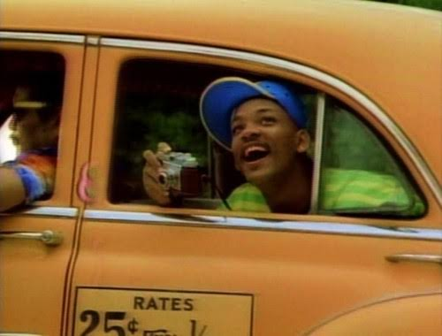
Data-Driven
Suppose you are a data-driven Lyft driver and want to make the most money possible. Exploring real trip data could help you.
Data: Dec 2017 Yellow Taxis Rides (20% random sample)
Count off 1 to 15, from groups of all 1’s etc. Should be ~3
Spend the next 30-45min performing EDA on NYC Taxi Data and discussing any interesting findings.
Prepare the data set with vtreat

Slide 88
Data-Driven
See if you can answer the following in your group.
How many vendors are in the data set? How many trips did each take in Jan?
What is the average trip fare plus tip?
What is the average trip distance?
What is the average number of the trip passengers?
How long (time) do trips take on average?
What day of the week should you work? (requires engineering)
What hours of the day should you work? (requires engineering)
Should you work on holidays? (Hanukkah was Dec12-Dec20, Christmas Dec24-25 & Kwanzaa Dec 26-Jan1, last date not in data)
Construct any interesting visuals you think will aid you in maximizing your fares and relationships with other vectors.

